Slide 1
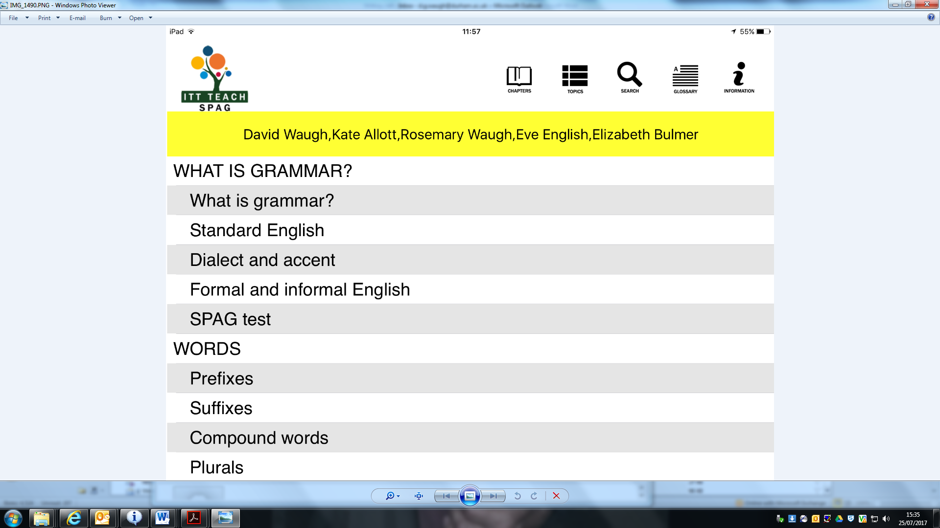
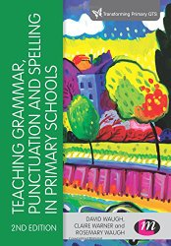
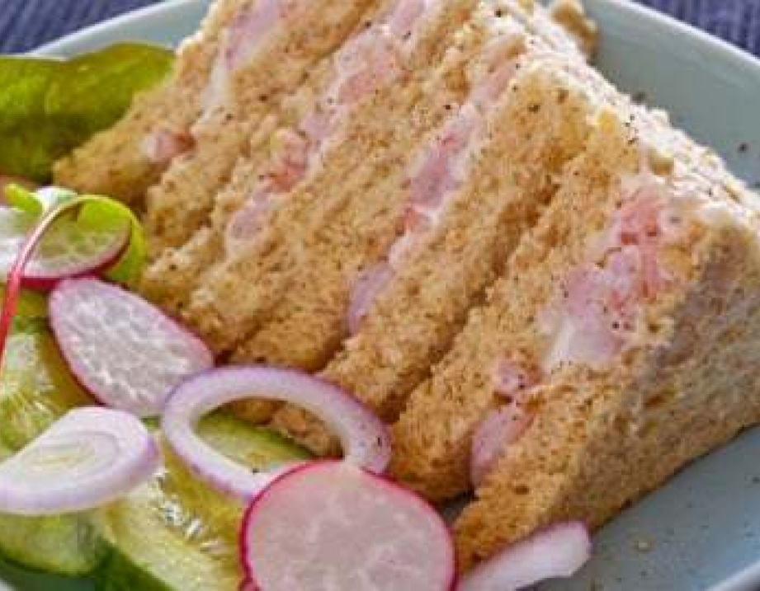
Embedding SPaG into high quality English teaching
David Waugh

Slide 3
9th May, 2017

Slide 5
A short chapter

Slide 6
QUESTIONS TO CONSIDER TODAY
What are the implications of the emphasis on grammar in the curriculum for trainees and teachers?
How can we embed SPaG in a meaningful way through writing, reading and oracy?
How can we teach rather than simply test spelling, punctuation and grammar?

Slide 7
Which year group?
noun, noun phrase
statement, question, exclamation, command
compound, adjective, verb
suffix
tense (past, present)
apostrophe, comma

Slide 8
YEAR | TERMINOLOGY FOR PUPILS
1 | letter, capital letter word, singular, plural sentence punctuation, full stop, question mark, exclamation mark
2 | noun, noun phrase statement, question, exclamation, command, compound, adjective, verb, suffix tense (past, present) apostrophe, comma
3 | adverb, preposition, conjunction word family, prefix clause, subordinate clause direct speech consonant, consonant letter vowel, vowel letter inverted commas (or ‘speech marks’)
4 | determiner pronoun, possessive pronoun, adverbial
5 | modal verb, relative pronoun relative clause parenthesis, bracket, dash cohesion, ambiguity
6 | subject, object active, passive synonym, antonym ellipsis, hyphen, colon, semi-colon, bullet points

Slide 9
Grammar for Writing (DfEE, 2000, p.7)
“,,,the purpose of teaching grammar is not simply the naming of parts of speech, nor is it to provide arbitrary rules for ‘correct’ English. It is about making children aware of key grammatical principles and their effects, to increase the range of choices open to them when they write.”

Slide 10
Which do we learn first: the game or the terminology of the game?
direct free kick
offside
corner
dive
penalty
indirect free kick
tackle
cross
yellow card
defend

Slide 11
Which do we learn first: the language or the terminology of the language?
direct speech
apostrophe
ellipsis
subordinate clause
pronoun
indirect speech
preposition
adjective
adverb
fronted adverbial

Slide 12
What does Alex know about grammar?

Slide 13
Waugh (2015)
…there is an intrinsic value in understanding more about our language and being able to create a language for discussing it with the children you teach. If you make learning about grammar integral to children’s reading and writing rather than separating it into discrete lessons, you will enable them to reflect upon their language usage and that of others.

Slide 14
Podrobs
Look at the sentences below and place podrobs in the spaces.
Dave ran ______ towards the goal.
Craig laughed _________ when he heard the joke.
Notes:
If you completed the sentences, you almost certainly inserted words like quickly in the first sentence and heartily or loudly in the second. You probably wondered what a pobdrob was, but this is a lecture about grammar and you probably expect to find some unfamiliar terms, so you simply completed the sentences anyway. But would you remember what a pobdrob is next week? There is actually no such thing as a pobdrob, and the missing words were in fact adverbs, but the point we want to make is that a knowledge of terms is meaningless without understanding, and understanding comes through using and discussing language.

Slide 15
How I develop trainees’ understanding of word classes…
What is it?

Slide 16
Which one is it?

Slide 17
What is it doing?

Slide 18
How is the one on the right different from the others?

Slide 19
What is it doing now?

Slide 20
How is it doing it?

Slide 21
Where is it doing it?

Slide 22
Now describe what you can see.

Slide 23
Sentence Countdown
the | are | do | about | and
up | me | got | a | had
down | their | to | my | dad
people | said | her | big | your
in | what | when | put | he
there | it’s | could | i | out
see | house | of | this | looked
old | it | have | very | too
was | went | look | by | you
be | don’t | day | they | like
come | made | on | some | will
time | she | so | into | i’m
is | not | back | if | for
then | from | help | at | were
children | mrs | his | go | him
called | but | little | mr | here
that | as | get | off | with
no | just | asked | all | mum
now | saw | we | one | came
make | can | them | oh | an
Nouns | Verbs | Adjectives
1 time 2 person 3 year 4 way 5 day 6 thing 7 man 8 world 9 life 10 hand 11 part 12 child 13 eye 14 woman 15 place 16 work 17 week 18 case 19 point 20 government 21 company 22 number 23 group 24 problem 25 fact | 1 be 2 have 3 do 4 say 5 get 6 make 7 go 8 know 9 take 10 see 11 come 12 think 13 look 14 want 15 give 16 use 17 find 18 tell 19 ask 20 work 21 seem 22 feel 23 try 24 leave 25 call | 1 good 2 new 3 first 4 last 5 long 6 great 7 little 8 own 9 other 10 old 11 right 12 big 13 high 14 different 15 small 16 large 17 next 18 early 19 young 20 important 21 few 22 public 23 bad 24 same 25 able

Slide 24
Look at the cover What questions are you asking? I wrote this book. Do you think I agree with the opinion expressed in the title?

Slide 25
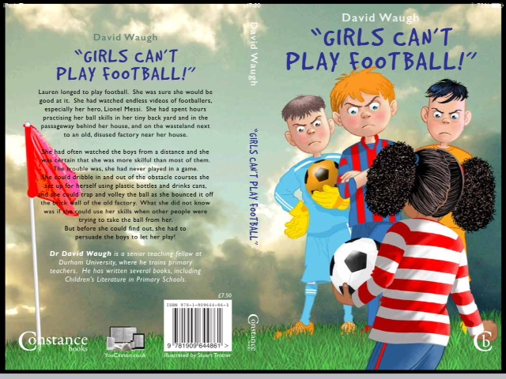
CHAPTER ONE It’s not a proper game if she plays
“It’s not a proper game if she plays!” Adam
Stevens stood with his foot on the ball and
his hands on his hips.
“Go on, let her,” said Ryan Jones.
Lauren Morris looked longingly towards the football pitch, where about twenty boys had stopped their game when she had asked to play.
“Even if she wasn’t a girl, she’s too small and she’d get hurt,” said Faisal Ahmed, who was eleven.
“She’s bigger than me,” piped up Sam Bell.
“Everyone’s bigger than you, Belly!” chorused about five people together.

Slide 26
Lauren longed to play football. She had taken months to pluck up the courage to ask the boys if she could join in with their daily game after school, and now she seemed likely to be rejected. She was sure she would be good at soccer. She had watched endless videos of matches, and she spent hours practising her ball skills in her tiny back yard and in the passageway behind her house, and on the wasteland next to an old, disused factory near her house.
She had often watched the boys from a distance and she was certain that she was more skilful than most of them. The trouble was, she had never played in a game. She could dribble in and out of the obstacle courses she set up for herself using plastic bottles and drinks cans, and she could trap and volley the ball as she bounced it off the brick wall of the old factory. What she did not know was if she could use her skills when other people were trying to take the ball from her.
The boys began to get restless. They wanted to get on with their game and Lauren’s request had stopped them.
“Why shouldn’t she play?” asked Mark Langley. “Just because she’s a girl, it doesn’t mean she’s no good.”

Slide 27
How does Lauren feel?
short phrases
adjectives
synonyms
similes

Slide 28
Punctuation matters
Thank you! Your donation just helped someone. Get a job!
My hobbies are cooking my family and my dog.
Gate in constant use illegally. Parked cars will be clamped.
He has trouble-making friends.
He has trouble making friends.

Slide 29
For children and teachers
Discuss language in speech and in texts
Shared writing
Sentence-combining
Share real examples
Make limited use of exercises
Try feature searches
Make collections
Play games!

Slide 30
A model for teaching grammar in context
Firstly, be clear about what you want the children to learn. Remember that there is no point teaching grammatical meta-language unless you can explain how it will make a difference to their writing.
Check your own subject knowledge and make sure that you feel confident about this.

Slide 31
Consider when to introduce the terms
This may be through discrete teaching, through an investigation, or through interactive grammar games to find patterns, word play or games.
Shared and guided reading: identify examples of the particular grammatical feature you are focusing on in the high quality texts you are reading with the class.
Make sure you have identified examples beforehand and can talk about them. Use the correct terminology to make this explicit.

Slide 32
Consider when to introduce the terms (continued)
Invite children to find examples for themselves and to make up some of their own. Remember to remind them of the purpose of the task – they are developing this skill because it opens up all kinds of possibilities for their writing.
Model writing before asking children to write themselves. Make explicit the choices that writers have made and help children to know the choices available to them when writing for themselves.
Invite the children to use these in the context of an appropriate piece of writing. Encourage the children to be adventurous and to play with language and word choice.
Review the writing as part of the plenary and not just through ‘distance’ marking.

Slide 33
Implications of research findings on writing
We need:
explicit teaching of the process of writing and strategies which emphasise the different stages, such as planning, drafting and sharing ideas.
emphasis on self-evaluation and developing pupils’ capability to assess their own work through revising and editing.
work on summarising texts in writing (such as through précis) and combining sentences.
modelling of specific skills to support pupils, but where the support is deliberately faded out so that there is a gradual shift in responsibility from the teacher to the pupil so that they become independent writers.
engaging pre-writing activities which help them to develop a range of strategies. This could be by helping them work out what they already know, or to research an unfamiliar topic, or arrange their ideas visually or thematically.
Higgins (2015)

Slide 34
If writing evolves…

Slide 35
…use of language devices evolves…

Slide 36
Mistakes are valuable

Slide 37
The results can be impressive!

Slide 38
A Y5 child’s writing

Slide 39
The simple view of writing
Compositional
processes
Good composition; poor transcription
Good composition; Good transcription
G
o
o
d
Transcriptional skills
Poor
Good
Transcriptional skills
P
o
o
r
Poor composition; Poor transcription
Poor composition; Good transcription
Compositional
processes
Notes:
39

Slide 40
Why is this important for teachers?
They need to have a positive attitude to writing if they are to teach it successfully
They need to understand the process of writing so that they understand the challenges children face
They need to develop their own confidence in writing
They need to understand the language of writing.

Slide 41
Cremin and Baker (2014)
“A stronger community of writers can be built in the classroom if teachers and support staff are able to connect to and share their writing lives and enable children to recognise and celebrate the diversity of their own writing practices” (p.5).

Slide 42
Out of the mouths of children…
“Anyone can write – unless they haven’t got a pen!”
(Child in National Writing Project)
“People who have got pensions write because it will give them something to do before they die.”
(Child in National Writing Project)

Slide 43
A novel written with 45 children

Slide 44
Writing with and for children
We can all write – we just need a reason
By writing, we develop our understanding of the process
By writing, we develop our understanding of how language works
By writing, we become more confident teachers of writing

Slide 45
Try this: write about your life in 6 words
Head in books, feet in flowers.
Trust me, I did my best.
Best selling author? Instead there's this.
Wasted my whole life getting comfortable.
Worry about tomorrow, rarely enjoy today!
Lifetime partner, love, laughs - what now?
I'm just happy to be here!

Slide 46
Every subject can involve writing

Slide 47
Higgins, 2015
Evidence (Graham et al. 2012) indicates it is important to expose pupils to a variety of forms of writing and to practise these so that they learn to write for a variety of purposes and master different genres of writing (e.g. description, narration, persuasion or argumentation, information and explanatory texts).
Seeing examples of good writing in these different forms and being given positive feedback when they develop key features is essential.
Teach explicit strategies. For example, in descriptive writing one approach which has been shown to be effective is to link written descriptions with the senses: What did you see? How did it look? What sounds did you hear? What did you touch? How did it feel? What could you smell? What did you taste?

Slide 48
Grammar and writing
Myhill, Lines and Watson (2011) examined ways of developing children’s writing and discovered that actively engaging children with grammar through writing was more effective than teaching grammar as a separate topic. They found that children were less likely to see the purpose of grammatical knowledge when it was taught out of the context of actual writing, and asserted that children can become more aware to the infinite possibilities of the English language through studying how language works, and that this can enable them to evaluate others’ language use. They suggest that:
‘… a writing curriculum which draws attention to the grammar of writing in an embedded and purposeful way at relevant points in the learning is a more positive way forward. In this way, young writers are introduced to what we have called ‘a repertoire of infinite possibilities’, explicitly showing them how different ways of shaping sentences or texts, and … different choices of words can generate different possibilities for meaning-making’
(Myhill et al, 2012, p.3)

Slide 49
Terminology
Horton and Bingle (2014, p.17) argue that terminology should be introduced when children are exploring and using language:
“You would not teach children to swim without introducing terms such as breast stroke, front crawl and sculling in order to communicate precise meaning and it is more than likely that you would do this whilst swimming. It is no different from teaching children about language: terms such as adverbial, subordinate clause and collective noun can all be used effectively whilst engaged in a writing activity. The use of a metalanguage will give children the tools with which to discuss choices and manipulate language confidently and powerfully”.

Slide 50
70 words Y3-4 should learn (draft NC)
accident, advertise, approve, benefit, behave, bicycle, breath, breathe, building, calendar, certain, concentrate, chocolate, congratulate, conscience, continue, decorate, describe, dictionary, difficult, discover, disturb, early, earn, earth, educate, excite, experience, experiment, explore, extreme, February, grammar, guide, guard, half, heart, immediate, improve, increase, independent, injure, inquire, interest, island, junior, knowledge, library, material, medicine, mention, multiply, murmur, nephew, occasion, often, opposite, paragraph, particular, peculiar, position, possess, produce, professor, promise, property, prove, punctuate, quality, quantity, quarrel, quarter, recite, recover, register, regular, reign, remember, sentence, separate, sew, situate, strength, sufficient, sure, surprise, surround, thought, though, weary

Slide 51
70 words Y3-4 should learn (draft NC)
accident, advertise, approve, benefit, behave, bicycle, breath, breathe, building, calendar, certain, concentrate, chocolate, congratulate, conscience, continue, decorate, describe, dictionary, difficult, discover, disturb, early, earn, earth, educate, excite, experience, experiment, explore, extreme, February, grammar, guide, guard, half, heart, immediate, improve, increase, independent, injure, inquire, interest, island, junior, knowledge, library, material, medicine, mention, multiply, murmur, nephew, occasion, often, opposite, paragraph, particular, peculiar, position, possess, produce, professor, promise, property, prove, punctuate, quality, quantity, quarrel, quarter, recite, recover, register, regular, reign, remember, sentence, separate, sew, situate, strength, sufficient, sure, surprise, surround, thought, though, weary

Slide 52
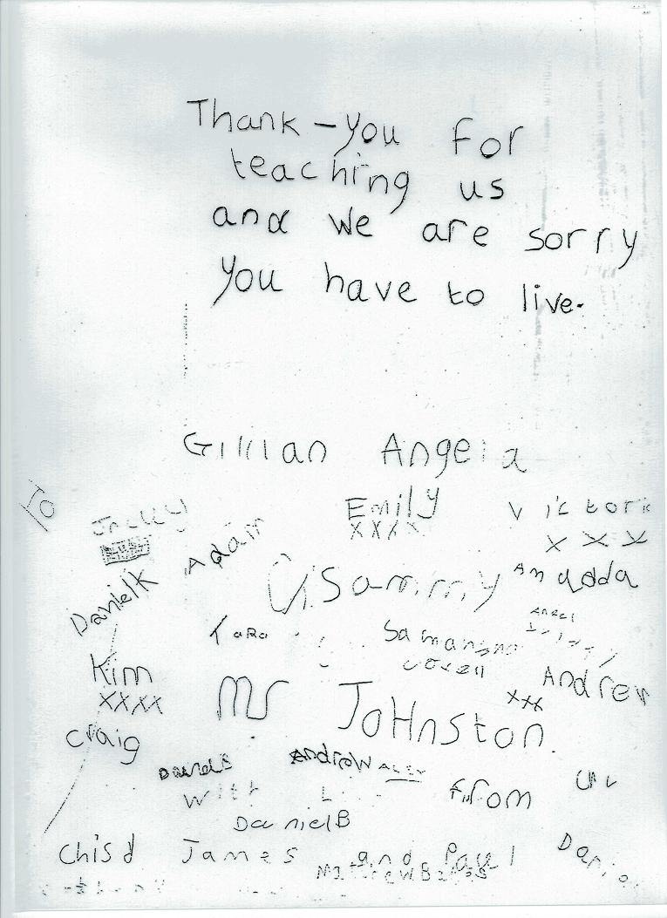

Slide 53
Spelling rules – OK?
Tell your neighbour a spelling rule.
Who said i before e except after c?
Now name another spelling rule.

Slide 54
Work out spelling rules for each of the following:
Which letters don’t you find at the end of English words?
Plurals for words ending with y
Making words ending with s into plurals
Deciding which word endings add –es in the plural

Slide 55
Y5-6 spelling list
accommodate | criticise | individual | relevant
accompany | curiosity | interfere | restaurant
according | definite | interrupt | rhyme
achieve | desperate | language | rhythm
aggressive | determined | leisure | sacrifice
amateur | develop | lightning | secretary
ancient | dictionary | marvellous | shoulder
apparent | disastrous | mischievous | signature
appreciate | embarrass | muscle | sincerely
attached | environment | necessary | soldier
available | equipped | neighbour | stomach
average | especially | nuisance | sufficient
awkward | exaggerate | occupy | suggest
bargain | excellent | occur | symbol
bruise | existence | opportunity | system
category | explanation | parliament | temperature
cemetery | familiar | persuade | thorough
committee | foreign | physical | twelfth
communicate | forty | prejudice | variety
community | frequently | privilege | vegetable
competition | government | profession | vehicle
conscience | guarantee | programme | yacht
conscious | harass | pronunciation
controversy | hindrance | queue
convenience | identity | recognise
correspond | immediate | recommend

Slide 56
Y5-6 spelling list
accommodate | criticise | individual | relevant
accompany | curiosity | interfere | restaurant
according | definite | interrupt | rhyme
achieve | desperate | language | rhythm
aggressive | determined | leisure | sacrifice
amateur | develop | lightning | secretary
ancient | dictionary | marvellous | shoulder
apparent | disastrous | mischievous | signature
appreciate | embarrass | muscle | sincerely
attached | environment | necessary | soldier
available | equipped | neighbour | stomach
average | Especially | nuisance | sufficient
awkward | exaggerate | occupy | suggest
bargain | excellent | occur | symbol
bruise | existence | opportunity | system
category | explanation | parliament | temperature
cemetery | familiar | persuade | thorough
committee | foreign | physical | twelfth
communicate | forty | prejudice | variety
community | frequently | privilege | vegetable
competition | government | profession | vehicle
conscience | guarantee | programme | yacht
conscious | harass | pronunciation
controversy | hindrance | queue
convenience | identity | recognise
correspond | immediate | recommend
occupies
occupied
????????
preoccupation
occupying
preoccupied
preoccupy
occupation
unoccupied
occupational

Slide 57
What should we do?
Discuss words and their meanings and origins.
Talk about morphemes and how words are put together.
Make collections of words, for example, homonyms, antonyms, synonyms, loan words, homographs and homophones.
Read to children regularly from a range of genres and be prepared to discuss authors’ use of language.
Discuss phrasing, words and punctuation in the whole texts.
Make use of children’s writing as a resource for discussing grammar and punctuation.
Develop a vocabulary for discussing writing and don’t be afraid to use correct terminology – if children can differentiate between a diplodocus and a brontosaurus, they can distinguish between an adjective and an adverb!

Slide 58
Use shared and guided writing to model and to discuss ways in which language can be presented.
Don’t over-use exercises. Use exercises to reinforce and check learning rather than to teach, and explain how applying their new learning will improve the writing children are doing.
Make use of investigations into spelling patterns etc. to help develop and reinforce learning.
Talk with children about why it is useful to develop a good knowledge about language.
Develop your own knowledge and understanding of language and show that your enthusiastic
Read about language. (e.g. Bryson, Crystal and websites which offer simple guidance on such issues as using apostrophes and the etymology of our words).

Slide 59
Conclusions
Children’s grammatical understanding can be developed through reading and writing, if you make use of modelling and discussion
You can engage children’s interest in grammar by providing meaningful activities
The teacher’s role in developing grammar through writing includes modelling the writing process, talking about writing, prompting discussions and guiding children’s writing.
Children can be helped to understand appropriate grammatical terminology through meaningful activities which involve a range of language features and which lead naturally to discussion of grammatical terminology.

Slide 60
QUESTIONS
Which terms do you think are essential for children’s language and literacy development?
Which terms, if any, do you consider unnecessary?
How can teachers develop children’s understanding of language through reading to them without detracting from their enjoyment?
How can teachers’ modelling of writing facilitate children’s understanding of language?

Slide 61
Reading
Bushnell, A and Waugh, D (2017) Inviting Writing Across the Curriculum. London: Sage.
Cremin, T and Baker, S (2014) Teachers As Writers; a PETAA occasional research paper. PETAA, Sydney.
Department for Education (2012). What is the research evidence on writing? Research report DFE-RR238. London: Department for Education. https://www.education.gov.uk/publications/eOrderingDownload/DFE-RR238.pdf
Graham, S., McKeown, D., Kiuhara, S., & Harris, K. R. (2012). A meta-analysis of writing instruction for students in the elementary grades. Journal of Educational Psychology, 104(4), 879.
Higgins, S (2015) ‘Research-based approaches to teaching writing’ in Waugh, D, Bushnell, A and Neaum, S (eds) Beyond Early Writing. Northwich: Critical Publishing
Horton, S and Bingle, B (2014) Lessons in Teaching Grammar in Primary Schools. London: Sage.
Myhill, D.A., Jones, S.M., Lines, H. & Watson, A. (2012) Re-Thinking Grammar: The Impact Of Embedded Grammar Teaching On Students’ Writing And Students’ Metalinguistic Understanding. Research Papers in Education 27, 2, pp. 139-166.
Myhill, D, Lines, H & Watson, A (2011) Making Meaning with Grammar: a repertoire of possibilities. University of Exeter.

