Slide 1
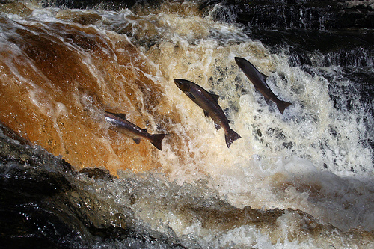
How do I get started with research?
Confronting the challenge of becoming research active
Gill Adams and Michael Inglis
Liverpool John Moores University
Notes:
Origins: this presentation came out of a desire to share aspects of our experience of working on teacher and teacher educator professional development in Ethiopia, to capture some of our learning and to consider whether it may be used to inform practice in the UK. It is well known in Voluntary Service Overseas (VSO) circles that the returned volunteer is keen to find audiences to share their experience with: three years after returning to the UK the desire is still there – but this is more than merely an opportunity to re-live our experience. This question ‘How do I get started with research?’ is one that has challenged us, albeit in different ways, since our return. Here we aim to stimulate further thought about the particular needs of beginning teacher educators as regards research through an examination of existing literature on the subject and consideration of two cases of support, interwoven with our own stories as teacher educators, three years into our new careers. We hope that these stories will support those new to teacher education in making sense of their own development.
Having initially viewed this presentation as an end in itself, our collaboration has resulted in an outline for further exploration of the journey (in part prompted by Gill’s doctoral studies) in the form of a critical autobiography – of which more later.
Activity: Think/pair/share – how did /will you get started with research?

Slide 2
Aims
The beginning teacher educator - shifting identities
Becoming a researcher
case 1: Ethiopia
case 2: UK
Where to next?
Notes:
Exploring the process of becoming research active – making public our experience. Starting to find our voices?
Our aim is to stimulate further thought on the process of becoming ‘research active’ (which has a different meaning to us at present than it probably does to some of you) for beginning teacher educators through a focus on two cases.
We are three years in to our careers in higher education in England and characterise the journey so far in terms of the salmon, fighting its way upstream. The salmon are often supported by salmon ladders, deliberately created to facilitate progress, a scaffold to help salmon get upstream, to overcome obstacles. What are the scaffolds supporting teacher educators to engage with research? How visible are they?

Slide 3
Biographical notes
Gill
Michael
Mathematics/education
Teacher professional development
‘Scholarly’ habits!
Geophysics in industry
Science education
An unconscious positivist
A thwarted HoD
Notes:
Our backgrounds:
Gill gained a degree in Mathematics and Education and spent many years teaching mathematics before moving in to support teacher professional development in a local authority. Often engaged in further study; ‘scholarly habits’ driven by a desire to see what others were doing – and, at least initially, by a lack of confidence.
Michael – industry – functional approach, absolutes with no ambiguity; PGCE left that mindset unchallenged; approached early teaching with a problem-solving mentality; mocked for reading School Science Review and unable to bring department along

Slide 4
Teacher educator professional identity
What is a teacher educator?
“…there were not distinct moments when we were only researchers or only practitioners…” (Cochran-Smith, 2005:219)
Sub-identities of teacher educators (Swennen et al., 2010):
as school teachers
as teachers in HE
as researchers
as teachers of teachers
But I teach teachers: there is no time for research!
Notes:
Gill’s question: ‘What is a teacher educator?’ was prompted by a flyer advertising an ESCALATE professional development day for those new to teacher education – well, I knew I was in the business of teacher education, had been for many years, but this ‘teacher educator’ in UK Higher Education appeared to be one exclusively concerned with INITIAL teacher education, hence my question. This moment was important, focussing attention on the professional identity of the teacher educator and the multi-faceted role.
Sub-identities of teacher educators (Swennen et al (2010):
as school teachers (Murray’s “novice” (2002))
as teachers in HE (PGCert)
as researchers
as teachers of teachers (e.g. Korthagen, Lunenberg, Loughran)
These are some aspects of Holland et al’s (1998) multiple and often contradictory identities – how are you supported to understand this as a beginning teacher educator?
Induction into teacher education is commonly through ‘micro-communities’ (Murray, 2008) and yet in this period constant change and fragmentation both within our institutions and nationally how are these communities able to support induction?

Slide 5
Teacher educator as researcher
“There’s a desperation for people to do the teaching…that’s the emphasis…I suspect that a lot of people have the desire to do research…but they find when they get here there’s a huge teaching load” (Griffiths et al., 2010:253)
Why is it important for a teacher educator to be research active?
Notes:
Griffiths et al (2010) Case study of 6 teacher educators and 6 mentors in 2 universities note the focus on the teaching for new teacher educators, research is squeezed out.
This is borne out elsewhere: Murray (2008) found that induction into research less well supported than induction into teaching/admin. This gives new teacher educators the message that the research is less important.

Slide 6
Teacher educator as researcher?
Tanner & Davies (2009) found that being research active influenced the practice of teacher educators in these ways:
improved knowledge of the literature impacting on teaching
increased research capacity, confidence and skills
greater critical awareness
“To build a culture of reflective practice, research must be an essential part of teacher professional development from the outset” (ibid:386)(our emphasis)
Notes:
Tanner & Davies (2009:386) echo the concerns raised by Griffiths, noting that “research may not be an institutional priority”. However, their study of one of the research groups supported by WERN (Welsh Education Research Network), draws out several ways in which being research active has influenced the practice of teacher educators:
increased knowledge of relevant scholarship impacting on teaching
increased research capacity, confidence and skills – with consequent improvement in student experience e.g. ITE student research projects, (in our experience, especially at M-level)
greater critical awareness – modelling to students being reflective practitioners
The evidence from their research supports their assertion that: ‘To build a culture of reflective practice, research must be an essential part of teacher professional development from the outset’ (p.386) – links to the role of HE in teacher education.

Slide 7
I am surrounded by researchers: they seem to be working inside a glass house. I can see much of what they are doing but cannot find a way to join them.
Research? I would love to be researching but I don’t have time!
Notes:
Gill – how do you become research active?
My clear aim on returning to the UK was to continue to work in teacher professional learning but in higher education. My image of those working in higher education was that there was a balance of teaching and research, that there would be not just an expectation of engagement with research but a culture that supported and promoted it. I turned down one job I was offered as it was made clear to me that my engagement with research was nowhere on the departments list of priorities for the first few years. Having already postponed my doctorate whilst in Ethiopia I was keen to make a start and was somewhat confused by job advertisements, descriptions and person specifications emphasising research only to find in practice what was wanted was a teacher. Obviously, there are large variations according to type of HE institution...

Slide 8
Swimming against the flow?
Beginning teacher educator
researching your own practice (Mason, 2002) – pedagogical practice
Experienced teacher educator
?
Experienced researcher/Professor
‘original research’
“scholarship of discovery” (Boyer et al., 1994; in Boyd et al., 2007:16)
Notes:
What are the progression routes for teacher educators? We struggled to represent it here.
Munn (2010:420) warns of “the dangers of a separation of research and initial teacher education” (particularly in terms of those institutions which score highly on the REF it must be noted) – “teacher educators can be seen as second-class academic citizens” (p. 41). She talks of the importance of the link between research and ITE in terms of the development of new teachers:
So that they know and understand research findings and can apply them to their own practice
In terms of fostering a ‘researcherly disposition’ (Munn & Ozga, 2002; cited in Munn, 2010:422) - critical engagement with practice
Becoming research-active is the final issue addressed in the ITE induction guidelines (Boyd et al., 2007) though its importance is highlighted. They note that it may be useful to consider progression in research and scholarly activity ‘moving from inquiring into an area of expertise…through to contributing actively to it (ATE, 2003)’ (Boyd et al, 2007:16). ‘Scholarship of application (integrating theory with practice)’. ‘Scholarship of discovery (the production of original research)’ (p.16)
Ref to McIntyre and McIntyre (1999) four types of research in Tanner and Davies
McIntyre and McIntyre (1999) distinguish between four types of research about teaching and learning:
(1) research aimed at applying knowledge from social sciences to policies and practices for teaching and learning;
(2) educational research aimed at achieving improved understanding of teaching and learning practices, processes and contexts;
(3) research designed to provide direct evidence of effective approaches to teaching and learning;
(4) practitioner research and especially schools as research and learning institutions. (McIntyre and McIntyre 1999, v)

Slide 9
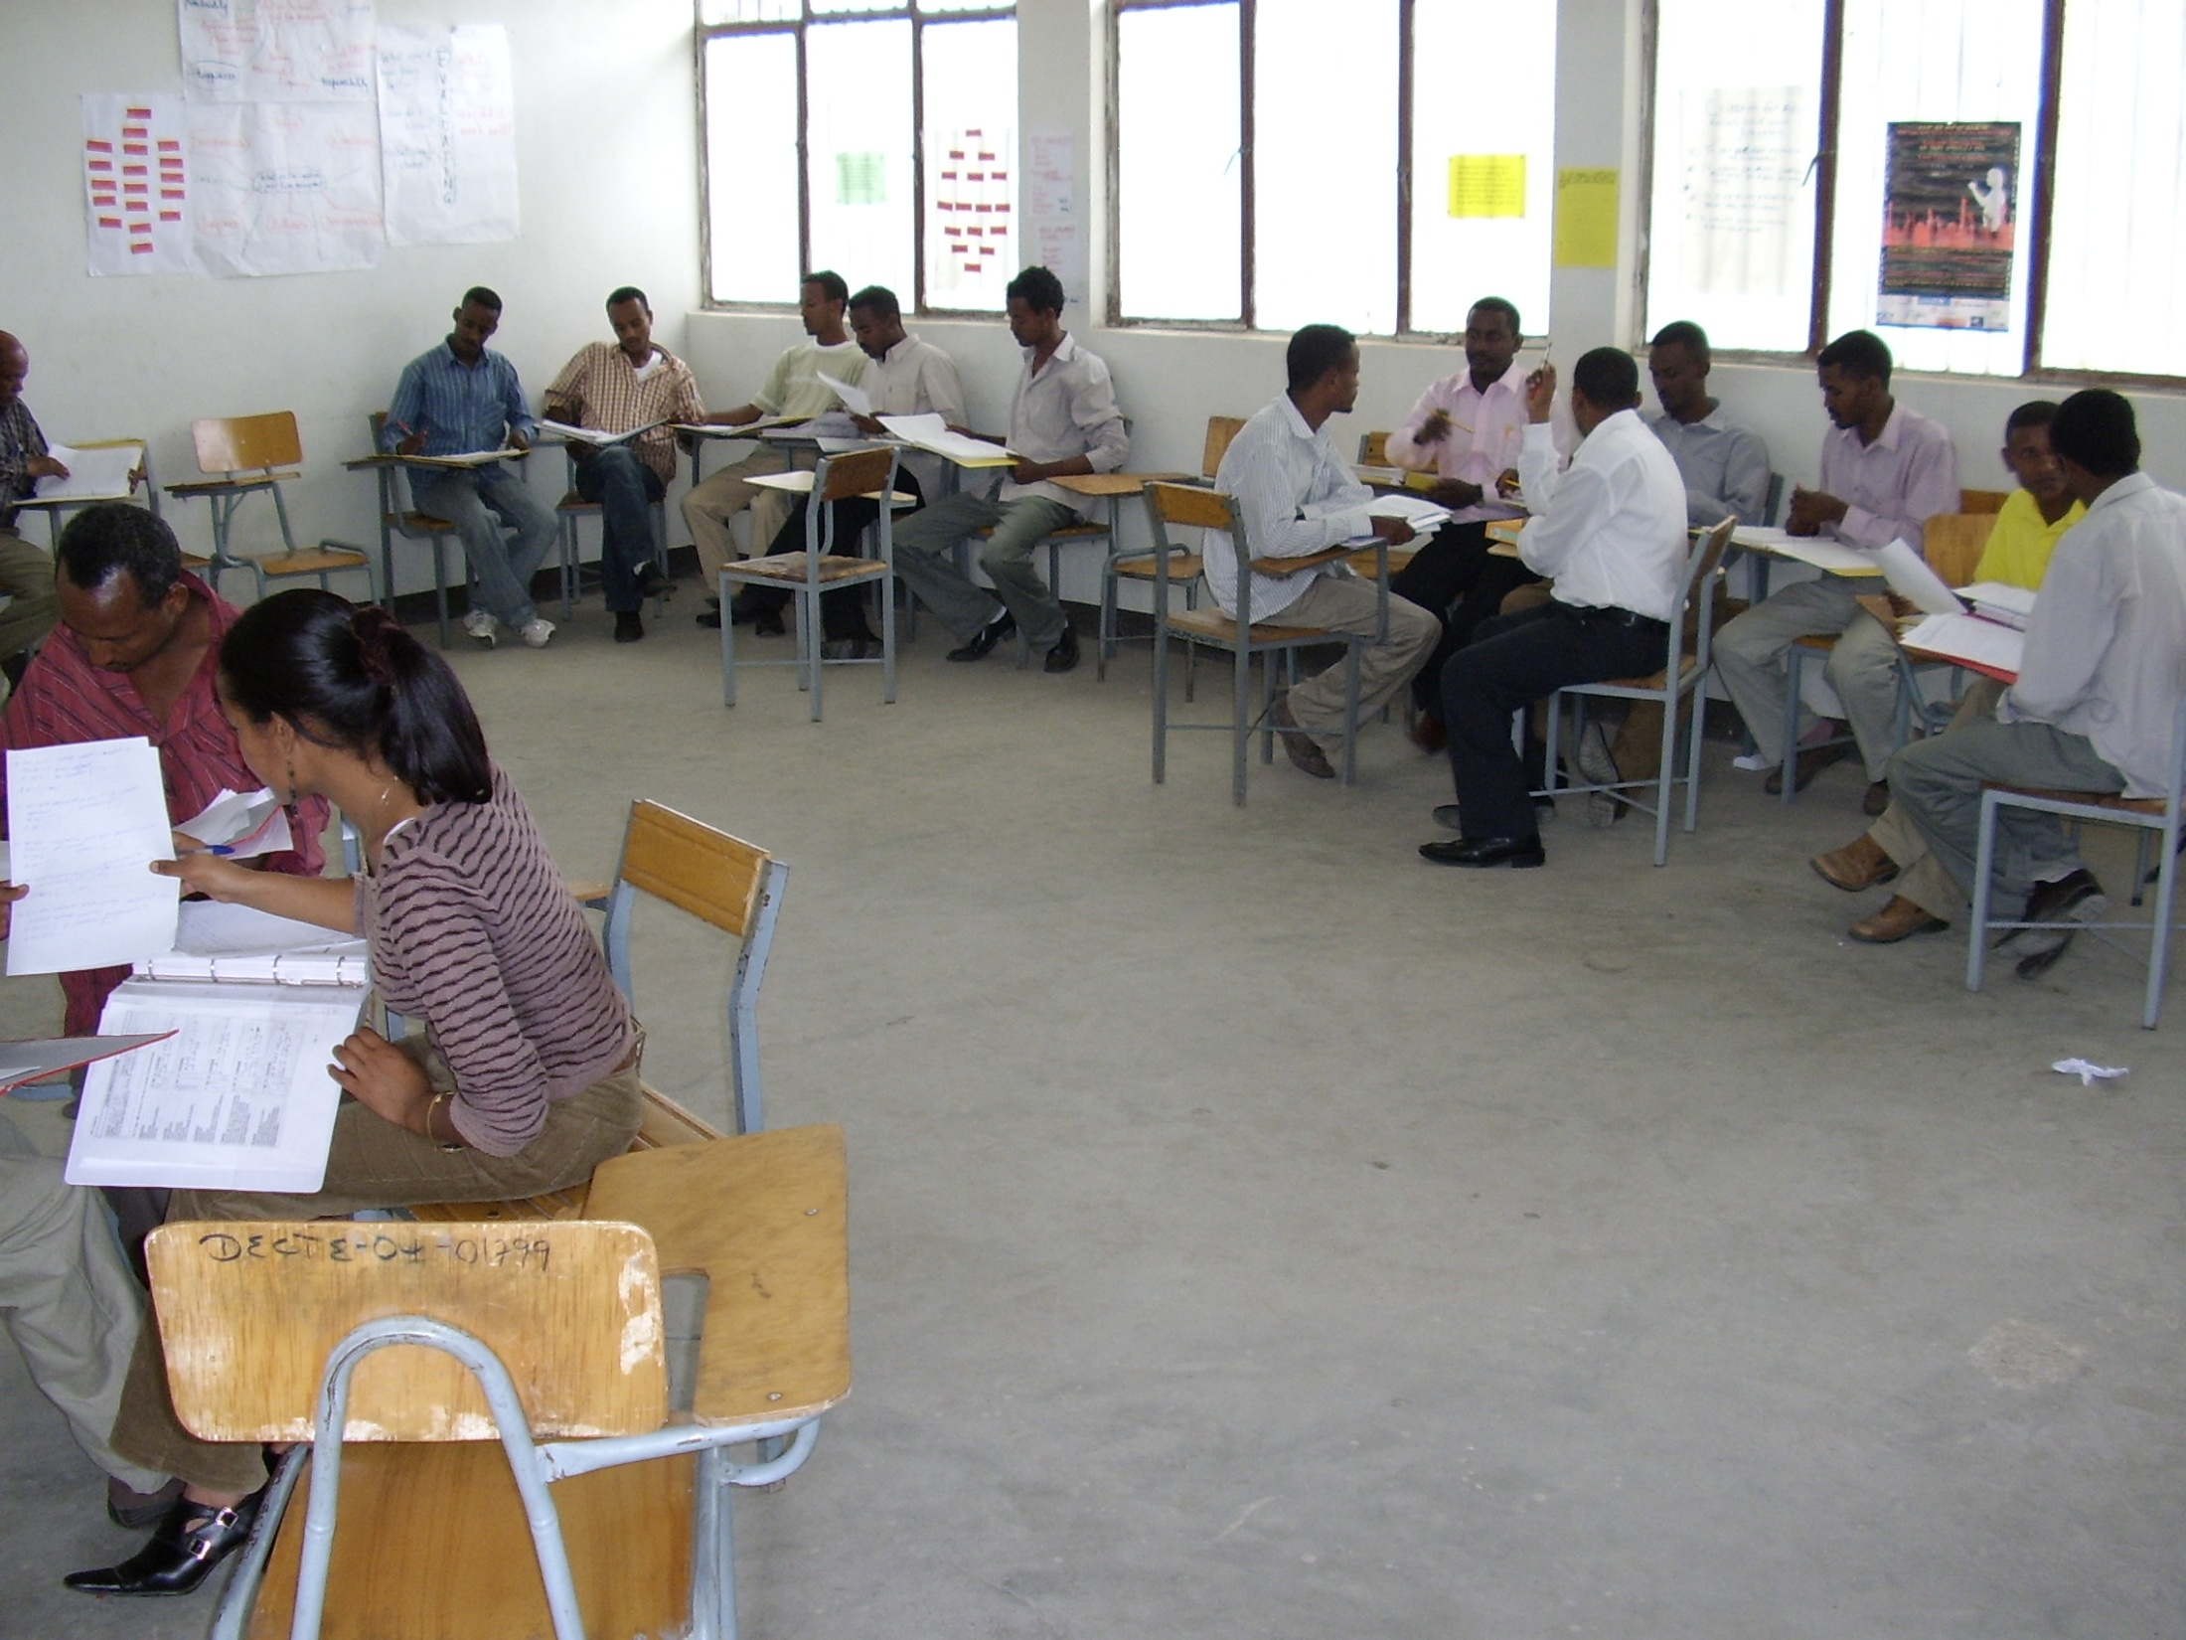
Case 1: Collaborative Action Research and the Higher Diploma Programme
Massification in HE:
contradictions e.g. “skilling/deskilling” (Tessema, 2006)
centralized control (Bekele, 2008)
Higher Diploma Programme (HDP)
A 9 month in-service course in active learning, assessment for learning and action research
Notes:
70% of staff in new universities only qualified to Bachelor degree level in Ethiopia and the country faces the challenges of ‘massification’ in HE (from 2 to 22 universities in 10 years with another 10 imminent) (Ashcroft, 2010). The population has tripled in 30 years. The Higher Diploma Programme (HDP) is a key part of induction into HE, part of the Teacher Education System Overhaul (TESO). We have not the time here to explore criticisms of the model (e.g. Tessema (2006) referring to contradictions such as skilling /deskilling (“a lack of a self-improving situation or dehumanisation…which is rampant” and use of plasma), the importation of initiatives from N to S). Bekele (2008:52) described the HDP as “a government initiative and the control is highly centralized”. Here we want to focus on features of HDP that could be adapted in the UK – collaborative action research.

Slide 10
Case 1: Collaborative Action Research and the Higher Diploma Programme
“…impetus for change/innovation through deepening the participants’ understanding of social processes and developing strategies to bring about improvement” (Noffke & Somekh, 2005:91)
Notes:
Somekh & Zeichner (2009) point out that in some settings the ‘action’ (schools) is emphasised while in others it is the ‘research’ (HE). Action Research is viewed as supporting teacher educators to engage with their practice and empower them to question/change it in a centralised, top-down system and culture of not questioning authority. Bassey (1999:6) deplores the amount of practitioner research conducted as part of award-bearing courses that never sees the light of day. One of the goals of HDP was to encourage critical discourse about practice. The collaborative nature of the AR project was essential for achieving this; another key aspect was making the research public. The photographs show a group of teacher educators in Awassa sharing their research with colleagues and with key figures in the local education community. HDP is specifically for teacher educators (NO UK equivalent?).

Slide 11
What’s the big deal with action research?!
Notes:
For me (Michael) it was the first real encounter with action research and the complexity of teaching about teaching. I was initially very slow catching on to the significance of action research and its distinctiveness compared to ‘scientific’ research. With time I started to see the power of action research for enabling teachers to become more autonomous and to take more responsibility for practice. At the same time I started studying the Open University MA Education programme, which opened my eyes to the landscape of educational research and helped me to start to make a transition from a very positivistic view of knowledge to a wider view of what constitutes knowledge in educational settings.

Slide 12
Case 2: The PG Certificate in LTHE
HE/ITE induction
Tailored to needs of teacher educators?
Supporting engagement with/in research
Notes:
New teacher educators in the UK are typically encouraged to do PGCert with some exemptions/apel.
Boyd et al (2007), in induction guidelines for new teacher educators, question whether new teacher educators should be exempted.
Aims of LJMU PGCert LTHE include focus on developing skills as researcher and working collaboratively to develop practice underpinned by research and scholarly activity – but the main focus is on developing practice. Peer learning groups are a key tool to support this. It is a high quality professional learning experience but there is no specific focus on the very different needs of the teacher educator.
The PG Cert at LJMU plays an important role in supporting engagement with/in research e.g. making public –CETL journal (http://www.ljmu.ac.uk/ecl/cetl/92936.htm), presentations at L&T conference.
We think that exemption from elements of the PG Cert is a wasted opportunity and feel some frustration with lack of teacher educator-specific content. Informed by our experience of the HDP in Ethiopia we suggest the addition of an AR project/module (informed by HDP experience). This could be linked to team development plans and supported by a more experienced researcher. This approach appears to have been successful in WERN & TERN.

Slide 13
The bigger picture
Institutional support
TEAN/ESCalate
TERN (Murray et al., 2009) - collaboration
Sustained award-bearing courses (HDP, PGCert, MA, EdD/PhD,…)
Notes:
Institutional support – dependant on the particular institution and team(s) you find yourself in? The variability highlights the mportance of leadership and culture.
TEAN/ESCalate – new teacher educators day – helps to connect the new teacher educator with the wider community. It may herald the first encounter with the ITE induction guidelines. The TEAN conference and focussed day conferences are also useful supports.
TERN (Murray et al., 2009) – collaboration, building a research network.
So what role do sustained award-bearing courses (HDP, PGCert, MA, EdD/PhD,…) have? For us they have been particularly important, beginning with M level courses before entering teacher education and continuing now with doctoral studies. But what about more collaborative research as part of award-bearing courses? Interestingly Tanner & Davies (2009) found that some of those who had participated in WERN went on to engage in research as part of award-bearing courses.
All of these aspects of the bigger picture provide supports for beginning teacher educators to engage in research but how well are these scaffolds signposted?

Slide 14
Where next?
How do I get started with research?
Confronting the challenge of becoming research active
Notes:
Our critical autobiography of our journeys into research – ethical considerations.
Our plan now is to examine our own progress upstream aiming to provide a story which may help to reduce the isolation often experienced by new teacher educators.
We aim to explore further our own learning through this process, from initial idea, abstract writing to today – ideas and identities shifting.
Return to opening question – how did /will you get started with research? What are the enablers and barriers?

Slide 15
References
Bassey, M. (1999), Case study research in Educational Settings. Maidenhead: OUP
Bekele, A. (2008), Application of Higher Diploma Training skills in classroom instruction: The case of Education Faculty, Jimma University (Ethiopia), Ethiopian Journal of Education & Society, 4(1), pp. 51-72
Boyd, P., Harris, K. & Murray, J. (2007), Becoming a teacher educator: guidelines for the induction of newly appointed lecturers in Initial Teacher Education, Bristol, HEA ESCalate, available at http://escalate.ac.uk/3662
Cochran-Smith, M. (2005), Teacher educators as researchers: multiple perspectives, Teaching and Teacher Education, 21, pp. 219-225
Griffiths, V., Thompson, S. & Hryniewicz, L. (2010), Developing a research profile: mentoring and support for teacher educators, Professional Development in Education, 36(1), pp. 245-262
Holland, D., Lachicotte, W., Skinner, D & Cain, C. (1998). Identity and Agency in Cultural Worlds, London, Harvard University Press
Mason, J. (2002), Researching your own practice: the discipline of noticing, Abingdon, Routeledge Falmer
Munn, P. (2008), Building research capacity collaboratively: can we take ownership of our future?, British Educational Research Journal, 34(4), pp. 413-430

Slide 16
References
Murray, J. (2008), Teacher educators’ induction into Higher Education: work-based learning in the micro communities of teacher education, European Journal of Teacher Education, 31(2), pp. 117-133
Murray, J. et al. (2009), Research and teacher education in the UK: building capacity, Teaching and Teacher Education, 25, pp. 944-950
Somekh, B. & Zeichner, K. (2009) Action research for educational reform: remodelling action research theories and practices in local contexts, Educational Action Research, 17(1), pp.5-22
Swennen, A., Jones, K. & Volman, M. (2010), Teacher educators: their identities, sub-identities and implications for professional development, Professional Development in Education, 36(1), pp. 131-148
Tanner, H. & Davies, S. (2009) How engagement with research changes the professional practice of teacher-educators: a case study from the Welsh Education Research Network, Journal of Education for Teaching, 35(4), pp. 373-389
Tessema, K. A. (2006), Contradictions, challenges and chaos in Ethiopian teacher education, Journal for Critical Education Policy Studies, 4(1) www.jceps.com/?pageID=article&articleID=62

Slide 17
How do I get started with research?
Confronting the challenge of becoming research active
Gill Adams and Michael Inglis
Liverpool John Moores University

