Slide 1
The Important Role of Higher Education in Teacher Education
2nd. TEAN Annual Conference, 20. 05.11
Manchester
Prof. Hilary Cooper, University of Cumbria

Slide 2
The Importance of the Philosophy of Education and of Understanding WHY and HOW to Engage with it
A Matter of Universal Interest!
Professional Studies in the Primary School (ed. H. Cooper, Sage 2011)

Slide 3
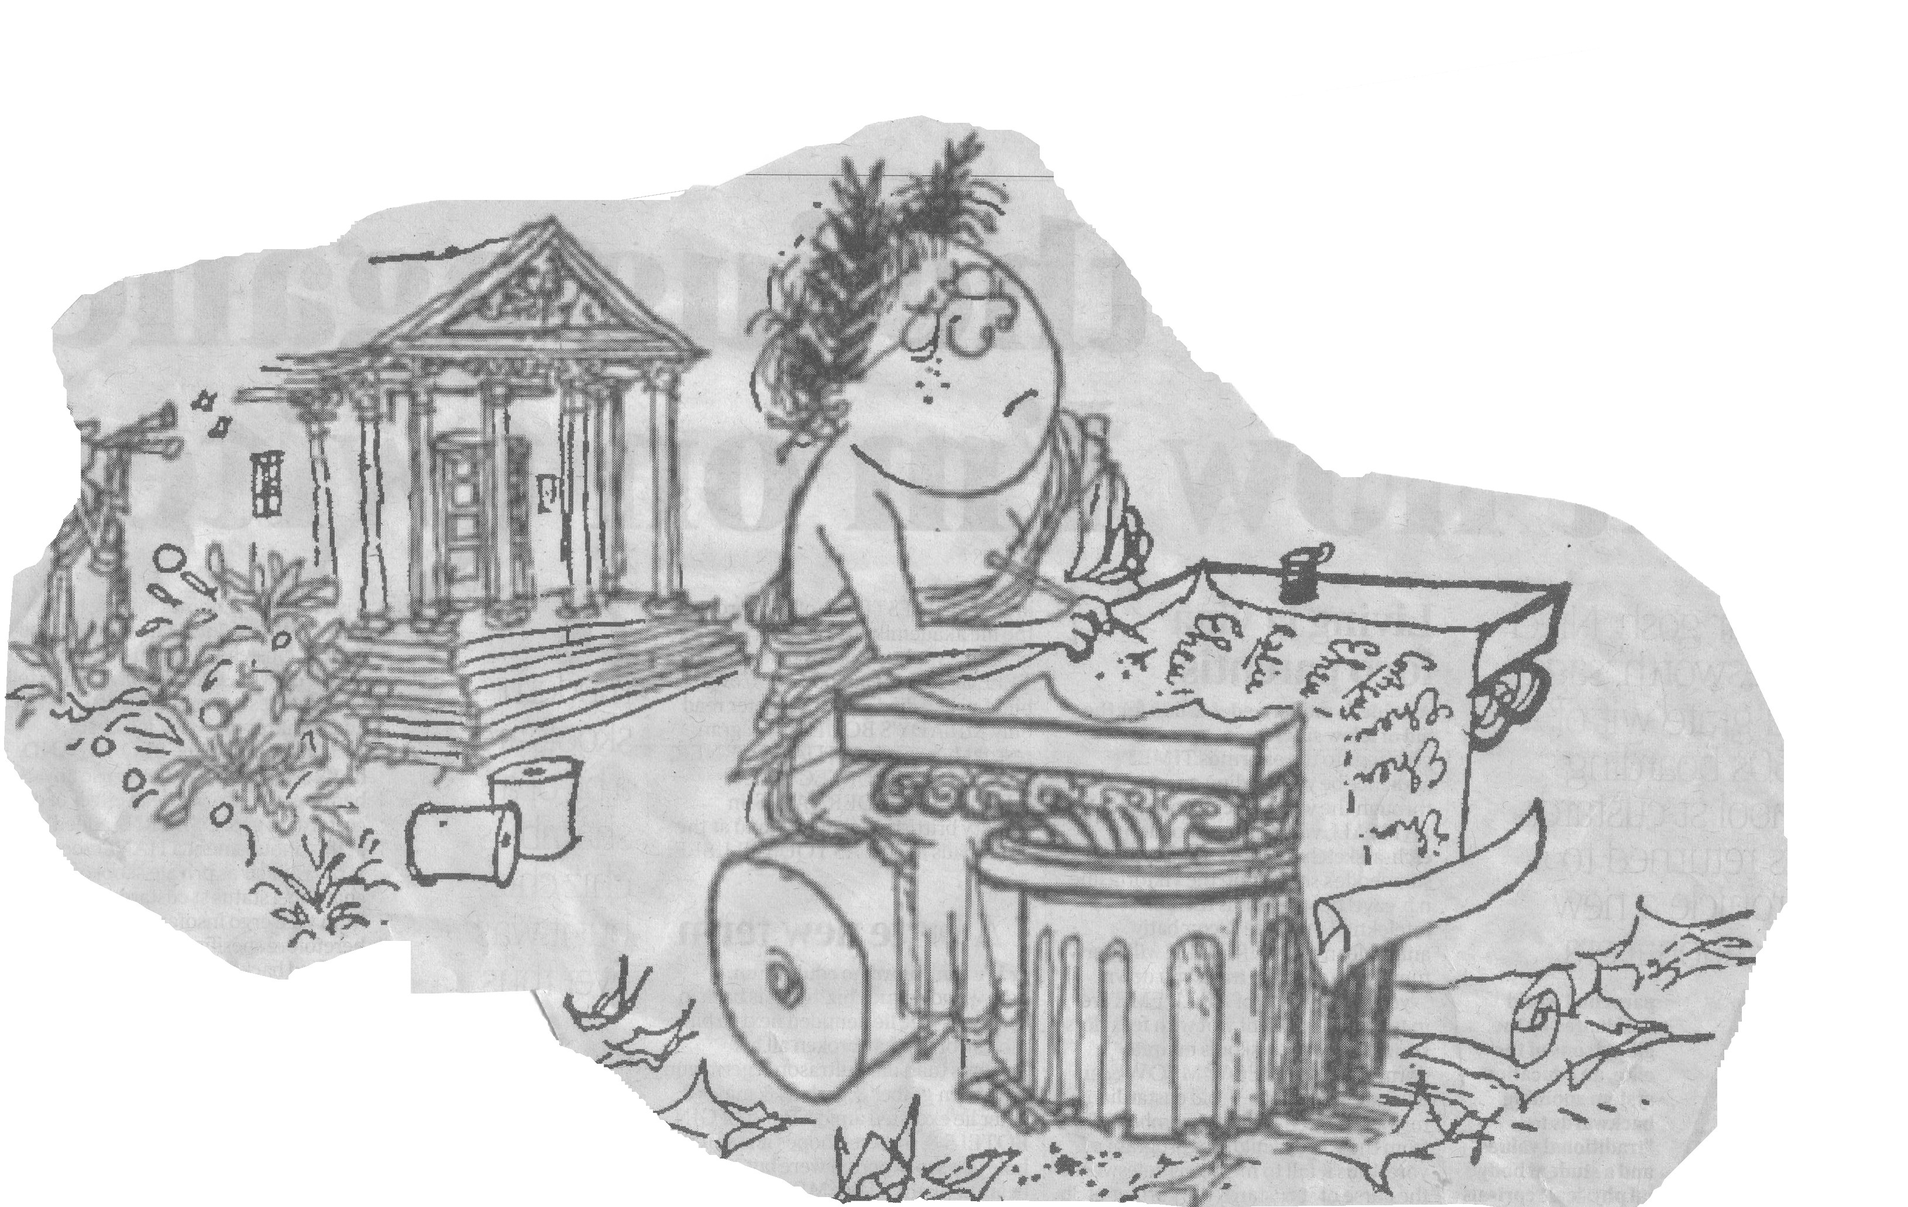
The Wite heat of reform
Masters to be recruted from
the army
Independunt foundashun skools
LEEG tables to be SHAKEN up
Return of trad
learning
Wot of the future
Notes:
Have you had students who: think that good education began in 1989?
That they are the best teachers ever?
Who can not suggest any improvements in the curriculum?
Who download endless QCA schemes
Who make no connections between literacy and other subjects
Whose evaluations of the Educational Issues course say, ‘Frankly I’ve got better things to do with my time?
How are they going to cope with The Wite heat of reform?

Slide 4
What questions do educational philosophers ask?
How do they discuss them?
Why is it important to engage in such enquiries?
How can we help students to do this?

Slide 5
Q8
Have a creative and constructively critical approach towards innovation, being prepared to adapt their practice, where benefits and improvements are identified.
Notes:
The Professional Attributes for Qualified Teacher Status do not expect you to explore questions about the aims purposes and value of education but to ‘deliver’ the curriculum, with little responsibility for professional discretion. This chapter aims to help you to do this. First it gives an overview of the questions philosophers have asked about education in the past and ask currently and shows you how to engage with them.

Slide 6
What are the Aims of Education?
This is a fundamental philosophical question
Teachers have had little encouragement recently to question why, what or how they teach
Notes:
Discussing a broad set of aims will prevent you from narrow thinking about what children can and should do.
it is essential that, having begun to discuss educational aims that you use these to shape what you do as a teacher and what children you teach experience, in the curriculum, teaching, assessment..

Slide 7
‘The Basics’
Since the beginning of state education these have been generally seen as central to primary education, but what are ‘the basics’ in the 21st. Century?
How can we empower children to find meaning in their lives?
Notes:
? Independence and empowerment are achieved through exploring, knowing, understanding and making sense, through imagination and dialogue, through constructivist approaches. And before they can educate pupils, based on these aims, students must learn to empower yourself.

Slide 8
Cambridge Review 2010 m p.5
‘Primary education suffers more than its fair share of scare-mongering and hyperbole, not to mention deliberate myth-making.
Isn’t it time to move on from populism and name calling, which for far too long have supplanted real educational debate and progress?’
Children deserve better from the nation’s leaders and shapers of opinion.’
Notes:
Yet if children’s lives are not to be at the mercy of political whim it is essential that teachers learn the skills of robust critical evaluation, based on their reading, experience and reflection, so that they develop strong personal philosophies about what, how and why we teach children, in order to interpret changes in ways which are professionally valid and have integrity. It is important to learn scepticism, and concern about the larger questions and to have a deep understanding of what we teach, to have time to reflect, research and study.

Slide 9
The Long Tradition of Educational Philosophy
For over 2,500 years thinkers have been debating what education is, and what it is for.
Throughout this period ideas emerged which SHOULD inform political views about the aims and processes of education.
Do they?

Slide 10
Plato to Rousseau
Plato (5, BC) and Aristotle (4c BC)
Holistic, balance of practical and theoretical
Avicenna (10c CE) Children should discuss, debate and learn from each other
John Stuart Mill (1859) Importance of contesting and defending ideas
Rousseau (1762) Education is developmental, changes in response to pupils’ needs, children learn by interacting with their environment

Slide 11
Spencer to Steiner
Spencer (1851) Moving from concrete to abstract
Froebel (1895) Learning through play; children. at centre of own worlds
Montessori (1914) Children can make decisions for themselves
Dewey (1916) Social and moral nature of education, essential to democracy
Steiner (1919) Freedom of teachers to shape their own curriculum

Slide 12
Peters and Hirst:
Peters and Hirst (1960 -70s) asked the same questions as Socrates had asked:
What is worth knowing?
What do we mean by an ‘educated person?
Is the education system fair?
Who knows best what children should learn?
Is education different from training; teaching from learning?

Slide 13
How do you analyse such ‘fuzzy’ questions, which people might understand differently and which have no ‘right answers’? Peters:
What do you mean by this question?
How do you know?
Collect different examples, based on reading and experience
Can we find some key principles which allow us to interpret the constantly changing demands being made of us?
Notes:
These are questions which are complex and have no single answer or dictionary definition and in an open society they must be argued over.
Peters definition of an educated person at the end of this process was,’ essentially: someone who has been changed, by their knowledge and understanding, in the way they look at the world around them; has a body of principles for organising knowledge, (subjects or areas of learning), can make connections between areas of knowledge, and cares about what they know and understand.
Do you Agree?
BUT this concept raises questions.
Is it possible to be educated if you excel in only one area of knowledge? Does being educated involve only knowledge and understanding or does it include, for example, behaviour? Can everyone be educated if we accept this definition? Should they be?
Matthew Arnold said that education should convey ‘the best that has been thought and said.’
But is this still appropriate?
Education must be relevant to the culture and society in which childrenlive and ‘the best’ may not be relevant to their worlds. Yet should they have access to it?

Slide 14
Hirst, Wright, Rorty (1980s)
Agreed that there could be no ‘universal answers’; Peters work was part of an evolutionary approach.
They, and subsequent educational philosophes, took a more conversational approach, based on more pragmatic discussion of current issues.
Before we ask, ‘what are the aims of education we must ask ‘what are the values of our society?

Slide 15
Contemporary Educational philosophy is concerned with:
Multiculturalism, identity, education and religion, inclusion, education for citizenship and democracy, the curriculum, educational methods, organisation, assessment, the role of other adults in the classroom, governance, who controls schools, behaviour, personal and social development, the curriculum, moral questions, gender.

Slide 16
How does contemporary educational philosophy enable us to achieve our visions within political constraints?
When philosophical discussion becomes a habit it enables us to develop
our own practice with integrity
We stop accepting simple solutions to what we know are complex problems
It stops us knee-jerking in reaction to change by allowing us to define and
work towards what we value
It allows us to define what beliefs and values underpin our work and to use
these to interpret our responses to change
This constitutes professionalism
Notes:
Education embodies values and ideals. Most student teachers I have known have been highly motivated by a vision of the kind of teachers they want to be. They have ideas about what they think is valuable and how it might be achieved. But visions vary. For example interviewees often talk of their aim to help children ‘to be creative’, ‘to love art or books’, ‘to be independent’. But when such aims are analysed in a group they become controversial. They are all based on value judgements about what the student thinks is important, which not everyone agrees with. They involve concepts which are abstract and are understood in different ways. What exactly is meant by ‘creative’, ‘loving books’, ‘independent’?

Slide 17
Philosophical analysis allows us to dissect slogans: Education for
‘democracy’
‘citizenship‘
‘equal opportunities’
‘learning to learn’
‘collaboration’
Once we do we realize such slogans are not self evident
or beyond criticism

Slide 18
The Wite heat of reform
Independunt foundashun skools
Masters to be recruted from
the army
LEEG tables to be shaken up
Return of trad
learningl
Wot of the future

