Slide 1
How Assessment Drives Subject Knowledge
Professor Martin Fautley
Centre for Research in Education
Birmingham City University

Slide 2
Caveats
Curriculum: “…is a term…with several meanings” Kelly 2010:7
“Assessment is not an exact science, and we must stop presenting it as such” (Gipps 1994: 167).

Slide 3
Fautley & Savage 2011 p18

Slide 4
What we have?

Slide 5
This isn’t ‘teaching to the test’. It’s more invidious than that!
This is what Popham (2011, p44) calls “assessment-influenced instruction”.

Slide 6
‘Backwash’ effect
What is happening here is assessment backwash

Slide 7
Planning
Fautley and Savage 2008:57

Slide 8
What should be included?
What subject knowledge is there to learn?
Selecting from this, what should be learned?
Why?
Therefore, what should be omitted?
Why?
Who makes these decisions?

Slide 9
Questions…
Is there a curriculum mapping process undertaken realistically in schools?
Do we know what subject knowledge is valued?
Who knows (apart from the pupils) what the totality (gestalt?) of the curricular experience is?

Slide 10
Whose subject knowledge?
‘Education is not a product like cars and bread, but a selection and organization from the available knowledge at a particular time which involves conscious or unconscious choices’. (Young 1971: 24)

Slide 11
Some thoughts
What should be learned…
… drives what should be taught
Does this vary for schools in different contexts?
…it should certainly affect how it should be taught

Slide 12
Shulman
Content knowledge
Pedagogical content knowledge
Curricular knowledge
Shulman (1986)
Notes:
Content Knowledge
this area includes knowing why a particular proposition is warranted, why it worth knowing, and how it relates to other propositions.

Slide 13
Shulman: PCK
“Within the category of pedagogical content knowledge I include, for the most regularly taught topics in one’s subject area, the most useful forms of representation of those ideas, the most powerful analogies, illustrations, examples, explanations, and demonstrations in a word, the ways of representing and formulating the subject that make it comprehensible to others. Since there are no single most powerful forms of representation, the teacher must have at hand a veritable armamentarium of alternative forms of representation, some of which derive from research whereas others originate in the wisdom of practice.”

Slide 14
More Shulman I
Content Knowledge
In the different subject matter areas, the ways of discussing the content structure of knowledge differ. To think properly about content knowledge requires going beyond knowledge of the facts or concepts of a domain. It requires understanding the structures of the subject matter…
Teachers must not only be capable of defining for students the accepted truths in a domain. They must also be able to explain why a particular proposition is deemed warranted, why it is worth knowing, and how it relates to other propositions, both within the discipline and without, both in theory and in practice.

Slide 15
More Shulman II
Curricular Knowledge
In addition to the knowledge of alternative curriculum materials for a given subject or topic within a grade, there are two additional aspects of curricular knowledge. I would expect a professional teacher to be familiar with the curriculum materials under study by his or her students in other subjects they are studying at the same time.
This lateral curriculum knowledge … underlies the teacher’s ability to relate the content of a given course or lesson to topics or issues being discussed simultaneously in other classes. The vertical equivalent of that curriculum knowledge is familiarity with the topics and issues that have been and will be taught in the same subject area during the preceding and later years in school, and the materials that embody them.

Slide 16
To which I’d add
Curricular assessment mapping.
For some – eg SLT, learning managers, to have an overview of of the assessments which drive the learned curriculum at KS3
i.e. are similar things beings assessed in different parts of the curriculum?

Slide 17
Curriculum by Assessment
Fautley & Savage 2011

Slide 18
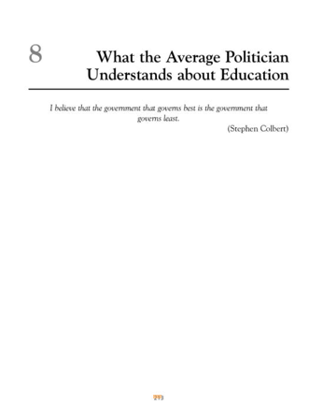
Notes:
Kelly – The Curriculum, Theory and Practice, 6th Edition. Chap 8 in full

Slide 19
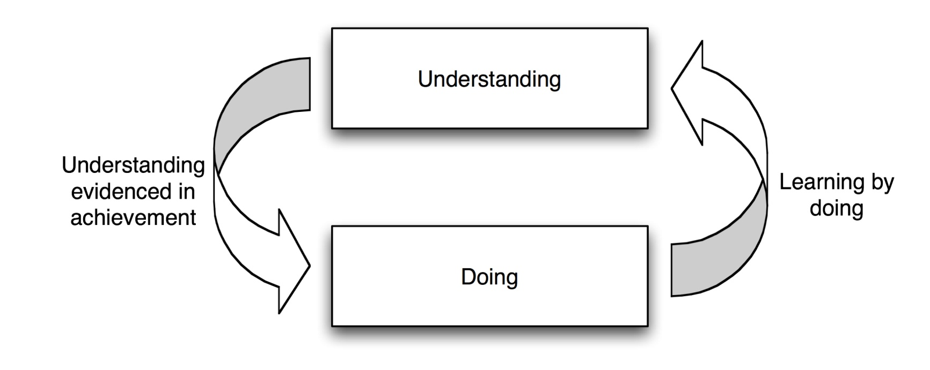
Learning and Doing

Slide 20
For ITT
For trainees, devising appropriate learning experiences
Writing these into plans
“A good intended learning statement can become its own assessment criterion”

Slide 21
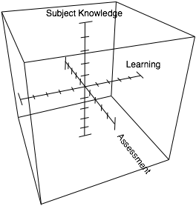
Three dimensions of knowing, learning, and assessment
Modified version from Fautley 2010

Slide 22
Pirsig: Zen and the Art of Motorcycle Maintenance
Quality -- you know what it is, yet you don't know what it is. But that’s self-contradictory. But some things are better than others, that is, they have more quality. But when you try to say what the quality is, apart from the things that have it, it all goes poof! There's nothing to talk about. But if you can’t say what Quality is, how do you know what it is, or how do you know that it even exists? If no one knows what it is, then for all practical purposes it doesn’t exist at all. But for all practical purposes it really does exist. What else are the grades based on?
(Pirsig, 1974, p187)

Slide 23
The role of assessment
to get at degrees of quality.
“What makes a good…”
Why do we want to know?
Do we know what a good one is?
Do we share this with the pupils so…
Do they know what a good one is?
Notes:
Enter on click

Slide 24
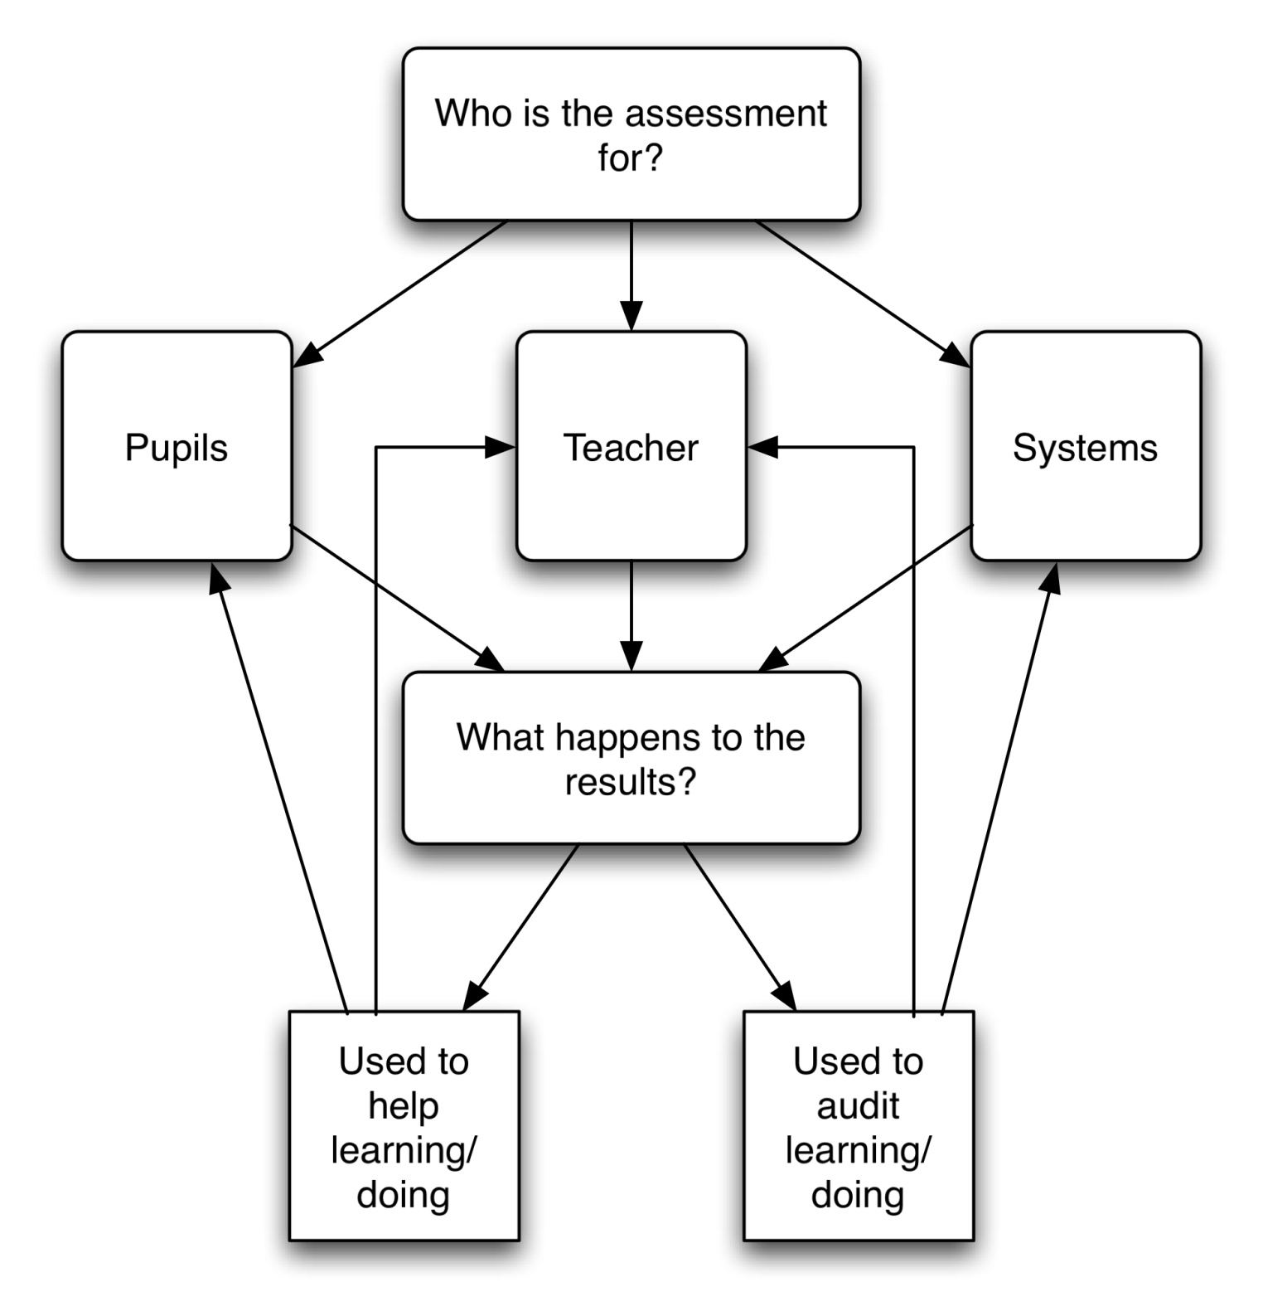
Fautley 2010

Slide 25
‘Double Duty’ of Assessment
‘They have to encompass formative assessment for learning and summative for certification
They have to have a focus on the immediate task and on implications for equipping students for … [the] future’ (Boud 2000: 160).
Notes:
This is the centre of the confusion, music teachers, doubtless taking their lead from school assessment managers, are providing a series of snapshots, and using these as the basis of assessing what their pupils are able to do at that particular moment in time. What this means is that assessments are having to do what (Boud 2000) refers to as ‘double duty’:

Slide 26
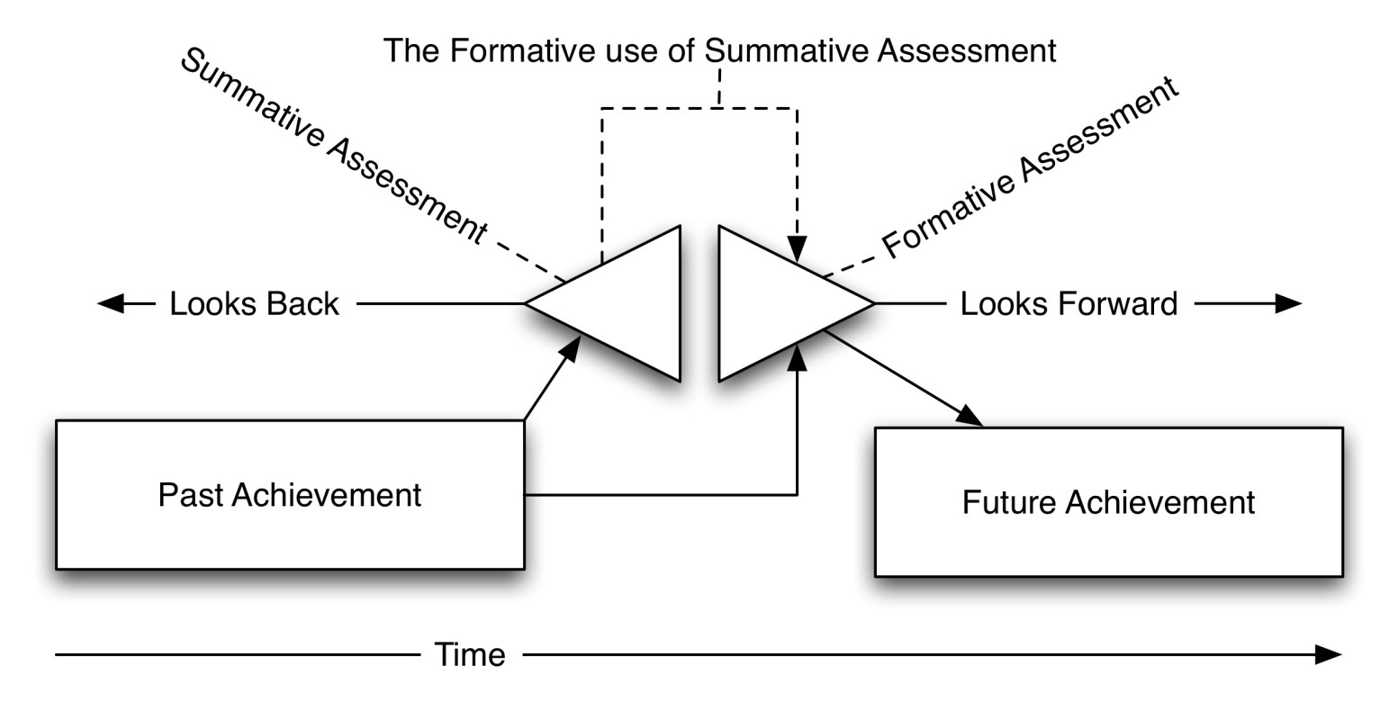
Revision: Assessment Modalities
Fautley and Savage 2008
Notes:
Emphasise the formative use of summative assessment

Slide 27
ARG, 2009
The nature and impact of assessment depends on the uses to which the results of that assessment are put. A system whose main priority is to generate information for internal use by teachers on the next steps in pupils’ learning may have different characteristics and effects from one where the drive is to produce a qualification which will provide a grade on which an employer or a university admissions tutor might rely in order to judge the suitability of a candidate for employment or further study.
Assessment in Schools – Fit for Purpose?

Slide 28
A subject specific interlude – the case of NC music at KS3

Slide 29
Formative Assessment
Something music teachers were good at (once!)
Then along came assessment managers…
…and told them they were doing it all wrong!

Slide 30
What happened to formative assessment?
“…because formative assessment has to be carried out by teachers, there is an assumption that all assessment by teachers is formative, adding to the blurring of the distinction between formative and summative purposes and to teachers changing their own on-going assessment into a series of ‘mini’ assessments each of which is essentially summative in character” (Harlen & James, 1997 p2)

Slide 31
So what happened instead?
For music (and other subjects) The ‘assessment lesson’!

Slide 32
Overheard in schools…
“We are doing assessment a fortnight on Wednesday”
“We’ve done assessment already”
“I need to level the kids by next Friday”
“The assessment manager wants my levels tomorrow”

Slide 33
Dylan Wiliam said:
“If what you are doing under the heading of assessment for learning involves putting anything into a spreadsheet, then you are not doing the assessment for learning that makes the most difference to student learning”.
(source: https://secure.ssatrust.org.uk/eshop/default.aspx?mcid=21&scid=31&productid=1325)

Slide 34
Where did quality go?
In the Arts?
In Music?
“But when you try to say what the quality is, apart from the things that have it, it all goes poof! There's nothing to talk about.”
Is this true?
Notes:
Each bullet on click

Slide 35
Assessment as tool – the National Curriculum for Music

Slide 36
“When the only tool you have is a hammer, everything looks like a nail”
Nicky Thomas - If I Had A Hammer (1970)

Slide 37
Right tool for the job I

Slide 38
Right tool for the job II
Because teachers have been given only one tool - NC levels – they use them all the time
Other tools are
Not available
Not credible
Not known
Notes:
Not credible – include Bentley test (1966)

Slide 39
NC levels (Ofsted)
‘In one lesson seen, for example, students were told: 'Level 3: clap a 3 beat ostinato; Level 4: maintain a 4 bar ostinato; Level 5: compose an ostinato.' This demonstrated a significant misunderstanding of the expectations inherent in the level descriptions’ (Ofsted 2009: 31)

Slide 40
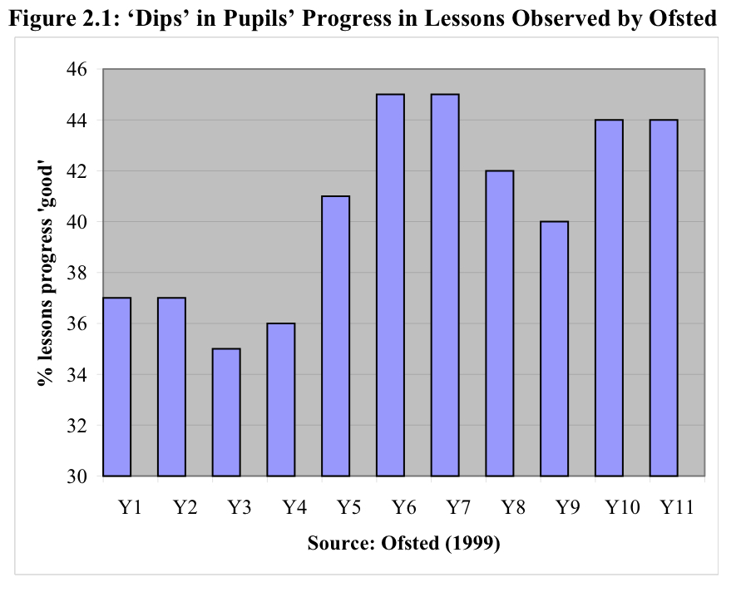
Is progression linear?
Galton, M., Gray, J., Rudduck, J., Berry, M., Demetriou, H., Edwards, J., Goalen, P., Hargreaves, L., Hussey, S. & Pell, T. (2003) Transfer and transitions in the middle years of schooling (7-14): continuities and discontinuities in learning.

Slide 41
Or…
http://nationalstrategies.standards.dcsf.gov.uk/node/169945?uc=force_uj#a2

Slide 42
NC sub levels (Music)
From current research
Other: Variations on “told by SLT that a = secure, b=working at, c=just about”
“to be honest, I make them up as I go along”
Notes:
The box at bottom needs clicking on
Also works with down arrow

Slide 43
Something is wrong when…
Research in progress

Slide 44
Developing Assessment Criteria
“In the hurly-burly of contemporary teaching we need clear criteria that help us to say ‘yes, that is effective music-making’, or ‘this is astute appraisal’.” (Swanwick, 1997 p.209)
….sadly we haven’t got these!

Slide 46
The effect is…
The summative ‘hammer’ is everywhere
True formative assessment – now undervalued by teachers (and SLTs?)
Notes:
Question – do SLTs care, so long as the stats add up!

Slide 47
How you measure matters
White, O. R. (1986). Precision teaching—Precision learning. Exceptional Children, 52, 522-534
Notes:
the same data plotted on two different scales can suggest different impressions of a student's progress

Slide 48
But…
“One of the key elements of AfL is the emphasis on making explicit both what is being learned and what successful learning would look like … However, achieving clarity in this process is like walking a tightrope, if [it] is not clear what is being learned (and why) and what success would look like, then learners will remain bemused, if it becomes too tightly specified then it becomes an exercise in compliance.” (Stobart, 2008)

Slide 49
Is it the case…
That NC assessment levels have become a signifier for the curriculum?
If so, is this a problem?
If not, then how, and by whom, is subject knowledge decided?

Slide 50
Subject knowledge and Assessment
Do we assess knowledge?
How?
Do we assess skills?
How?
Do we assess understanding?
How?
Do we assess knowledge and skills, and assume these equate to understanding?
Do we assume knowledge+skills+understanding= the curriculum?

Slide 51
“Assessment procedures are the vehicle whereby the dominant rationality of the corporate capitalist societies typical of the contemporary Western world is translated into the systems and process of schooling” (Broadfoot 1999: 64)

Slide 52
Andy Hargreaves, 2003
“In a low-trust system, high on standards but weak on discretionary judgment, comes an associated overemphasis on bottom lines, basic competence, and zero tolerance…” (p56)
“Since the late 1980s, centrally prescribed curricula, with detailed and pressing performance targets, aligned assessments, and high stakes accountability, have defined a ‘new orthodoxy’ of educational reform worldwide – providing standardized solutions at low cost…” (p57)

Slide 53
My worries
We spend more time trying to get assessment results ‘right’ than being concerned with what is being assessed, meaning assessment is driving subject knowledge
For example, when the new NC came out, many teachers looked first at the Assessment levels, then at the Key Concepts and Key Processes

Slide 54
More worries
I hear from teachers who are told to ‘massage’ their KS3 level results
Schools are often more concerned with assessment data than with curriculum mapping, or curriculum content and/or delivery

Slide 55
Final Thoughts
You don’t fatten a pig by weighing it frequently
As Adrian Mole found out, things don’t get bigger by measuring them often!
Subject Knowledge should be content driven, not assessment driven (discuss…!)

Slide 56
References
Boud, D. (2000) Sustainable Assessment: rethinking assessment for the learning society. Studies in Continuing Education, 22, 2, 151-67.
Broadfoot, P. (1999) 'Assessment and the emergence of modern society'. In Moon, B. & Murphy, P. (Eds), Curriculum in Context, London, Paul Chapman/Open University.
Fautley, M. (2010) Assessment in Music Education, Oxford, Oxford University Press.
Fautley, M. & Savage, J. (2008) Assessment for Learning and Teaching in Secondary Schools, Exeter, Learning Matters.
Fautley, M. & Savage, J. (2011) Cross-curricular Teaching and Learning in the Secondary School: The Arts, Abingdon, Routledge.
Gipps, C. (1994) Beyond Testing: Towards a theory of educational assessment, London: Falmer Press.
Hargreaves, A. (2003) Teaching in the Knowledge Society: Education in the age of insecurity, Maidenhead, Open University Press.
Harlen, W. & James, M. (1997) Assessment and Learning: differences and relationships between formative and summative assessments. Assessment in Education, 4, 3, 365-79.
Kelly, A. V. (2009) The curriculum : theory and practice (6th Ed), London, SAGE.
Ofsted (2009) 'Making more of music'. London, Ofsted.
Popham, W. (2011) Classroom assessment: What teachers need to know (6th Ed), Boston MA, Pearson.
Shulman, L. (1986) Those who understand: knowledge growth in teaching. Educational Researcher, 15, 2, 4-14.
Stobart, G. (2008) Testing Times - The Uses and Abuses of Assessment, Abingdon, Routledge.
Young, M. (Ed) (1971) Knowledge and Control, London, Collier-Macmillan.

