Slide 1
The value of an academic network: Inspiration in professional practice with TEESNet.
Teacher Education for Equity and Sustainability Network
Notes:
http://teesnet.liverpoolworldcentre.org/
The purpose of education
UN SDGs and OECD
TEESNet
Relevance and responsibility
Book offer
Tweet
Executive summary
TEESnet aims to develop a UK wide community of practice in ESD/GC within Teacher Education (TE) in higher education and schools that shares research and practice to develop new understanding across the sector in the UK and beyond.
This is achieved through • Embedding ESD/GC in Teacher Education in the UK regions, with links to Europe and the wider world, in relation to ethos, values, curriculum content, learning, teaching and assessment.
• Encouraging and promoting research on ESD/GC within TE, with particular emphasis on exploring its impact on student teachers, teachers, young people and their communities.
• Connecting researchers and practitioners across the UK and Europe concerned with teacher education and ideas from ESD/GC / Development Education / Global Learning / Environment Education, and Moral/Values Education
• Reflecting upon and shaping the debate on ESD/GC and the implications for the lives and the work of teachers
Objectives 2015-2017
1. Deliver an annual conference on Education for Sustainable Development and Global Citizenship
2. Supporting members to prepare papers for annual conferences, and develop research in area of ESD/ GC.
3. Maintain active membership of steering group to steer direction of TEESNet and support work of Directors
4. Develop funded research project proposal 5. Provide appropriate level of advocacy for ESD/ GC learning in Higher Education settings

Slide 2
Outline
The purpose of education
Global education frameworks: UN SDGs and OECD
TEESNet
Relevance and responsibility
Useful resources and Book offer
Tweet

Slide 3
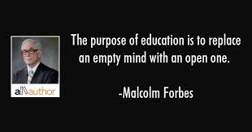
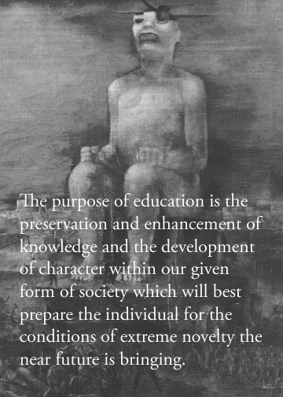
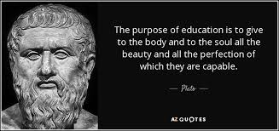
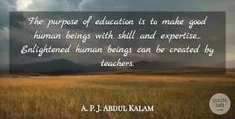
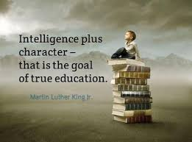
Notes:
The purpose of education:

Slide 4
‘….to put the interests of children and young people first, by making sure that inspection values and rewards those who educate effectively and act with integrity. We hope that you will agree that this framework can be a real and positive step in that direction.’
Amanda Spielman
Notes:
References:
No Teacher Is an Island: How Social Networks Shape Teacher Quality
Kira J. Baker-Doyle
Promoting and Sustaining a Quality Teacher Workforce. 2015, 367-383
SMSC targets: Through their provision of SMSC, schools should: • enable students to develop their self-knowledge, self-esteem and self-confidence; • enable students to distinguish right from wrong and to respect the civil and criminal law of England; • encourage students to accept responsibility for their behaviour, show initiative, and to understand how they can contribute positively to the lives of those living and working in the locality of the school and to society more widely; • enable students to acquire a broad general knowledge of and respect for public institutions and services in England; • further tolerance and harmony between different cultural traditions by enabling students to acquire an appreciation of and respect for their own and other cultures; • encourage respect for other people; and • encourage respect for democracy and support for participation in the democratic processes, including respect for the basis on which the law is made and applied in England.
https://assets.publishing.service.gov.uk/government/uploads/system/uploads/attachment_data/file/380595/SMSC_Guidance_Maintained_Schools.pdf
British Values: an understanding of how citizens can influence decision-making through the democratic process; • an appreciation that living under the rule of law protects individual citizens and is essential for their wellbeing and safety;
PSHE: Mental well being, health and fitness, health prevention

Slide 5
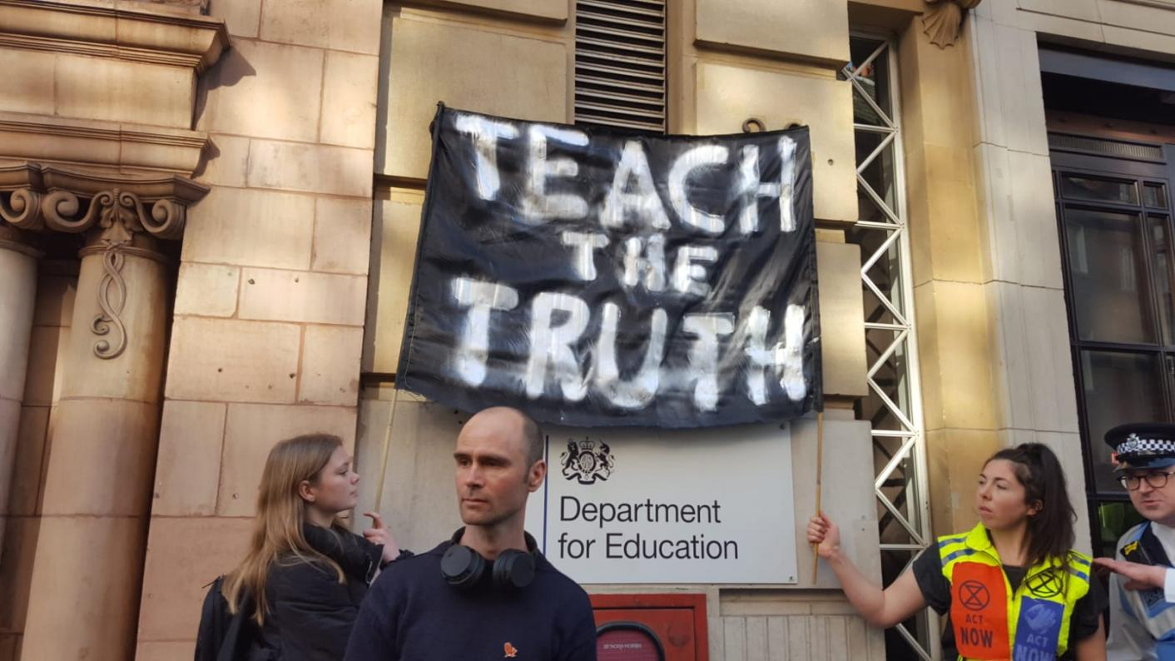
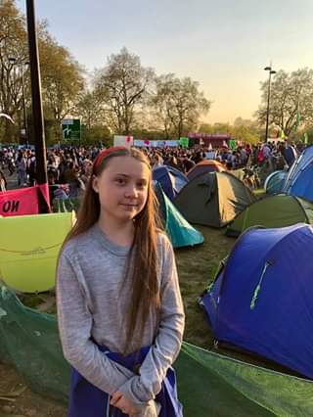
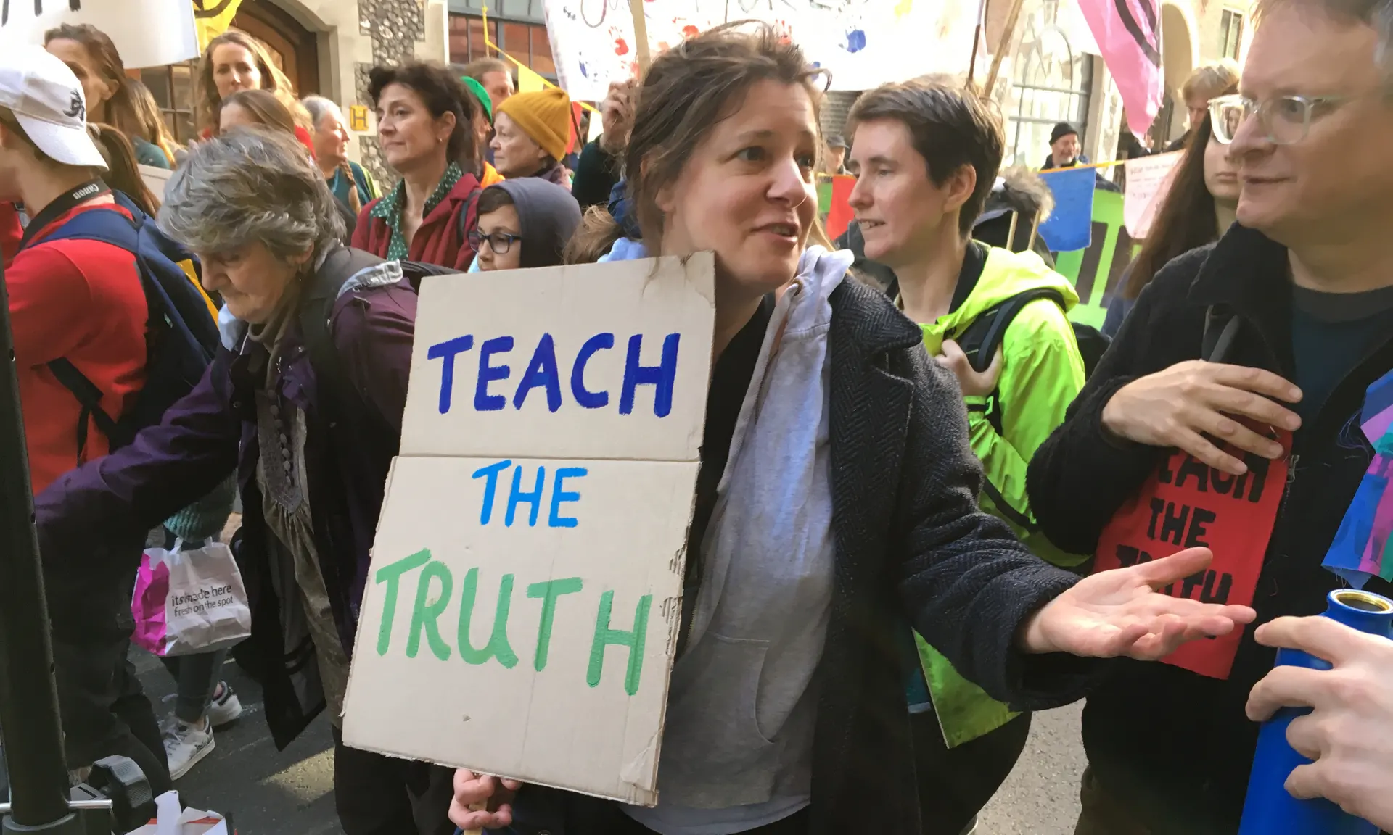
Teachers protest outside the Department for Education in London against what they say is the government’s lack of action on climate change.
Extinction Rebellion ‘Die In’ at the European Commission
Greta Thunberg
Extinction Rebellion
1st May 2019
Notes:
https://news.sky.com/video/extinction-rebellion-stage-die-in-at-european-commission-11711453
https://www.independent.co.uk/news/uk/politics/climate-change-environment-emergency-commons-motion-mps-vote-latest-a8895456.html?utm_medium=Social&utm_source=Facebook&fbclid=IwAR0Mz2KT_MUoNYButwEkH-4zTq2ai7gvAKIKfh4h8TDVgIz5p7jZpXeVVFs#Echobox=1556734746
MPs have passed a motion making the UK parliament the first in the world to declare an “environment and climate emergency”.
The symbolic move – recognising the urgency needed to combat the climate crisis – follows a wave of protests launched by the Extinction Rebellion strikers in recent weeks.
The demonstrators – who carried Teach the Truth, Rebel for Life and Climate: More Important Than Brexit banners – urged the government to make the climate and ecological crisis an educational priority.
https://www.theguardian.com/environment/2018/may/17/uk-taken-to-europes-highest-court-over-air-pollution UK taken to Europe's highest court over air pollution
This article is more than 11 months old
European court of justice can impose multimillion euro fines if the UK and five other countries do not address the problem
Ella Kissey-Debrah (9) - https://www.theguardian.com/uk-news/2019/may/02/ella-kissi-debrah-new-inquest-granted-into-air-pollution-death inquest granted into air pollution death
March 2019: 64,000 annually (reported in the I) https://inews.co.uk/news/health/air-pollution-kills-64000-people-in-the-uk-every-year/ in European Heart Journal: UK = 98/100000
https://www.theguardian.com/environment/2019/feb/22/teachers-and-students-stage-mock-climate-classes-national-curriculum

Slide 6
#Worldslargestlesson
#TeachSDGs
Notes:
The Sustainable Development Goals (SDGs, or “the Global Goals”) are an initiative of the United Nations.
Together, the Global Goals set out an ambitious agenda for a better world by 2030 – fairer, safer, healthier, more prosperous and in better balance with nature. The goals have been described as “the closest thing the world has to a strategy”.
The Global Goals were born out of a vast consultation process and were ratified by 193 global leaders in September 2015. There are 17 goals, with 169 targets sitting underneath them, covering every facet of life on Earth – social, economic and environmental.
Unlike the Millennium Development Goals which preceded them, the SDGs are not primarily focused on developing countries; they are about sustainability everywhere.
The SDGs are a common blueprint for a sustainable future - as relevant to communities, households and individuals as they are to governments, businesses, and NGOs.

Slide 7
In the UK:
8% of people are in poverty
3 million people are undernourished
40,000 people die from air pollution every year
5% of young people in the North East are not in employment, education or training
We are set to miss the target of 15% of our energy coming from renewable sources by 2020
(Source: Newcastle University)
Notes:
Context in the UK – not new, not out of the blue
https://www.ukssd.co.uk/Handlers/Download.ashx?IDMF=62c71dd6-d83b-4b3b-b98b-e7f9f1e21907
We believes that the SDGs are the ideal framework to address some of the greatest social and environmental challenges we face in the UK, including those listed below.
In the UK:
8% of people are in poverty
3 million people are undernourished
40,000 people die from air pollution every year
5% of young people in the North East are not in employment, education or training
We are set to miss the target of 15% of our energy coming from renewable sources by 2020
(Source: Newcastle University)

Slide 8
Notes:
https://www.oecd.org/education/Global-competency-for-an-inclusive-world.pdf
The Organisation for Economic Co-operation and Development is an intergovernmental economic organisation with 36 member countries, founded in 1961 to stimulate economic progress and world trade
Programme for international student assessment – testing, every 3 years, 15 yo numeracy and literacy.

Slide 9
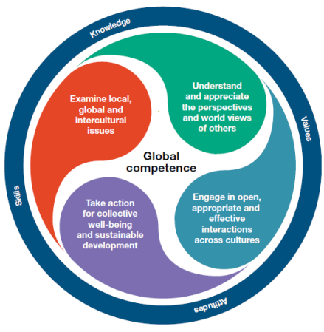
“Schools play a crucial role in helping young people to develop global competence by: teaching students how they can develop a fact-based and critical worldview of today”
What is global competence?
Global competence is the capacity to examine local, global and intercultural issues, to understand and appreciate the perspectives and world views of others, to engage in open, appropriate and effective interactions with people from different cultures, and to act for collective well-being and sustainable development.
Notes:
Why is this relevant to teachers? Asides from wanting you all to have mental peace
OECD; Organisation for Economic Co-operation and Development
PISA: Programme for International Student Assessment
Why do we need global competence? to live harmoniously in multicultural communities
to thrive in a changing labour market
to use media platforms effectively and responsibly
to support the Sustainable Development Goals
Can schools promote global competence? Schools play a crucial role in helping young people to develop global competence by: providing opportunities to learn about global developments;
teaching students how they can develop a fact-based and critical worldview of today;
equipping students with the means to analyse a broad range of cultural practices and meanings;
engaging students in experiences that facilitate intercultural relations;
promoting the value of diversity

Slide 10
Why do we need ‘Global Competence’?
to live harmoniously in multicultural communities to thrive in a changing labour market to use media platforms effectively and responsibly to support the Sustainable Development Goals What is the role of schools? providing opportunities to learn about global developments; teaching students how they can develop a fact-based and critical worldview of today; equipping students with the means to analyse a broad range of cultural practices and meanings; engaging students in experiences that facilitate intercultural relations; promoting the value of diversity

Slide 11
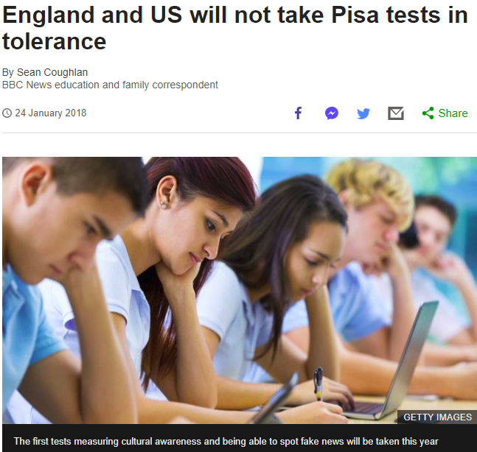
“Schools in England and the United States will not be taking the new international Pisa test designed to assess respect for other cultures, challenge extremism and help identify fake news.”
Reference; https://www.bbc.co.uk/news/business-42781376
Accessed: 4th October 2018
Notes:
The OECD's Pisa rankings have become important international benchmarks for education systems.
But the economic think tank has decided to introduce a very different kind of test, addressing the type of skills young people need to navigate a world of "post-truth" and social media "echo chambers"
Schools in Scotland, Australia and Canada are among those that will take the global competence test, which is being launched this year
Andreas Schleicher, the OECD's education director, said the success of education systems had to be measured on more than exam results. Schleicher said the "crunch" point was that some countries were reluctant to be compared on these measures.
And there had been a "hesitation" about moving from discussing students' beliefs to "hard data" from testing them.
But the Scottish government said it wanted to carry out a test which would help young people to "thrive in today's world".
"The results will help us understand how we can further support young people to be responsible global citizens, capable of taking part in local, regional and global decision making and debate," said the Scottish government spokeswoman.
https://www.bbc.co.uk/news/business-42781376

Slide 12
Notes:
Who are they?
What do they do?
Origins – actions – conferences, publications, range (membership)
Interacting with MPs, informing DFID programmes
Executive summary
TEESnet aims to develop a UK wide community of practice in ESD/GC within Teacher Education (TE) in higher education and schools that shares research and practice to develop new understanding across the sector in the UK and beyond.
This is achieved through
• Embedding ESD/GC in Teacher Education in the UK regions, with links to Europe and the wider world, in relation to ethos, values, curriculum content, learning, teaching and assessment.
• Encouraging and promoting research on ESD/GC within TE, with particular emphasis on exploring its impact on student teachers, teachers, young people and their communities.
• Connecting researchers and practitioners across the UK and Europe concerned with teacher education and ideas from ESD/GC / Development Education / Global Learning / Environment Education, and Moral/Values Education
• Reflecting upon and shaping the debate on ESD/GC and the implications for the lives and the work of teachers
Objectives 2015-2017
1. Deliver an annual conference on Education for Sustainable Development and Global Citizenship
2. Supporting members to prepare papers for annual conferences, and develop research in area of ESD/ GC.
3. Maintain active membership of steering group to steer direction of TEESNet and support work of Directors
4. Develop funded research project proposal 5. Provide appropriate level of advocacy for ESD/ GC learning in Higher Education settings

Slide 13
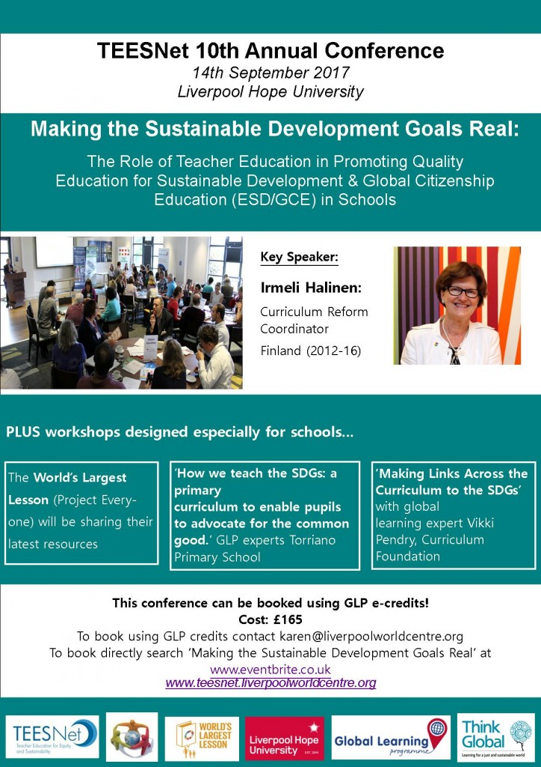
Notes:
Classroom teacher findings 2016
SDGs in ITE 2017
SDGs in West Midlands schools 2018 – publication in Research in Action - Getting to the Heart of the Sustainable Development Goals (SDGs):
The Role of Teacher Education in Prompting Critical Engagement and Action
Proposal to British Council
No Teacher Is an Island: How Social Networks Shape Teacher Quality
Kira J. Baker-Doyle
Promoting and Sustaining a Quality Teacher Workforce. 2015, 367-383

Slide 14
Findings re: GTE
Notes:
What do you know about the World’s Largest Lesson?

Slide 15
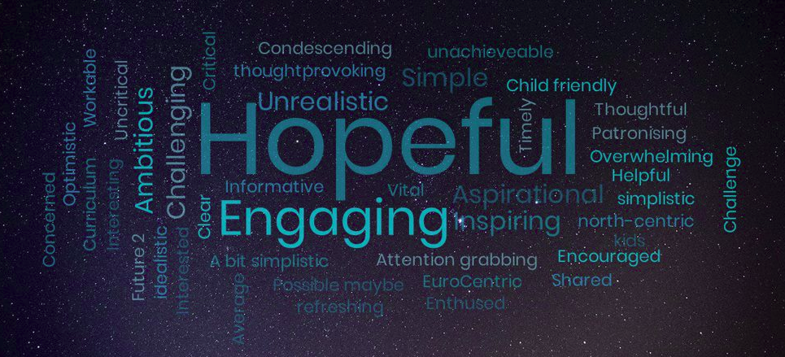
Notes:
Following an introduction to the Worlds largest lesson by Malala yousafzi attendees were asked to share their thoughts and feelings.

Slide 16
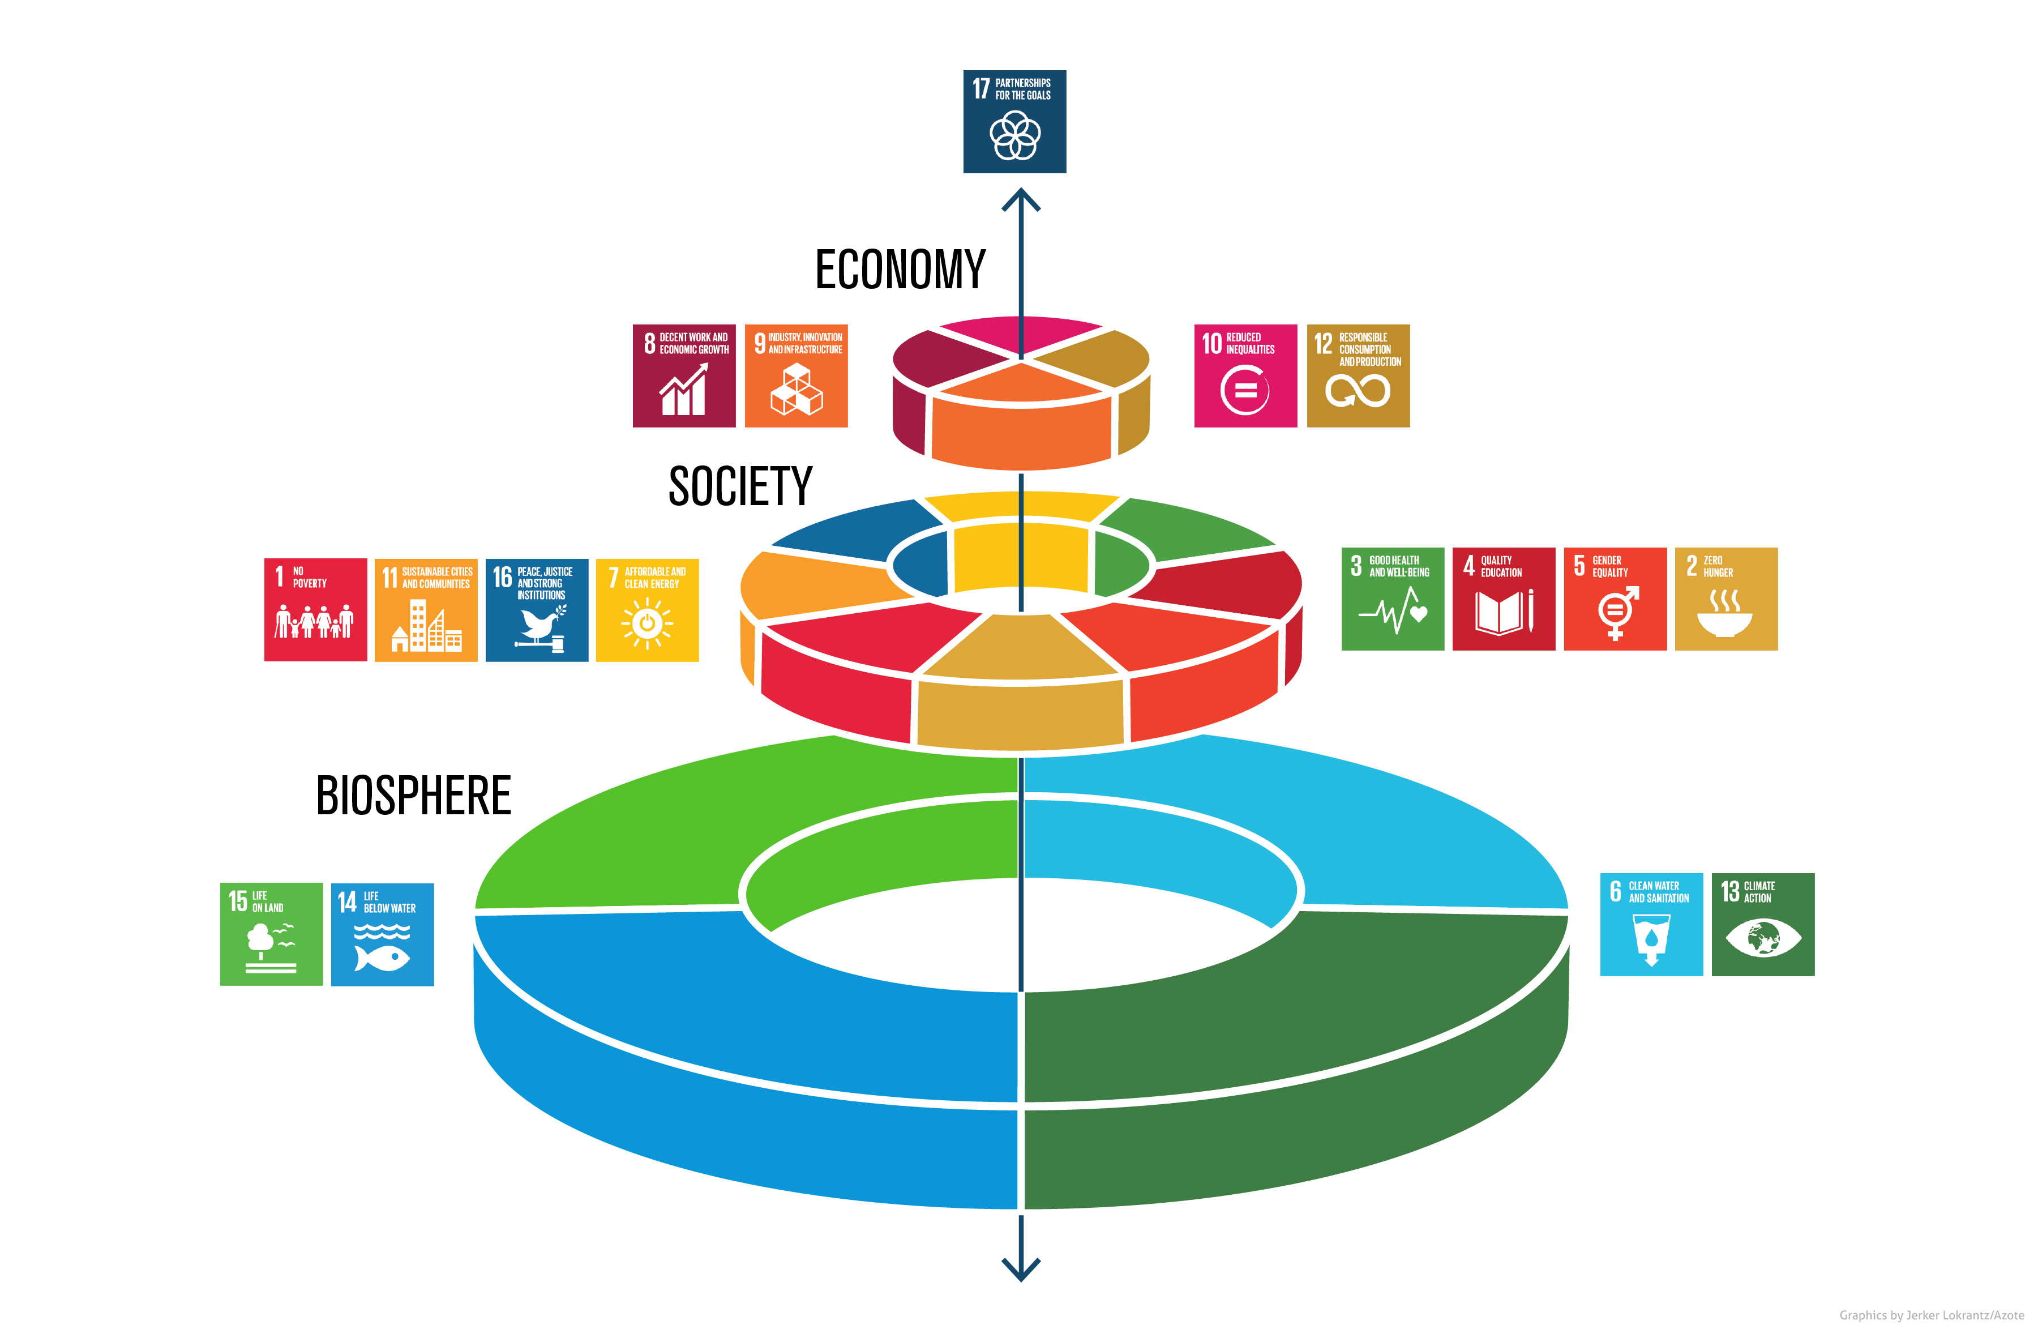
Relevance and responsibility
SMSC, PSHE, British Values
Findings
A cross-curricular appetite for the goals.
A personal responsibility to the goals and to young people in relation to the goals.
A call for high level responsibility.
Perceptions and experiences of a humanities burden.
Notes:
SMSC targets: Through their provision of SMSC, schools should: • enable students to develop their self-knowledge, self-esteem and self-confidence; • enable students to distinguish right from wrong and to respect the civil and criminal law of England; • encourage students to accept responsibility for their behaviour, show initiative, and to understand how they can contribute positively to the lives of those living and working in the locality of the school and to society more widely; • enable students to acquire a broad general knowledge of and respect for public institutions and services in England; • further tolerance and harmony between different cultural traditions by enabling students to acquire an appreciation of and respect for their own and other cultures; • encourage respect for other people; and • encourage respect for democracy and support for participation in the democratic processes, including respect for the basis on which the law is made and applied in England.
https://assets.publishing.service.gov.uk/government/uploads/system/uploads/attachment_data/file/380595/SMSC_Guidance_Maintained_Schools.pdf
British Values: an understanding of how citizens can influence decision-making through the democratic process; • an appreciation that living under the rule of law protects individual citizens and is essential for their wellbeing and safety;
PSHE: Mental well being, health and fitness, health prevention
2. The relevance participants in the workshop felt the SDGs have within their curriculum areas and wider professional role.
2. The relevance participants in the workshop felt the SDGs have within their curriculum areas and wider professional role.
All of the trainees recognised the relevance of the Global Goals to educators, with most feeling personally responsible and that all teachers’ have responsibility for the delivery of the SDGs. Some of the trainees revealed that they felt the workshop, alongside conversations that the workshop prompted, have prepared them for embedding the global goals into their teaching practice or are keen to work with young people on the goals. Respondents additionally suggested that there is a need for strong leadership to drive forward ESD in schools, from its inclusion within statutory DfE frameworks, to empowered senior leaders with sustainability responsibilities. One respondent perceived an inequitable burden on humanities subjects to address the SDGs, whilst all interviewees (from MFL, Science and Geography) recognised the responsibility of educators.
Reponses on whose responsibility, within the education system, the SDGs are, were varied. Ranging from ‘everyone’ to, ‘those in power’ and ‘the DfE’. Interviewee C suggested that all educators, in every phase, have a responsibility and goes on to suggest that it would be a help for introductions to the SDGs to come through higher education in all fields of study. Interviewee B identified the responsibility as resting ultimately, further to suggested DfE insistence, with head teachers but that it could be delegated to a designated member of staff.
Trainees shared their perception of the role of educators in delivering the SDGs. One interviewee (A) suggested that educators have an opportunity to deliver the goals explicitly through signposted sessions in PSHE/form time, as well as through different subjects such as geography, RE, Science and English. Whilst interviewee C suggested that the responsibility falls too often on the shoulders of geography educators: ‘..it needs to be the effort of the whole school as an institution of educators to work together to develop a scheme and create a culture where all subjects help contribute…’
Interviewee E suggested that it requires strong will from the school leadership, as classroom practitioners lack the time and perhaps will. Respondent D suggested that both pupils and teaching colleagues needed education on the SDGs in terms of their purpose and to challenge misconceptions with facts.
Interviewee B described teaching the SDGs as a responsibility, enabling pupils to make informed decisions. They suggest that all educators should be teaching the SDGs as part of an institution wide scheme.

Slide 17
University of Worcester
5/150 in the UK’s greenest universities in 2016 People & Planet University League
First EcoCampus Platinum status in June 2010, and the second to gain ISO14001:2015 for all our campuses
Responsible Futures accreditation from the NUS
Green Gown finalists in 8 categories in 3 years
Notes:
As one of the country’s major providers of education, training and research for the children’s workforce
We have been ranked 5th out of 150 in the UK’s greenest universities in the 2016 People & Planet University League. Student action on world poverty and the environment.
We were the first English University to achieve EcoCampus Platinum status in June 2010, and the second to gain ISO14001:2015 for all our campuses
Green Gown finalists in 8 categories over the last 3 years, Bike loan scheme winners 2014. The Green Gown Awards, run by the Environmental Association for Universities and Colleges (EAUC) and now in their eleventh year, recognise ‘exceptional sustainability initiatives’ being undertaken in universities and colleges across the UK, and are regarded as the most prestigious recognition of best practice within the sector. International Green Apple Award winners for Environmental best practice 2017, in for two projects; A City Council and University recycling collaboration, and Go Green Week in the City.
We were a Higher Education Academy Green Academy first cohort participant
Accredited with FairTrade status since 2008
The University of Worcester is working to include the SDGs in the practice of our trainee educators and this year held its first Institute of Education workshop on the Global Goals. We achieved Responsible Futures accreditation from the NUS for our whole institution approach to social responsibility and sustainability

Slide 19
A comparative review of policy and practice in ESD/GC in teacher education across the four nations of the UK
Notes:
https://journals.sagepub.com/doi/full/10.1177/0892020616653179

Slide 21
#TEESNet What do teacher educators want/need from TEESNet?

Slide 22
Notes:
Department for Education statistics show 26% of teachers in England are men - accounting for 38% of secondary and 15% of primary school teachers. TEACH FIRST – BBC 2016
Future Leaders Trust: Despite a workforce dominated by women, just 36% of secondary school headteachers are female. Lottie O’Conor looks at how this imbalance can be corrected – Guardian May 2015

Slide 23
The value of an academic network: Inspiration in professional practice with TEESNet.
Teacher Education for Equity and Sustainability Network
Notes:
http://teesnet.liverpoolworldcentre.org/
The purpose of education
UN SDGs and OECD
TEESNet
Relevance and responsibility
Book offer
Tweet
Executive summary
TEESnet aims to develop a UK wide community of practice in ESD/GC within Teacher Education (TE) in higher education and schools that shares research and practice to develop new understanding across the sector in the UK and beyond.
This is achieved through • Embedding ESD/GC in Teacher Education in the UK regions, with links to Europe and the wider world, in relation to ethos, values, curriculum content, learning, teaching and assessment.
• Encouraging and promoting research on ESD/GC within TE, with particular emphasis on exploring its impact on student teachers, teachers, young people and their communities.
• Connecting researchers and practitioners across the UK and Europe concerned with teacher education and ideas from ESD/GC / Development Education / Global Learning / Environment Education, and Moral/Values Education
• Reflecting upon and shaping the debate on ESD/GC and the implications for the lives and the work of teachers
Objectives 2015-2017
1. Deliver an annual conference on Education for Sustainable Development and Global Citizenship
2. Supporting members to prepare papers for annual conferences, and develop research in area of ESD/ GC.
3. Maintain active membership of steering group to steer direction of TEESNet and support work of Directors
4. Develop funded research project proposal 5. Provide appropriate level of advocacy for ESD/ GC learning in Higher Education settings

Slide 25
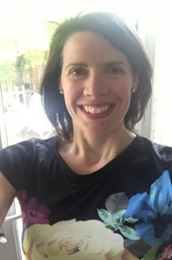
Elena Lengthorn
Teacher Education
University of Worcester
Binyon 1138, Henwick Grove, Worcester,
WR2 6AJ
Tel: 01905 542151
Twitter: @ELengthorn

