Slide 1

Knowing about Teaching: Building Professional Capital
TEAN Conference, Birmingham May 2015
Kenneth Muir
Chief Executive, General Teaching Council for Scotland

Slide 2

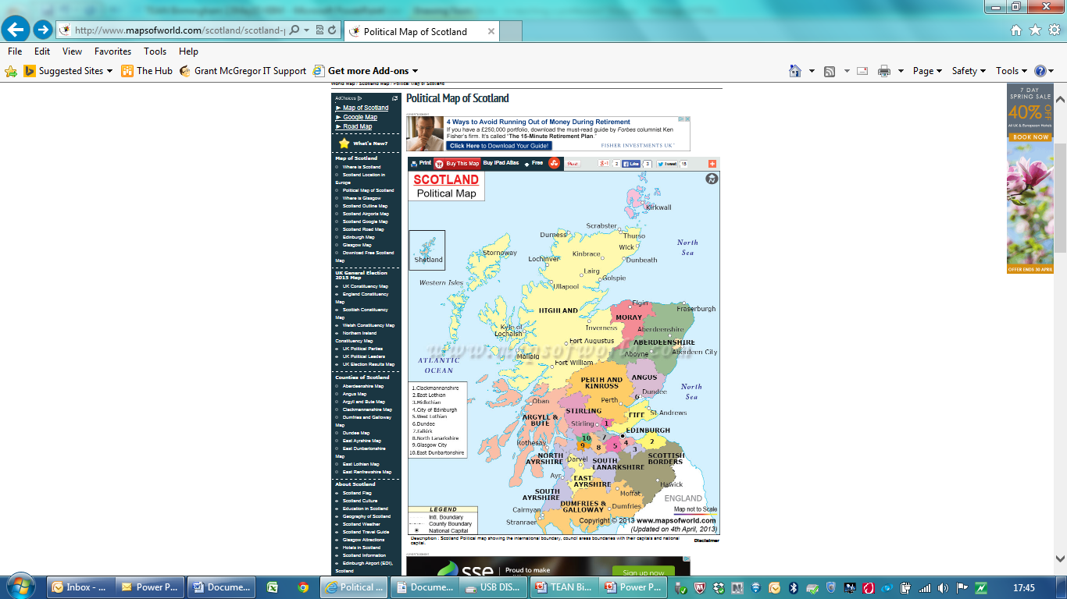
Scotland
General Teaching Council for Scotland
Professional Standards
Entrance to teaching via University ITE programmes
Degree/equivalent profession
Consensus in educational policy
Strong partnership working
No Teach First or Schools Direct
No Free Schools or Academies
No Carter Review

Slide 3
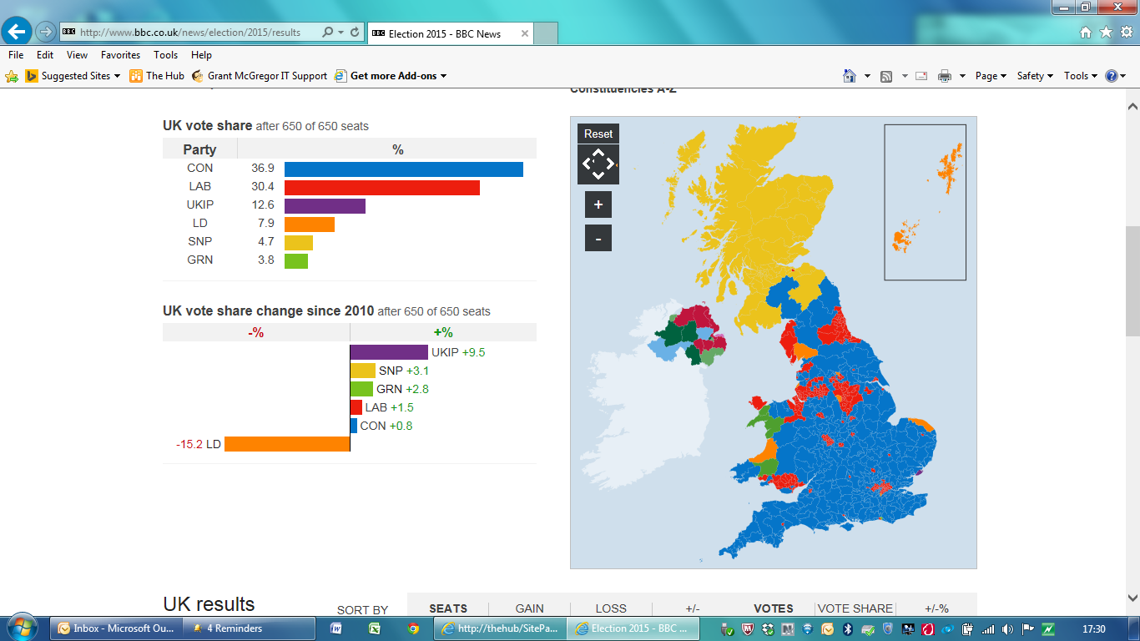

Slide 4
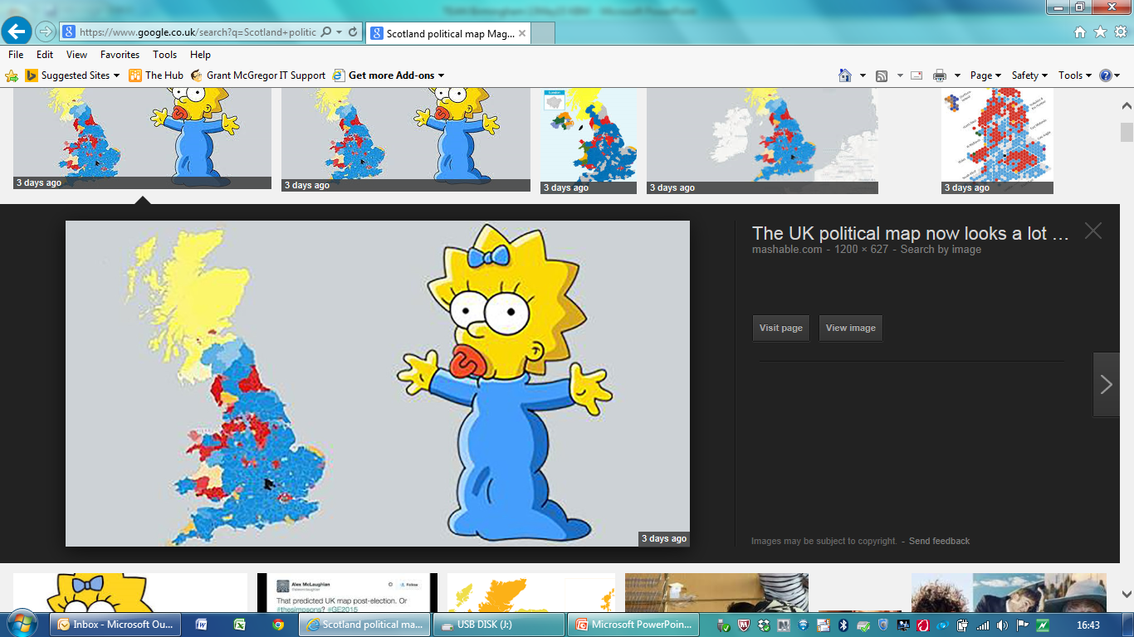

Slide 5
Challenges facing Scottish Education
Creating a world-class, sustainable, “future-
proofed” education system
Closing the attainment gap
Delivering the aspirations of Curriculum for
Excellence
Supporting teaching staff to deliver high
quality learning and teaching now and in
the future
“Talking up” the teaching profession

Slide 6

Political/Societal Expectations
“Although Scotland’s economic performance is improving, poverty remains an issue for too many people. In order to tackle this, we must ensure not only that we are getting more people
into work which is fairly paid, but also
that we are tackling the underlying
causes of poverty by, for example,
raising educational attainment.”
“We want a cohesive education system
which provides young people with a
variety of routes to a positive future.”

Slide 7
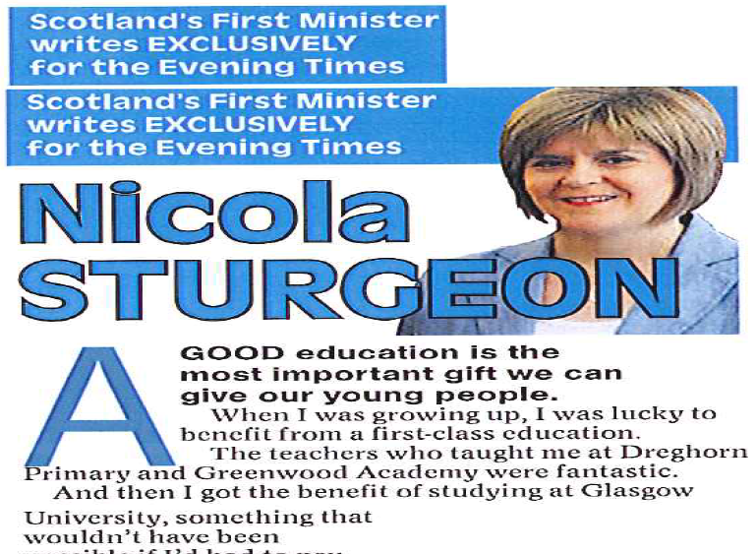
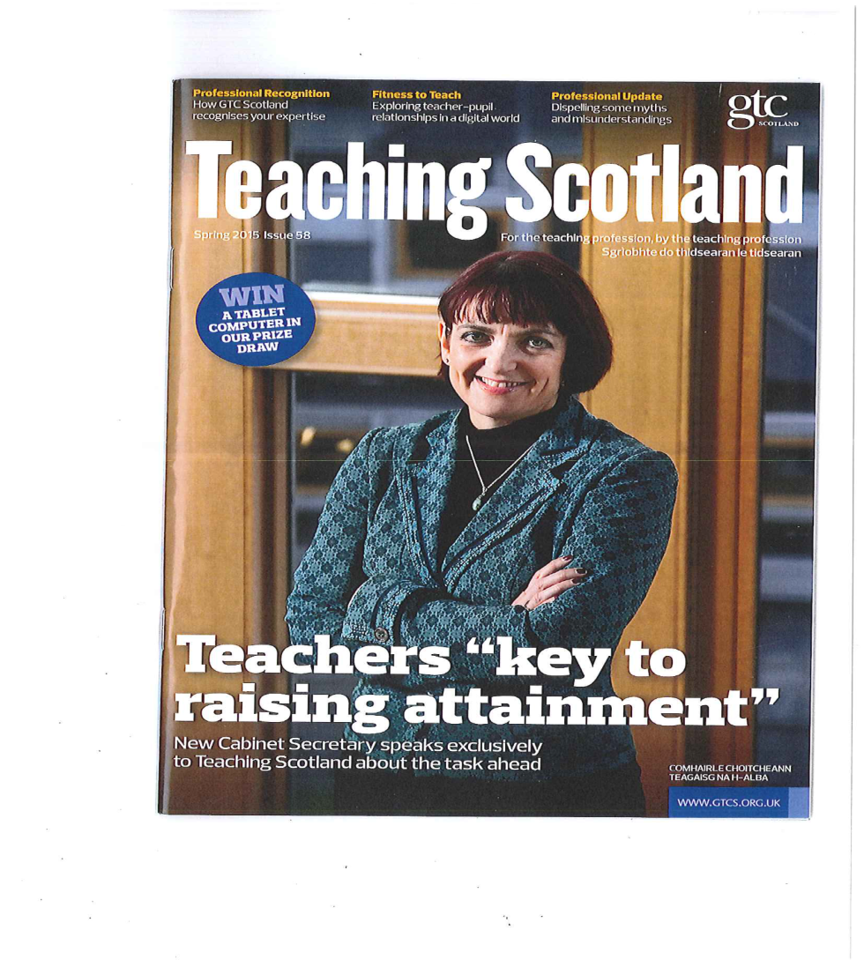

Slide 8
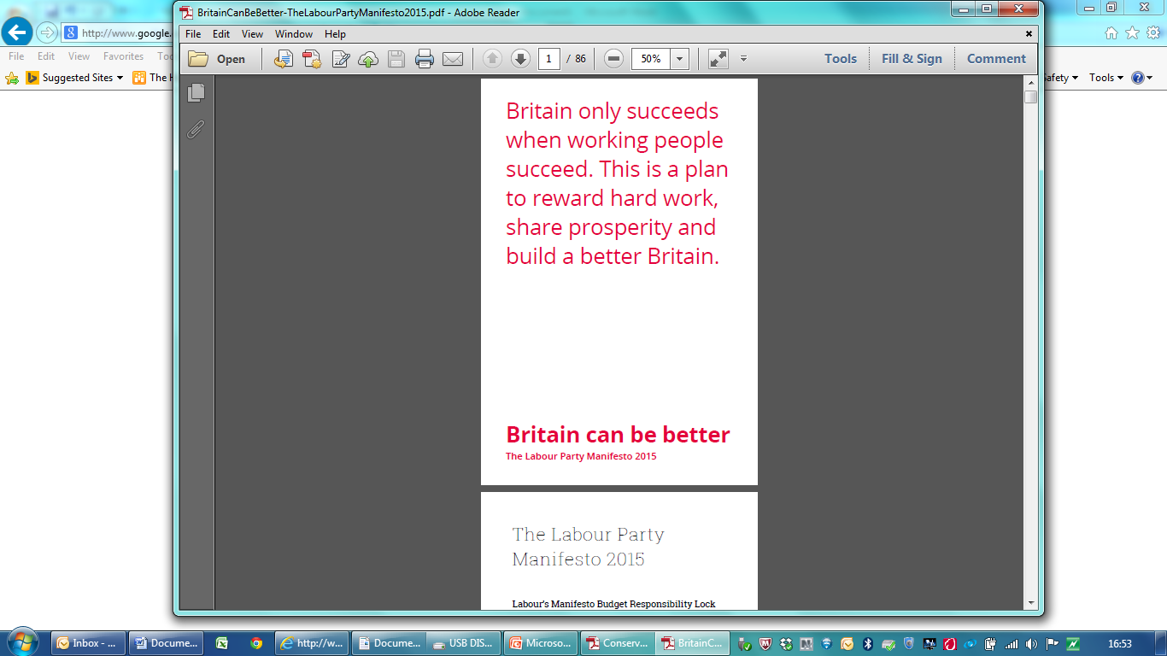
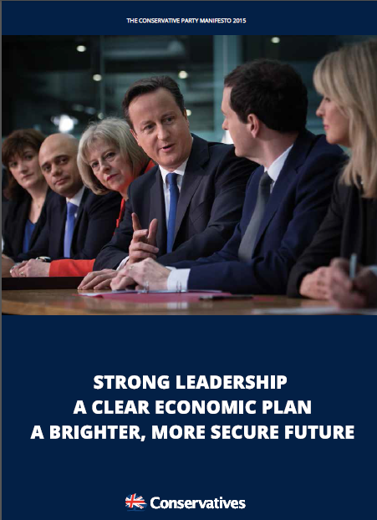
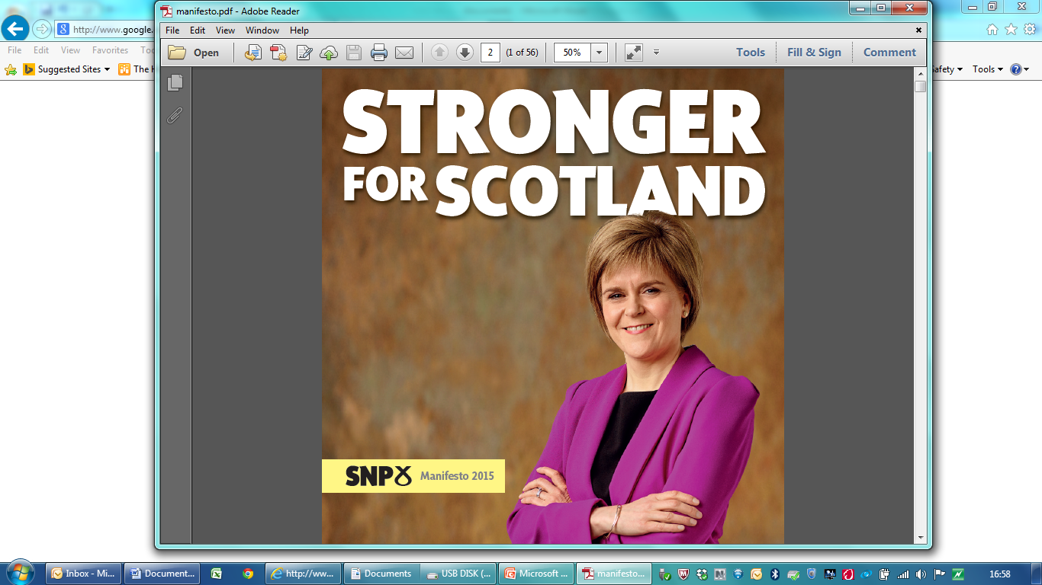


Slide 9
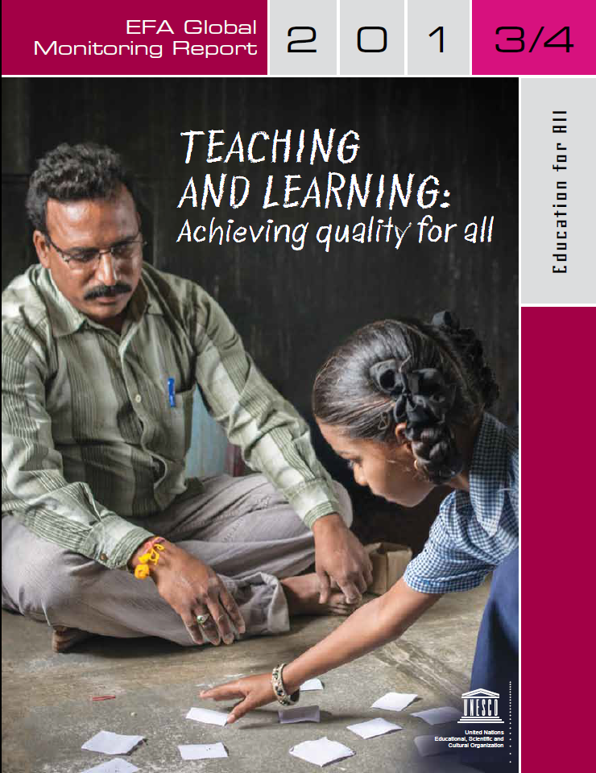
Political/Societal Expectations
The 2013/4 Education for All Global Monitoring Report shows why education is pivotal for development in a rapidly changing world. It explains how investing wisely in teachers, and other reforms aimed at strengthening equitable learning, transform the long-term prospects of people and societies.

Slide 10
“There is an urgent need to recognise teachers’ work as complex and demanding, and improvement in teacher quality requires a reconceptualisation of how we prepare a new generation of teachers...It is manifested in qualities that require teachers to value and sustain the intellect, to work collaboratively with other stakeholders in education, to be responsible and accountable and to be committed to lifelong learning and reflexivity”
International Alliance of Leading Education Institutes (2008)

Slide 11
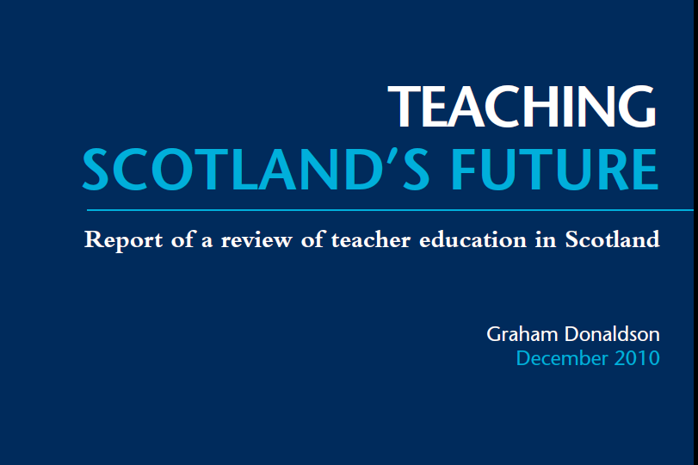
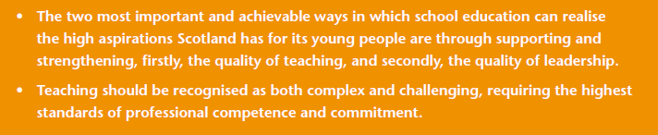

Slide 12
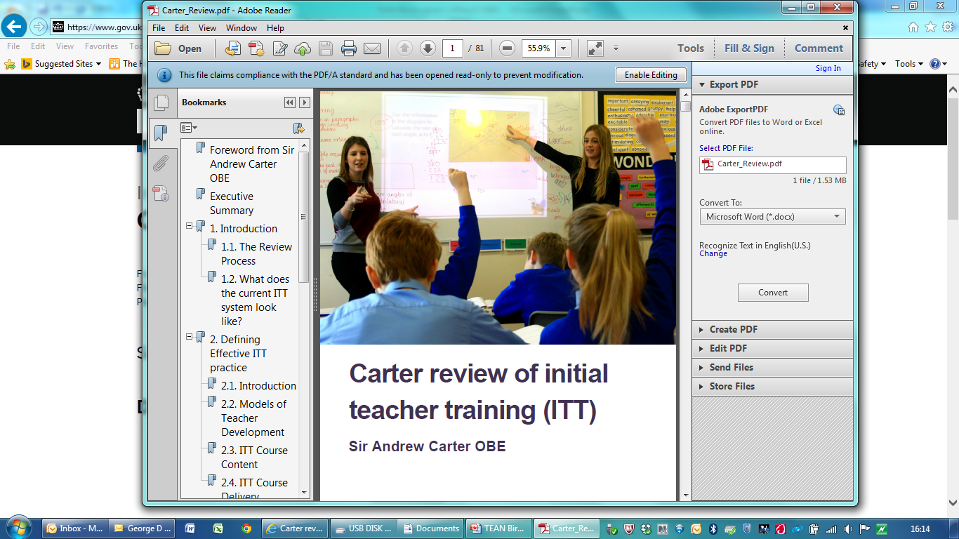
Carter on Complexity
2.2.1. Whatever the route, it is clear that ITT has to prepare teachers to be able to cope effectively in the classroom in terms of both the knowledge and the practical skills that they will require. We believe that the complexity of this process cannot be overestimated.
....ITT programmes need to be structured in a way that takes careful account of the complex learning needs of trainees
....we believe it is critical that ITT should teach trainees to challenge and evaluate evidence so that new teachers have the skills to navigate this complex landscape.
Recommendation 14: Building on the development of school-led ITT, DfE should work in collaboration with the sector (all those involved in ITT) to consider the way in which teachers gain qualified teacher status (QTS) with a view to strengthening what has become a complex
and sometimes confusing system.

Slide 13


Slide 14
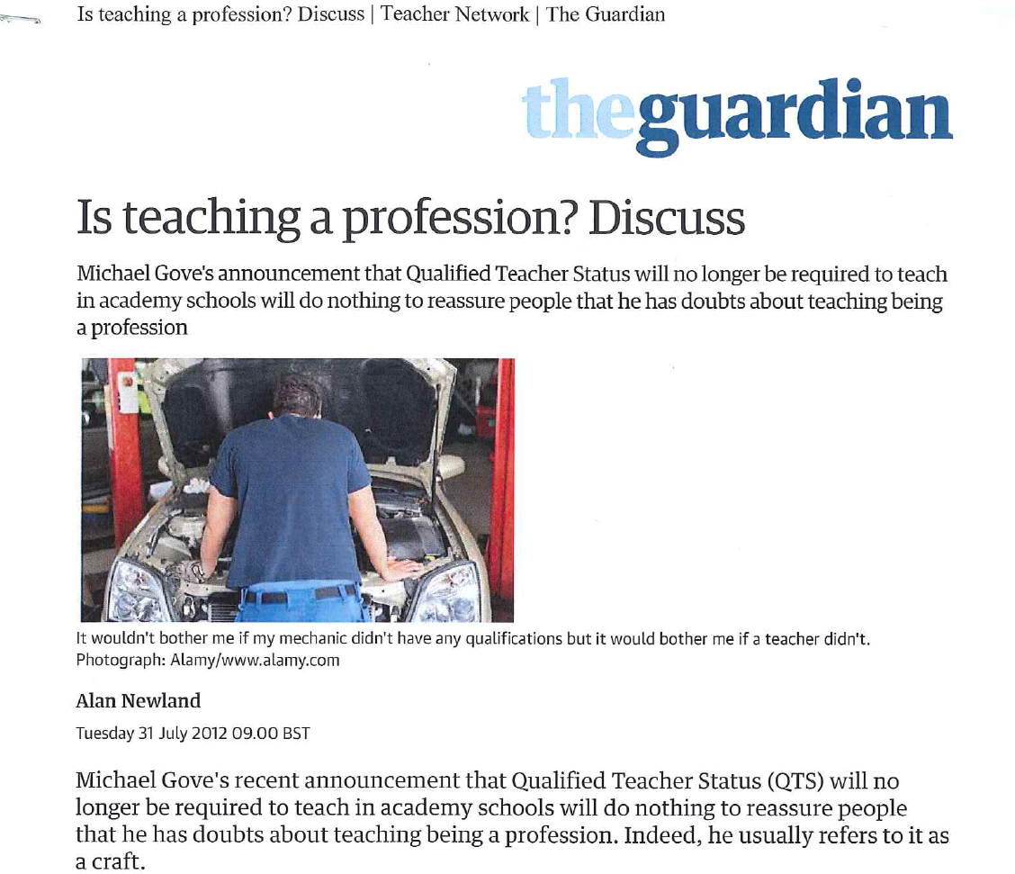

Slide 15
Talking up the profession?
“Policy interventions such as Teach First which suggest that graduates go into teaching initially, before potentially moving on to careers in other sectors, do not ameliorate, but arguably exacerbate the profession’s weak standing. If teaching is only something that is useful to pursue for a couple of years as a part of a specially sponsored management programme, this does not actually speak well for the profession, even if a good proportion of Teach First graduates decide to stay on in teaching. A sense is being conveyed that by ‘just teaching’, graduates are perhaps limiting themselves and it is quite difficult to imagine a similar programme for professions such as medicine, law or accountancy.”
Annette Braun
The politics of teaching as an occupation in the professional borderlands: the interplay of gender, class and professional status in a biographical study of trainee teachers in England
Journal of Education Policy Vol 30, Issue 2, 2015

Slide 16
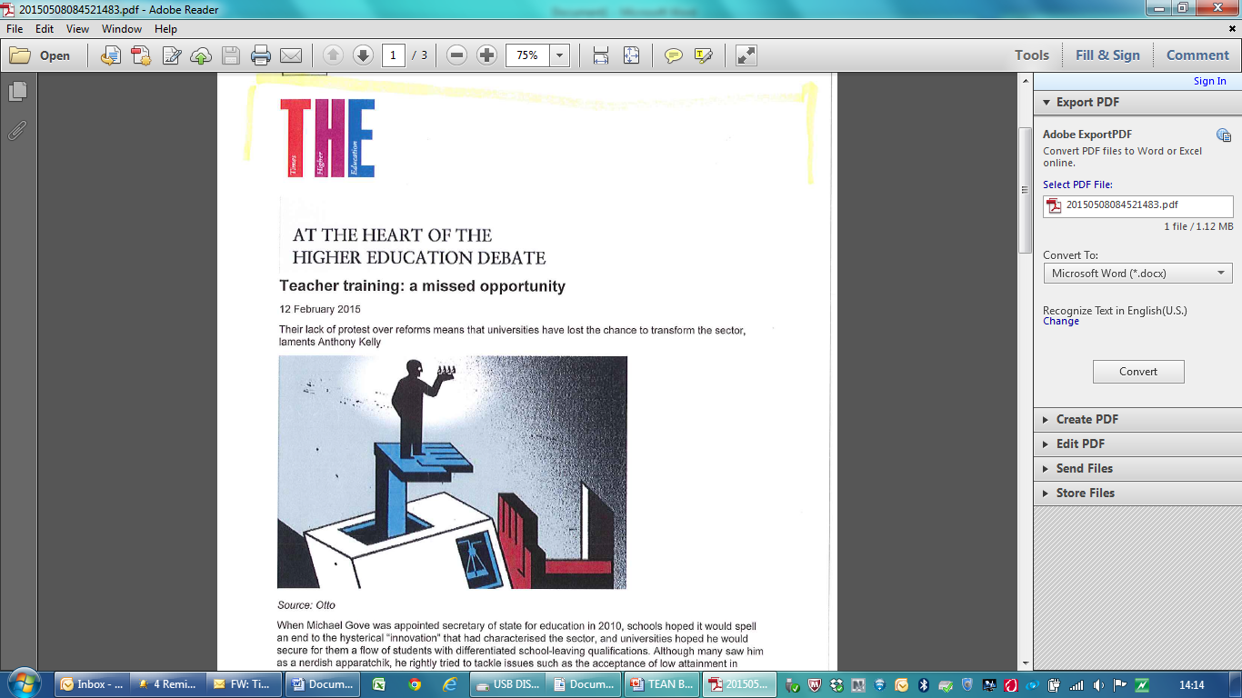

Slide 17
The changing role of teachers and teaching in the 21st century
What are schools for?
What should students learn (in them)?
What learning and teaching approaches?
What should be assessed and how?
How is success in education to be measured?
What is the role and purpose of the teacher in
a world defined by change, complexity,
fluidity and uncertainty?
How do we best support teachers to delivery
high quality education?

Slide 18
The changing role of teachers
“If 21st c. schooling’s main aim is to build students’ “learning capacity”, to help them develop into lifelong, active, independent learners, then teachers need to be “learning coaches” – a role that is very different from that of a traditional teacher.”
“Leading learning in 21st century schools” Bull and Gilbert (2013)

Slide 19
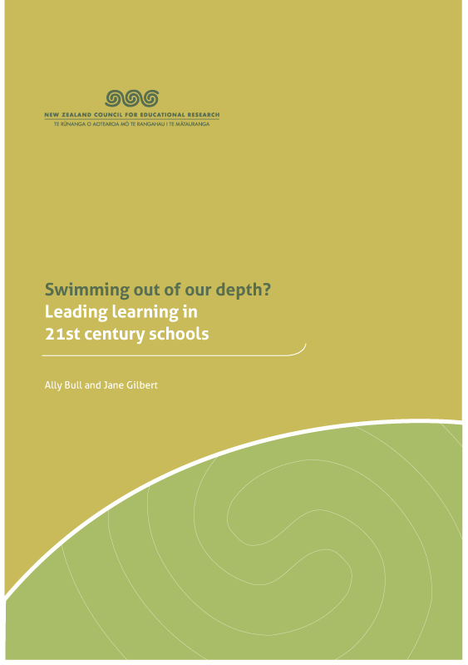
The changing role of teachers and teaching in the 21st century
21st c. learning focuses on the need to develop students’
cognitive, inter- and intra-
personal capacities. However,
a necessary precursor to this
is that teachers’ capacity for, and awareness of, their own learning needs to be developed
“Leading learning in 21st century schools” Bull and Gilbert (2013)

Slide 20

“The major source of student
variance lies within the person
who gently closes the door
of the classroom and
performs the teaching act.”
“The remarkable feature of the
(research) evidence is that the
biggest effects on student
learning occur when teachers become
learners of their own teaching.”
John Hattie “Visible Learning”

Slide 21
Knowing about Teaching: Investing in teachers
“ The most successful education systems invest in developing their teachers as reflective, accomplished and enquiring professionals who are able, not simply able to teach successfully in relation to current external expectations, but who have the capacity to engage fully with the complexities of education and to be key actors in shaping and leading educational change”.
“Teaching Scotland’s Future” 2011

Slide 22
Knowing about Teaching: Professional Learning
Teachers should be:
“Increasingly expert practitioners whose professional practice and relationships are rooted in strong values, who take responsibility for their own development and who are developing their capacity both to use and contribute to the collective understanding of the teaching and learning process.”
“Teaching Scotland’s Future” 2011

Slide 23
Knowing about Teaching: Building Professional Capital
“At the heart of the Donaldson report is the idea of a “twenty first century professionalism”, a “reinvigoration of professionalism” and “extended professionalism” where teachers are agents of change, not passive or reluctant receivers of externally-imposed prescription and this to be realised by increasing teacher agency through their ongoing professional development”
Rethinking professional standards to promote professional learning Forde, McMahon et al, Prof Dev in Education (Mar 2015)

Slide 24
Teacher Agency
Teacher agency is viewed as “the capacity of
actors to critically shape their responses to
problematic situations”
Effective agency requires:
- strong, horizontal connections and relationships across the school
- a collegial, sharing culture
- a culture where innovation and risk taking are encouraged and supported
- high levels of trust
Understanding Teacher Agency: The Importance of Relationships Priestley, Biesta + Robinson (2012)

Slide 25
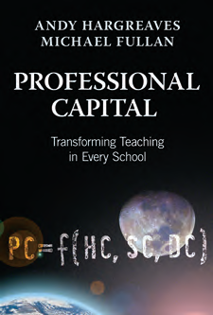
Knowing about Teaching: Building Professional Capital
“In the business capital view, teaching is technically simple. Teaching doesn’t require rigorous training, hard work in universities, or extensive practice in schools. In this view, teaching can be learned over six weeks in the summer, as long as you are passionate and enthusiastic. Imagine if we said that about our doctors or architects or engineers.”

Slide 26
Knowing about Teaching: Building Professional Capital
“The opposite stance toward teaching is a professional capital approach. In this approach, teaching is hard. It’s technically difficult, for example, knowing the signs of Asperger’s, differentiating instruction, learning all the skills to deal with difficult adults. It requires technical knowledge, high levels of education, strong practice within schools, and continuous improvement over time that is undertaken collaboratively, and that calls for the development of wise judgment.”

Slide 27
Knowing about Teaching: Building Professional Capital
“Over time, professional capital policies and practices build up the expertise of teachers individually and collectively to make a difference in the learning and achievement of all students.
Three kinds of capital that comprise professional capital: human capital (the talent of individuals); social capital (the collaborative power of the group); and decisional capital (the wisdom and expertise to make sound judgments about learners that are cultivated over many years). That’s the vision of professional capital.”

Slide 28
Knowing about Teaching: Scotland’s Approach to Building Professional Capital
Creating an “infrastructure” that supports teachers to:
  move from being reflective practitioners to becoming enquiring practitioners
  move from continuing professional development to the concept of career-long professional learning

Slide 29
Knowing about Teaching: Scotland’s Approach to Building Professional Capital
Professional Standards
Teacher Induction Scheme
Professional Update
Supporting Professional Enquiry
- EBSCO and Education Hub
Professional Recognition Awards

Slide 30
Professional Standards and Professional Update
“If Standards are to become the basis for promoting high quality professional learning, they need to be regarded as a series of signposts to guide an integrated professional learning agenda, rather than a series of discrete accomplishments to be ticked.”
Timperley (2011)

Slide 31
Using Professional Standards to support Professional Learning
The Standards for Registration (mandatory, comprising the SPR and the SFR)
The Standard for Career-long Professional Learning
The Standards for Leadership and Management (for middle leaders and Head Teachers)
Professional Skills and Abilities
Professional Knowledge and Understanding
Professional Values and Personal Commitment

Slide 32
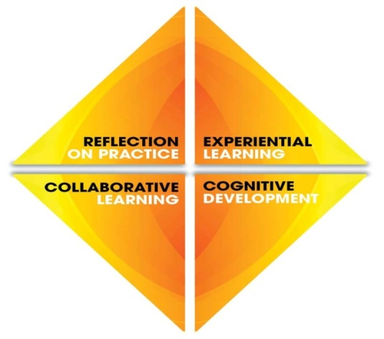
Professional Update
Standards for Leadership and Management
Standards for
Registration
Standard for Career-Long Professional Learning
SPR
SFR
Provisional Registration
Full Registration (General)
Professional Review + Devt.
ITE
TIS
FR
The Enquiring Professional
Entry Memorandum & Guidelines
Teaching Qualifications
Qualified Outside Scotland
Registration
Dual
Registration
Professional Recognition
Professional Qualifications & Professional Registration

Slide 33
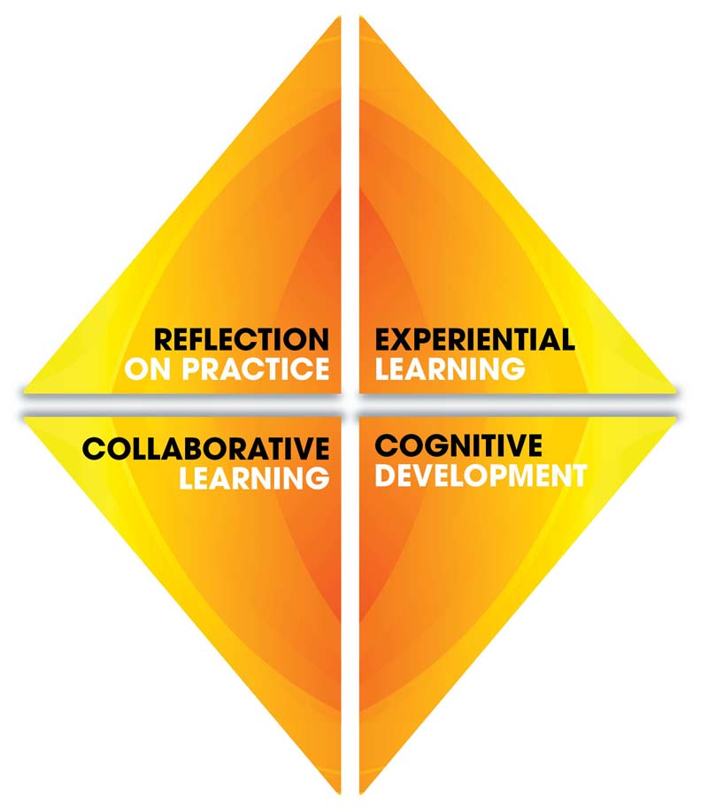
Knowing about Teaching: Building Professional Capital

Slide 34
Building Professional Capital through Professional Update
To maintain and improve the quality of our
teachers as outlined in the relevant
Professional Standards and to enhance the
impact they have on pupils’ learning
To support, maintain and enhance
teachers’ continued professionalism and
the reputation of the teaching profession in
Scotland

Slide 35
Key principles of Professional Update: teachers have.....
a responsibility to consider their own
development needs
an entitlement to a system of supportive PRD
confirmation that they are maintaining the
high standards required of a teacher

Slide 36
Teacher Induction Scheme
Guaranteed probationary year paid for by
Scottish Government
Maximum of 18 hours per week class contact
time (0.8 FTE)
Where practicable, part of a probationer’s
relief time to include one full day out of class
Regular meetings with their supporter and fellow
probationers
Maintain a record of professional development
Engage, where possible, in research relating to
their practice and to the impact of that practice
on pupil learning;

Slide 37
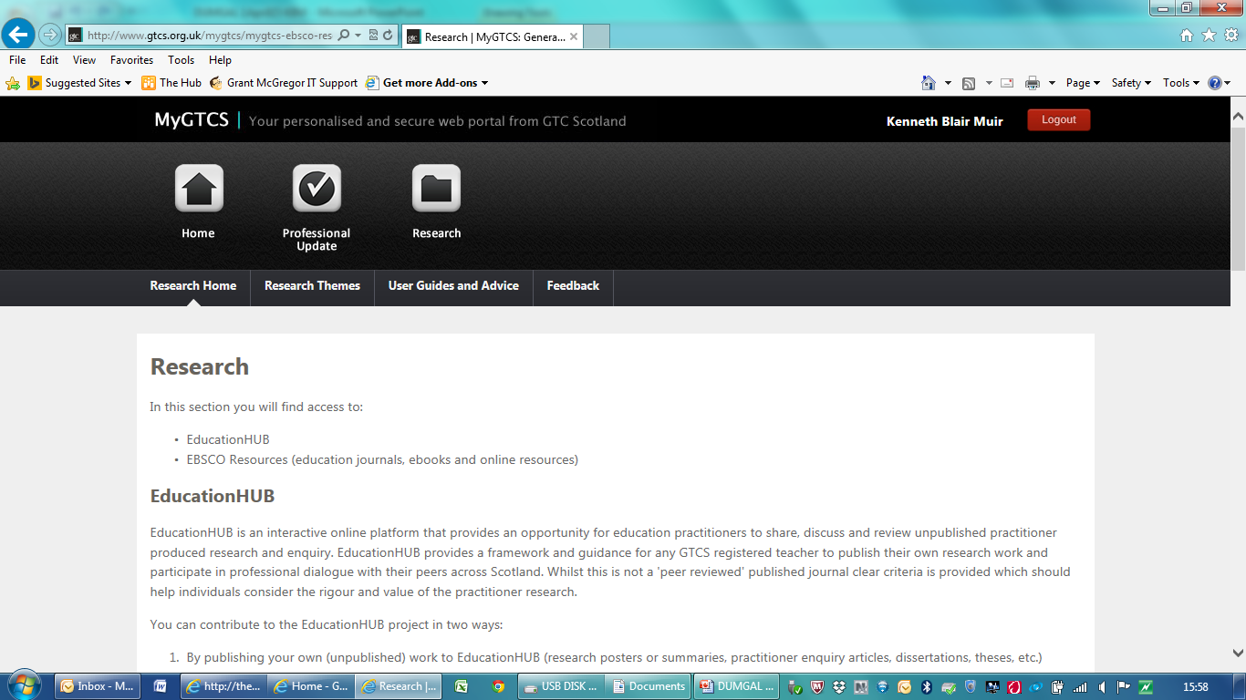
GTCS: Supporting Professional Enquiry
EBSCO – online access to 1700 educational journals + e-books
Research Engagement Group – developing and trialling teacher engagement with EBSCO
Education Hub

Slide 38

GTCS: Supporting Professional Enquiry
x

Slide 39
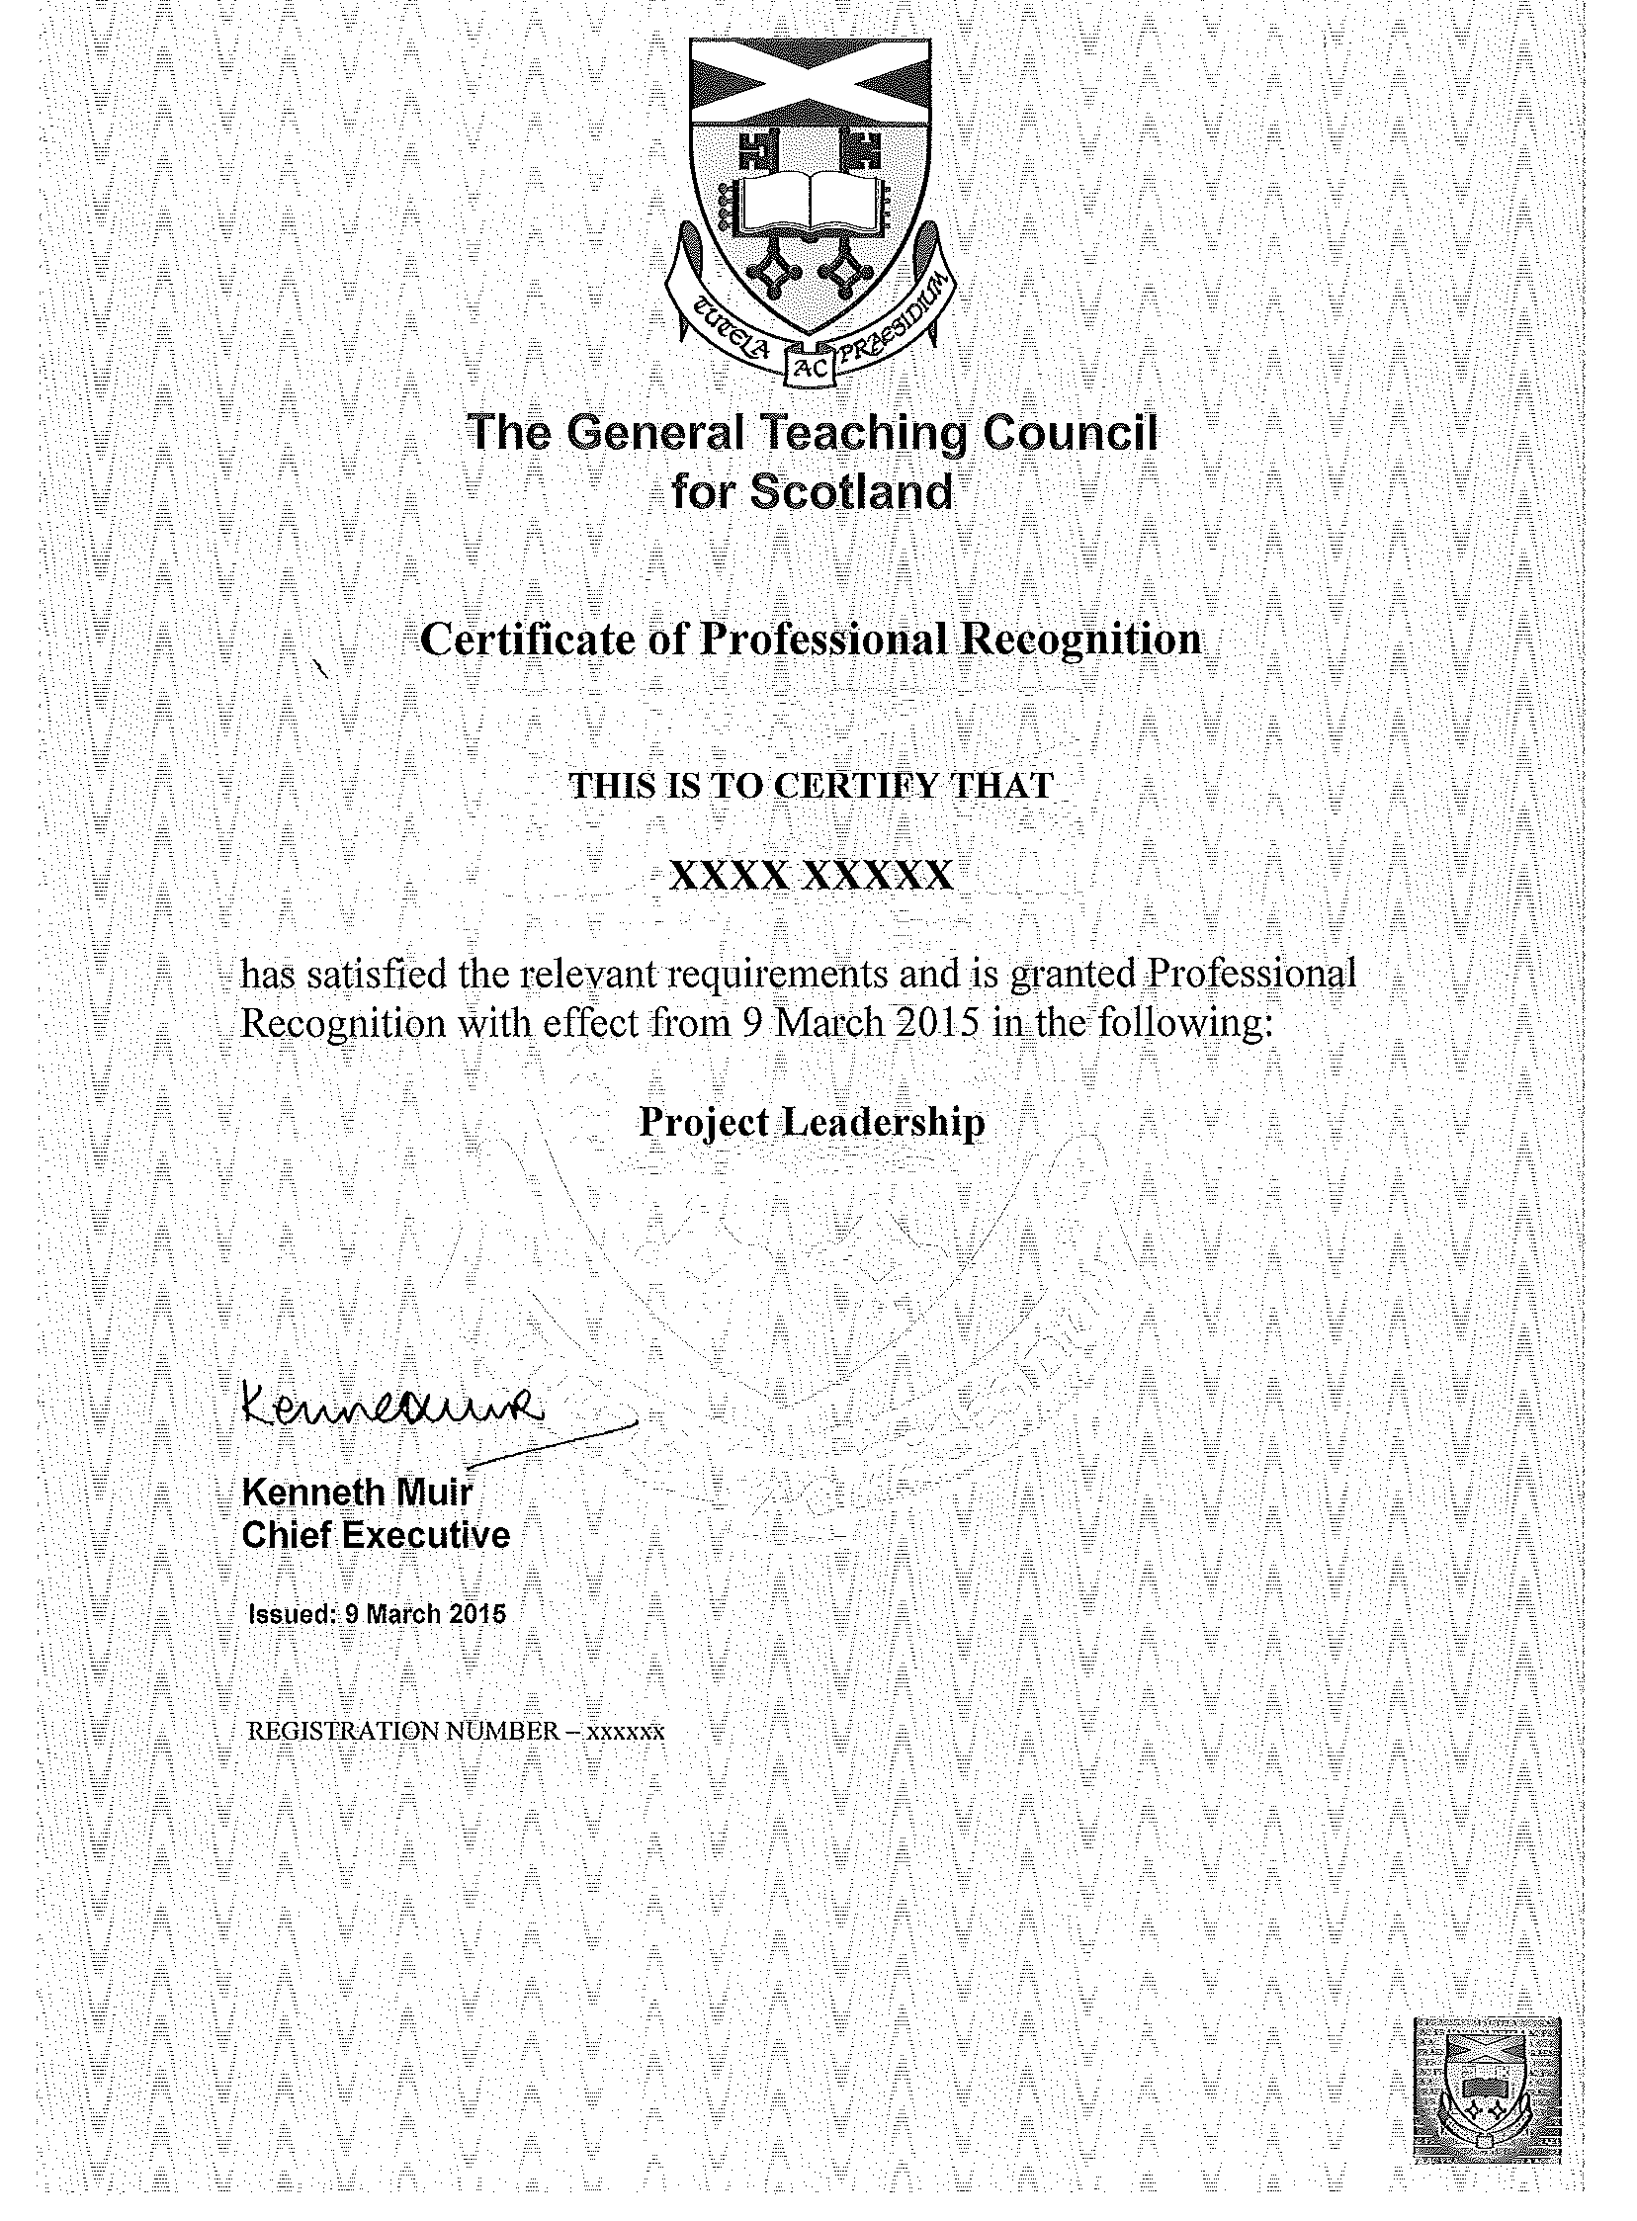
GTCS Professional Recognition Awards
Professional Recognition provides
the opportunity for those who are
fully registered with the GTCS and
have completed one year of
professional practice to focus
on and develop their
professional learning in
particular areas of expertise
and gain recognition for
enhancing their knowledge,
understanding and practice.

Slide 40

The illiterate of the 21st century will not be those who cannot read and write but those who cannot learn, unlearn and relearn
Alvin Toffler 1972
Future Learners

Slide 41
The least effective teachers of the 21st century will not be those who cannot change but those that cannot continuously innovate, change and improve
Future Teachers

Slide 42
“Systems that invest in professional capital recognize that education spending is an investment in developing human capital from early childhood to adulthood, leading to rewards of economic productivity and social cohesion in the next generation
Professional capital requires attention not only to political and societal investments in education but also to leadership actions and educator needs, contributions, and career stages.”

Slide 43
Knowing about Teaching: Building Professional Capital
Key question
“What are YOU doing to building the professional capital of teachers?”

Slide 44
GTC Scotland
ken.muir@gtcs.org.uk
Twitter @GTCSKen

Slide 45
A New Professionalism
“Teacher professionalism is at a threshold. Moral purpose and change agentry are implicit in what good teaching and effective change are about, but as yet they are society’s (and teaching’s) great untapped resources for radical and continuous improvement. We need to go public with a new rationale for why teaching and teacher development are fundamental to the future of society.”
Why Teachers Must Become Change Agents Michael Fullan (1993)

Slide 46
A New Professionalism
“Above all, we need action that links initial teacher preparation and continuous teacher development based on moral purpose and change agentry with the corresponding restructuring of universities and schools and their relationships... The new paradigm for teacher professionalism synthesizes the forces of moral purpose and change agentry.”
Why Teachers Must Become Change Agents Michael Fullan (1993)

