Slide 1
Apprenticeship to Teaching?
Problems and Possibilities
Chris Winch
King’s College London
May 2017

Slide 2
An Outline
Current developments
Apprenticeship including the Dual System in Germany
Different conceptions of teaching – craft, protocol-driven, professional
How apprenticeship to teaching might work with each of these
The current evolution of teacher education policy in England
A possible apprenticeship model for early career teachers and why it would be worthwhile

Slide 3
The Present: The Campaign for an Apprenticeship in Teaching –National Schools Training
Become a founding school of the QTS Teaching Apprenticeship
National Schools Training (NST) are inviting schools to become part of an exciting new Government ‘Trailblazer’ initiative to create a Degree-level QTS Teaching Apprenticeship pathway.
Schools will pay approximately £400 million over the next 5 years towards the Apprenticeship Levy. That levy fund will expire if it is not spent on approved apprenticeship standards to train the school workforce. It is therefore imperative that schools have an appropriate suite of Degree-level apprenticeships, including a QTS Teaching Apprenticeship pathway.
As a founding school you will play an important role in designing a school-centered QTS Teaching Apprenticeship to complement existing initial teacher training (ITT) programmes. If your school has valuable ITT experience and would like to play a role in the future of Teacher Training, please click the link below to register your interest in becoming a founding school.

Slide 4
Key Attributes of the Proposed Apprenticeship
Duration – 1 year.
Off the job learning – 20% of time.
Prerequisites – Bachelor degree desirable but not necessary.
Level – 7 the same level as a Masters qualification.

Slide 5
The Past
Apprenticeship is the oldest form of professional education.
An apprentice is a junior employee who is a learner as well as a worker.
S/he is paid accordingly.
Very often a parent paid an employer
to take on a son as an
apprentice.

Slide 6
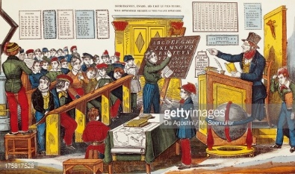
This Model also served for Teaching
The apprentice learned through carrying out simple tasks under supervision before being given greater responsibility.

Slide 7
For a long time, apprenticeship was not thought suitable as a preparation for teaching.
But….times are changing and the increasing influence of school-based teacher education (or training) means that the profession needs to think about what its attitude should be.
This talk outlines both positive and negative possibilities and suggests a way forward.
The apprenticeship levy has turned some schools towards recouping the cost via a teaching apprenticeship.

Slide 8
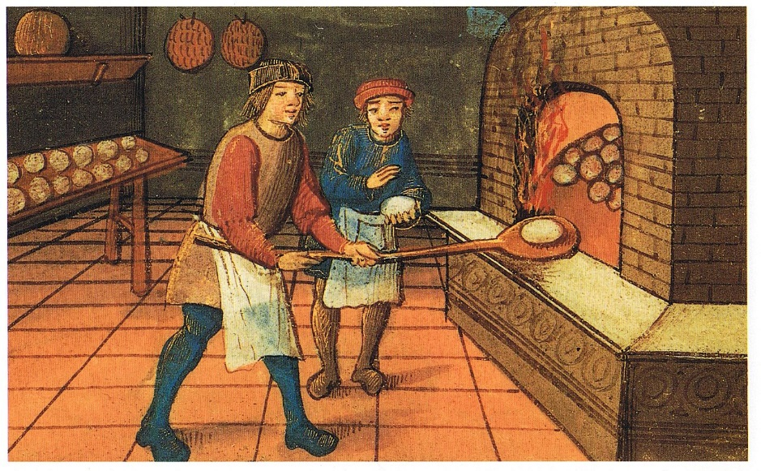
Two Models of Apprenticeship
The traditional mode: seven years of time served with little or no formal educational input.

Slide 9
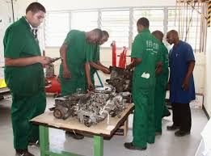
A Modern Alternative
The Dual System common in the German-speaking countries. Usually three years in duration with a mixture of formal and work-based learning.
Is based on the idea of putting theory into practice.

Slide 10
German Teacher Education
Does not follow the dual system but is based on:
5 years of study and internship up to Master’s level.
2 years as a kind of apprentice working in controlled conditions in a school (the Referendariat) before full accreditation as a teacher.
But there is little or no co-ordination between university and school-based elements of the programme.

Slide 11
More on the Dual System
The main form of German VET
About 75% of Germans aged 16-25 engage in VET. About 60% of these use the dual system
The Dual System involves an employee (Auszubildender) who is enrolled on what is usually a three year programme. It involves college attendance at least once a week
DS apprenticeships are based on the application of systematic knowledge (Wissen) to operational practice (Können)
Qualifications are at level 3

Slide 12
The Scope of the Dual System
About 340 occupations covered.
3-4 days per week in workplace
on the basis of training regulations within the framework of a training contract
mainly at the workplace
Final qualification: State-recognized training occupation (chamber certificate)
Prerequisites: Full compulsory education (no leaving certificate required)
Duration: Two, three or three and a half years. Most are three years

Slide 13
How Important is it?
The DS has been criticised for inflexibility
But DS occupations are all recognised and remain under review
About 50% of DS occupations are ‘white collar’
But the DS is based on the idea of preparation for an occupation (Beruf) rather than a job
Possession of a Beruf has social as well as economic significance

Slide 14
Examples of new training occupations: 49 since 1996
 Specialist in market and social research
 Tourism and leisure agent
 Machine and plant operator
 Safety and security specialist
 Recycling and waste management technician
 Health services administrative assistant
 Microtechnologist

Slide 15
Some Initial Cautionary Observations
Although both share common assumptions, professional and vocational education systems in Germany have different legal and conceptual bases. VET is level 3.
Professional education is based on level 6 at least.
It emphasises ability to operate in complex and changing circumstances.
Like in the Dual System, there is supposed to be a link between theory and practice in operation in the workplace.
But the link is not so intimate as in the Dual System.

Slide 16
So What Might We Learn?
There is no principled reason why dual apprenticeship should not occur at a higher education level (4+).
Note the time spent on gaining a level 3 occupational qualification in the German VET system.
Note the intimate link between academic, simulatory and workplace learning.

Slide 17
But Conditions in England are Different!
True.
But work-based learning in education is increasingly advocated as a means of effective teacher education (and is also mentioned in connection with other occupations such as nursing).
How could apprenticeship work without a massive disruption to existing teacher education?
We already have School Direct (Employment), which is based on the prior acquisition of a level 6 Bachelor qualification in most cases.
Is this enough? (we know that there are quality concerns).

Slide 18
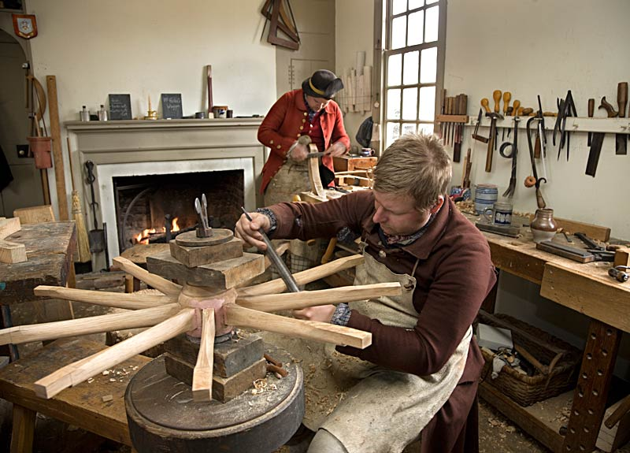
Interlude: 3 conceptions of the teacher
Craftworker – like a potter or traditional midwife
Executive technician – a semi-skilled worker
Professional – uses research in practice

Slide 19
The Craftworker
A medium on which to work.
The ‘mysteries’ and skills of the craft.
A spiritual or ethical ‘calling’.
Local and tacit knowledge.
Situational judgement
Instruments with which to work.
A body of subject knowledge.
Made of the ‘right stuff’.

Slide 20
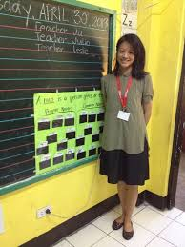
The Teacher as Executive Technician
‘Pedagogic Taylorism’ - we break up the role of the teacher into different functions:
Research into ‘what works’
Curriculum design based on 1.
Lesson planning based on 2.
Classroom routines based on 3.
Classroom routines have a clear
theoretical warrant

Slide 21
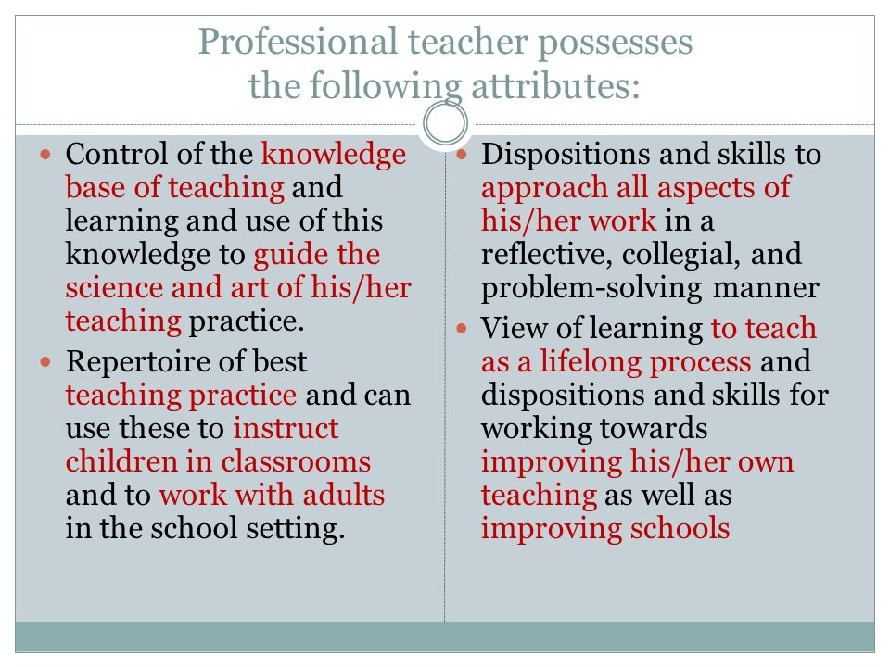
The Teacher as Professional
Work is informed by research and theoretical considerations.
Has professional autonomy to a high degree.
Has a role beyond the classroom.
But…can apply theory and research to particular situations.
Realises that research claims
cannot just be ignored.
Example of a definition of a
Professional teacher

Slide 22
How a Professional Can Use Theory
To make judgements in complex situations by…..
providing a conceptual map of the educational terrain.
consulting research findings -but
interpreting them in the light of her circumstances
providing a filter against ill-thought out ideas and fads.

Slide 23
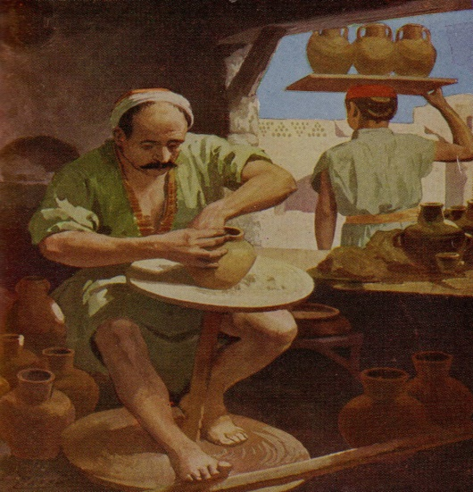
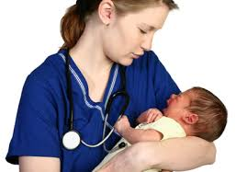
Characteristics of a Craft Occupation
Craft knowledge is not systematically organised, does not apparently derive from scientific enquiry and is very often local rather than universal. It is transmitted informally within the workshop and within social activities connected with the craft.

Slide 24
Apprenticing a Craft Teacher
Theory and research not needed, so emphasis is on observation and imitation.
Apprenticeship is focused on effective and compliant practice within a particular school.
Institutionally, the apprentice’s time is spent almost entirely within a school environment.
Difficult to create a national system of teacher education in this way.
We can conclude that this form of apprenticeship would be highly undesirable for a high quality teaching force.

Slide 25
The Executive Technician: Breaking it Down
Each lesson is subdivided into sections of several minutes long.
Activities for each of these sections is prescribed.
Resources needed for each section are prescribed.

Slide 26
Apprenticing an Executive Technician
The ET does not need to acquire theoretical knowledge or knowledge of research.
Educational level need not be very high.
The ET is a competent carrier-out of routines devised by someone else.
Above all the ET is compliant with protocols.
Apprenticing an ET can be confined largely to the classroom, with some pooling of sessions with other institutions in order to explain routines more efficiently.
Again, not a desirable model for teacher apprenticeship.

Slide 27
Apprenticing a Professional (model 1)
A good educational background at university level is an absolute prerequisite. Universities have a say in recruitment.
Episodes of teaching in controlled conditions are integrated with university study.
The apprentice gets opportunities to meet with colleagues and academics at university and is seconded to other schools.
Integration of research and theory with classroom practice is assessed.
There may be problems of scale (capacity) and cost (salaries) which impede the massification of this model.
There is also the issue of duration – one year is clearly not enough.

Slide 28
Does England Need a National Teaching Force?
The implication of current policy suggests ‘No’.
MATs will ‘grow their own’.
But MATS are variable in quality and in their approach both to pedagogy and curriculum.
The implication seems to be that either teachers will be confined to particular MATS for their careers or that they will have to be ‘retrained’ when they move from one MAT to another.
This will have serious implications for teacher mobility and the ability of England to develop a consistently high-quality teaching force.

Slide 29
The Evolution of Teacher Education Policy: a Scenario
Most secondary teachers will be trained by MATS.
A growing number of primary teachers will be trained in MATS.
A small number will do the PGCE in ‘elite’ universities.
Apprenticeship will become a preferred route for MAT teacher training.
There is a desire among some MATS to ‘grow their own’ from their teaching assistants.
One could even see a new career structure emerging:
Teaching Assistant Apprentice Teacher Partly qualified teacher fully qualified teacher.
This would have the potential to keep salary bills down, to make use of the levy and to help meet government apprenticeship targets.

Slide 30
What is the proposed apprenticeship in teaching? (currently under debate)
It will be school-based and offered by schools.
It will be a year’s duration.
20% of the time will be spent out of the classroom.
There is no prescription for the involvement of higher education.
It will be a level 7 qualification.
It will not be necessary to have a degree in order to enter the teacher apprenticeship programme. (there is some debate about this).
Evidently it will be suited to the craft or the ET model.

Slide 31
Is the proposed teaching apprenticeship really an apprenticeship?
There need be no theoretical or research-based input.
It will be very short (1 year).
German dual apprenticeships last three years have an academic input and are awarded at level 3.
How could the teaching apprenticeship be a level 7 qualification?

Slide 32
Potential Problems along the Way
The proposed apprenticeship does not meet QAA criteria for a professional masters qualification, which involves being able to apply research to practice.
New Ofqual regulations for the award of qualifications are rigorous about the need for guided learning and an adequate amount of time to be spent on study.
Parents might not be best pleased with their children being taught by teachers with such qualifications.

Slide 33
An Alternative Model for Professional Teachers
Retain the PGCE with QTS and keep the university contribution.
Award provisional licensure on beginning teaching with QTS.
Enroll all NQTs on a workplace-based M level qualification leading to full licensure over a two - three year period.
NQTs would attend university 1 day per week.
They would be supported by their schools, working with a university, in their professional development.
They would pay no fee to undertake the programme.
Prior models: MTL in England and MET in Wales. Note also the different trajectory in Scotland.

Slide 34
Advantages of this ‘Modest Proposal’
Route to a genuine professionally-based M level teaching qualification.
NQTs receive strong support during the early years of their careers, helping with retention.
Common curriculum allows for development of national teaching force.
Link with universities ensure good quality academic content.
Strong integration of workplace learning with university study ensures quality and integration of research and theory with practice.

Slide 35
But it will cost!
Use apprenticeship levy to pay for some elements: this is a ‘sunk cost’.
Teachers involved in study impart a dynamic to school improvement efforts thus improving the productivity of schools.
Can substitute for other CPD activity for NQTs in an integrated package.
By reducing attrition, recruitment and replacement costs are reduced and expertise and experience are conserved within the system.
A high quality teaching profession cannot be purchased on the cheap, although it can cost less than many assume.

Slide 36
What Should University Schools of Education do?
Have a clear vision about what a teacher should be.
Be clear about their contribution to teacher education within their own institution.
Make the case outside for a professionally based teacher education.
Not be afraid to develop a policy for professionally based teaching.

Slide 37
Thank You!

