Slide 1
Dr Carroll Smith 6th March 2023 hosted by Sally Elton-Chalcraft
Prof Sally Elton-Chalcraft
Director of the Learning Education and Development Research centre
University of Cumbria
Session will be recorded.
Please MUTE until Q and A

Slide 2
Q and A and Events Catalogue
https://www.cumbria.ac.uk/led-research-centre/
Charlotte Mason centenary 2023 - https://www.cumbria.ac.uk/media/CM2023-events-catalogue-(1).pdf to book https://store.cumbria.ac.uk
Please write questions/ comments in the ‘chat’
Sally will invite you to unmute, turn on your camera and ‘take the floor’ !

Slide 3
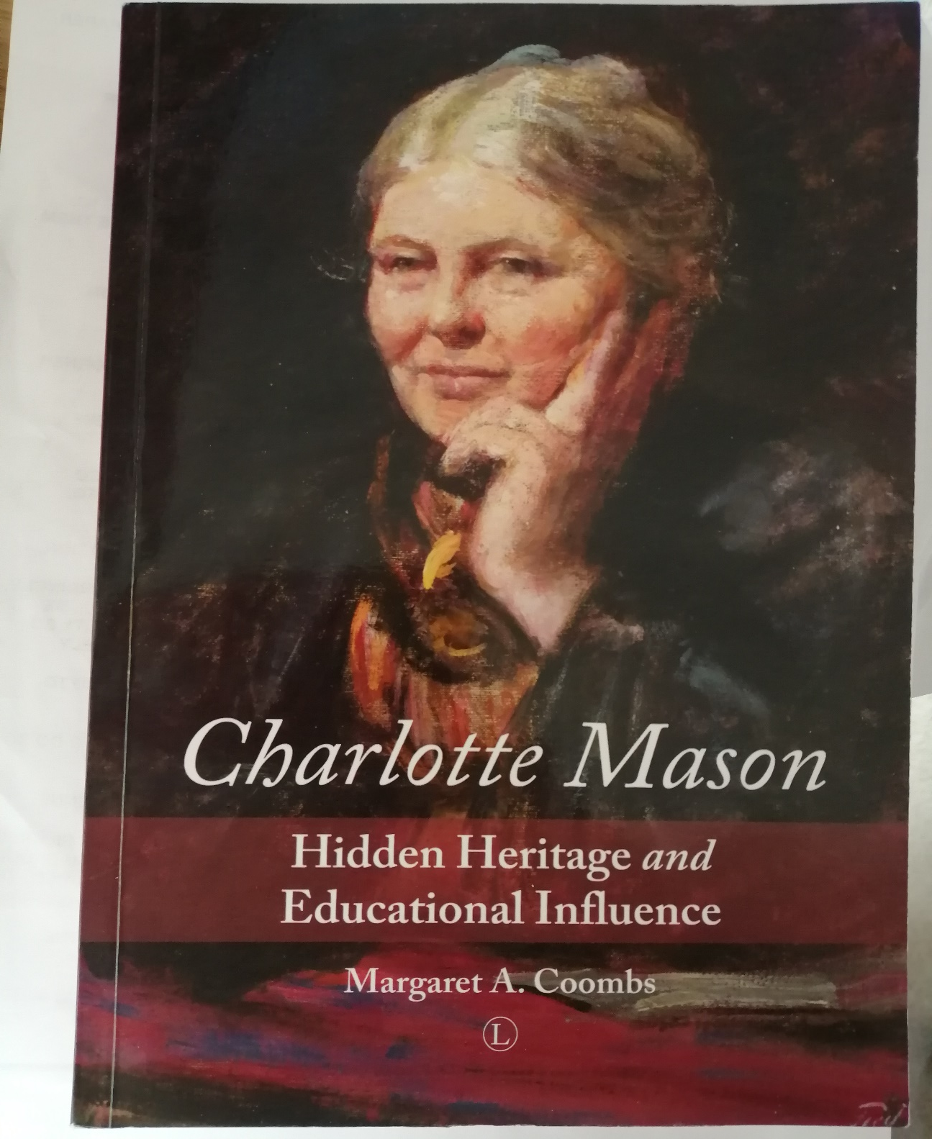
Past events
Margaret Coombes in conversation with Faye 8th Feb 2023 hosted by Sally
The Thirteenth Child and her Secrets
Part 1: The early life of Charlotte Mason
Margaret Coombs
Link to youtube video
https://www.youtube.com/watch?v=NVuqFUynGFo
and ppt https://www.cumbria.ac.uk/led-research-centre/

Slide 4
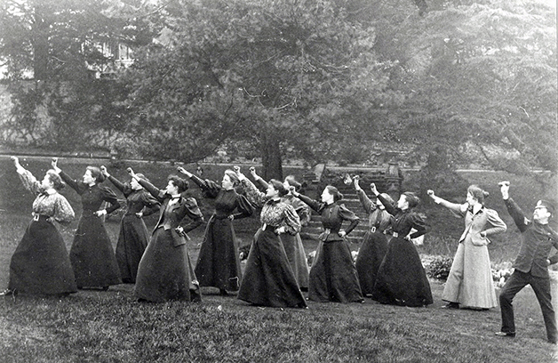
2023 events
Mason for the 21st Century Dr Carroll Smith
Date: 6th March 2023, 7.30pm Venue: online Cost: free How to Book: go to: https://store.cumbria.ac.uk then search: carroll smith
Charlotte Mason and the Bradford and Gloucestershire projects John Thorley
Date: Tuesday 28th March 2023, 7.30pm Venue: Percival Lecture Theatre, Ambleside Campus Cost: £5/ person How to Book: go to: https://store.cumbria.ac.uk Search for John Thorley
Charlotte Mason's Philosophy on Outdoor Education and History applied to contemporary contexts Professor Hilary Cooper
Date: Wednesday 26th April 5.30pm Venue: Percival Lecture Theatre, Ambleside Campus Cost: £5/ person How to Book: go to: https://store.cumbria.ac.uk Search for Hilary Cooper

Slide 5
Home Learning Environments for Young Children Online talk Dame Professor Cathy Nutbrown
Date : Tuesday 23rd May 5.30pm Venue: Talk on line Cost: free How to Book: https://store.Cumbria.ac.uk then search 'Cathy Nutbrown‘
Family workshop Dates : Tuesday 30 May Venue: the Armitt Museum Leah Boden & Lynn Seddon
Armitt Museum Ambleside Cost: £5 adults, children free, tickets must be booked in advance How to book: https://www.armitt.com/event-directory/
Modern Miss Mason book signing with Leah Boden on Friday 2 June at The Armitt, 5:30pm-7pm How to Book: please follow this link: https://www.armitt.com/event-directory/
Realising a Pedagogy Charlotte Mason - Timeless Truths, Teaching and Learning Jack Beckman
How to Book: go to https://store.cumbria.ac.uk Search for Jack Beckman

Slide 6
Conference July 2023 Ambleside Campus
Charlotte Mason Centenary Conference Charlotte Mason's Design for Education: An Enduring Legacy for Education Today?
Dates : July 19th 3pm to Friday July 21st 9pm Costs: £249 until Dec 31st; student rate £139 Conference page: https://www.cumbria.ac.uk/events/conferences/charlottemasons-design-for-education-an-enduring-legacy-for-today.html

Slide 7
Acclaimed Educator Part 2: the Life of Charlotte Mason A Talk by Margaret Coombs
Date: 20 September 2023 5.30pm Venue: Percival Lecture Theatre, Ambleside Cost: £5/ person How to Book: on line at: https://store.cumbria.ac.uk Search for Margaret Coombs
Adventures with the Morecambe Bay Curriculum: A curriculum for lifestyle learning online Chris Barlow
Date: 17 October 2023 7.30pm Venue: online Cost: free How to Book: go to https://store.cumbria.ac.uk Search for Chris Barlow
Charlotte Mason Expert Panel Hosted by Prof Sally Elton-Chalcraft : Elaine Cooper, Prof Hilary Cooper, Dr Deani van Pelt, Prof Stephanie Spencer
Date: 8th November 5.30 to 6.45pm Venue: online Cost: free How to Book: go to https://store.cumbria.ac.uk search ‘panel’

Slide 8
Thanks for attending!
A recording of this session will be available on the LED website soon, together with the power point and links
Please check out our catalogue
https://www.cumbria.ac.uk/led-research-centre/
Charlotte Mason centenary 2023 - https://www.cumbria.ac.uk/media/CM2023-events-catalogue-(1).pdf to book https://store.cumbria.ac.uk
We look forward to seeing you at our future events!

