Slide 1
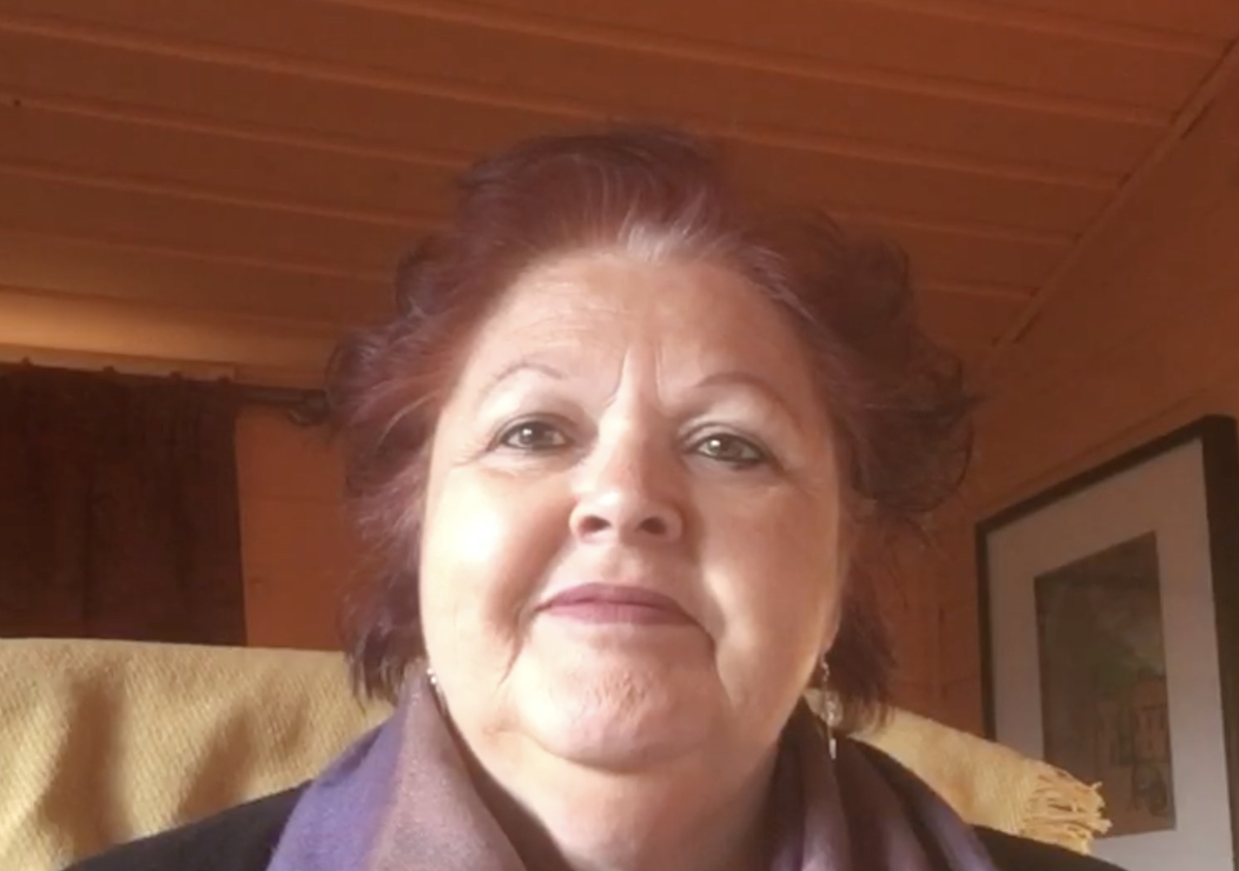
Home Learning Environments for Young Children
Professor Dame Cathy Nutbrown
The University of Sheffield
Charlotte Mason Centenary Lecture
Tuesday 23rd May 2023
University of Cumbria, Ambleside Campus.

Slide 2
Outline
Roots of home learning in Charlotte Mason’s advocacy of mothers teaching their children at home.
how work with parents in diverse contexts and communities helps families to enhance their young children’s learning.
Manifesto for Home Learning – Birth to Five

Slide 3
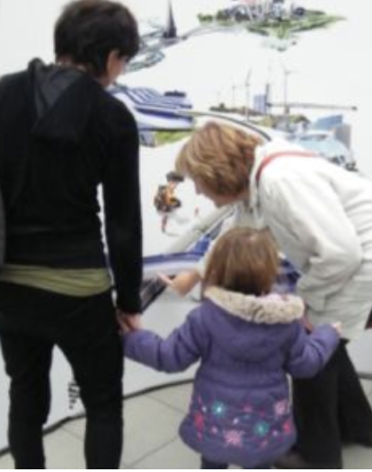
“Education is an Atmosphere”
Atmosphere - the home environment
The richness of a child’s home and community, is key to their growth, development and learning. The people young children spend their time with, the spaces they spend time in, and the environments they encounter are essential to their living and learning.

Slide 4
Some roots of home learning
A child’s home is the first place of learning
The people children connect with are their earliest teachers
Their gardens, parks and community spaces are their first introductions to the outdoors and to nature.
Their books and the people who read and talk with them are doorways to more ideas and knowledge and introductions to the importance of stories.
Their cultures, languages, habits, and interests are core to their identities

Slide 5
Work with parents to enhance their young children’s learning.
The Sheffield Raising Early Achievement in Literacy Project (REAL)
Home visiting
Early Literacy Development
The ORIM Framework
Collaboration

Slide 6
The Sheffield Raising Early Achievement in Literacy Project (REAL)
a family literacy initiative where parents’ and children’s literacy as inextricably linked.
Inclusivity
10 Teachers - 8 families each, cover for half a day a week - contact once every 3 or 4 weeks in term time - 18 months duration - children aged 3 years - 4.5 and in Reception
children in disadvantaged communities.
children whose mothers had no formal educational qualifications benefitted most.

Slide 7
The ORIM Framework

Slide 8
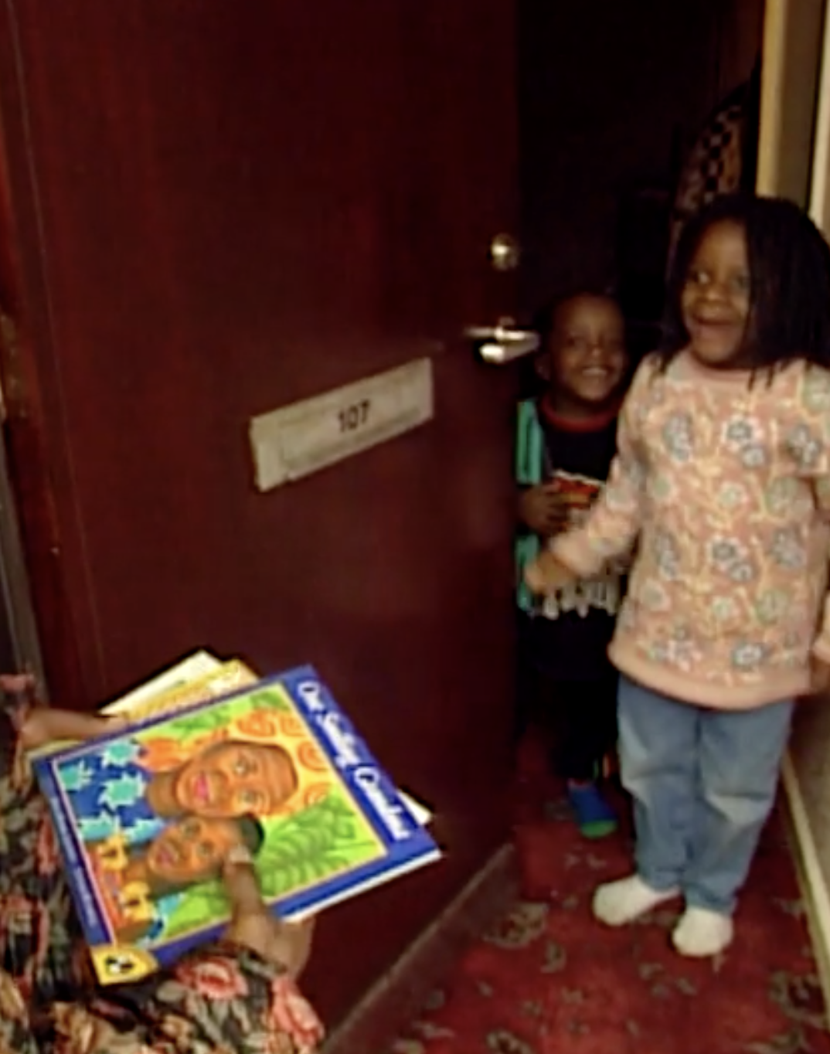
Home visiting
Crossing professional boundaries?
Parents’ territory
Working one-to-one
Starting with what parents know and can do
Power dynamics and relationships can change
Teacher/educator-as-visitor
Fit with families
Training and CPD

Slide 9
Collaborations
The University of Sheffield, Sheffield Local Authority, The Nuffield Foundation, 70 schools, 150 teachers, countless families
RCT - 10 schools, 10 teachers, 80 families
The ORIM Network
Charities and Development organisations- Darts - Daring Discoveries; Peeple: Learning Together; NCB: Making it REAL; Pact: Family Literacy in Prisons
Many staff in LAs and Boroughs including - Blackpool, Dewsbury, Doncaster, East Sussex, Jersey, London, Oldham, Peterborough, Sandwell, Sheffield, Warwickshire.

Slide 10
Examples of USING ORIM and REAL Approaches with families
Archie’s grandad’s car
Festival of words with ‘Writing on the beach’ Jersey (NCB)
Family literacy in prisons

Slide 11
Archie’s grandad’s car
Learning in the moment
Tuned in adults
Listening
Talking
Observing
Funds of Knowledge

Slide 12
Festival of words with ‘Writing on the beach’ Jersey (NCB)
All settings in Jersey came together to provide a wide variety of literacy activities on the beach which were accessible to all families and included a multilingual approach involving: Signers, English, Polish and Portuguese languages:
stories on the beach,
exploring ‘base camp’ making maps and models,
‘fishing’ for letters in pools,
writing with sticks in the sand,
Singing and rhyme sessions were supported by a Makaton signer
Children’s books were hidden all over the island for families to find, read and to re-hide for someone else.
https://beststart.je/useful-resources/

Slide 13
Family literacy in Prisons (Pact)
Family Literacy in Prisons (FLiP) is a prison-based course run by Pact [Prison Advice and Care Trust] facilitators who have undertaken professional development run by us at the University of Sheffield in conjunction with Pact. Developed collaboratively FLiP uses:
REAL Approaches including the ORIM Framework.
Four workshop sessions
A child-centred literacy focussed visit
FLiP supports parents to play a more active role in developing their children’s literacy using everyday practices of looking at print, talking, reading and early mark making.

Slide 14
Manifesto for Home Learning – Birth to Five
Action 1. Reaffirm children’s rights in practice
Action 2. End poverty
Action 3. Value cultural and community capital
Action 4. Include all families
Action 5. Fund family learning
Action 6. Provide Initial and Continuing Professional Development
Action 7. Build research collaborations
Action 8. Make Family Learning a Policy Priority

Slide 15
Manifesto for Home Learning – Birth to Five
Action 1.
Reaffirm children’s rights in practice

Slide 16
Manifesto for Home Learning – Birth to Five
Action 2.
End poverty

Slide 17
Manifesto for Home Learning – Birth to Five
Action 3.
Value cultural and community capital

Slide 18
Manifesto for Home Learning – Birth to Five
Action 4.
Include all families

Slide 19
Manifesto for Home Learning – Birth to Five
Action 5.
Fund family learning

Slide 20
Manifesto for Home Learning – Birth to Five
Action 6.
Provide Initial and Continuing Professional Development

Slide 21
Manifesto for Home Learning – Birth to Five
Action 7.
Build research collaborations

Slide 22
Manifesto for Home Learning – Birth to Five
Action 8.
Make Family Learning a Policy Priority

Slide 23
From a parent….
‘thinking about learning this way has really opened my eyes to what I can do as a parent’ Parent during a home visit

Slide 24
References and other resources
Hannon, P., Nutbrown, C. and Morgan, A. (2020) Effects of extending disadvantaged families’ teaching of emergent literacy. Research Papers in Education, 35(3):310-336 https://doi.org/10.1080/02671522.2019.1568531
Hirst, K., Hannon, P., and Nutbrown, C (2010) Effects of a preschool bilingual family literacy programme Journal of Early Childhood Literacy 10(2):183–208. DOI: 10.1177/1468798410363838
Morgan, A., Nutbrown, C. and Hannon, P. (2009) Fathers’ involvement in young children’s literacy development: implications for family literacy programmes. British Educational Research Journal 35(2)167-185.
Nutbrown, C., Clough, P., Davies, K. and Hannon, P. ( 2022) Home Learning Environments for Young Children London: Sage.
Nutbrown, C., Clough, P. Stammers, L., Emblin, N. and Alston-Smith, S. (2019) Family literacy in prisons: fathers’ engagement with their young children. Research Papers in Education, 34(2):169-191, DOI: 10.1080/02671522.2017.1402085
Nutbrown, C., Bishop, J., and Wheeler, H. (2015) Co-production of family literacy projects to enhance early literacy development Journal of Children’s Services 10(3)265-279. DOI 10.1108/JCS-02-2015-0011
Nutbrown, C. and Hannon, P. (2003) Children’s Perspectives on Family Literacy: Methodological Issues, Findings and Implications for Practice Journal of Early Literacy Research 3(2):115-145. https://doi.org/10.1177/14687984030032001
Nutbrown, C., Hannon, P. and Morgan, A. (2005) Early literacy work with families: policy, practice and research. London: Sage
Websites https://sheffield-real-project.sites.sheffield.ac.uk
https://www.prisonadvice.org.uk/family-literacy-in-prisons

