Slide 1
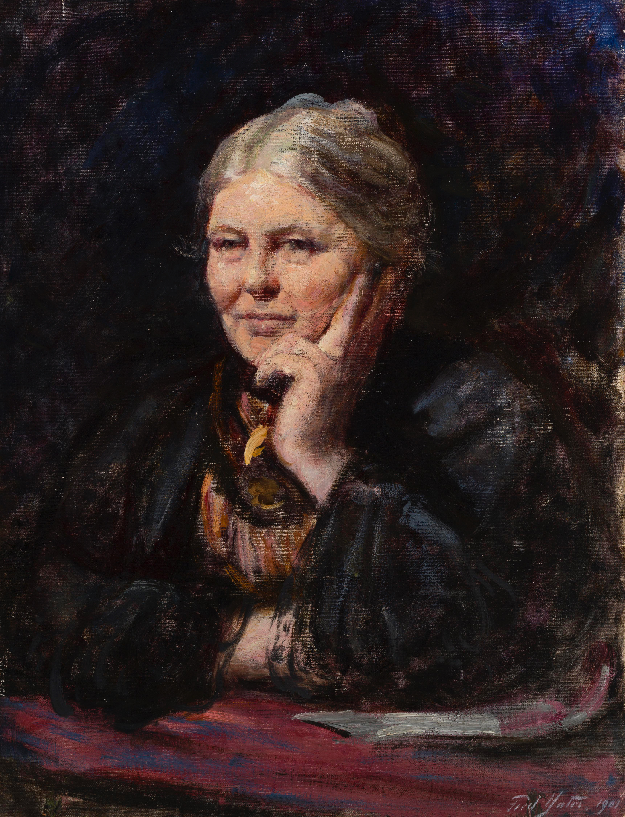

Charlotte Mason for the 21st Century
Carroll Smith

Slide 2
Mason as a poet

Slide 3

We attempt to define a person, the most common-place person we know, but he will not submit to bounds; some unexpected beauty of nature breaks out; we find she is not what we thought, and begin to suspect that every person exceeds our
power of measurement.”
Charlotte Mason

Slide 4
Science

Slide 5
Science, history, philosophy, literature, must no longer be the luxuries of the 'educated' classes; all classes must be educated and sit down to these things of the mind as they do to their daily bread.

Slide 6
History must afford its pageants, science its wonders, literature its intimacies, philosophy its speculations, religion its assurances to every man, and his education must have prepared him for wanderings in these realms of gold.
An Essay Towards a Philosophy of Education, p. 42-43

Slide 7
Living Education

Slide 8
Language and Narration

Slide 9

Nature

Slide 10
History

Slide 11
Education

Slide 12
“What worked even fifty years ago will not work today, and what fulfils our needs today will not serve fifty years hence; there is no last word to be said upon education; (emphasis mine) it evolves with the evolution of the race” (School Education, p. 45).

Slide 13
I emphasised habit too much in H.E. What I
urged there is true enough but unnecessary.
From a letter to Henrietta Franklin, 10 September 1921

Slide 14
Questions

