Slide 1



Occupational Health Service

Slide 2


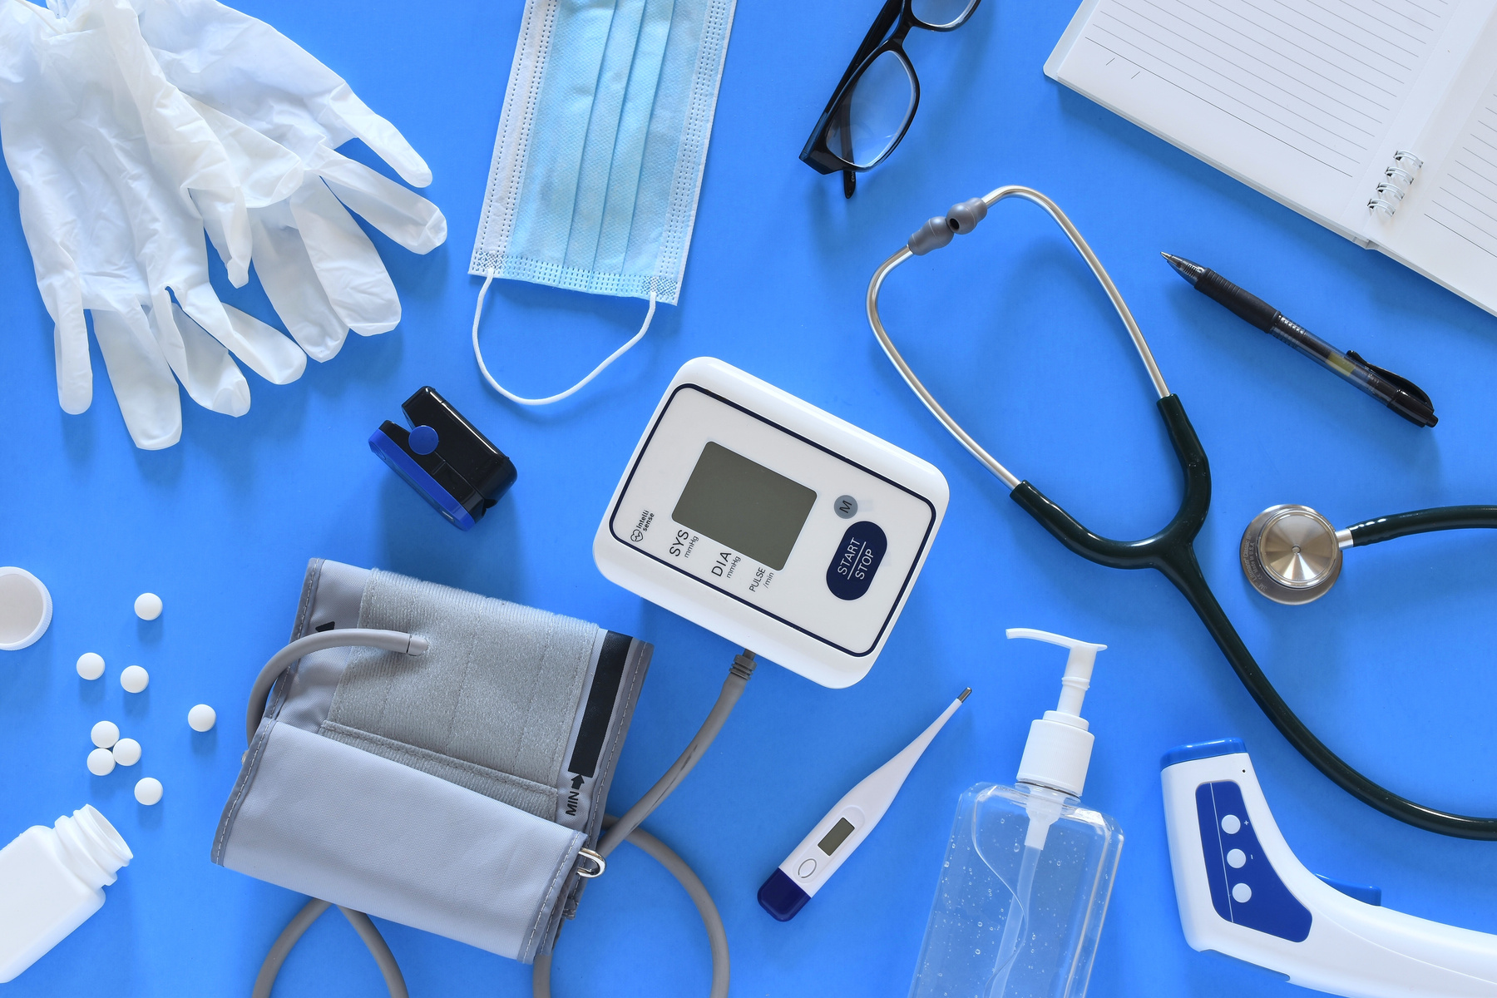


Occupational Health Services:
Fitness to Train
Vaccinations
Management Referrals

Slide 3
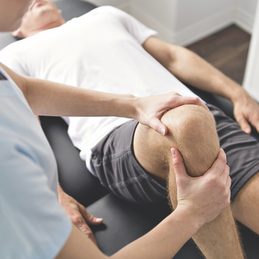
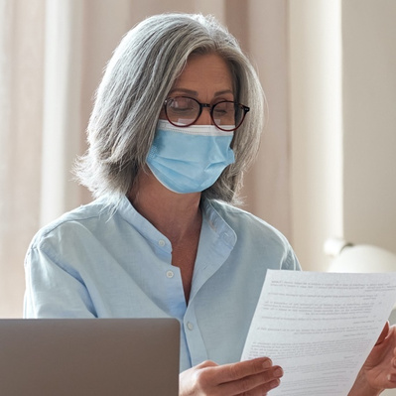

Fitness to Train
  An email will be sent from usersupport@yodha.io Read the email thoroughly and follow instructions to set up an account and access the occupational health app.
  Download the app and complete the health questionnaire.
  You may require an appointment if a declaration has been made.
  This will place you at either; fit, fit following scrutiny, fit with advice, fit with temporary/permanent adjustments, unfit.
  Please ensure you provide a valid email address and phone number when signing up for your course.
  You MUST pass the other screening processes before you are able to attend placement.

Slide 4


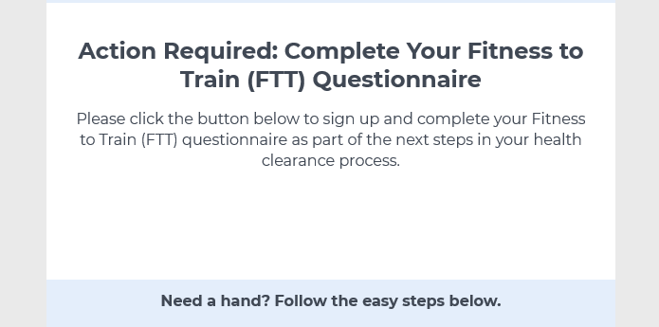
The email you receive will look like this…

Slide 5
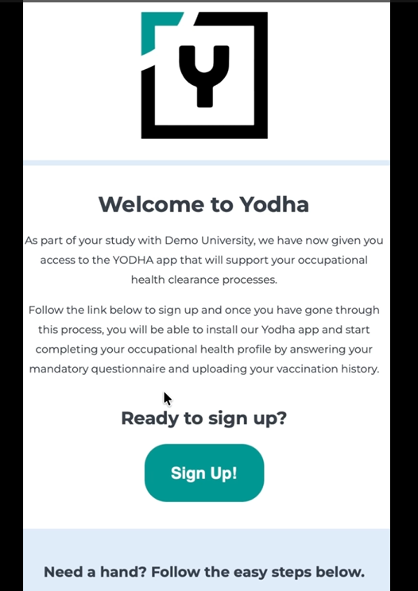
The student app will look like this look like this…

Slide 6
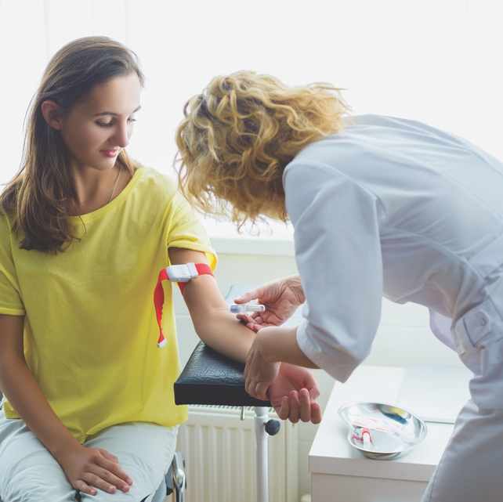
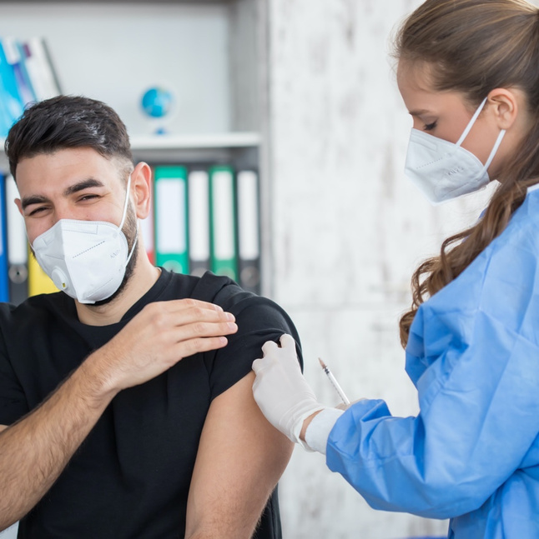
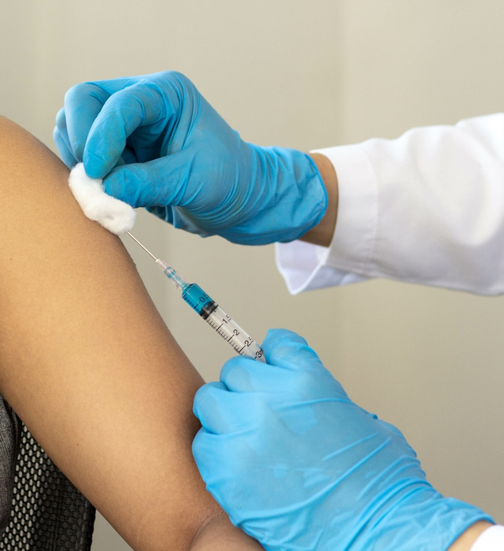
Vaccinations
  If you are enrolling on a course that requires vaccination clearance you must obtain a copy of your vaccination history.
  Obtain evidence of your past vaccinations and keep a copy for your records.
  Upload your vaccination history via the student app for occupational health to review.

Slide 7
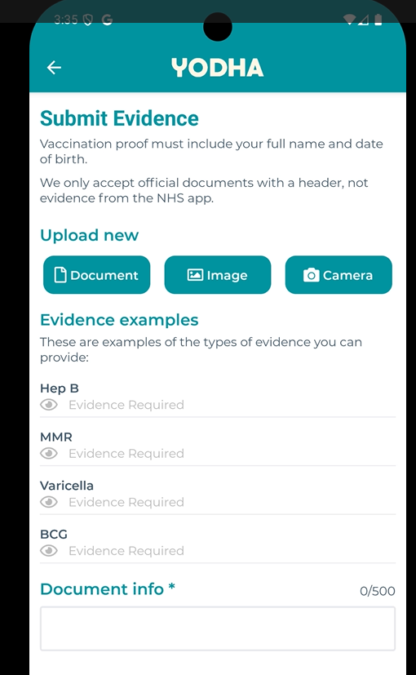
The page to upload your evidence will look like this…

Slide 8
Vaccinations - Breakdown
  Evidence of two MMR vaccines or blood test results showing immunity.
  Understand the history of chickenpox or blood test results showing immunity.
  Evidence you’ve previously received the BCG vaccine (TB). A scar may be visible.
  Evidence of three Hepatitis B vaccinations and a blood test result showing immunity.
  Further blood tests are required for courses involving exposure-prone procedures (Medicine, Paramedic, Midwifery). This involves screening for HIV, Hepatitis B surface antigens and Hepatitis C.

Slide 9
Vaccination Sessions
  Appointments will appear on your timetable as a block time period, however you will be notified via email of an individual appointment time.
  Attendance is compulsory for all students.
  Failure to attend WILL result in delays with placements.

Slide 10
Vaccination Courses
  If no evidence can be obtained and blood test results report a lack of immunity, additional vaccinations will be provided.
  Two MMR vaccines to be given four weeks apart.
  Two Varicella (chickenpox virus) to be given four weeks apart.
  Standard course of Hepatitis B vaccinations - three vaccines given over the course of six months. You will only require two before placement. This course requires a blood test to confirm immunity (after the third dose).
  Hepatitis B booster vaccines will be given if necessary (depending on the immunity result).

Slide 11



Management Referrals
  An appointment with a clinician to help with support during the course if required following a recent medical diagnosis/stress etc.
  A referral must be sent by your Course Director via the registry team.
  Occupational health is a service to provide support for students through their journey whilst at university.

Slide 12



Occupational Health wishes you the best of luck
with your university course
Contact Us
ohuocstudent@latusgroup.co.uk

