Slide 1





Occupational Health Service

Slide 2


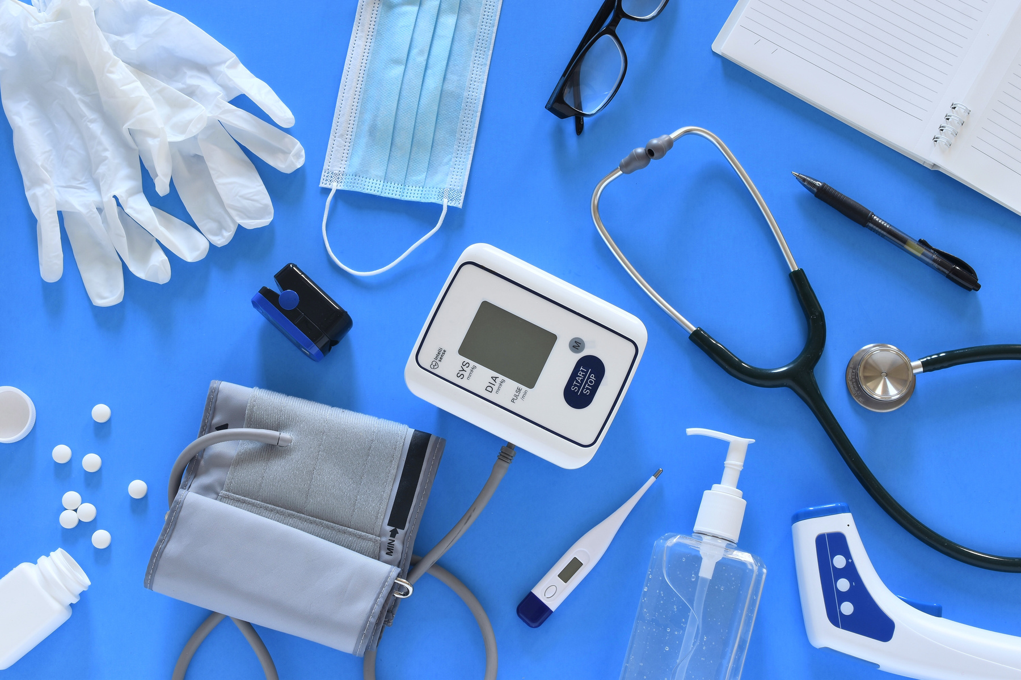



Occupational Health Services:
Fitness to Train
Vaccinations
Management Referrals

Slide 3
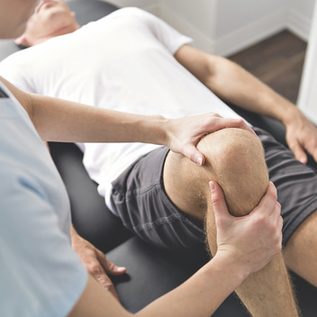
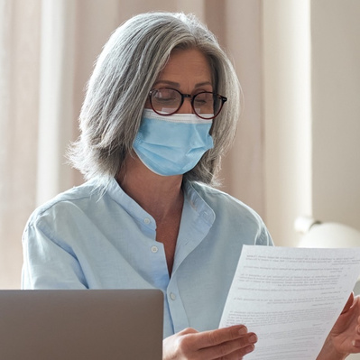

Fitness to Train
  An email will be sent from no-reply@ohims.co.uk
  Read the email thoroughly and complete the Health Questionnaire.
  You will receive a notification that the Health Questionnaire is complete.
  You may require an appointment if a declaration has been made.
  This will place you at either; fit, fit following scrutiny, fit with advice, fit with temporary/permanent adjustments, unfit.
  Please ensure you provide a valid email address and phone number when signing up for your course.
  You MUST pass the other screening processes before you are able to attend placement.

Slide 4


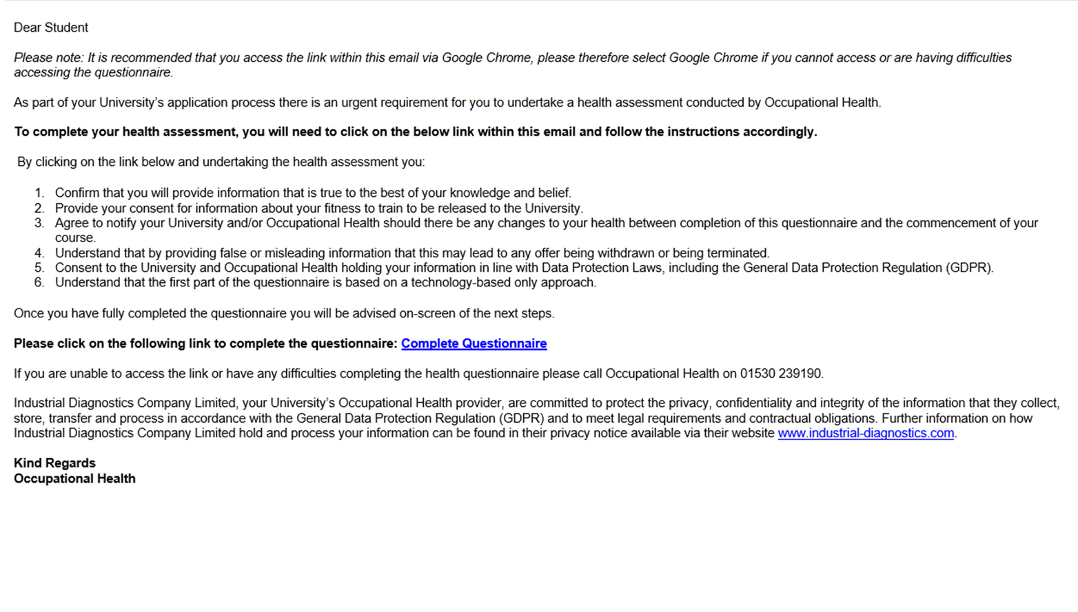
The email you receive will look like this…

Slide 5
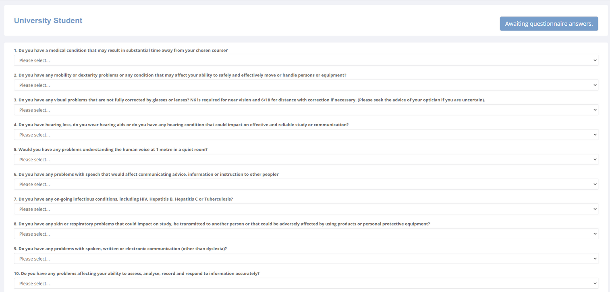
The questionnaire will look like this…

Slide 6
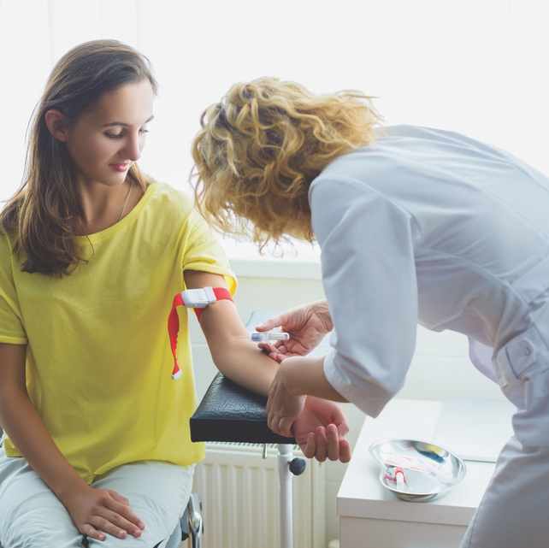
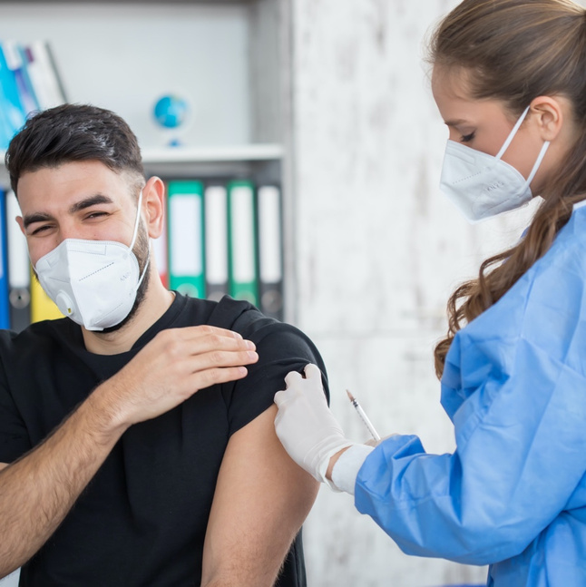
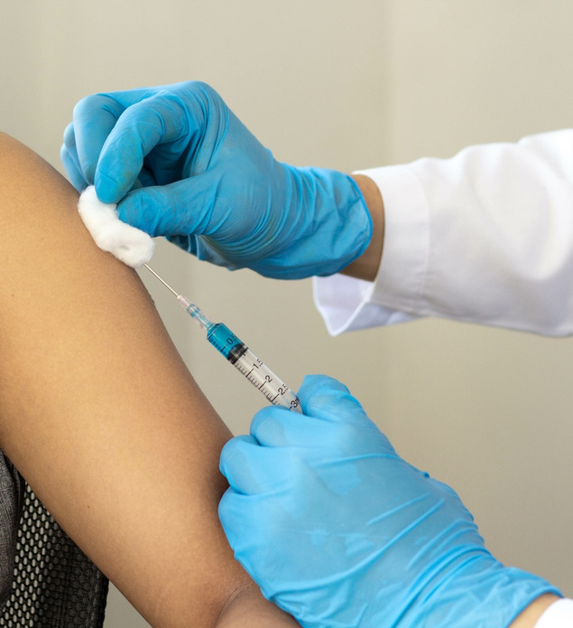
Vaccinations
  A further email will be sent from no-reply@ohims.co.uk upon completion of the Fitness to Train questionnaire.
  Read the email thoroughly.
  Obtain evidence of your past vaccinations and keep a copy for your records.
  Upload as instructed on the email.

Slide 7
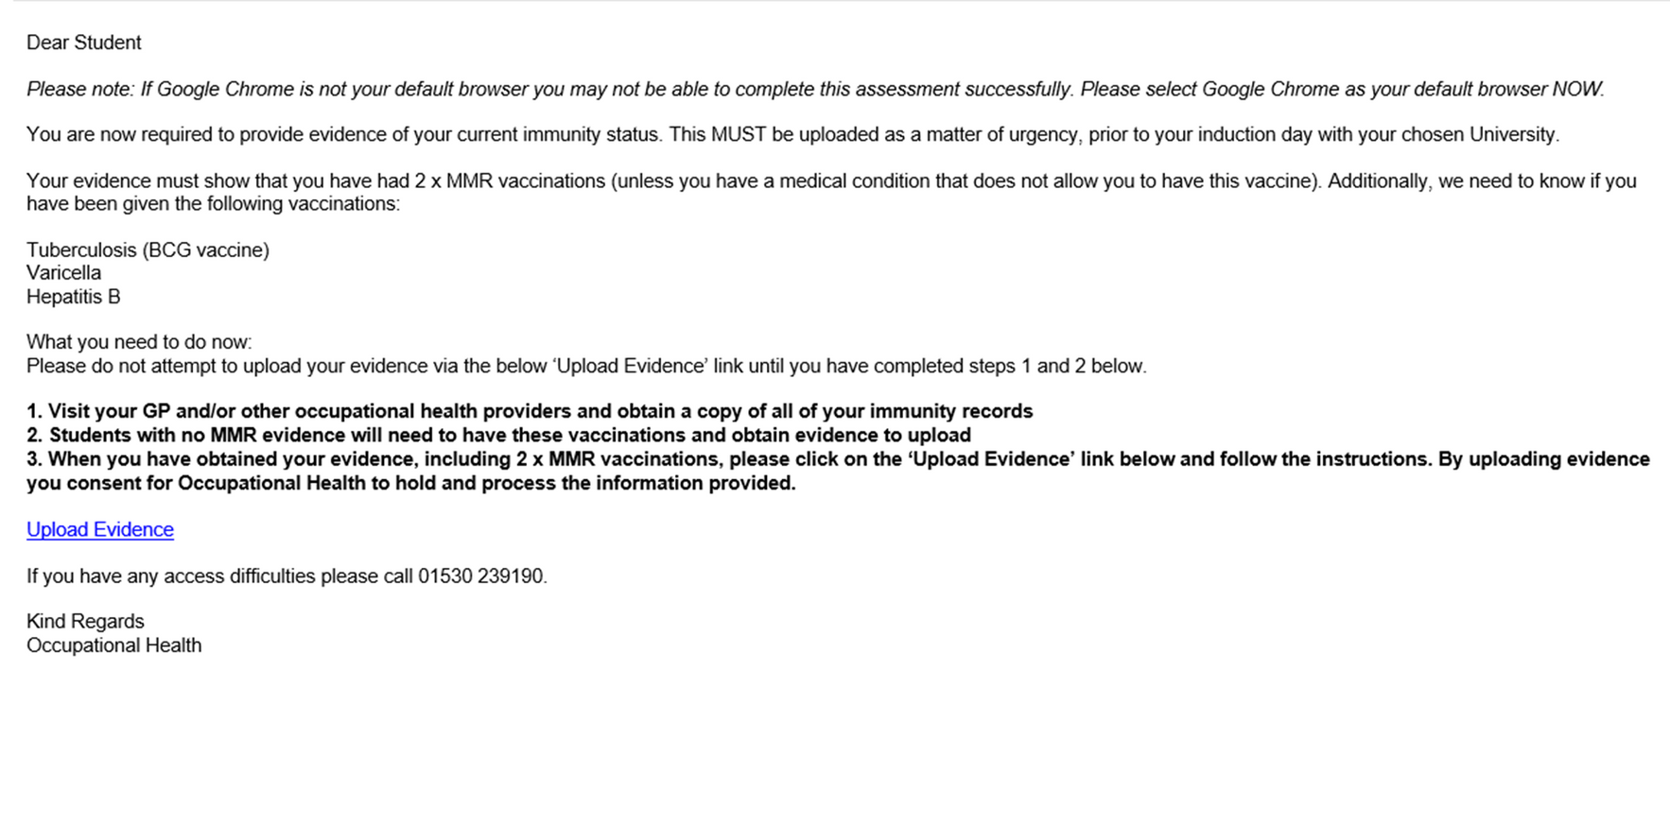
The email regarding vaccination evidence will look like this…

Slide 8
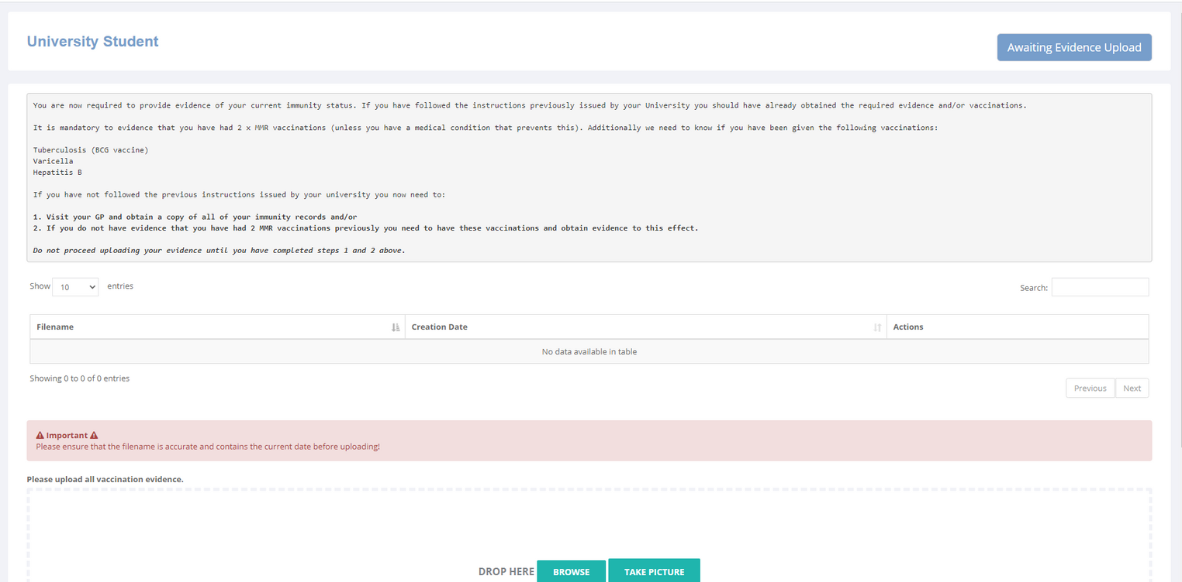
The page to upload your evidence will look like this…

Slide 9
Vaccinations - Breakdown
  Evidence of two MMR vaccines or blood test results showing immunity.
  Understand the history of chickenpox or blood test results showing immunity.
  Evidence you’ve previously received the BCG vaccine (TB). A scar may be visible.
  Evidence of three Hepatitis B vaccinations and a blood test result showing immunity.
  Further blood tests are required for courses involving exposure-prone procedures (Medicine, Paramedic, Midwifery). This involves screening for HIV, Hepatitis B surface antigens and Hepatitis C.

Slide 10
Vaccination Sessions
  Appointments will appear on your timetable as a block time period, however you will be notified via email of an individual appointment time.
  Attendance is compulsory for all students.
  Failure to attend WILL result in delays with placements.

Slide 11
Vaccination Courses
  If no evidence can be obtained and blood test results report a lack of immunity, additional vaccinations will be provided.
  Two MMR vaccines to be given four weeks apart.
  Two Varicella (chickenpox virus) to be given four weeks apart.
  Standard course of Hepatitis B vaccinations - three vaccines given over the course of six months. You will only require two before placement. This course requires a blood test to confirm immunity (after the third dose).
  Hepatitis B booster vaccines will be given if necessary (depending on the immunity result).

Slide 12



Management Referrals
  An appointment with a clinician to help with support during the course if required following a recent medical diagnosis/stress etc.
  A referral must be sent by your Course Director via the registry team.
  Occupational health is a service to provide support for students through their journey whilst at university.

Slide 13

Occupational Health wishes you the best of luck
with your university course
Contact Us
ohuocstudent@latusgroup.co.uk

