Slide 1
Masters: a route to teacher professionalism
TEAN at Aston June 2013
Bob Burstow

Slide 2
Questions
Is the advent, and increasing acceptance of, a master’s degree for teachers nothing more than an extension of the “technicality” of legitimising a qualification already identified as “post-graduate”?
Is this more than just opportunism and an extension of the top-down passive-recipient form of CPD?
Does a master’s qualification actually confer any significant or extra factor?

Slide 3
Answers
QAA 2011
A systematic understanding of knowledge…
critical awareness of current problems and/or new insights…
comprehensive understanding of techniques…
originality in the application of knowledge…
practical understanding…
conceptual understanding enabling the critical evaluation of current research
TEAN 2009
“a level of professional accomplishment,”
“a disposition towards enquiry and the use of research to inform teaching”,
“a recognition of complexity and the necessity of engaging in on-going understanding of complex matters”.
“mastery of a professional repertoire – attests to professional and academic accomplishment… all teachers should be masters of their profession”
“skilled performance – mastery”

Slide 4
Answers
An effective form of professional development in terms of the self-image of participants and changes in their practice (Seabourne 2009)
A high level understanding of the way in which theory and cutting edge research informs practice
(Burstow & Maguire 2013)

Slide 5
Issues
The medieval idea of artists, masons and other skilled trades producing master-works as a transition point between journeyman and mastery levels.
(Hopkins 2010)
The more theoretically-focussed master’s degree conferring (developing?) mastery of the specialist subject
The idea of a practice-focussed (or pedagogy –focussed) degree recognising ‘mastery’ of practice within the classroom

Slide 6
Tensions?
The Higher Education “disposition of enquiry”
The government view of the “apprenticeship” of teachers
Viewpoint
Profession
Craft
Beneficiary
Organisation
Individual
Source of initiative
Top-down
Bottom-up

Slide 7
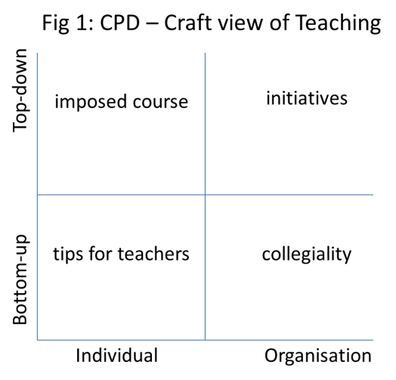
CPD Programmes

Slide 8
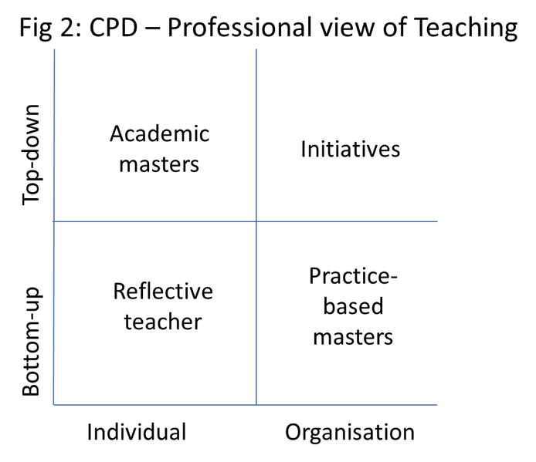
CPD Programmes
Notes:
The need for accreditation? Anything beyond imposed deadlines? But without deadlines do we actually do anything?

Slide 9
Mastery: So how can we tell?
Stance – distance - moving away from the emotive personal
Inspiration – the light bulb moment
Change – in practice, approach, understanding
Confidence – encouraged by depth of understanding

Slide 10
Mastery: Testing the idea
Anecdotal/observational
Examples of changes in practice:
  Geography
  PE
  Year 6 Primary
  Ofsted inspections
Analytical

Slide 11
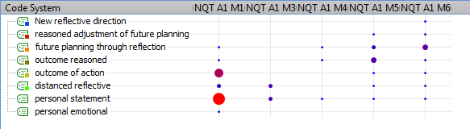
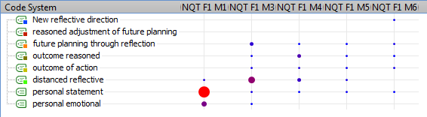
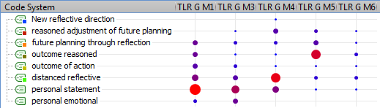

Slide 12
So can't you get there just by experience?
Yes but:
Speed of arrival – 2 to 3 years as opposed to ‘a lifetime’
(but not instant – primary teachers researching their own classrooms)
Parochialism/breadth and depth of vision
You may become a master in your own establishment (eg the old ‘Senior Masters’ who predated AST and Assistant Head posts) – but for that school only
Applicability across different establishments
(for comparative craft situations see
Sturt, G, 1963,The Wheelwrights Shop, CUP)
Notes:
So is an AST another example of mastery? They were supposed to be able to do it across schools

Slide 13
Tension – a third way?
The Higher Education “disposition of enquiry”
The government view of the “apprenticeship” of teachers
The school as organisation might expect to gain more from their staff studying a practice based masters
The collegiality inherent in many of the current practice-based degrees might be expected to generate a stronger coherent reflective and proactive workforce

Slide 14
Thank you
Burstow, B. & Maguire, M. 2013. Disentangling What it Means to be a Teacher in the Twenty-first Century: Policy and Practice in Teachers’ Continuous Professional Learning. In: MCNAMARA, O. (ed.) Teacher learning in the workplace: widening perspectives on practice and policy. London: Springer
Burstow, B. & Winch, C. 2013. Providing for the Professional Development of Teachers in England: a contemporary account of a government led intervention. Professional Development in Education in press.
Daly, C., Pachler, N. & Lambert, D. 2004. Teacher learning: towards a professional academy. Teaching in Higher Education, 9, 99-111.
DCSF 2008. Being the best for our children: Releasing talent for teaching and learning. Nottingham: Department for Children Schools and Families.
Seabourne, P. 2009. TDA: A longitudinal review of the postgraduate professional development of teachers.
UCET. Teaching – a Masters profession? The continuing conversation. UCET, 2009

