Slide 1
The Legacy of MTL
TEAN 2011
The Important Role of Higher Education in Teacher Education
Friday 20th May
Manchester Conference Centre

Slide 2
What a difference a year makes
In 2010 Masters in Teaching and Learning (MTL) was ‘the’ hot
topic, in 2011 things have clearly cooled.
A casualty of the coalition government’s spending review the
subsidy for the MTL has been withdrawn.
Building upon the roundtable presented at the previous
TEAN conference (Glasgow Caledonian University, 2010) this
session will begin with a short re-cap to inform colleagues
present of the current status of MTL.

Slide 3
MTL: A brief history
The Masters in Teaching and Learning (MTL) grew out of the
recommendations of the McKinsey report (2007); How the World’s
Best Performing School Systems Come Out on Top.
"Our aim is that every teacher over time should have the new
masters in teaching and learning. It will raise the status of
teachers and ensure that they get the recognition that they
deserve."
Ed Balls
Speaking at the Association of
School and College Leaders' (ASCL) conference, Brighton
(Source Education Guardian Friday 7 March 2008)

Slide 4
Eight universities working with local authorities and schools to deliver the MTL in
the North West of England where all Newly Qualified Teachers (NQT) in
maintained schools (who took up teaching posts in September 2009) are eligible
to sign up for the first programme.
In this format the MTL is a three-year classroom based programme. The first
phase of which was offered to NQTs (2009/10).
Our interest in MTL originated from our involvement with the programme and
from the perspective of our work in Initial Teacher Training (ITT).
The original MTL programme was also available to NQTs in “national challenge” schools across the country (those with sub 30% five A* to C grades including Maths and English at GCSE level).
Prior to the general election (May 2010) it was the then government’s aim to roll out MTL nationally in 2012.

Slide 5
About the roundtable
The session will be approximately 30 minutes in duration.
We aim to provide an opportunity for all participants to share their perspectives and experiences of MTL.
Our role is to facilitate the discussion to help ensure everyone has the opportunity to contribute to the discussion.
Key points and salient issues will be noted and disseminated to delegates (and other interested parties) via the TEAN website, potentially leading to a paper.

Slide 6
Ensuring teachers develop throughout their career is
essential in maintaining a high quality education
system. The aim of the roundtable is to provide a forum
that will facilitate and encourage discussion between
colleagues from a range of backgrounds to engage in
lively debate around the session’s title and focus
question;
Is teaching still going to become a Master’s level
profession?

Slide 7
Potential areas of debate
Perspectives and perceptions; the currency of MTL as a qualification and the implications for NQTs and recently qualified teachers currently undertaking the degree.
Funding; what next and who will pay? Voluntary or mandatory study?
Facilitation; implications for school based mentors, work load, classroom practice and Continual Professional Development (CPD).

Slide 8
What next?
Dissemination of key issues from this session via the TEAN website .
The creation of a forum for participants of this session (and other interested parties) to feed forward their questions, queries and experiences of MTL.

Slide 9

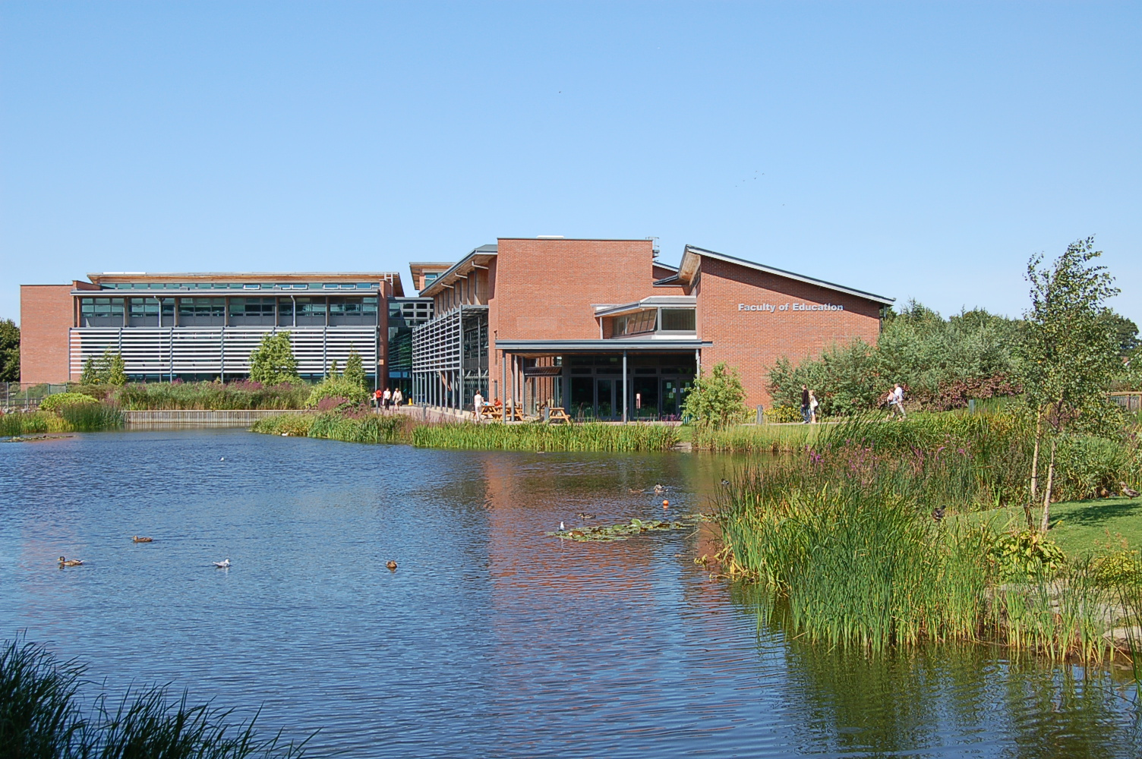
Thankyou
Dawne Bell
Senior Lecturer in Design and Technology,
PGCE (Flexible) Design and Technology Course Leader
David Wooff
Senior Lecturer in Design and Technology,
B.Sc (Hons) Design and Technology (with QTS) Course Leader
Christopher Hughes
Independent Consultant

