Slide 1

Sheffield Teaching School Alliance:
Birley Spa Community Primary School &
Silverdale School Sheffield
Gaynor Jones
Strategic Manager/Assistant Headteacher

Slide 2
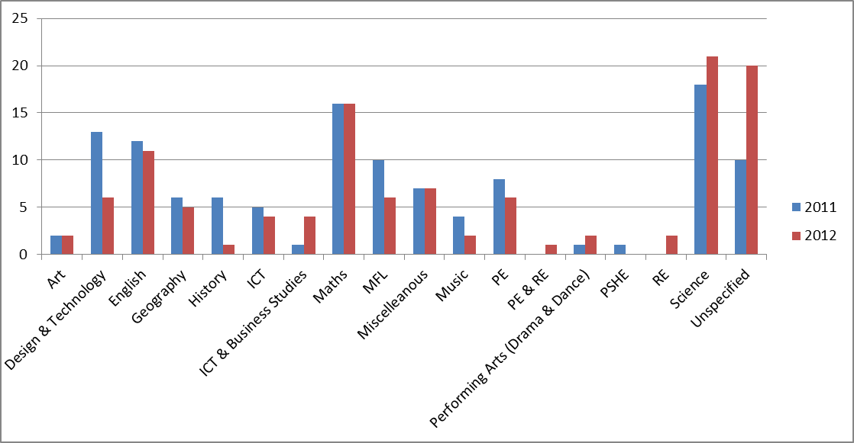
Secondary = 129
Undergrad = 9
PGCE = 101
GTP = 17
SCITT = 1
Teach First = 2
Primary = 152
Undergrad = 48
PGCE = 83
GTP = 19
SCITT = 2

Slide 3

Building an alliance of schools in September
Intention to employ
Application system
Agreements about entry requirements
Working together with a new balance
Joint interviews
Communications – NCTL – HEI - Applicants
Programme development in schools and staff capacity
Partnership agreements and funding

Slide 4

UCAS system and experience
Closer relationships between schools & HEI colleagues
School Direct Reference Group and other means of communicating our desire to redefine partnership but not lose any expertise.
Linking School Direct to other TSA priorities: R&D, Masters study, CPD and school 2 school support.
Genuine collaboration at subject level.
Innovative courses to meet the needs of schools
New roles for school colleagues.
New roles for academic colleagues
Alliance Mentor Coordinator

Slide 5
The Naming of the New Partnership
Definitions of Schools:
Cluster Lead School/TSA:
Birley Spa Community Primary and Silverdale School (Sheffield TSA) The cluster administrative hub. Alliance Mentor Coordinator.
Training School:
A partner school with the commitment to host a trainee in a specific subject or
Phase for 2/3 of a year.
Placement School:
A partner school with a commitment to take a trainee for a 4-6 week
diagnostic/contrasting placement.

Slide 6
  Awarding body
  CPD for mentors
  Extensive experience of ITT
  Subject expertise
  Masters level work
  University link tutor
  Research and development
  Links to NQT year CPD onwards
  Strategic direction
  Innovation
  Alliance building
  Overview of recruitment
  Marketing
  Recruitment & Selection
  Administration & liaison
  Coordination of placements & training
  Alliance Mentor Coordinator
  Management of NQT ‘pool’
HEI
TSA
DIAGNOSTIC PLACEMENT SCHOOL
TRAINING SCHOOL
  School Needs Analysis
  Recruitment and selection
  Main ITT placement in ‘sandwich model’
  Subject delivery/enhancement
  Mentor support
  Intention to employ
  Building capacity
  ITT placements for 6 weeks – diagnostic and personalised
  Mentor support
  Access to the NQT pool

Slide 7


