Slide 1
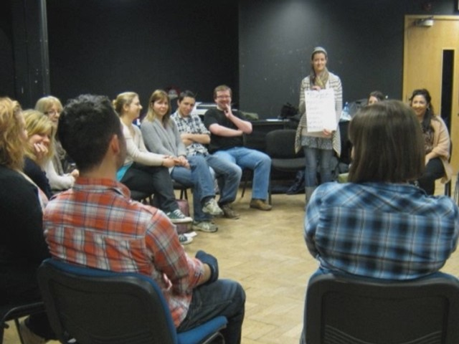
EXPECT TO ACHIEVE
Reciprocal peer teaching
Judith Kneen – Senior Lecturer Secondary English
Elaine Pattison – Senior Lecturer MFL

Slide 2
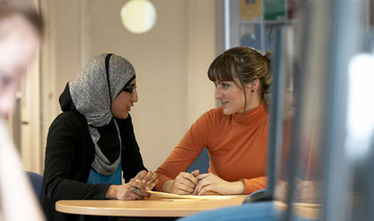
EXPECT TO ACHIEVE
Task
In pairs, label yourselves A and B.
A to teach knowledge/understanding/
skill to B (2 minutes)
B can seek clarification and ask questions.
B will teach new understanding/skill to group.
E.g.
using Twitter; rules of a game; applying make-up; a theory; words from a foreign language; the offside rule; global warming; interest rates; how to eat spaghetti...

Slide 3
EXPECT TO ACHIEVE
Qui docet discet
He who teaches, learns
Our rationale
Teaching supports learning; teaching the skill of teaching, supports students’ learning about teaching.
Trainee teachers within HEI institutions are a rich resource
Aims of today
To share our experience
To provide a possible framework for peer teaching

Slide 4
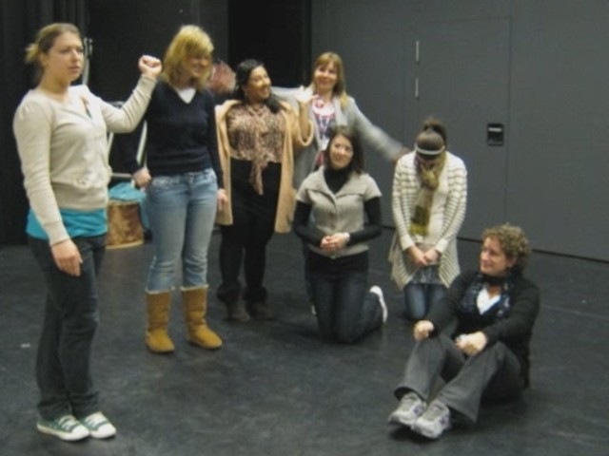
EXPECT TO ACHIEVE
Background
‘Buddies’
MFL – KS2/3 PGCE (10)
English – secondary PGCE (20)
Drama skills focus
Workshop approach
Developing process
Notes:
Background
Started through pre-Ofsted initiative – to buddy up subjects, in order to learn from each other
MFL group – numbers in both years,
English group – numbers – between 20 and 24
Drama skills – decided that this area was relevant to both (could have chosen other areas such as language). English has workshop already as part of course – being taught by tutor. This was additional for MFL. Aim to improve outcomes
Started in 2010 and developed this year

Slide 5
EXPECT TO ACHIEVE
The workshops
Tues
English trainees taught by tutor. They prepare w’shop for MFL.
Wed
English PGCEs deliver workshop for MFL students. They prepare w’shop for English, though focusing on MFL skills.
Fri
MFL trainees deliver w’shop. Evaluation.
Notes:
The workshops –points to bring out:
Short time scale
Effect of numbers
Role of tutors
Our Expectations of trainees

Slide 6
EXPECT TO ACHIEVE
Terminology
Peer learning
‘students learning from and with each other in both formal and informal ways’ (Boud et al 2001 p4)
Peer tutoring
co-operative learning – pairs of students ‘with an asymmetrical relation and a common known and shared objective’ (Duran and Monereo (2005 p181)
Peer teaching
‘peer teaching or peer tutoring is a far more instrumental strategy’ where students ‘take on a limited instructional role’ (Boud et al 2001 p4)
Reciprocal Peer Teaching
‘students alternate roles as teacher and students’(Krych et al 2005 noting term first used by Allan And Boraks)
Notes:
Terminology – peer learning, peer tutoring – all have different angles or nuances. We think reciprocal peer teaching describes our process – but there is clear blending and blurring between terms

Slide 7
EXPECT TO ACHIEVE
Theoretical advantages/disadvantages
Topping 1996
‘Supported exploration through social and cognitive interaction with a more experienced peer’ (social constructivist view)
Preparing to teach enhances cognitive process (Hartman 1990)
Annis study (1983) a) read b) read to teach c) read to teach and teach
Other advantages include: interactivity, participation, swift feedback, student ownership, etc.
Consumes organisational time
‘the requirements for training students in teaching and learning skills are greater’
Quality of tutoring may vary

Slide 8
EXPECT TO ACHIEVE
Considerations and questions
To what extent do student teachers regard RPT as beneficial to building classroom skills and confidence?
Widely used strategy
Requires careful organisation
What can ITE gain from it?
Notes:
Not a new idea – used already and widely in different disciplines (e.g. medicine)
Perhaps underused in ITE
As an approach it’s time intensive and requires careful planning on part of tutors, as well as extra time from the trainees.
WE as tutors saw benefits, but wanted to test whether trainees felt it was a worthwhile approach.
Hence research question and attempts to find out answer.

Slide 9
EXPECT TO ACHIEVE
Methodology
Drama techniques confidence scale questionnaire
Pre-workshops
Questionnaire about RPT
Post-workshops
Group discussion on RPT
Post -workshops
Post-workshops
Queries whilst on school experience
Notes:
9

Slide 10
EXPECT TO ACHIEVE
Findings
Confidence scales
Trainees had to use scales to indicate confidence in 15 areas, including:
Using particular techniques, such as mime, improvisation, props
Planning and managing active learning
Making drama techniques relevant to their teaching
1st survey just before initial session
2nd survey after they had taught other group
Notes:
10

Slide 11
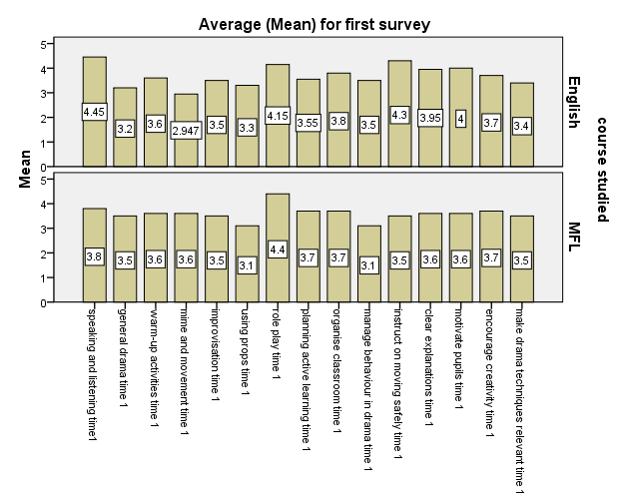
EXPECT TO ACHIEVE
Findings
Confidence scales – 1st survey
English highs: use of S&L (average 3.7)
MFL high: role play (average 3.6)
Biggest difference: Instructing on moving safely
Notes:
11

Slide 12
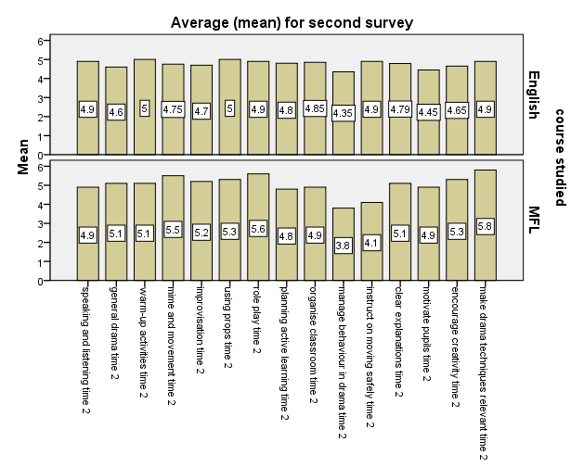
EXPECT TO ACHIEVE
Findings
Confidence scales – 2nd survey
English highs: warm ups and using props
(average 4.8)
MFL high: making drama relevant
(average 5)
Biggest difference: making drama relevant
Notes:
12

Slide 13
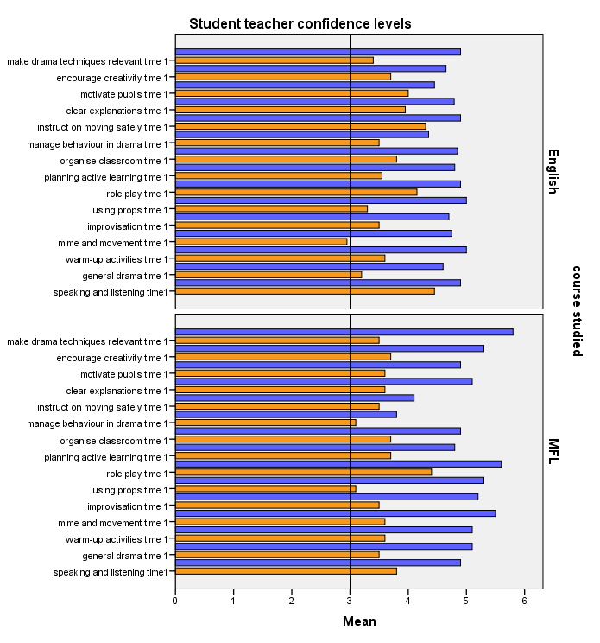
EXPECT TO ACHIEVE
Findings
Confidence scales
English average moved from 3.7 to 4.8
MFL average moved from 3.6 to 5
Greatest gains:
English – 1) mime & movement 2) props
MFL – 1) making drama relevant 2) props
Notes:
13
This table takes in all the changes.
Orange indicates 1st survey
Blue (above) indicates 2nd survey
Shows main points of movement – and non-movement (e.g. motivating pupils – in English 0.45; instructing on moving safely in MFL 0.6)

Slide 14
EXPECT TO ACHIEVE
Findings
RPT questionnaires
Questionnaire
Likert scale questions and open questions – targeted on peer teaching
Completed after all of the workshops
Returns – MFL = 10, English = 11

Slide 15
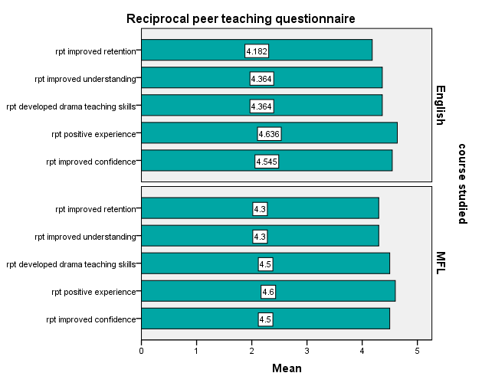
EXPECT TO ACHIEVE
Findings
RPT questionnaires – likert scale responses
Overall positive impact
Felt strongly
positive experience
improved confidence

Slide 16
EXPECT TO ACHIEVE
Collaboration
Adaptation
Emotional impact
positive and negative
Application
Findings
RPT questionnaires – open questions Identification of key themes
“bounced ideas”
“same problem, different solutions”
“shape techniques in own way”
“re-teaching gives time to reflect”
Notes:
collaboration- getting to know other cohorts, feeling less isolated, exchange of ideas
Learning process- adapting and applying- benefits of willing pupils, wider experience, practice in non-threatening environment
Emotions were key- overcoming embarrassment, stress, enjoyment(fun, creative)

Slide 17
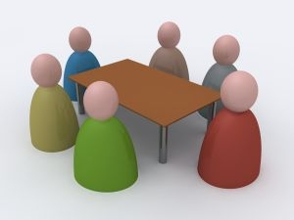
Group Interview- Findings
EXPECT TO ACHIEVE
Themes mirrored :
Unpicking the collaborative process
Acknowledging emotions
Recognising pedagogical applications
PLUS
Articulating the intellectual process

Slide 18
EXPECT TO ACHIEVE
Outcomes: impact on school practice
“I was pleasantly surprised with their performance and their behaviour throughout the lesson”. MFL
“It was fairly successful as it got all the kids involved”. E
“The children visibly enjoyed it and it was nice to see them working together out of their seats, creating something” MFL
“Their responses became more sophisticated and deep. They are a middle set class, who are quite shy and this really helped to bring them out of their shells”. E

Slide 19
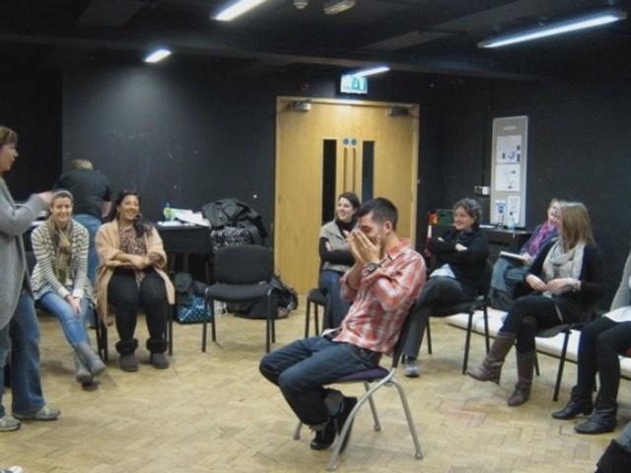
EXPECT TO ACHIEVE
Key Findings
Overall messages
Raised confidence levels
Emotionally engaged
Different perspectives
Social benefits
“Moving beyond independent learning to interdependent learning” Boud
Notes:
Raised confidence – it was challenging and demanding – it was ‘real’ - they had to think through the problems – all helped to raise confidnece
Emotional engagement – fear, tension, fun, inspiring, stimulating – this emotion provided strong learning experience – hopefully one that will stay with them
Different perspectives - benefits of working with other practitioners and providing for other practitioners enable multiple views and insights and angles - similarly with other subject area – thinking out of their ‘usual box’.
Social benefits – they appreciated collaborating and sharing– but the benefits went beyond the ‘classroom’ – and they recognised what a rich potential resource they were to each other

Slide 20
EXPECT TO ACHIEVE
References and further reading
Boud, Cohen and Sampson (2001), Peer Learning in Higher Education. London: Kogan Page.
Clift, R.T. and Wilson, S. (1984) 'Training Preservice Teachers to Use Dramatic Activities with Secondary School Students' Annual Meeting of the American Educational Research Association, New Orleans, LA, 23rd to 27th April.
Duran and Monereo (2005) 'Styles and sequences of cooperative interaction in fixed and reciprocal peer tutoring', Learning and Instruction 15:3 pp. 179-199.
Fantuzzo, J.W., Dimeff, L.A., Fox,S.L (1989) ‘Reciprocal Peer tutoring: A multimodal Assessment of Effectiveness with College Students’, Teaching of Psychology, 16(3),pp.133- 135
Harris, V. and Grenfell, M(2004) Language–learning strategies: A case for cross curricular collaboration. Language Awareness,13(2) pp.116-130
Krych, A.J., March, C.N., Bryan, R. E., Peake, B. J., Pawlina, W. and Carmichael, S.W. (2005) 'Reciprocal Peer Teaching: Students Teaching Students in the Gross Anatomy Laboratory', Clinical Anatomy 18 pp.296-301
Longaretti, L., Godinho, S., Parr, G. and Wilson, J. (2002) 'Rethinking Peer Teaching' Conference of the Australian Association for Research in Education Brisbane
Rittschof, K.A. and Griffin, B.W. (2001) ‘Reciprocal Peer tutoring; re-examining the value of a co-operative learning technique to college students and instructors’, Educational Psychology, 21(3) pp. 313-331
Topping, K.J. (1996) 'The effectiveness of peer tutoring in further and higher education: A typology and review of the literature', Higher Education 32:3 pp. 321-345.

