Slide 1
Masters: a route to teacher professionalism
Professor Ken Jones
Dean of Humanities
UWTSD: Swansea Metropolitan

Slide 2
Focus:
Approaches to Masters
‘Professional Development’ and ‘Professional
Learning’
How Masters work aligns with models of
professional development
Masters as an academic award as distinct from
professional learning at M level
The Welsh ‘Masters in Educational Practice’
Current tensions and issues

Slide 3
Approaches to Masters
‘traditional’ – philosophy, curriculum theory, transmission of higher level knowledge; assessed through examinations, coursework, dissertation); individual orientation; university located – no intended direct impact on practice; achievement of award
school- focused but university located. Emphasis on equipping participants to enquire into practice, reflect and change pedagogical or leadership practice as appropriate; assessed through coursework, portfolio, dissertation. Individual orientation.

Slide 4
Approaches to Masters
classroom focused – distance learning with nodal contact points; assessed through coursework, dissertation, portfolio. Individual orientation
classroom located - mentor supported; focus on pedagogy; individual orientation.
School(s) located –focus on institutional priorities (Swansea model school-based M); plc (team or group) orientation.

Slide 5
Focus
Location
Individual
HEI / distance learning
Collaborative group
Institution

Slide 6
Professional development
Encompasses some aspects of PL; career development; measurable outcomes; growth;
Professional learning
Active learning process; enquiry, analysis, reflection, evaluation, further action; continuing process; professionally critical; collaborative; lateral not linear.

Slide 7
Turner & Simon (2013) – In what ways does studying at M-level contribute to teachers’ professional learning? Professional Development in Education
quote from a teacher
‘sometimes at school you can get a bit ... blinkered and you don’t even use your higher brain ... ‘ p13
contribution of M-level studies to teacher development: “teacher learning is extended through engagement with new forms of knowledge .... And deepened through talk about teaching and learning ...” p18

Slide 8
Models of professional development (Kennedy, 2005)
Training model
Award bearing model
Deficit model
Cascade
Coaching/mentoring model
Community of practice model
Action research model
Transformative model

Slide 9
Professional development / professional learning
Kennedy’s models are useful here but M can encompass both PD and PL – the key difference between M and other forms of PD/PL is the academic level
(eg SM middle leadership programme. It is a PD programme in that it supports middle leaders in developing understanding of principles of leadership, enquiring into leadership in own and other schools, using range of literature to inform reflection on own practice, setting out strategies for change, implementing and evaluating these. L6 not M/L7. Key difference is expectation of depth of analysis, synthesis and rigour of enquiry.

Slide 10
Scotland – CLPL – Career-long Professional learning (Kennedy (2013) ipda Scotland symposium)
- Careers are not linear
– socio-economic context changes
– pedagogy and leadership skills must be adaptable
– lateral and divergent thinking needed from teachers and leaders
– critical approaches to government priorities needed rather than compliance models – eg PISA is driving priorities
PRD models in Wales and Scotland: ‘P’ is different

Slide 11
the political element (this is how you must do it)
the professional element (this is how you should do it)
the pragmatic alternative (this is how we will do it)
Jones (2010)

Slide 12
Welsh Government Education Funding is related to 3 priorities:
Improve literacy
Improve numeracy
Reduce the achievement gap linked to poverty

Slide 13
The new Masters in Educational Practice (MEP) in Wales
3 year programme
Consortium of Cardiff, Aberystwyth, Bangor, IoE London
Fully funded (induction and EPD budgets)
‘Given the unique nature of the programme we are unable to offer exemptions for prior Masters level credits’
Notes:
Task1 – who is responsible for CPD in your school (is there a staff development coordinator)?
What is their job title?
How is CPD funding allocated?
To what extent is CPD focused on pedagogy?
Are there any restrictions on CPD entitlement for teachers?
How effective is performance management in identifying and providing for your CPD needs?

Slide 14
The Masters in Educational Practice (MEP)
Programme Structure
8 x 15 credit modules (max 3,000 words or equiv.)
60 credit ‘Action Based Inquiry Project’ (15K words)
1. Intro to teachers’ professional enquiry | 5. Numeracy
2. Child & adolescent learning & development (0-19) | 6. Additional Learning Needs
3. Behaviour management | 7. Reducing the impact of poverty on attainment
4. Literacy | 8. Leadership
Notes:
Task1 – who is responsible for CPD in your school (is there a staff development coordinator)?
What is their job title?
How is CPD funding allocated?
To what extent is CPD focused on pedagogy?
Are there any restrictions on CPD entitlement for teachers?
How effective is performance management in identifying and providing for your CPD needs?

Slide 15
Wales: context
The programme has been designed by the Welsh Government to meet its objectives in terms of literacy, numeracy and reducing the impact of poverty on attainment, as well as three additional core areas that have been identified as priorities for newly qualified teachers (NQTs): additional learning needs, behaviour management and reflective practice.
Notes:
Task1 – who is responsible for CPD in your school (is there a staff development coordinator)?
What is their job title?
How is CPD funding allocated?
To what extent is CPD focused on pedagogy?
Are there any restrictions on CPD entitlement for teachers?
How effective is performance management in identifying and providing for your CPD needs?

Slide 16
The Welsh Government’s review of CPD in 2009/10 ‘may be construed as a lack of confidence in the ability of the teaching profession itself to generate consistent and coherent professional development that impacts on the leadership of schools and the learning of pupils in a cost effective way’
Jones (2011) p761
Notes:
Task1 – who is responsible for CPD in your school (is there a staff development coordinator)?
What is their job title?
How is CPD funding allocated?
To what extent is CPD focused on pedagogy?
Are there any restrictions on CPD entitlement for teachers?
How effective is performance management in identifying and providing for your CPD needs?

Slide 17
Potential implications (and current concerns) for the existence of non-WG funded Masters programmes in other universities in Wales

Slide 18
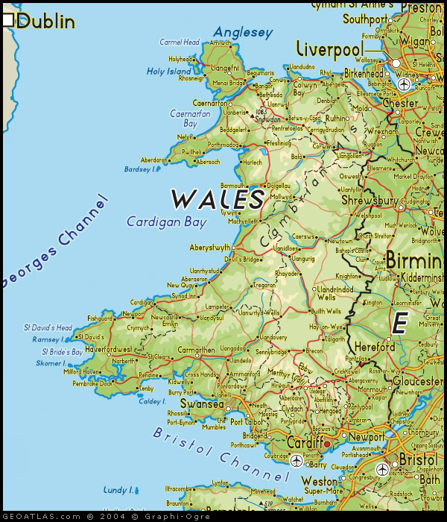
Wales: professional demographics
Teacher Age in Wales (GTCW March 2012):
M
F
Notes:
Task1 – who is responsible for CPD in your school (is there a staff development coordinator)?
What is their job title?
How is CPD funding allocated?
To what extent is CPD focused on pedagogy?
Are there any restrictions on CPD entitlement for teachers?
How effective is performance management in identifying and providing for your CPD needs?

Slide 19
Evaluation of Impact

Slide 20
Tensions:
Funding (who pays?) (secondment; institutional; individual)
‘Real costing’ (part-time credits cf full time credits @£9,000 pa)
Individual or institutional return on investment (impact)
Sustainable return (one-off award or embedding of knowledge / skills/ attitude to professional learning)
University led: HE/practitioner ‘fault lines’ (Jones 2011) – linguistic, rigour, research-informed, university ‘guardians of standards’ through traditional approaches to QA (validation, academic learning outcomes, external examiner verification)
Optional or contractual requirement; salary / budget implications (USA states; Scottish Charter Teacher; MTL)

Slide 21
We shouldn’t just be asking whether teachers should have a Masters degree – but what difference this will make to teaching & learning – (and for teacher learning & pupil learning) and school leadership.
Is there a shift in values and practice as a result of engagement with M level learning opportunities? (evidence of impact – issue then is how impact is ‘measured’ – if PL rather than PD we need different tools and criteria)
M level learning is different to an M level profession

Slide 22
References
Jones, K. (2011) Central, local and individual continuing professional development (CPD) priorities: changing policies of CPD in Wales Professional Development in Education Vol 37 No 5 November 2011 759-776
Kennedy, A. (2005) Models of Continuing Professional Development: a framework for analysis Journal of In-service Education 31 (2) 235-250
Turner, K. And Simon, S. (2013) In what ways does studying at M-level contribute to teachers’ professional learning? Research set in an English University. Professional Development in Education Vol.39, No 1, 6-22.
Welsh Government (2013) Masters in Educational Practice Programme Handbook Cohort One Cardiff: Welsh Government

Slide 23
Website:
tandf.co.uk
Notes:
Task1 – who is responsible for CPD in your school (is there a staff development coordinator)?
What is their job title?
How is CPD funding allocated?
To what extent is CPD focused on pedagogy?
Are there any restrictions on CPD entitlement for teachers?
How effective is performance management in identifying and providing for your CPD needs?

