Slide 1

The use of eportfolios for subject knowledge development
Mike Martin
LJMU
m.c.martin@ljmu.ac.uk

Slide 2
Outline
Eportfolios – a useful tool
Examples of eportfolios for assessment
Subject knowledge – complex
Incompetent competences
SKE eportfolio v1 – open
Knowledge areas – subdomains
Importance of reflection
Issues – ownership...
Next steps?

Slide 3

Background
Uncomfortable with subject knowledge competencies – what students can’t do
Critique of competence model (Martin 2008)
Exploration of eportfolios for previous 5 years
Presentations at subject conferences
Now focus of doctoral work

Slide 4
Eportfolios – a useful tool?
Compact, paper-free and editable
Potential for multimedia content to capture procedural knowledge
Opportunity for collaboration
Personalised in a way that traditional audit documents cannot be
Non-linear and easily searchable

Slide 5
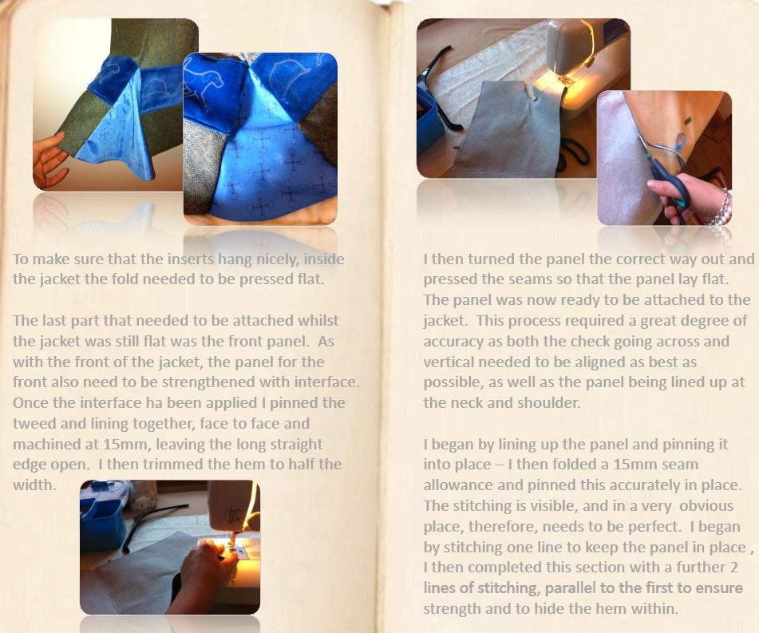

Slide 6
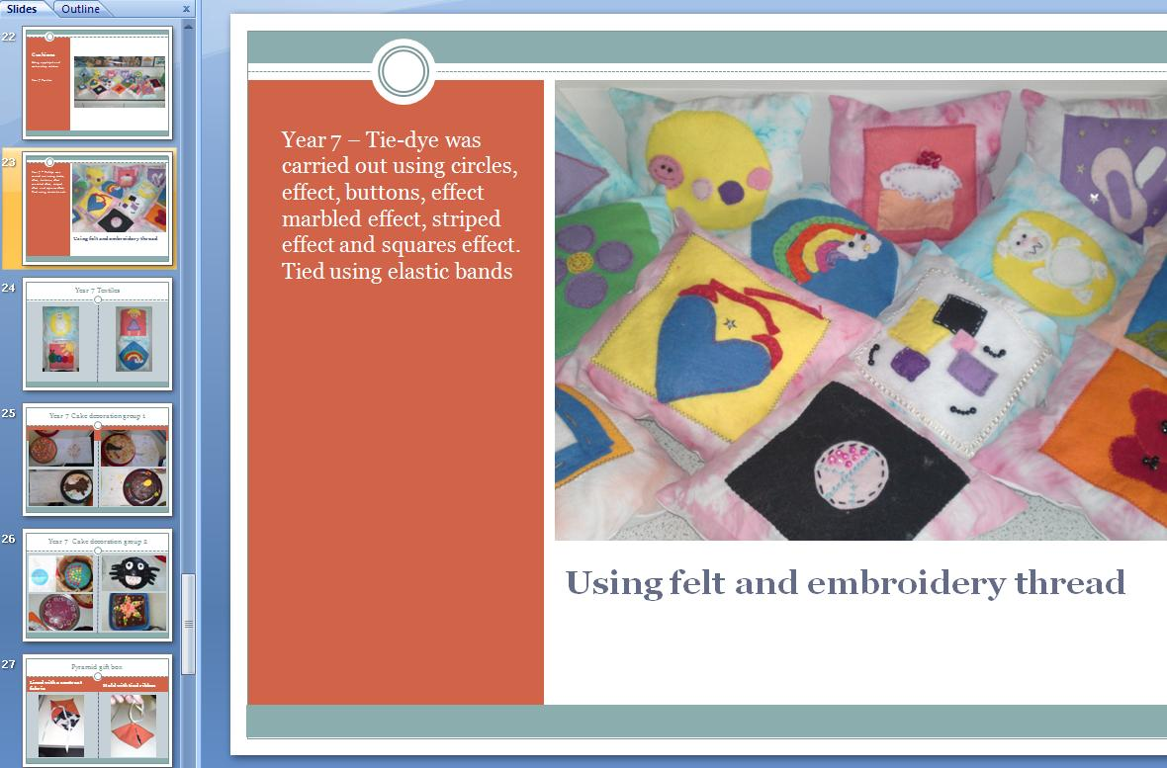
Examples

Slide 7
(Subject) knowledge
Forms of knowledge - Hirst (1974)
Content knowledge - Shulman (1986)
Tacit knowledge - Polanyi (1967)
Situated and social - Putnam & Borko (2000)
Knowing that & knowing how - Ryle (1949)
Strategic knowledge - McCormick (2007)
Personal knowledge – Eraut (2007)
Individual knowing, collective knowledge and cultural identity - Davis and Sumara (2000)

Slide 8
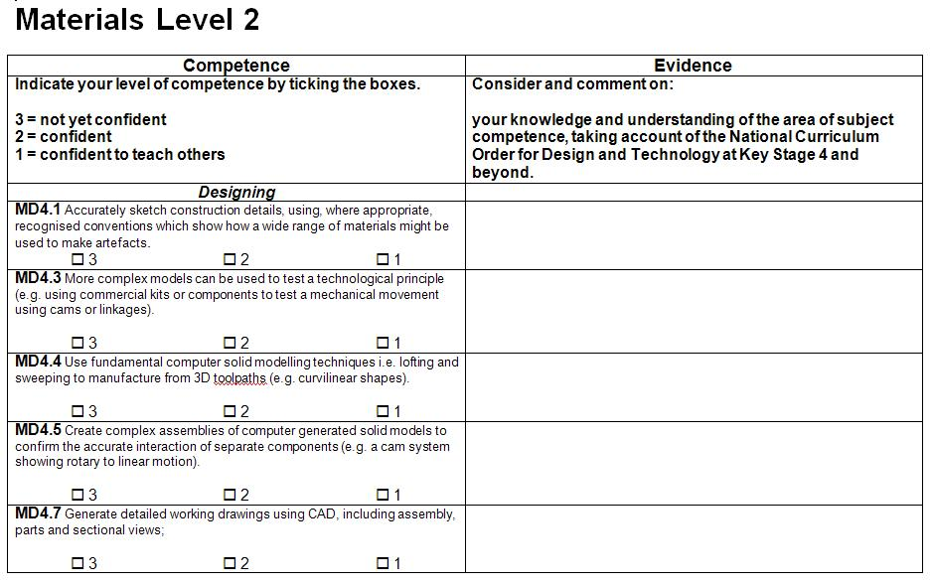
Competences
Self assessed
Written statement

Slide 9
Incompetent competences
Eraut (ref to his work of 1996 and 2001) highlights difficulties in articulating and representing the nature of competence including:
Level of detail
Developing a consensus
Capturing the essence
Part-whole problem
Difficulty in covering all aspects
Chnaging nature of what counts as competence

Slide 10
Version 1
Starting from what students know
Portfolio of what they can do and can teach
Structure-less, electronic and software independent
Feedback from students – need structure

Slide 11
Knowledge areas - subdomains
Design
making
Research
Ideas
Modelling
Evaluation
Use of ICT
Material preparation
Measuring
Cutting
Shaping
Forming
Joining / combining
Handtools / equipment
Machine tools /equipment
Components
Finishing
Evaluation

Slide 12
Importance of reflection
Annotation of visual examples of subject knowledge work is important
Reflective commentary ensures authenticity

Slide 13
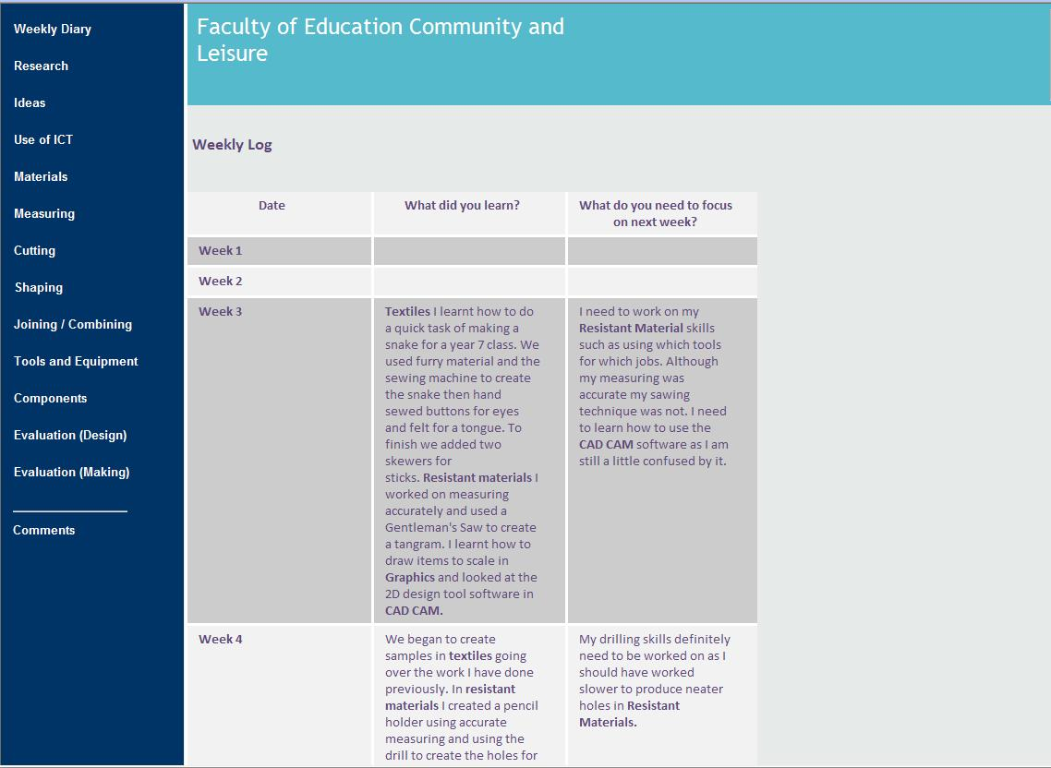

Slide 14
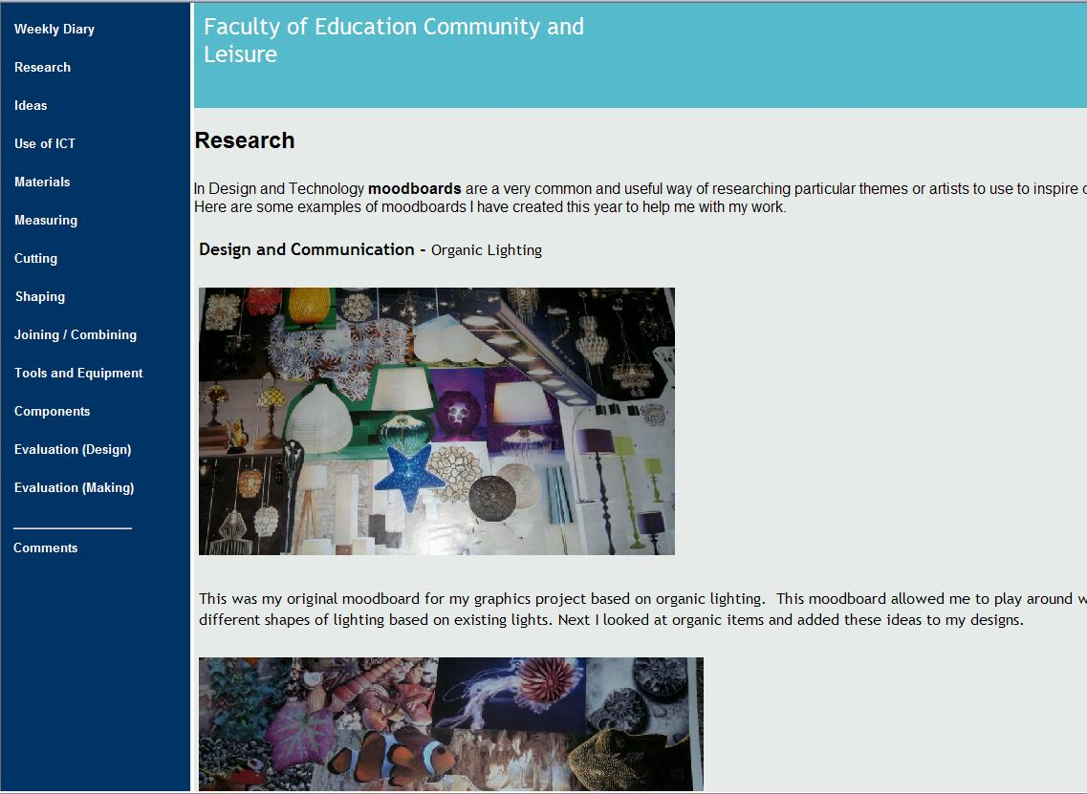

Slide 15
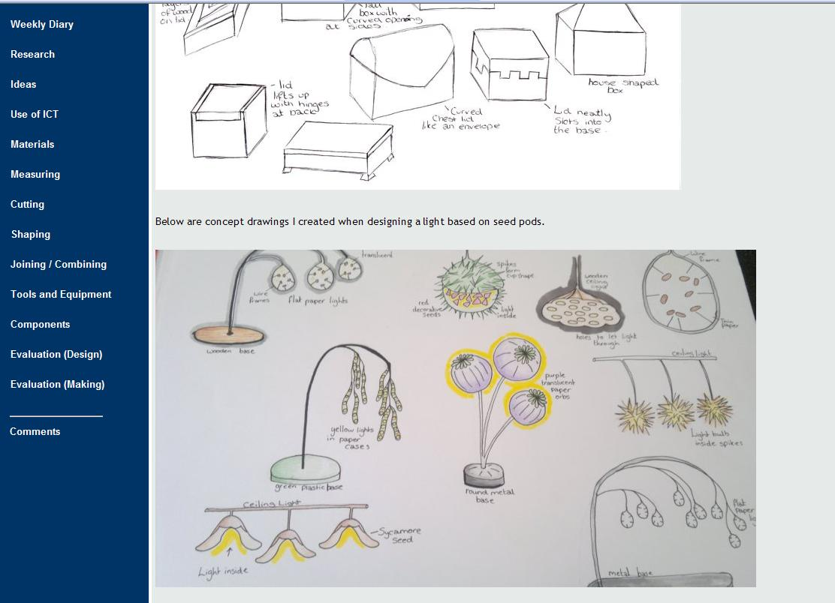

Slide 16
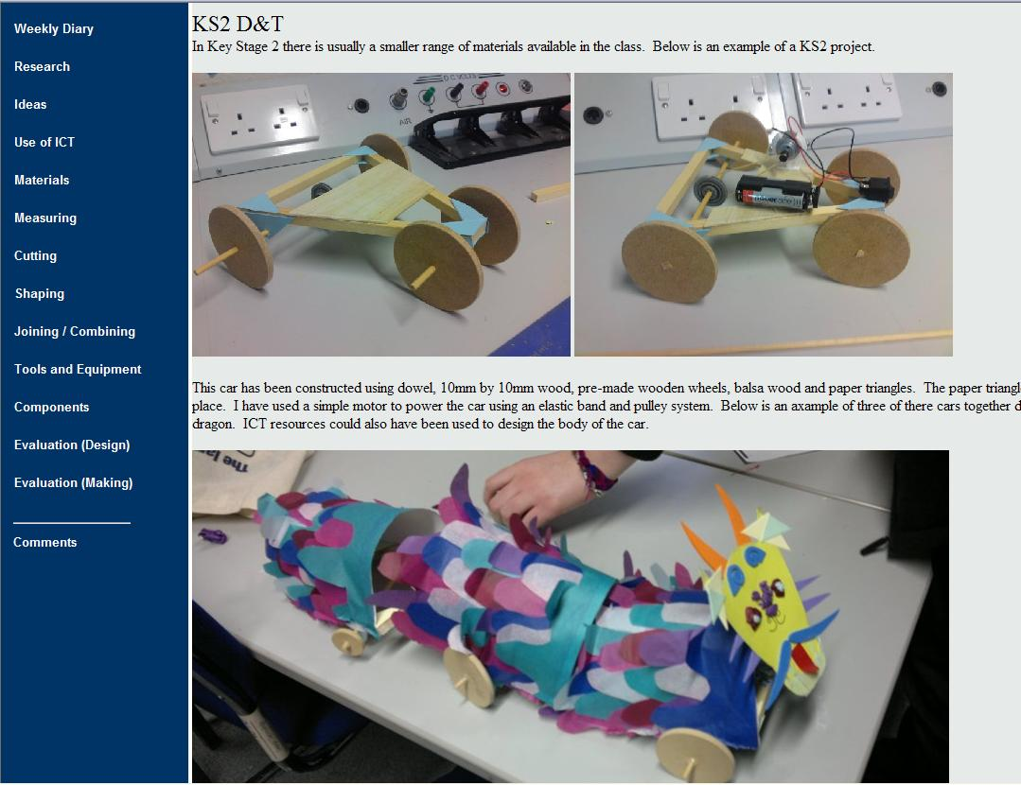

Slide 17
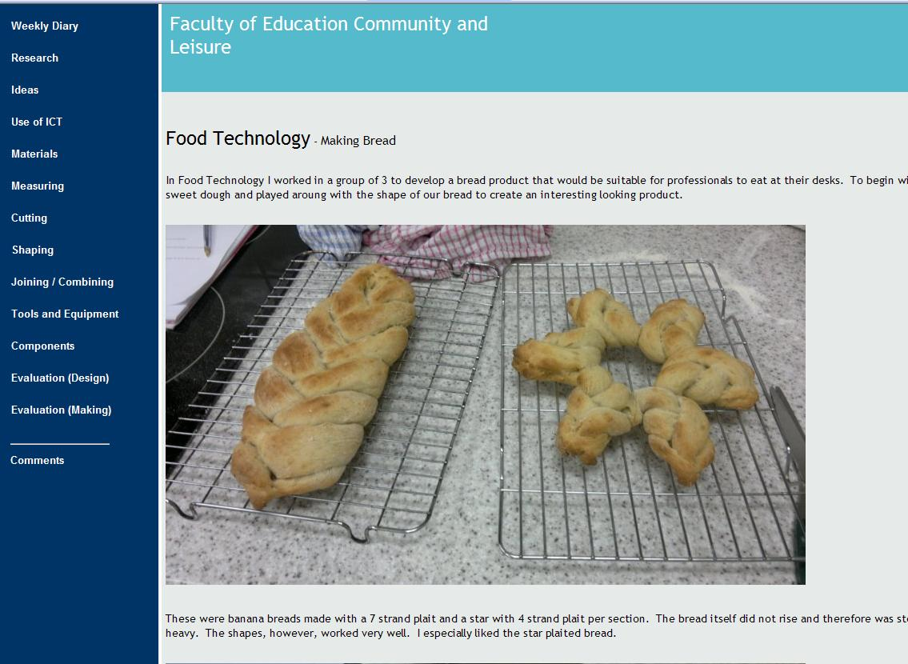

Slide 18
Emerging issues
Skills required
Content vs application
Monitoring / target setting
Involvement of subject mentors
Assessment – criteria grid rather than competence threshold
Progression from ‘novice’ to ‘master’

Slide 19
Ownership
Owned by institutions – knowledge static, content focused and uniform
Owned by professionals – curriculum driven, delivery focused and diverse
Owned by the individual – personalised, unique and diverse, non-uniform
Storytelling – Helen Barrett
www. electronicportfolios.org

Slide 20
Next steps…
Provide a part-populated SKP
Work on annotation of images
Other ideas?
Contact me for more detailed information at m.c.martin@ljmu.ac.uk
www.staff.ljmu.ac.uk/edcmmart

