Slide 1
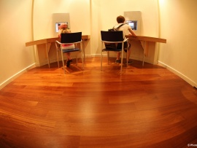
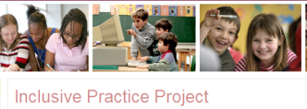

E-pedagogies for Inclusion
Nigel Beacham
N.Beacham@abdn.ac.uk
2nd TEAN Conference
Friday 20th May 2011
Manchester Conference Centre

Slide 2
Content
Introduction
Background
Theoretical framework
The e-pedagogies for inclusion project
Key findings
Implications for inclusion and ITE
Conclusions

Slide 3
Introduction
Originates from the need to study E-pedagogies for inclusion
  Concerns about student teachers’ preparedness for inclusion
  Concerns about waves of new technology for learning
  Concerns about the digital divide in affluent countries

Slide 4
Background
E-learning and accessibility
Inclusive education
Digital inclusion and exclusion
The Inclusive Practice Project
Notes:
Findings in terms of learning attainment tended to be mixed
Findings tended to focus on knowledge, behaviours, and beliefs and attitudes
Centred on the need to dispel teachers views towards inclusive practices
Findings tended to lack inclusive pedagogical aspect
Learning without limits

Slide 5
Internet use and home access
Penetration rates differ greatly by region: digital spectrum
  Home access (2009, 2010)
    74% US
    70% UK
    65% EU
Some of the less connected regions represent very large populations
  Internet use (2010)
    53% Europe
    8% Africa
    20.1% Asia
    28.8% Middle East
    31.9% Latin America/Caribbean
    76.2% North America
    60.8% Oceania/Australia
    26.6% World
Statistics on percentage of use may give a false idea of the quantity of learners engaged or potentially engaged online – digital spectrum

Slide 6
Home and school access
Access from home can be particularly important for learning
Access at home follows socio-economic lines
  Factors: race, income, education, disability, gender, age, community type
    88% of children from middle-class
    66% of children from working-class
    22-26% of adults are non-users (part of landscape)
Access at school ???? (Livingstone & Bober, 2005)
  3:1 pupil-computer ratio
  3% of children make no use of the Internet
  22% of parents make no use of the Internet
  13% of children considered low users
Differences between regions, communities and schools
  Gap between groups had increased (Dutton, Helsper & Gerber, 2009)

Slide 7
Delayed use and exclusion
Digital divide as a spectrum
Can be a significant source of social inequality and unequal participation
  Continuous adoption
  Continuous discontinuance
Important to maintain awareness of the implications of who can participate, and balance this with choices and support
  Even more important with web 2.0

Slide 8
Theoretical framework
Transformability (Hart, 2004)
Framework for participation (Black-hawkins et al, 2007)
The 5Cs of digital exclusion (Bradbrook & Fisher, 2004)

Slide 9
Transformability: the forces constituting learning capacity
EXTERNAL FORCES
INTERNAL FORCES
opportunities and limits (arising from tasks, activities, language, interactions, relationships)
states of mind (cognitive, social, emotional)
resources (prior knowledge, skills, understanding)
affects
Expand or constrain
Expand or constrain
Learning capacity

Slide 10
Transformability: transforming learning capacity: the teacher’s part of the task
The teacher’s choices and actions – made to bring about
expanded learning opportunities
limits lifted
conditions enhanced
EXTERNAL FORCES
Enhanced states of mind
Limits lifted
Increasing resources (knowledge, skills and understanding)
INTERNAL FORCES
affects
Increasing learning capacity

Slide 11
The core idea of transformability
The core idea
TRANSFORMABILITY
The potential for transforming learning capacity
But how to do it?
Through practices with specific purposes...
Affective purposes
Social purposes
Intellectual purposes
And how are these purposes to be achieved?
Through key pedagogical principles
Strengthen confidence, security, competence, control
Increase acceptance, belonging community
Ensure access, enhance relevance, meaning, reasoning
THE KEY PEDAGOGICAL PRINCIPLES
Co-agency
Everybody
Trust
These principles work together to guide decision-making about what to do and what not to do.
ENHANCED CAPCITY TO LEARN

Slide 12
Framework for participation
PARTICIPATION and ACCESS
PARTICIPATION and COLLABORATION
PARTICIPATION and ACHIEVEMENT
PARTCICPATION and DIVERSITY

Slide 13
The 5Cs of Digital Inclusion
Connectivity
Capacity
Content
Confidence
Continuity

Slide 14
The e-pedagogies for inclusion project
Pilot study
12 month project
Funded by HEA: ESCalate
Newly Qualified Teachers

Slide 15
Project aims
To raise NQTs’ awareness and understanding of e-pedagogies for inclusion.
To develop NQTs’ use of e-pedagogies for inclusion.
To explore the impact of using e-pedagogies has on NQTs’ inclusive practice.

Slide 16
Research questions
Are NQTs aware of the impact ICT can have on inclusive practices?
How is ICT viewed and used in inclusive pedagogies by NQTs?
Is inclusion improved when NQTs consider and use e-pedagogies for inclusion?

Slide 17
Methodology
Sample consisted of NQTs from the University of Aberdeen who had completed the PGDE
  Scoping survey of NQTs who were undertaking their one-year placement to be NQTs
Follow up observations of four NQTs

Slide 18
Scoping results
24 NQTs participated
All used ICT within inclusive practices
  Used for learning by all
  Used for accessibility by pupils with SENs
Targeted specific ICT for pupils with SENs
Reported that ICT created barriers to learning

Slide 19
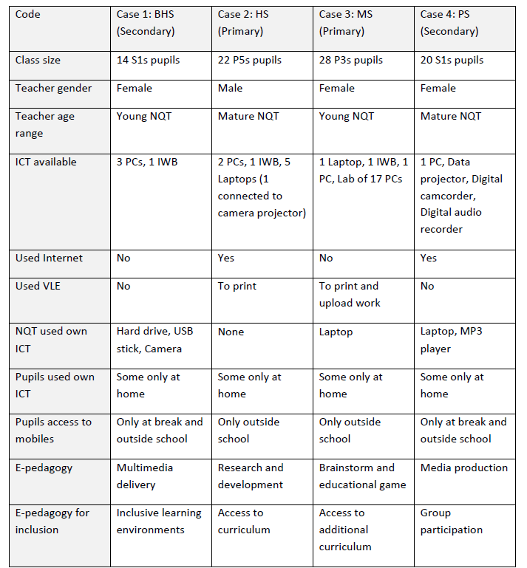
Follow up study
Notes:
Case 2 – most dynamic
Case 3 – pcs used to allow space in curriculum to remove pupils from class to receive additional support
Case 4 – most used digital technologies to show case inventions
Case 1 – least used technology

Slide 20
Analysis
Pedagogical aspects
Technological aspects
Transformability principles
  Co-agency
  Everybody
  Trust
Framework for participation
  Access
  Collaboration
  Achievement
  Diversity
5Cs of digital exclusion
  Connectivity
  Capacity
  Confidence
  Content
  Continuity

Slide 21
Follow up results: NQTs’ Awareness
Aware of inclusive practices and that ICT had a role to play in school
  Aware of accessibility of learning content in the classroom
Not aware of co-agency and trust involved using ICT
  Not aware that e-pedagogies for inclusion also involves working with and through others
Unaware of pupils being included in classroom and excluded by ICT
  Unaware that ICT excludes pupils

Slide 22
Follow up results: NQTs’ use and view of ICT
ICT used for accessibility of learning content
  Not used to improve inclusion of pupils
ICT viewed as a tool
  ICT not used as a media for inclusion
Viewed e-pedagogies for inclusion as inclusive pedagogies
  Believed they were already using e-pedagogies for inclusion
ICT used by NQTs to support some or most pupils
  ICT not used to support everybody

Slide 23
Key findings
Illustrated the complexity of inclusive practice
Enhanced the study of inclusion
Improved NQT’s awareness of ICT use in inclusive practices
Improved NQT’s ability to reflect and discuss e-inclusive practices

Slide 24
On-going issues
The replication of exclusive barriers from traditional learning environments to virtual learning environments
The decision by NQTs to use ICT for all as opposed to most or some

Slide 25
Conclusions and implications for inclusion and ITE
The digital divide between teachers and pupils
The digital divide between schools and homes
Addressing e-safety issues
The role of HEIs in ITE

Slide 26
References
Beacham & Rouse (in press)
Black-Hawkins et al (2007)
Bradbrook & Fisher (2004)
Florian & Rouse (2009)
Hart et al (2004)
Loveless & Ellis (2001)
URLs
  IPP, http://www.abdn.ac.uk/education/ipp/

