Slide 1

Learners First School Direct – About Us
Approximately 130 schools in and around Rotherham
Collective approach to improving standards across the board
Learners First Schools Partnership existed prior to School Direct starting
Structures for high quality training in place ready to be developed further for S.D.
‘Mission’

Slide 2
Mission
• all students making at least good progress
• no underperforming cohorts
• all teachers delivering at least good learning and
• all schools moving to at least the next level of successful performance

Slide 3
Learners First School Direct – Our Model
Creation of a central ‘pool’ of trainees
Interviewed by Heads / SLT members from various schools
Looking to create a collective identity through planners, induction, twilight, experiences
Training Plan – weekly twilights to ensure we know what trainees are doing
Centralised recruitment and allocation
Centralised Training Plan
Bespoke mini-training experiences across partnership
Expectation to employ – large number of schools to fulfil where possible

Slide 4
Learners First School Direct
The Training Plan
Designed and led by group of strategic partners, including 7 or 8 schools
Almost weekly to Easter, with impact evaluation activities designed to enhance professional files & raise standards for host school staff in terms of mini-presentations to departments
Non-negotiable and fully compulsory part of training year – QA procedures built in
Innovative – SEND element built into primary plan and to be put into secondary where possible

Slide 5
S.D. rushed into by TA
Application process chaotic for first few months
Misinformation – many potential candidates have struggled to find the correct information
Drop outs (more to come in September?)
Role negotiation with university – tough at times, but we all want the same outcomes
Recruitment to maths and science
Learners First School Direct – Hurdles

Slide 6
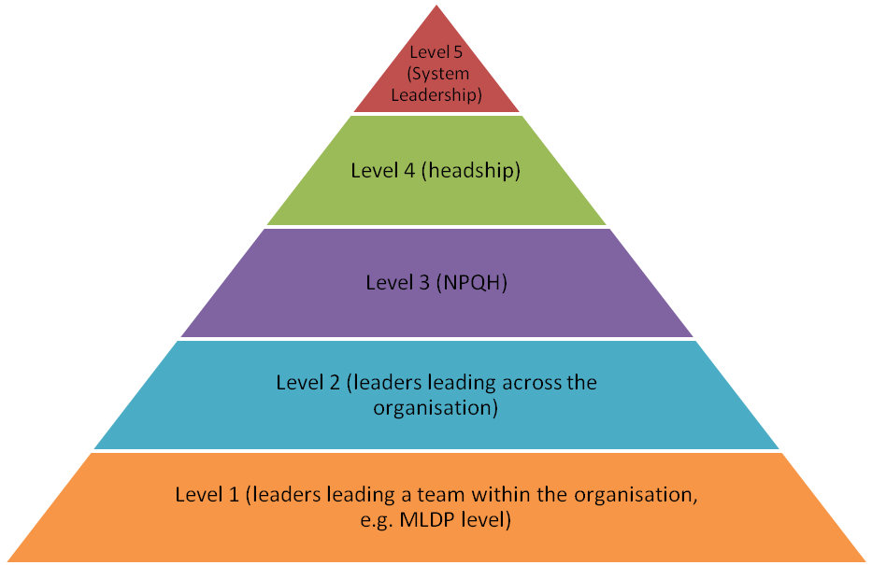
Recently Qualified Teachers (RQTs)
Newly Qualified Teachers (NQTs)
PRE-ENTRY TO THE PROFESSION
Initial Teacher Training (PGCE, School Direct)
Continue to raise standards
Developing career progression already in place – S.D. underpins what already existed
Expand S.D. provision – but only where expectation to employ isn’t concrete
Introductions between schools and trainees looking for jobs
Possible creation of a ‘pool ‘ of teachers once qualified in order to retain for Rotherham
Learners First School Direct – The Future

