Slide 1

Subject Knowledge;
Assessing the Ability of Effective Delivery
The Nature and Purpose of
Subject Knowledge in Initial Teacher Education
A Teacher Education Advancement Network Seminar
Friday, January 14th 2011
University of Cumbria, Lancaster Campus

Slide 2
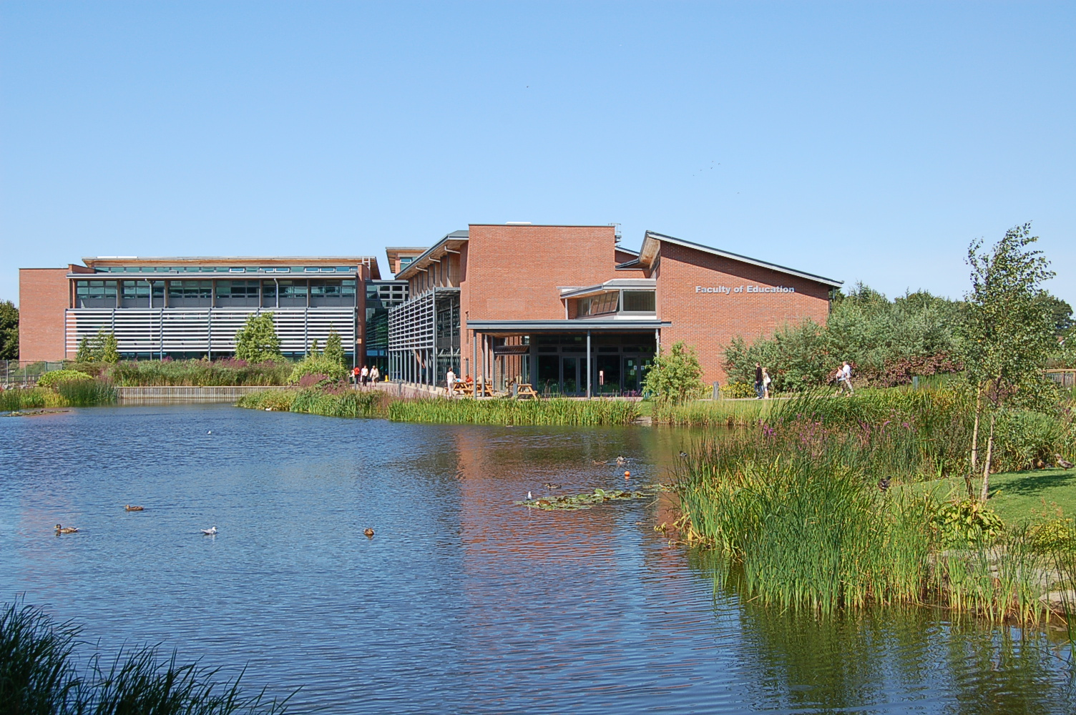
About the workshop
The workshop will be 60 minutes in duration. The session will be broken
down into four parts:
Session One: Introduction
Session Two: Delegate workshop
Session Three: Delegate workshop
Session Four: What next? Discussion and evaluation

Slide 3
Session One
Introduction:
My role is to steer the discussion to help ensure everyone has
the opportunity to contribute and take something away with
them.
Higher Education Institutions (HEI’s) have a vital role to play in
assessing trainee teachers’ subject knowledge and their ability to
deliver this to learners. It is hoped that you will be able to gain a
deeper insight into your own thoughts on what you determine to
be ‘appropriate subject knowledge’ in the context of Initial
Teacher Education (ITE).
Notes:
I wish I could attend the presentation by Hugh and Helen next door – who from their abstract appear to be presenting the notion that in depth subject knowledge should be a pre-requiste for teaching.
Note my perspective... Non subject related degree – what is a subject related degree?

Slide 4
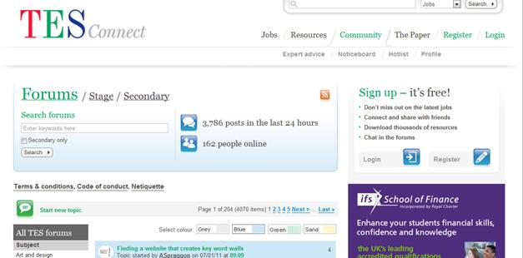
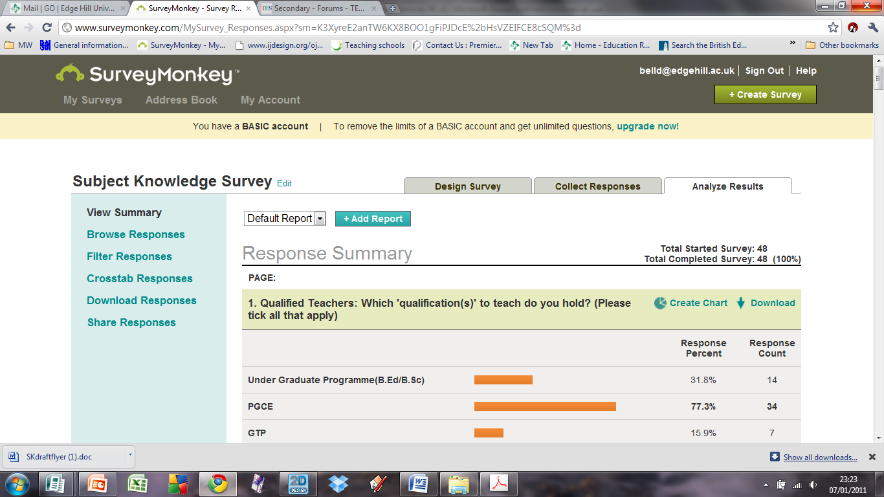

Slide 5
Session Two
Delegate workshop:
What constitutes an appropriate (subject related) degree?
How does this subject knowledge relate to the subject, as defined by the National Curriculum (NC)?

Slide 6


Slide 7
Mechanical Engineering
Mathematics

Slide 8
Ancient
History
English

Slide 9
Sports
Science
Biology

Slide 10
Computer
Science
ICT

Slide 11
Physics and
Astronomy
Mathematics

Slide 12
B.Ed. (Primary)
Business
Education

Slide 13
Politics and Sociology
Food Technology

Slide 14
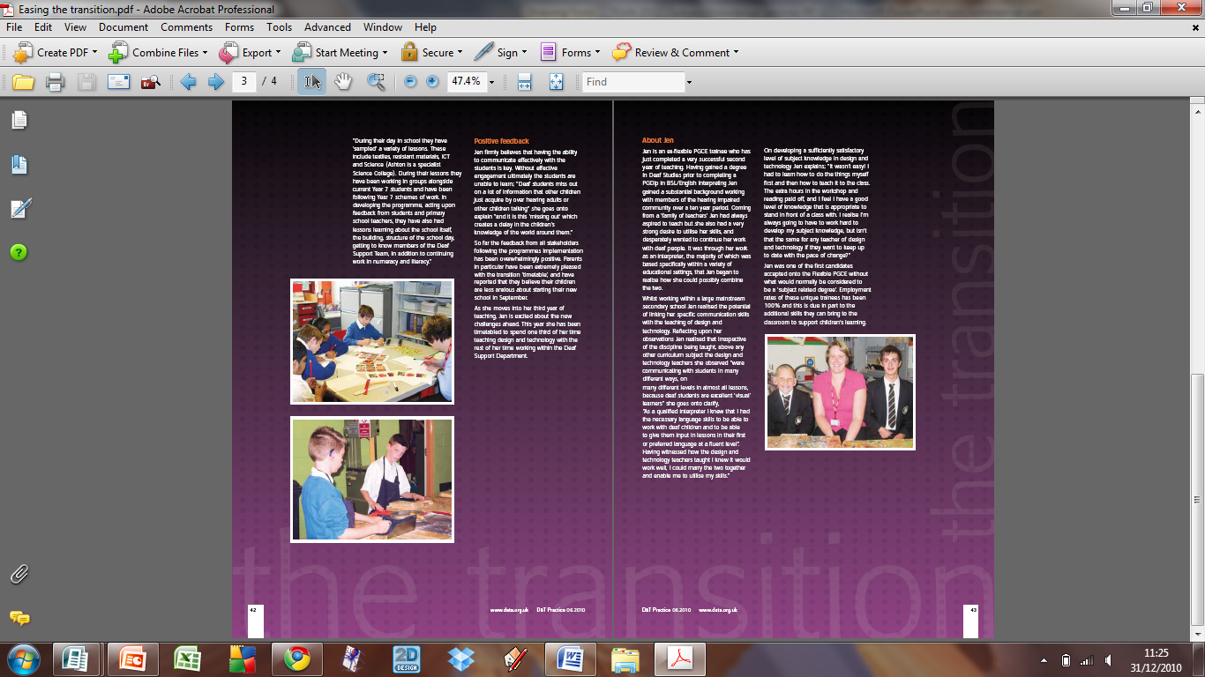
Qualified Teacher
British Sign Language
Design and Technology

Slide 15
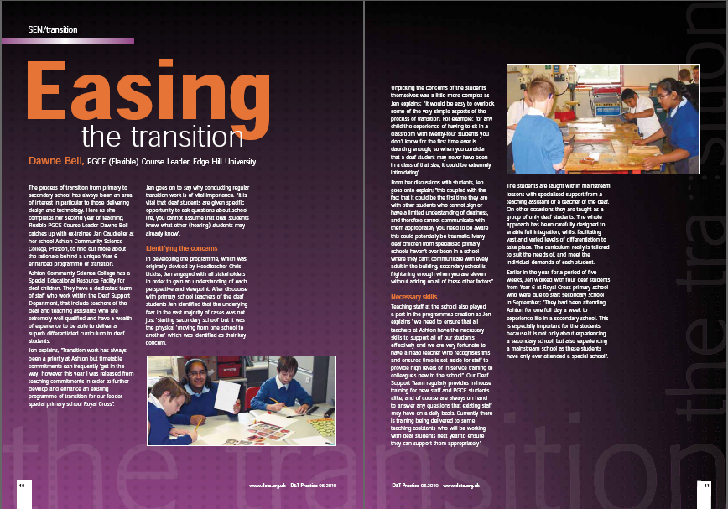

Slide 16
Session Three
Given that a trainee teacher can, by one means or another, develop sound subject knowledge, the emergent question is...
How can one distinguish the ability of an individual to learn ‘subject knowledge’ compared to ones’ aptitude to deliver it? (In such a way that leads others to be able to assimilate and apply it to a given application).

Slide 17
Session Three
Workshop and discussion:
Working in pairs discuss the implications and potential
difficulties of assessing the subject knowledge of the
trainees outlined in the case studies.
Alternatively discuss an experience of your own that you
are happy to share.

Slide 18
Session Four
What next?
Share findings, thoughts and views from this session
on the TEAN website.
Review of classroom practitioners thoughts on how to
develop subject knowledge.
Consideration of the impact of the current review on
QTS standards (when it is published).

Slide 19
Thank you
Dawne Bell
Senior Lecturer
Flexible PGCE Design and Technology Course Leader
belld@edgehill.ac.uk

