Slide 1
Location of subject knowledge development: institutional, professional or personal
Mike Martin
Liverpool John Moores University
m.c.martin@ljmu.ac.uk

Slide 2
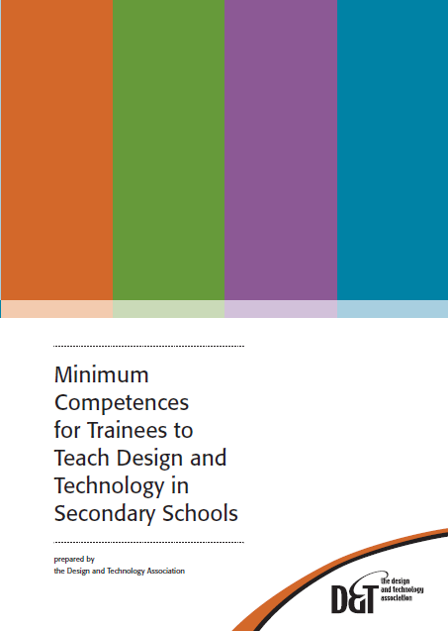
Background
Uncomfortable with subject knowledge competencies – what students can’t do
Critique of competence model (Martin 2008)
Exploration of eportfolios for previous 5 years
Presentations at subject conferences
Now focus of doctoral work

Slide 3
Nature of subject knowledge
Knowing in action –Schön (1983)
Pedagogical content knowledge and pedagogical reasoning – Shulman (1986)
Construction of knowledge through practical activities – Greeno et al (1996)
Situated and social – Putnam & Borko (2000)
Knowledge in practice - Ellis (2007)

Slide 4
Questioning subject knowledge
A fixed body of knowledge?
Knowledge developed as and when necessary so why audit and check?
Personal ‘body of knowledge’ – one size fits all does not work…

Slide 5
Perspectives
Looking at three perspectives
Institutional – ITE providers, TDA
Professional – schools, subject mentors
Personal – student / NQT / beginning teacher

Slide 6
Institutional
Acceptance of a place on the course subject to a particular level of subject knowledge
Auditing, target setting, tracking all managed by the ‘provider’
Lists of competences generated – often subject knowledge per-se, not application
Internal and external monitoring

Slide 7
Professional
Students come to the professional context already with subject knowledge
Focus on helping to teach what is already offered to pupils
What happens in the classroom is the focus
Knowledge required is driven by curriculum of the moment

Slide 8
Personal
Development of subject knowledge in the individual student / NQT / beginning teacher
Knowledge acquired by an individual according to their needs

Slide 9
Students perspective
Decided to canvas opinion
Questionnaire developed to get a snapshot of students’ opinions

Slide 10
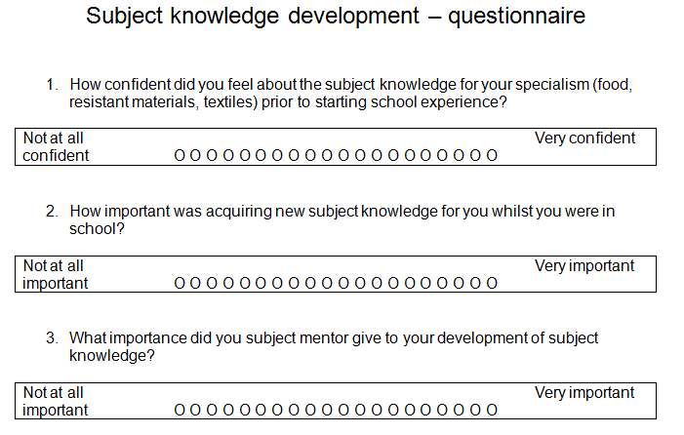
Questionnaire

Slide 11
Confidence
Not at all confident
Very confident

Slide 12
Importance of subject knowledge
Not at all important
Very important

Slide 13
Mentors
Not at all important
Very important

Slide 14
Relationships
Individual
Institution
Professional context

Slide 15
Ownership
Owned by institutions – knowledge static, content focused and uniform
Owned by professionals – curriculum driven, delivery focused and diverse
Owned by the individual – personalised, unique and diverse, non-uniform

Slide 16
Methods of learning
In institutions – learning with peers
In schools – learning with mentors, technicians
Self-taught – OK for knowledge acquisition

Slide 17
Assessment
A question of competence
What can be assessed?
Students work – annotated
Pupils work - annotated

Slide 18
Eportfolios
Used to capture a variety of media
Usually personal and ‘owned’ by the student
Storytelling – Helen Barrett
www. electronicportfolios.org
Annotation

Slide 19
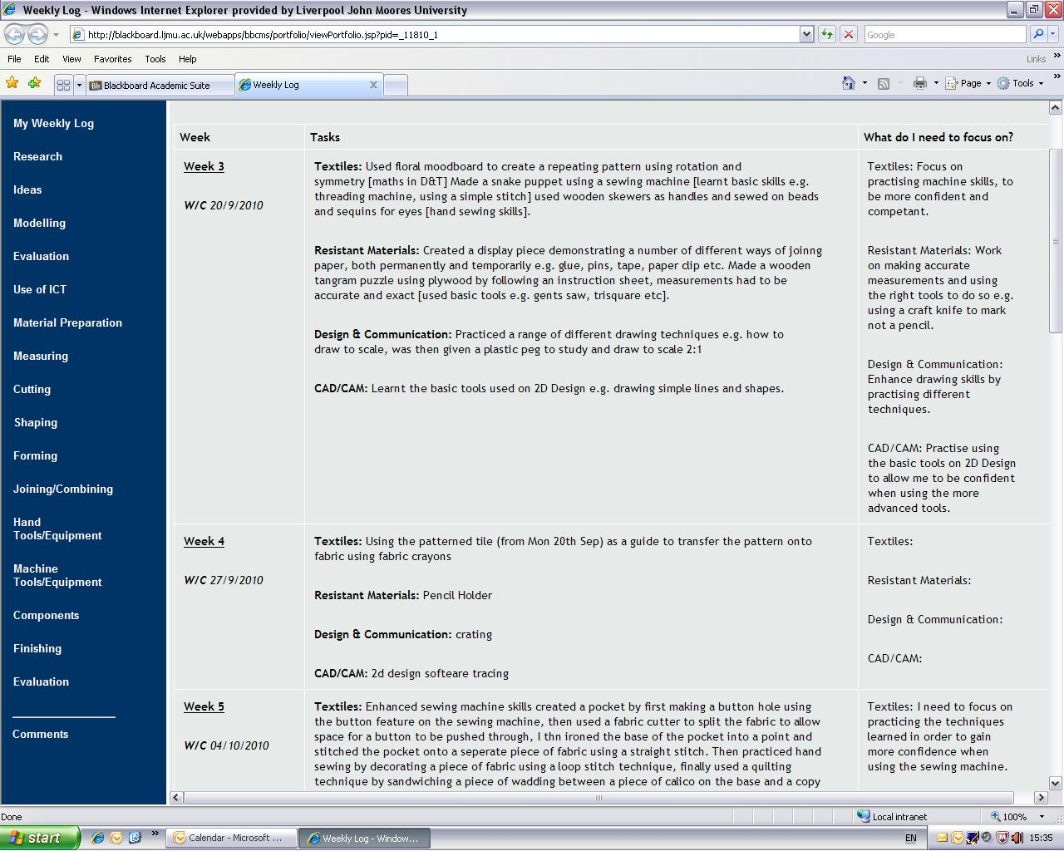
Eportfolios for subject knowledge

Slide 20
Eportfolios for subject knowledge

Slide 21
Question time…
Who should drive subject knowledge development in ITE?
How can differences between institutional and professional expectations be resolved?
What interventions / actions could improve subject knowledge development in schools?
What balance should there be between generic / transferable skills and single subject knowledge per se?
How much knowledge is needed to teach your specialist subject?

Slide 22
Keep in touch…
Mike Martin
Liverpool John Moores University
m.c.martin@ljmu.ac.uk
www.staff.ljmu.ac.uk/edcmmart

