Slide 1
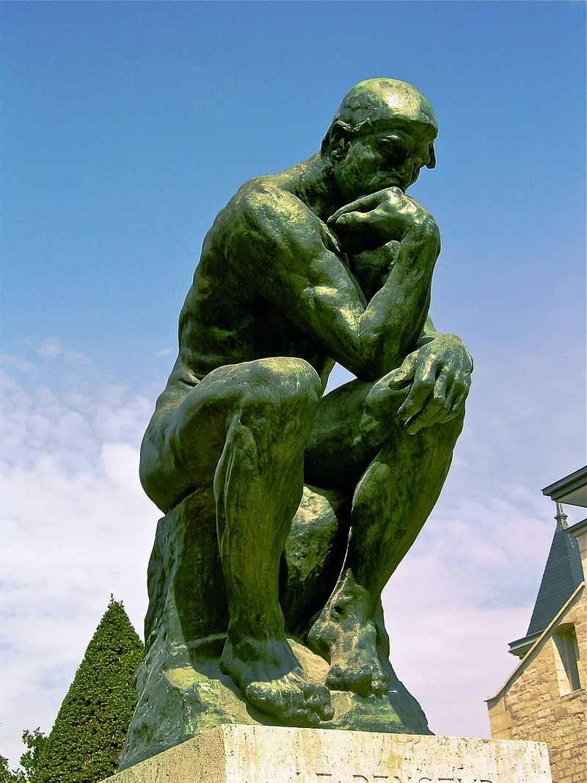
Deep thinking: pie in the sky?
Dr Katharine Burn

Slide 2
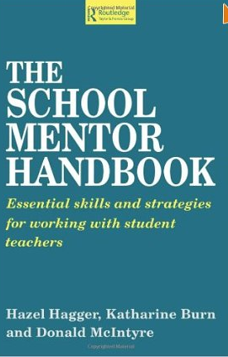
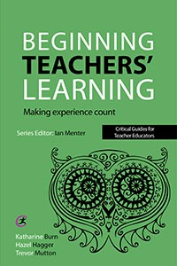
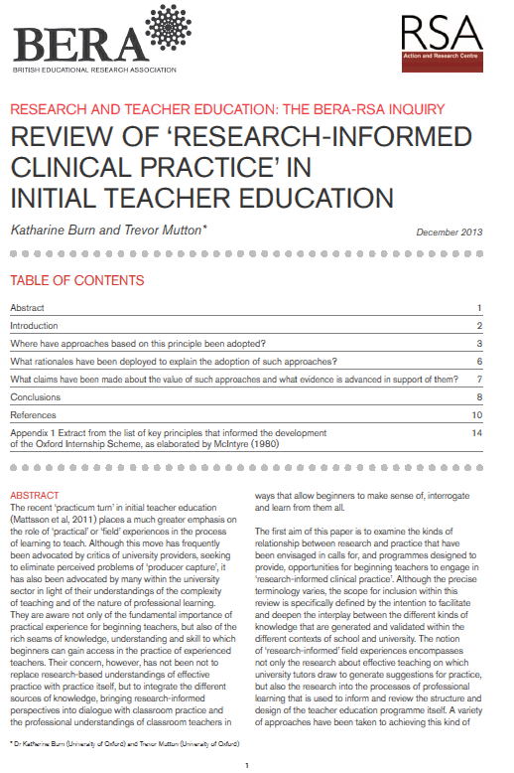
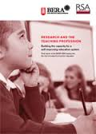
Thinking deeply about teacher education?
Oxford Internship Scheme (1987) Donald McIntyre
DEBT project Developing Expertise of Beginning Teachers Hazel Hagger Donald McIntyre
Trevor Mutton
BERA-RSA Inquiry
into the Role of Research in Teacher Education Trevor Mutton

Slide 3
But I’m not going to say much about any of them except…
Oxford Internship Scheme (1987) Donald McIntyre
DEBT project Developing Expertise of Beginning Teachers Hazel Hagger Donald McIntyre
Trevor Mutton
BERA-RSA Inquiry
into the Role of Research in Teacher Education Trevor Mutton

Slide 4
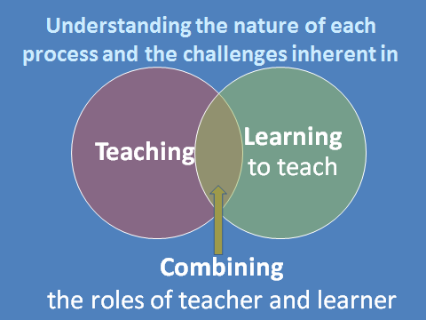
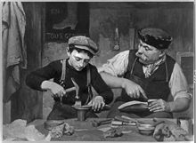
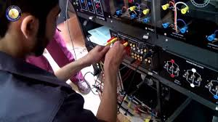
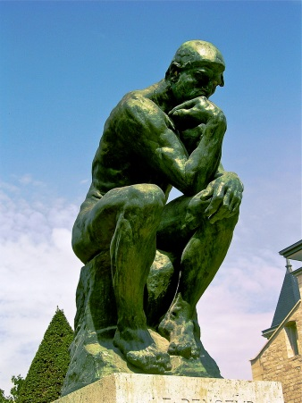
But I’m not going to say much about any of them except…

Slide 5
Theoretical episteme
Technical techne
Practical phronesis
Both [teacher as craft worker and teacher as executive technician] are wrong in their views of what educational research can and cannot do. Teachers need to be equipped to interrogate their own practice to understand why it is or isn’t working, or to learn from new ideas and adapt them to particular situations and contexts.
Winch, Oancea & Orchard, 2013; Winch & Orchard 2015

Slide 6
Hence the need for beginners to draw on ideas from diverse sources and test them in specific contexts: practical theorising (McIntyre 1993)
‘enquiry stance’ ‘practical problem-solving’ ‘ research orientation’
‘Clinical judgement and decision making’
the analytical and intuitive cognitive processes that professionals use to arrive at a best-judged ethical response in a specific practice-based context
Kriewaldt and Turnidge (2013)

Slide 7
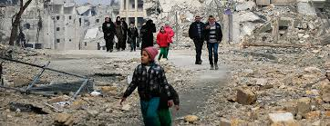
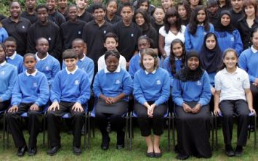
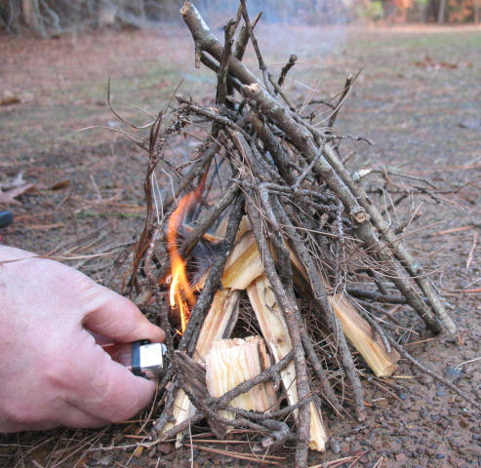
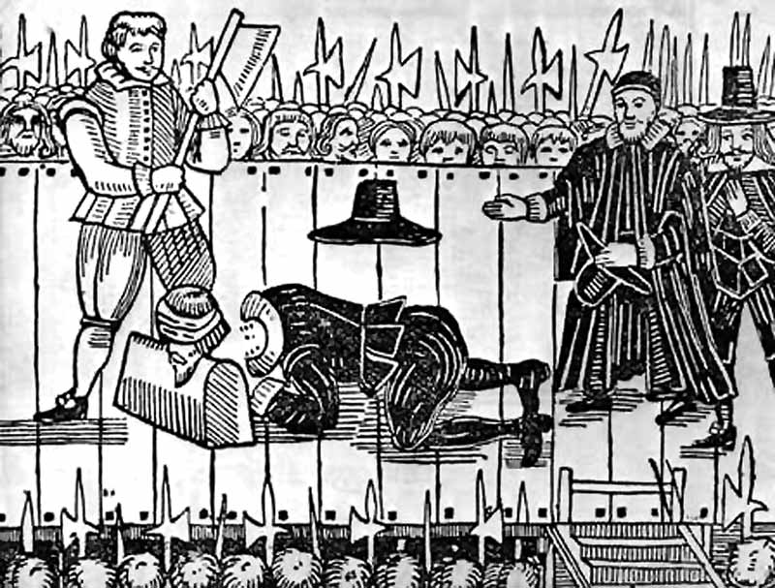
How can it not require deep thinking?! One example from history
Substantive knowledge
Procedural skills
Conceptual understanding
e.g. cause & consequence
These deep-seated grievances were not enough in themselves to provoke war. Conflict only erupted because….
Notes:
The complexity of trying to teach about the English Civil War as an example.

Slide 8
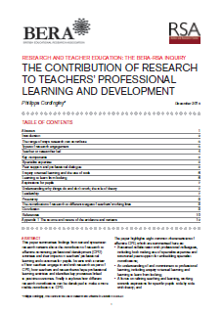
How can it not require deep thinking? given what we know about teacher learning (CPD) with an impact on student outcomes
Philippa Cordingley CUREE
Steve Higgins Durham Toby Greany UCL IOE
Robert Coe Durham (EEF)
Notes:
One specifically looking at teachers’ learning from research – and one looking more generally at professional learning – but key is looking at learning that makes a difference for pupils.
And in case you think that’s giving research too much emphasis I’ll come back at the end of my five minutes to a study I was involved in that focuses on learning from experience.
So what is needed for effective learning – what structures, what support, what kind of action – and what kind of time-scale do you think you need to be working on to see an impact.
I’ll give you 30 seconds to consider what you think is needed in terms of support/structures/encouragement to make sure you go ahead.
Time is up – can give yourself a cheer for each element that you correctly identified – or just smile smugly.

Slide 9
Cordingley (2013) The Contribution of Research to Teachers’ Professional Learning | Higgins et al (2015) Development of Great Teaching
1. Use of specialist expertise (including research) | Strong evidence, clear rationale
2. Peer support | Shared sense of purpose Peer support
3. Sustained, enquiry oriented (at least two terms) | Duration – at least two terms Rhythm – time to understand & to practise
4. Learning from looking (in detail at what’s going on)
5. Driven by aspirations for specific students | Responsive to teachers’ experiences and aspirations for specific students
6. Concerned with why things do and don’t work in specific contexts
7. Leadership support
8. Being proactive – e.g. seeking out leadership and peer support
Notes:
Taking conscious steps – making things happen – acting in very deliberate ways – which is why I am giving you time to think now about what you want to do.
Being proactive brings me to the last study I wanted to mention – and apologies to the former OUDE students who have heard this before – but the study of teachers’ learning from experience that I was involved in tracked teachers’ learning over 3 years.

Slide 10
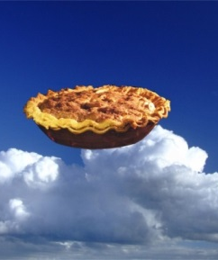
Deep thinking
Pie in the sky?
I’ve got a new A-level specification to plan and teach. I haven’t got time to be reading any history
Decide together (mentor and trainee) on one piece of historical scholarship that you will read and discuss…

Slide 11
Deep thinking
Pie in the sky?
Just to let you know that tomorrow’s Teacher Enquiry meeting has been cancelled. Our head is so worried about year 11 results she is cancelling CPD. Of course, I could be living in a surreal fantasy world or this could be a joke and it may turn out that the word of the day tomorrow is ‘Ironic’ and she is just using this to set that up…
Research Champions Leading teacher enquiry projects
Notes:
A thriving teacher enquiry programme in one of Oxford’s partnership schools – with the meeting suddenly cancelled in the face of other pressures. Email received from a Research Champion.

Slide 12
Deep thinking
Pie in the sky?
Decisions are made collectively rather than unilaterally… ‘People treat the leadership team on an equal footing, rather than as a hierarchy. (Interview 2)
I’m not convinced the effort is worth it. I do not feel valued, which is a shame. (Interview 8)
Notes:
Small scale research conducted locally into ways of supporting the recruitment and retention of NQTs. Despite the huge interest of headteachers in the findings – and the importance of the message about how staff feel treated and how they can develop a sense of agency – the meetings at which I have been asked to present and explore the implications with head teachers – are all focused essentially on how they can manage their schools with less money (and therefore squeeze even more out of teachers)

Slide 13
Deep thinking
Pie in the sky?
But it needs to be in bullet points…
Notes:
Even the most enthusiastic teachers committed to giving a Saturday up to engaging with research – insist that it’s only useful to them if it can be summed up in as few words as possible.

Slide 14
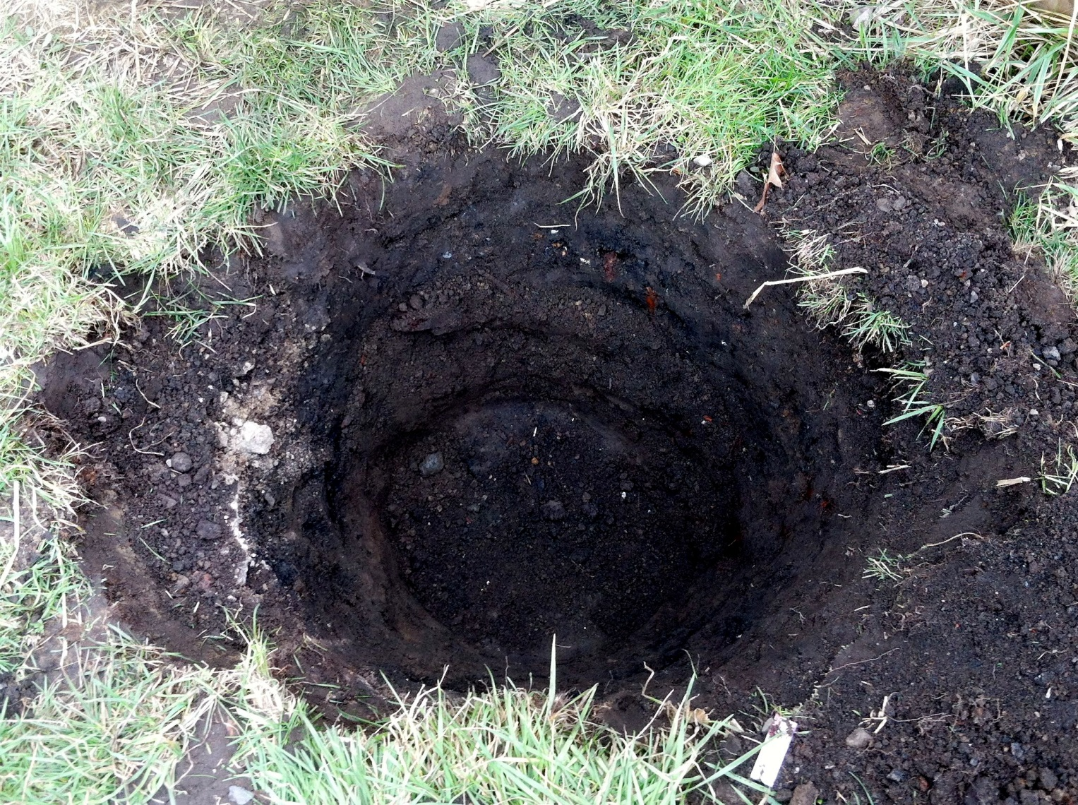
Thinking deeply about about teacher education?

Slide 15
Deep thinking about teacher education?

Slide 16
Aim for the pie rather than falling in the pit?

Slide 17
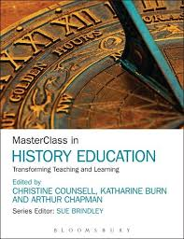
Aim for the pie rather than falling in the pit!
3 Projects
3 Principles
The impact of adopting a research orientation towards use of the Pupil Premium Grant
Burn, Mutton, Thompson, Ingram, McNicholl & Firth (2016)
Process
Pupils
Passion

Slide 18
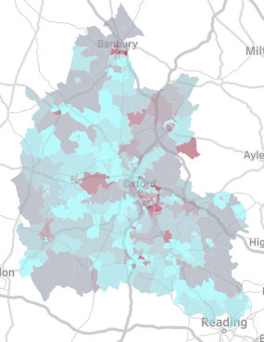
1. The Process (an enquiry stance)
Introduction in 2011 of a Pupil Premium Grant payment for disadvantaged students
(in receipt of Free School Meals, in local authority care or with parents in the armed forces)
Schools held accountable for its spending and expected to use it to ‘close the gap’
The impact of adopting a research orientation towards use of the Pupil Premium Grant in preparing beginning teachers in England to understand and work effectively with young people living in poverty
Burn, Mutton, Thompson, Ingram, McNicholl & Firth (2016)

Slide 19
Concerns about our capacity to provoke productive enquiry
Research has consistently shown poverty and social class largest correlations with educational success/failure (e.g. ESRC, 2011; Horgan 2007; Hills et al. 2010; Lupton, 2006; Marshall, 2002; Raffo et al., 2009).
Student teachers often lack understanding or experience of the effects of poverty – and many therefore hold deficit views (Gorski 2012)
While it was important to encourage them to question their preconceptions, our own research had suggested that their attitudes could be very hard to change. (Thompson, Menter and McNicholl 2015)

Slide 20
Decision that individual schools would determine the nature of the research they asked the interns to carry out
We researched the interns’ experience and outcomes through:
Detailed case studies within a number of urban and rural partnership schools
Each case study involved - an interview with the professional tutor - attendance at the interns’ presentation of their findings within the school - individual interviews with the interns
Whole cohort survey: Likert scale and open-ended questions

Slide 21
A risky undertaking (given professional tutors’ views)?
Societal model
Deficit model
I subscribe to what is put forward in The Spirit Level....essentially making the argument that there are all types of symptoms of unequal society
Lack of resilience, lack of self-esteem, reluctant to try anything so they don't engage in learning –these are always linked to social disadvantage
You have got to engage. There’s no short term fix. Got to have long term goals to address poverty and lack of stable upbringing.
I sometimes feel that there is not a huge amount that we can do by the time they get to us
Their ambitions aren’t particularly broad or wide
There doesn’t appear to be a lack of money, because they’ve got Sky TV and he’s got i-Pads and all those sorts of things.
He’s not had good parenting, he’s not had parents who know how to bring him up, basically, and who know how to develop him as a person’.

Slide 22
Findings: Conflicting object motives
Complex interplay between individual and institutional histories
Influence of interns’ preconceptions - but these did not determine the outcome
Multiple object motives in play (sometimes in competition): interns' learning; delivery of the teacher education; the school’s learning; protecting the school’s reputation; protecting colleagues’ workload

Slide 23
Findings: outcomes (Trust the process!)
Nature of the Professional Tutors’ views not in themselves enough to determine the nature of the outcome
Enquiry methodology and actual or vicarious engagement with individual young people prompted learning - in the view of the interns’ (74%) - in their suggestions for practice & differences in their practices - in their claims about learning: saw value of specific knowledge and of responding to young people as individuals
Especially powerful where seen as valued by the school
Prompted (renewed) engagement with research literature
High level of challenge for some schools – undoubtedly uncomfortable and potentially disruptive (but this did not prevent learning)

Slide 24
2. The pupils (aspirations and asking)
Developed proposal for a local (and international comparative) research bid focused on school use of a survey tool to identify how connected students feel, the barriers to connection and ways of addressing them.
Teacher enquiry – supported by academic researcher as critical friend
Notes:
From a small scale enquiry – a support teacher concerned about improving attendance rates for Pupil Premium students – beginning by deciding to meet with a small sample of students in Year 7 after each occasion they had been absent, simply to talk about their experience being off school and what it was like to come back in – how they felt, what made coming in again easy or difficult, and how they thought they might catch up – has led into the development of a substantial research proposal with academic reseachers on the issue of connections.

Slide 25
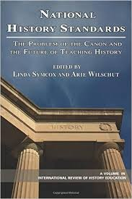
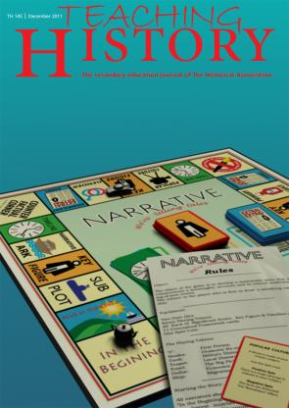
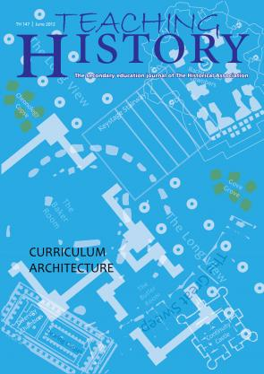
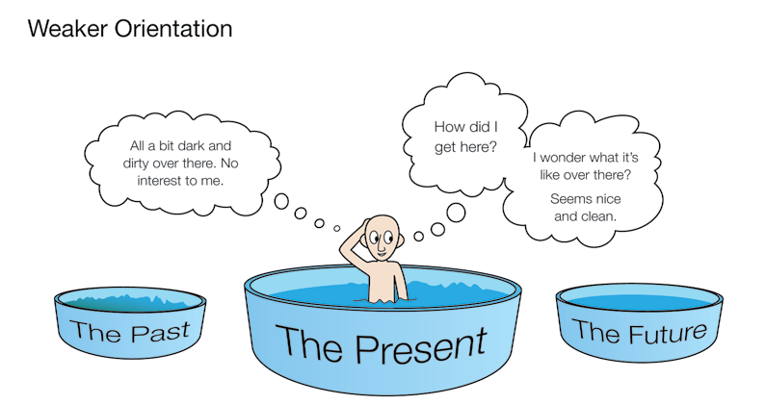
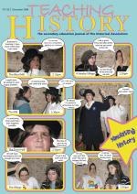
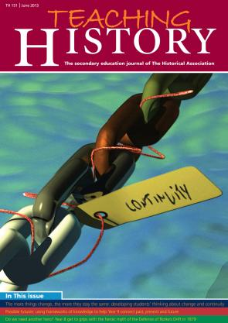
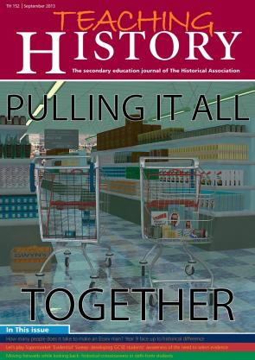
3. Passion (and deliberate pursuit)
Shemilt
(2009)
Blow
(2011)
Blow, Lee & Shemilt (2012)
Rogers (2008)
Usable Historical Pasts → ‘Frameworks’
(Foster et al. 2008) ESRC → QCA
Nuttall (2013)
Instone (2013)
Notes:
e.g. My own passion to support history teachers’ engagement with educational research and historical scholarship through co-editing a professional journal for history teachers that brings together academic research with historical scholarship and teachers’ own classroom enquiry (practitioner research).
This slide shows how history education research by academics was made accessible through the journal to teachers who shared their own classroom research in relation to it with others.

Slide 26
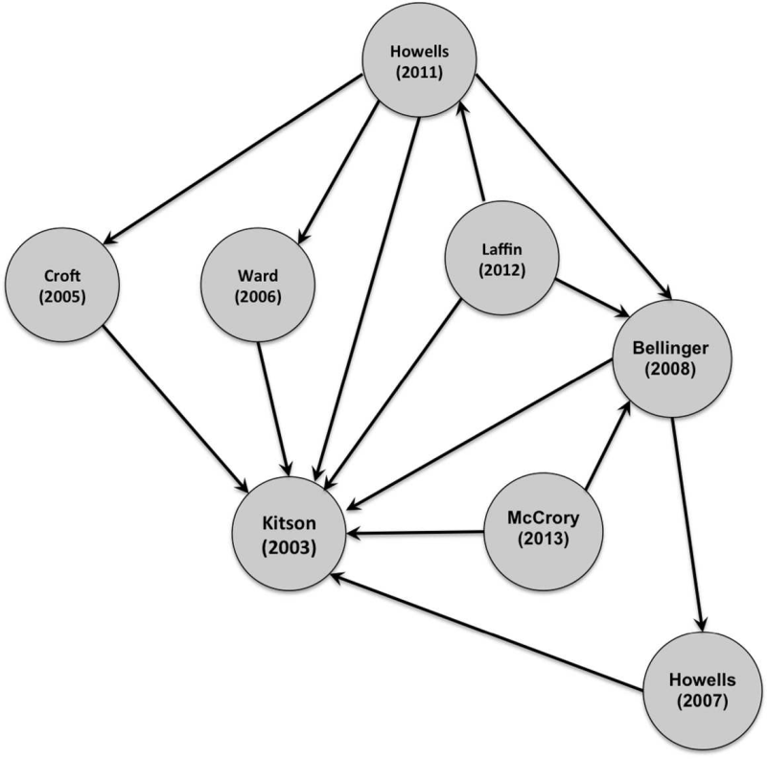
3. Passion: practitioner research as a cumulative critical discourse
‘teacher led renewal of classroom history’ Counsell (2011) Curriculum Journal
‘history teachers have gone further than Stenhouse originally envisaged by producing a sustained and coherent research tradition that transcends the boundaries of particular contexts and, as such, represents a coherent and codified form of professional knowledge.’ Fordham (2015) BERJ
Fordham’s social network analysis of citations based on Kitson (2003)
‘Teaching for historical understanding: thematic continuities with the work of Lawrence Stenhouse’
Elliott (2016)
In MasterClass in History Education

Slide 27
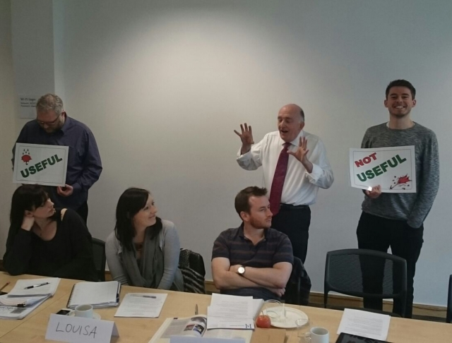
3. Passion
Weekend/online CPD
A ‘Teacher Scholar’ programme: ‘England’s Immigrants’ run by the University of York, in conjunction with The National Archives and the Historical Association
A ‘Teacher Fellowship’ programme: ‘Agincourt 600’ run by the Historical Association – funded by Agincourt 600
£1 million allocated by the Chancellor of the Exchequer to commemorate the 600th anniversary of the battle!
Notes:
My current experience evaluating forms of CPD (in history education) that try to accommodate academic historians’ need for impact and what we know about the necessary conditions for teachers’ professional learning that impacts on students. The challenge of devising a course that is sustained, gives access to specialist expertise, is focused on aspirations for specific students (etc etc)

Slide 28
3. Passion
Led by academics and a history teacher educator
Weekend residential
Followed by 8-week online programme
Further full Saturday or weekend
Resulting in publication of resource for other teachers

Slide 29
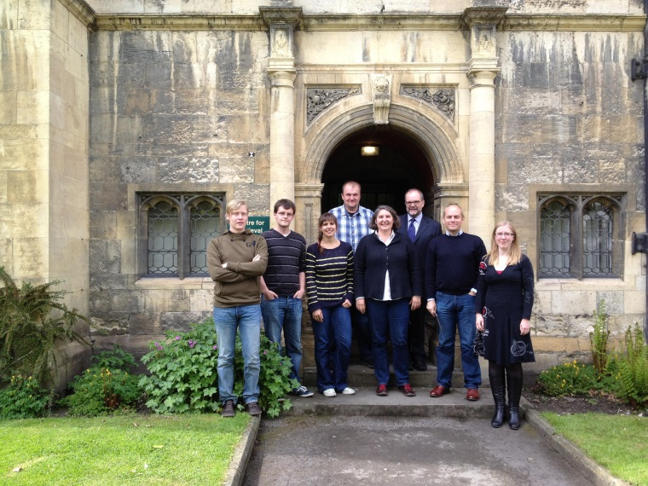
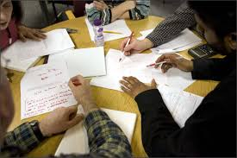
What does it offer the participants?
Networks
Access to experience
Inspiration
Understanding of specific demands (exam specifications)

Slide 30
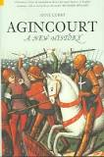
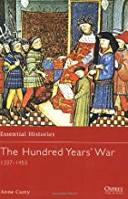
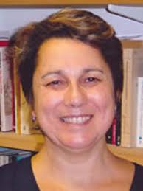
What does it offer the participants?
Content knowledge
Valued by ‘specialists’ and ‘non-specialists’
Specific knowledge (as required by their exam specification) e.g. weaponry, logistics, social & economic details
Broader knowledge – ‘texture’ e.g. relationship between England and Europe,
Human and humanising stories (e.g. slang terms, muster rolls crossed like a register)
Sources (nature, provenance, specific examples)
Reading suggestions – from the academics but also from other teachers
Access to historians’ thinking

Slide 31
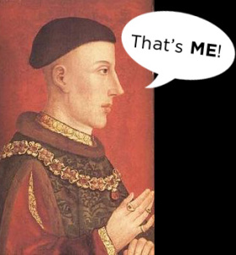
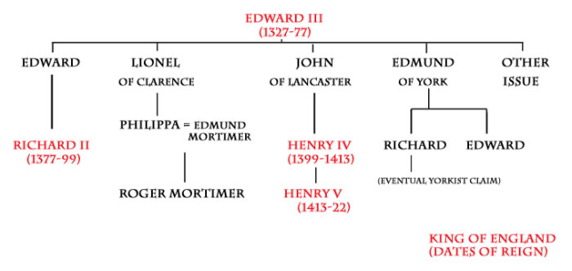
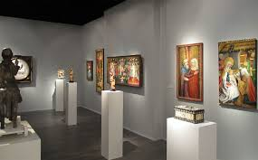
What does it offer?
Pedagogical content knowledge
In Shulman’s terms:
Ways of representing the subject (analogies, illustrations, examples, demonstrations)
What makes learning it (easy or) difficult
Preconceptions (misconceptions)
Strategies for re-organising the understanding of learners
Awareness of the importance of planning on bigger scale:
Single activity → Scheme of work → Curriculum structure (11 →18)
History specific → Cross-curricular collaborations

Slide 32
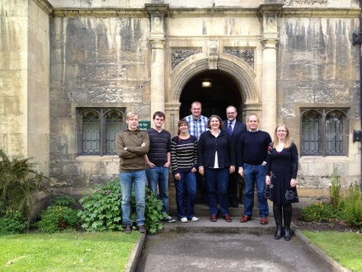
3. Passion
Identity
Creativity
Confidence
Sense of self as a learner
Member of a community
Respected status

Slide 33
Aim for the pie rather than falling in the pit!
Process of practical theorising
The impact of adopting a research orientation towards use of the Pupil Premium Grant
Burn, Mutton, Thompson, Ingram, McNicholl & Firth (2016)
Pupils
Aspirations for specific students (and ask them!)
Passion Pursue yours!

Slide 34
Dr. Katharine Burn
Director Oxford Education Deanery
katharine.burn@education.ox.ac.uk

