Slide 1
Embracing contradiction as a way of promoting the importance of the teacher educator role Alaster Scott Douglas University of Roehampton alaster.douglas@roehampton.ac.uk
TEAN (the Teacher Education Advancement Network)
Annual conference
‘The Ambition of Teacher Education’
Friday May 11th 2018

Slide 2
Aims of the Presentation
My teacher educator role
My research on the role of the teacher educator
Learning to be a teacher
How do we enable this learning?
Two research studies in PGCE student teacher education programmes
9 years on
Negotiating teacher education contradictions

Slide 3
The value of contradiction
Contradiction reminds us that resolution is fragile, temporary and, very often, incomplete – that disorder always looms. But perhaps these are the very qualities that fuel an inquiring mind. Perhaps we need contradiction to keep us alert to the responsibility of acting on our imaginations.
(Peseta and Grant 2011: 1)

Slide 4
Concern that higher education teacher educators in Europe are becoming solely trainers and mediators of government policy provides an impetus to challenge what has been termed the ‘training paradigm’.
(Beach and Bagley 2013)
To promote scholarship-informed teaching and re-draw ‘partnership boundaries and practices towards the development of a critical pedagogy of teacher education’
(McNamara and Murray 2013)

Slide 5
The teachers’ standards
Promoted internationally as providing a shared understanding of what counts as accomplished teaching (European Commission 2013 and OECD 2005)
Contradictions in the Teachers Standards (DfE 2013):
They are open to interpretation but can be narrowly defined
They support professional growth and bottom-up accountability but may be used as a top-down hierarchical and managerial means of ensuring compliance (Kennedy 2015)
Performative language – techniques necessary for performance are all that is necessary (Hordern 2014)

Slide 6
Meeting the teaching standards
Teacher educator: Let's carry on through your profile then – I'll write that – use information technology more for help. How are we for time [mentor]?
Mentor: 15 minutes
Teacher educator: Come on then.
(There are more quick fire questions about the scheme of work and how [student teacher] plans activities in order to meet the standards.)
Student teacher: Lesson plans
Mentor: Much better, only one teacher has given 'attention needed' for pitch. No one has said 'consistent' but you have improved a lot considering the initial concerns.
Teacher educator : Ok, I'll make a note of that – pitch improved but still needs working on.
(Field notes – 17 April)

Slide 7
Mentor: But you need to be in control of where you are at, you need to prove with evidence, need it written down, your sheets and feedback sheets. You haven't always done that. Where do you keep the descriptors? At home? Under the bed? (laugh). This is the purpose of self-review sheets. So we need to decide now.
(He gets copies of the descriptors with tick box columns and they both fill them in).
Student teacher: So we are looking at the 'attention needed' column?
Mentor: Yes, do a quick review and tick where you think you are, and I'll do it too.
(They do this in silence for 2 minutes.)
Mentor: Anything with 'attention needed'?
(The mentor suggests appropriate targets and what the student teacher can ask staff to look for in observations.)
Mentor: Next week with your feedback and self-evaluation sheets we can see how you have done, OK?
(Field notes – Tuesday 16 January)

Slide 8
Learning (Edwards 2005)
Learning reflects a concern with within-person changes, which modify the way in which we interpret and may act on our worlds.
Learning is therefore a change in state, which alters how we act on the world and in turn change it by our actions … [this] allows us to connect knowledge and emotion so that we see that both come into play in our responses.
Learning is about appreciating complexity and acknowledging the dilemmas and contradictions in educational practice

Slide 9
Alternative routes into the teaching profession in England:
School Direct (Department for Education 2011)
School Centred Initial Teacher Training - SCITTs (TDA 2007)
Teach First 2002
Teaching schools (Department for Education 2010)
Teaching apprenticeships (2018)
= A changing activity with new roles (including the School Based Teacher Educator - SBTE)

Slide 10
The Teacher Educator Role
Prevailing definitions of teacher education as training; simple work that need not be highly specialised as many perceive themselves as specialist teachers of discipline knowledge.
Standards for Teacher Educators
USA (Association of Teacher Educators) standards in place since 1992 – voluntary and not necessarily representing a consensus
Belgium, Israel, Netherlands (VELON) also have teacher educator standards

Slide 11
National Standards for school-based ITT mentors (TSC July 2016)
The standards, although not statutory, should be used by school-based ITT providers to strengthen the quality of support that trainees receive whilst on school placements, to create consistency within partnerships and across the ITT system in England.
Standard 2 - Teaching
The mentor should enable the trainee to access, utilise and interpret robust educational research to inform their teaching.
Standard 4 - Self-development and working in partnership
The mentor should continue to develop their own mentoring practice and subject and pedagogical expertise by accessing appropriate professional development and engaging with robust research.

Slide 12
The School Based Teacher Educator (SBTE)
A lack of perceived support and professional learning needs
(White et al. 2015)
Student teachers unable to interpret and elaborate their experience from a theoretical perspective
SBTEs need resources, time and training in the new role
The role of the university-based teacher educator has long been recognised as having potential benefit for offering modelling strategies for school mentors as well as offering written and verbal advice and help by conducting focused observations alongside mentors. (Hopper 2001, p.217)

Slide 13
We have also just set up a Masters in Teacher Education which is about if you like, training the trainers for the want of a better word. There are the kinds of things that would come up in a teacher educator development programme.
(Interview, 16 July 2015)
If it were the case that you could only be a SBTE if you have gone through substantial amounts of training, possibly a Masters or diploma, I think that would be a very good thing.
(Interview, 16 July 2015)

Slide 14
2 research studies
A secondary school
A primary school
Ethnographic
Observed ITE activities over 3 terms in one school
Interviewed personnel involved in ITE about understanding of their participation
Focused on four school subject departments (Geography, History, MFL, Science)
2 weeks of observation of ITE activities and interviewed personnel on understanding of their participation
Participated with staff in a ‘change laboratory’ workshop sharing my research findings
Negotiated the object of ITE activity

Slide 15
Findings from the year-long ethnography
Today's Daily Deal
Palgrave Macmillan

Slide 16
Nature of Data
S1
S2
Total
School Visits
59
21
80
School Interviews
24
31
55
Lesson Observations
MFL Department
History Department
Geography Department
Science Department
Total
11
9
9
16
45
2
2
2
1
7
13
11
11
17
52
Mentor Meetings
MFL Department
History Department
Geography Department
Science Department
Total
12
9
11
15
47
3
4
4
4
15
15
13
15
19
62
University teacher educator Interviews
0
6
6

Slide 20
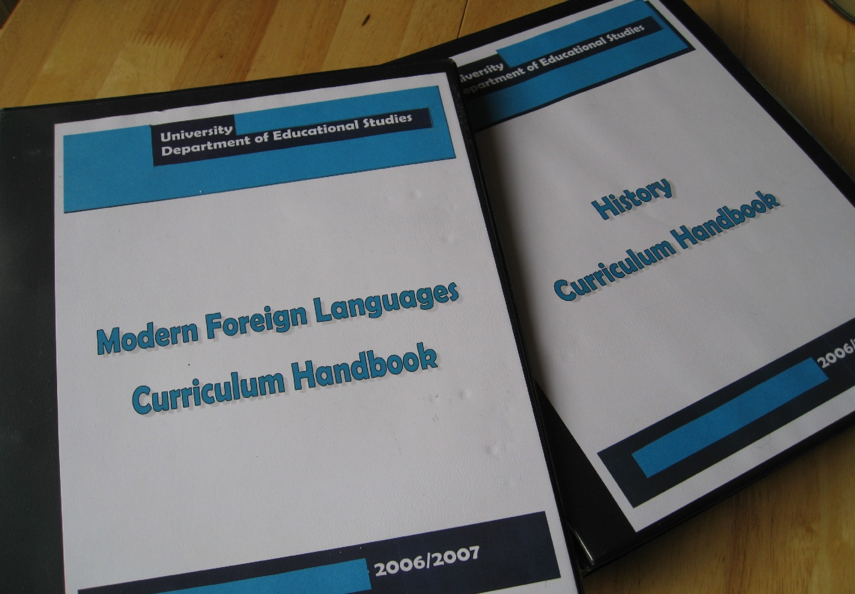
The Curriculum Handbooks

Slide 21
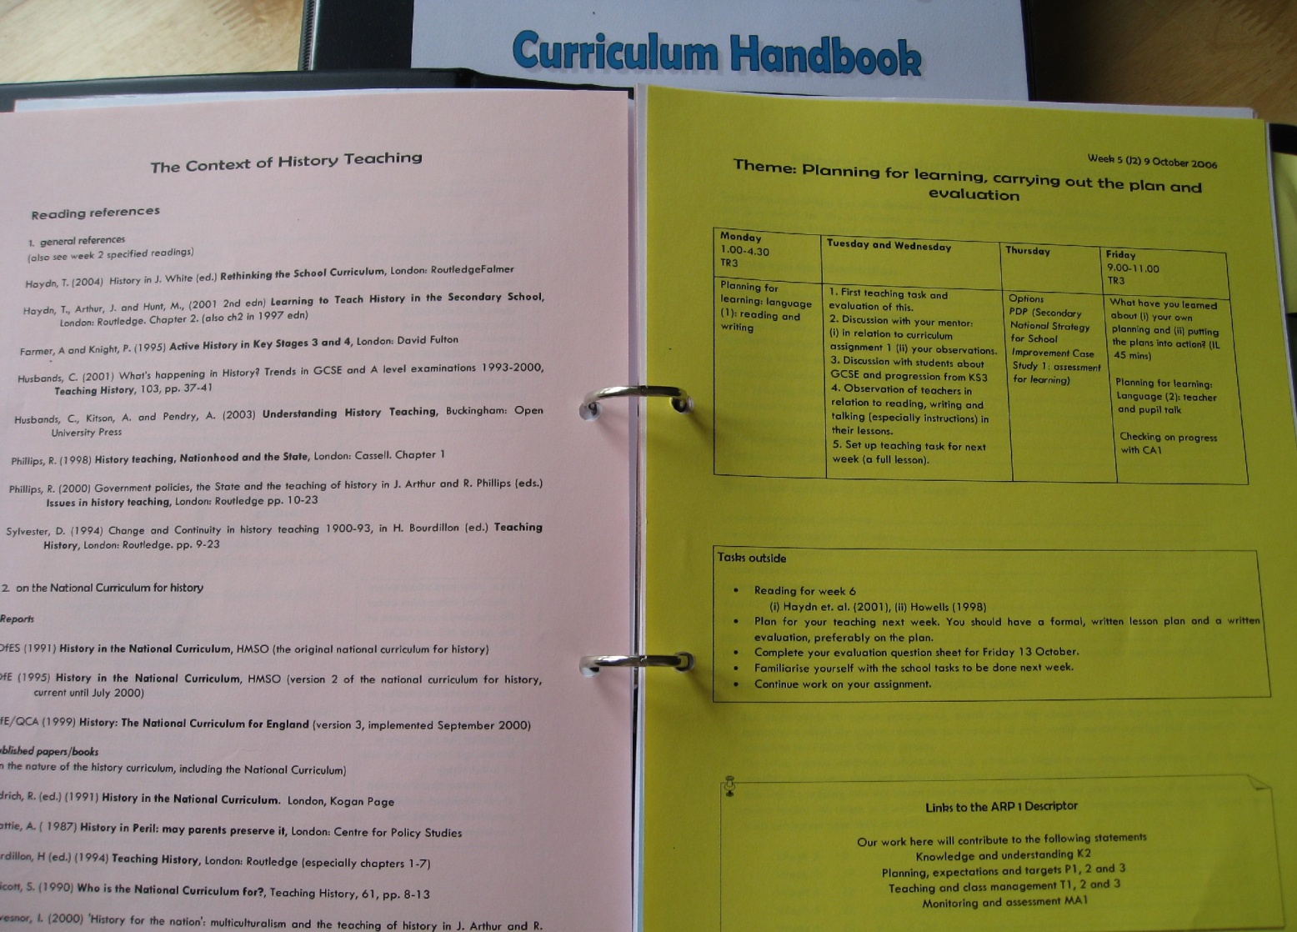
History

Slide 22
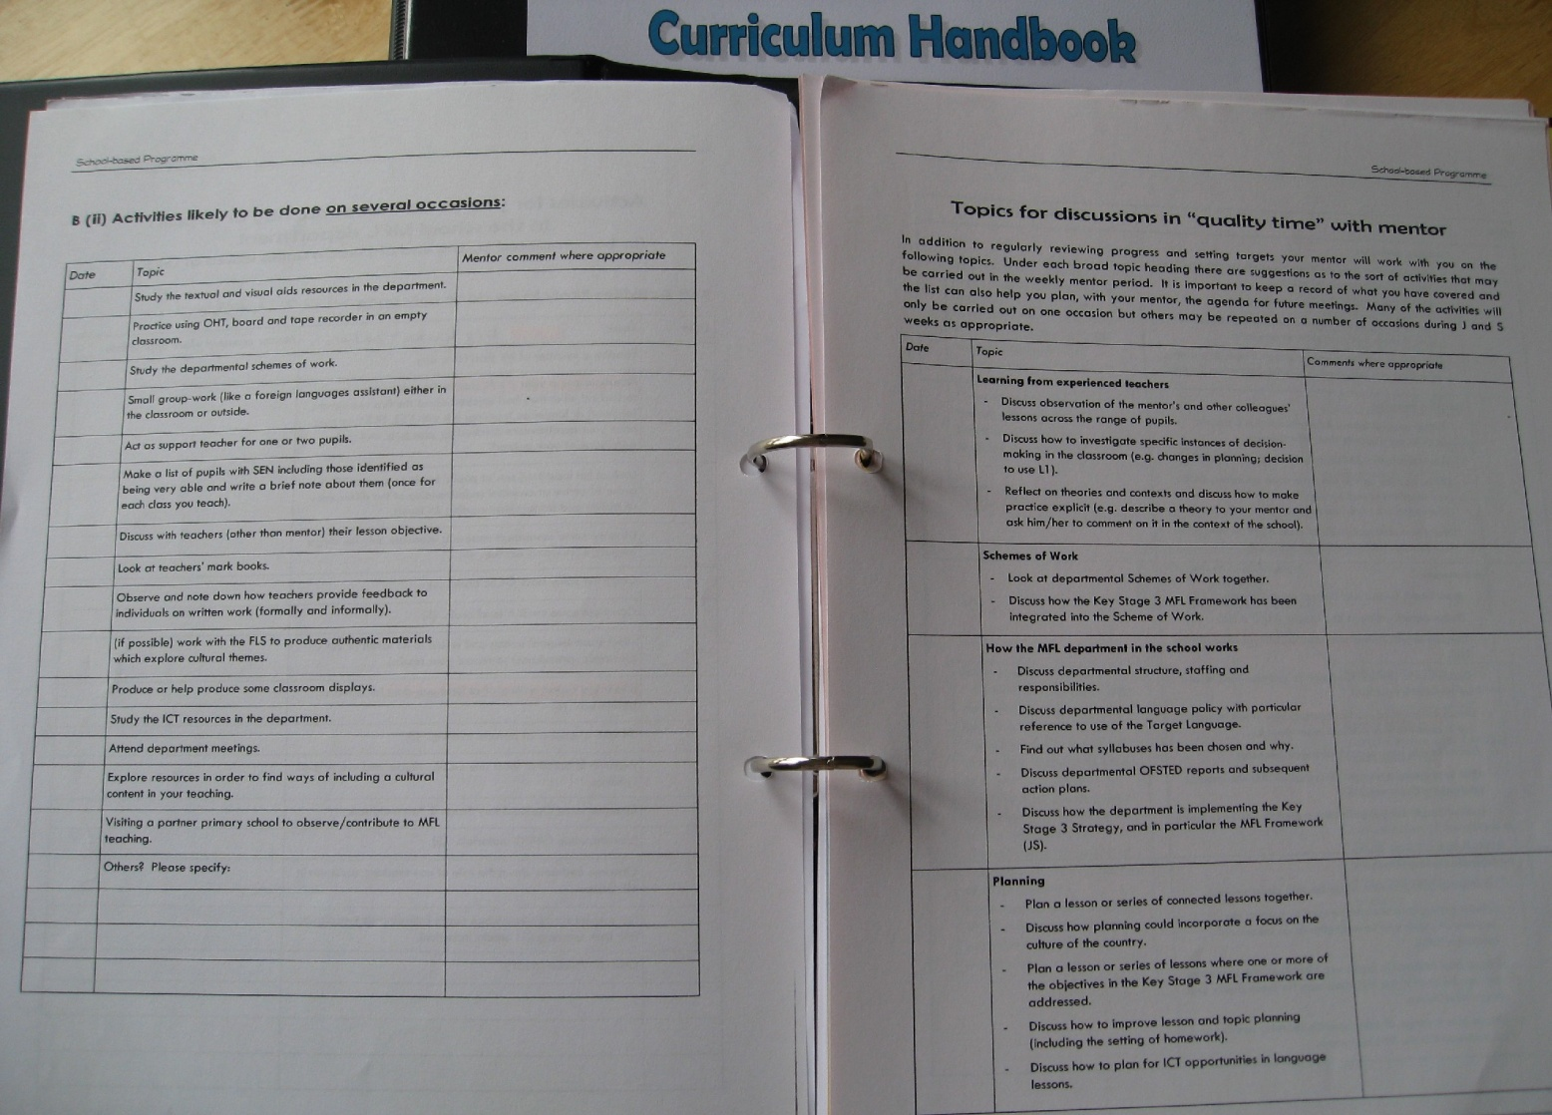
Modern Foreign Languages

Slide 23
Mentor: What kind of questions can you use in class? Would you change them on reflection? How are you developing inference skills?
Student teacher: Some could develop that in poster lessons. I see [History teacher 2] and [History teacher 3] in lessons trying to draw out inferences from sources. Would that be worth doing? Scaffolding – pros and cons of frameworks. I presume they [the pupils] ignore me when they don't want to do it.
Mentor: [History teacher educator] has quite strong views – year 11/12 exams assume students know strengths and weaknesses of sources and bias. How do we tell higher attainers? What is the evidence base, next step?
Student teacher: I don't know, what is the next step?
Mentor: You don't have to answer now – maybe in the NQT year. Should sources be taught explicitly? What is this department doing? The former is a sources lesson as not using them much – not integrated to all of teaching. How do you make source evaluation part of the scheme of work? [The school] suddenly throws sources in rather than drip-feeding, and that’s an issue.
(Field notes – 17th January)

Slide 24
Student teacher: Let’s just say we have done GNVQ [vocational] materials.
Mentor: But it might be checked. You could say you have seen the Business and Tourism thing – you can’t see what isn't done.
(They continue checking the list of activities.)
Student teacher 2: Questionnaire; a year 7 class in the autumn term – not done
Mentor: Drat, I am going to ignore that feedback and just keep nagging you.
Student teacher: There must be people who just don't do it.
Mentor: Tick off what you have done – cobble some kind of survey together. You have to create a questionnaire so do one together; an example can be asking if they did MFL in primary school, and for how long.
(Field notes – 31st January)

Slide 25
Contradiction: The university’s motive of enabling student teacher learning is in tension with perceptions of fulfilling course requirements.
I keep saying this over and over again, you are not here to simulate a teacher, you are here to learn, and therefore if I ask you to do some marking in a particular way, there's not much point in you saying to me that that is not what teachers do.
(Interview with MFL teacher educator 3rd July)

Slide 26
A focus on discussion
I guess teaching isn’t the kind of thing where you tell somebody this is what you do and then they go and do it, and it works. It is much more imprecise.
(Interview with History mentor – 23rd January)
She [the mentor] does ask me to be specific about what went wrong in a lesson if I say that wasn't good. She doesn't like me just saying it was really rubbish. She wants me to tell her which bit was good, and why I think bits that didn't work should be analysed. It's a good hour I have with her.
(Interview with History student teacher – 19th February)
I aspire to listen to them, and to listen quite hard to them … I aspire to ask questions rather than just give answers, and to try and make sense of what they are doing and why.
(Interview with History teacher educator – 14th August)

Slide 27
There is no right way
My philosophy is not to have a set mind of what you want to produce at the end of it. Far from a monopoly of knowing how … but the main thing is the encouragement to fail in a way. There's a feeling that you've got to know what you are talking about. Obviously, if I saw somebody have a really bad idea I would try and adjust that, but I would want them to keep trying lots of things and if it goes wrong, just to be able to push yourself off and go, ‘ok what do I learn from that, and I shall try and not make that mistake next time, but I will keep trying lots of new things’.
(Interview with History teacher – 17th May)

Slide 28
A focus on action
There is academic stuff in the [university] booklet with discussions, but I don't know anyone who does them. The [student teachers] are up to here with it by this stage. They just want to get on.
(MFL mentor: field notes – 16th May)
We get the long list of all the different criteria you know, the this, that and the other and I have to say I read once five years ago, and I am not going to have the time to learn them all so I have to rely on the [student teacher] to do that. I will comment and say ‘tick this box’. We have been given all the descriptors of the criteria, so if I wanted to I could find that and look them up.
(Interview with MFL teacher – 7th June)

Slide 29
The Right Way?
Everyone is so supportive, everyone is so nice and everyone always starts with positives and they are always really, really, really understanding. But each teacher does have a certain style and it is hard to know how to reconcile that. By doing something that one teacher has advised me to do in another teacher's class, she will be a bit kind of like – ‘oh I don't think you should do this so much’ – then it's hard to know how to develop your own style, so that it fits in with everyone else's styles.
(Interview with MFL student teacher – 22nd February)

Slide 30
The Problem:
Even if you have a very good role model as a class teacher, that doesn’t address the issue of different approaches. I see trainees attempt to model themselves on an outstanding teacher but they don’t actually see what underpins the excellence of the teaching.
They purely mimic what they’re doing without realising what underpins it.
(Interview with teacher – 14 June 2006)

Slide 32
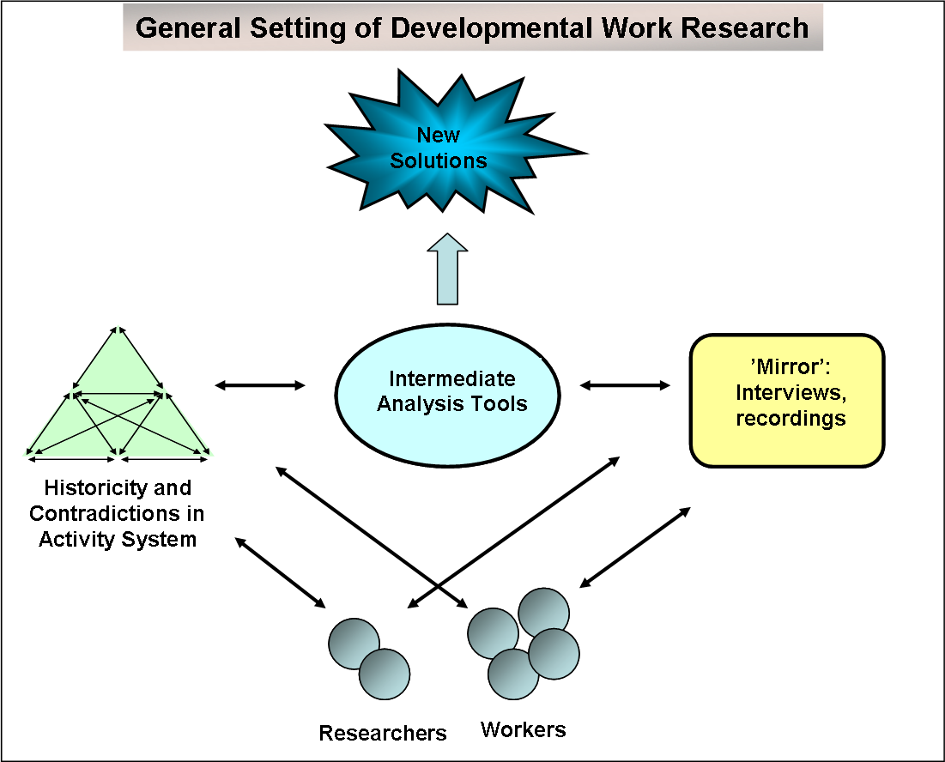

Slide 33
Contradiction 1: student teacher critique versus staff support
There’s this sort of policy of everyone’s helping everyone else and everyone’s learning from everyone else’s experience. (Teacher – 14 June)
I haven’t been challenged about that (teaching ethos); I think that would be hard to be challenged by a student, but interesting. (Teacher 2 – 11 June)
I would definitely say ‘interesting why did you do that because I never would have thought to do that’ or something like that … But I’ve seen it more as I’m here to learn, to expand my horizons rather than to shrink someone else’s, so if I needed to, I would definitely have that chat, but I’ve never had that opportunity, or that need. (Student teacher – 16 June)

Slide 34
DWR workshop
I am not particularly thinking about their role [as a student teacher] carefully enough. (Teacher – 16 December)
Another teacher suggested ways forward for encouraging collaboration:
You have to make an agreement between you if you are observing one another, for example what the purpose of the observation is and what is going to happen after the observation. (16 December)
(How tools can change in order to prevent contradictions)

Slide 35
Contradiction 2: student teacher experimentation versus school norms
From the class teacher’s point of view and for the best interests of the children we want to try and maintain what has previously happened by way of routines and consistency and things like that, because we have to pick the children up again when the student leaves. (Teacher – 17 June)
If they get with a really good teacher who’s got a strong personality and you go in and observe, you can almost hear that teacher speaking through the student and you think “actually I don’t want you to do that”. (Teacher – 17 June)
In the DWR workshop:
It’s about how to move the students on from safe places. Sometimes we feel we’ve managed it and other times not. (Teacher – 16 December)
Identified a need to increase the confidence of the class teacher to let go.

Slide 36
ITE discussion focus
Criticism of ITE as too much ‘emphasis on curriculum delivery at the expense of the experience of responsive pedagogical decision making’
(Edwards and Protheroe 2003: 240)
A concentration on the ‘maintenance of stable relationships through the recognition of the different [ITE] roles and mutual appreciation ... We now need to find ways to make tensions the subject of discussion and debate within our partnerships’.
(Spendlove et al. 2010: 74 &75)

Slide 37
Developmental Work Research
I see it as our responsibility in uni to say ‘look there are other ways of doing it’ so that they can bring that critical lens to bear on what they see in the classroom.
(Interview with teacher educator – 18 June)

Slide 38
Teacher educators developing tools
The Mentor Collective
We said can we do a school-based task where mentors and student teachers agree to read the same piece of scholarship which might be an article, it might be a chapter. You might then decide to base some teaching on it.
We knew we were asking a lot and we collectively discussed this concern with the mentors, and we introduced the task as a result of a mentor meeting. The mentors were generating the suggestions much more formally than we had dared to suggest, so one of the key points of leverage actually is what the other mentors do and suggest.

Slide 39
Scholarship activity outside partnership
It is very definitely a professional journal but is actually determined to bridge the world of academic [subject], [subject] education research and [subject] teaching.
So most of its articles are written by teachers, some articles are written by researchers. People cross reference each other’s articles and it has built systematically in not any planned way because we always insist that people relate their work to other published work which might be in the journal or elsewhere.
So it is not just handy tips of ‘this is what I did’, it’s what’s the rationale and how does this relate to what is going on in the professional community?

Slide 40
Research within the partnership
We got together with some local schools and from research we had done we came up with a series of eight principles. On the basis of those principles, the teachers agreed to produce some videos which were their interpretation of the principles.
So it was a way of integrating our work more with that of teachers. We did workshops around the country – seven workshops and hundreds of teachers came to those.

Slide 41
Tool appropriation
Valuing the co-operative learning of teacher educators and mentors makes it more likely that ‘deep reflections and theoretical underpinning can become part and parcel of daily practice’ (Boei et al. 2015, p. 16).
Research suggests that teacher learning (for school mentors and SBTEs) should mirror the way university-based teacher educators hope student teacher learning occurs by providing learning opportunities that engage teachers as learners (Conklin 2015)

Slide 42
Final quotations from the teachers:
I really had to change the way I thought because I had been brought up with academic success is the most important thing but then I can remember the lecture [in the teacher education course] and they didn’t use this phrase but ‘you’re not born with set intelligence’. So when I see it happen, I know it’s true (I’ve got quite emotional). And I have to believe that to teach.
I had 2 GCSE classes this year and the senior leadership wanted to take 3 people out of them because they said they wouldn’t pass and I wouldn’t let them. I said, ‘I am not having it, they are not going’.

Slide 43
Contradiction - resolution is fragile, temporary and, very often, incomplete
I don’t know even if they had told me that this is necessary in a didactic way I would have been able to absorb it. We hadn’t really had a clear idea of how to deliver segments of a lesson. It’s definitely something that I have come to think about and understand to be a key consideration in planning lessons but I don’t know to what extent that would have helped me then.
I am contradicting myself to an extent saying that that would have been helpful but the flip side of that is that yes it probably would have been helpful but would I have been in a position to absorb this information? I don’t know.

Slide 44
The object?
Student teacher: Is education the be all and end all? Does it really matter?
Mentor: Just that aspiration to do your best
Student teacher: To be happy
Mentor: I have a mate who works in a shop, has a girlfriend and kid and loves it. It's about well being in a system.
Student teacher: Is that wrong or just how it is?
Mentor: Just how it is
Student teacher: But we see education as very important
Mentor: mmm [Silence]. (Field Notes – 28 March)

Slide 45
References
Association of Teacher Educators (2008) The teacher educator standards. Available from: http://www.ate1.org/pubs/uploads/materialstouse1.pdf [Accessed 7 Feb 2016]
Beach, D. and C. Bagley (2013) Changing professional discourses in teacher education policy back towards a training paradigm. European Journal of Teacher Education, 36(4) 379-92.
Boei, F., Dengerink, J., Geursen, J., Kools, Q., Koster, B., Lunenberg, M., and Willemse, M. (2015) Supporting the professional development of teacher educators in a productive way. Journal of Education for Teaching, DOI: 10.1080/02607476.2015.1080403
Boyd, P. and Szplit, A. (2017) Teachers and Teacher Educators Learning Through Inquiry: International Perspectives, Kielce–Kraków: Wydawnictwo Attyka.
Boyd, P. and White, E. (2017) Teacher Educator Professional Inquiry in an Age of Accountability, in Teachers and Teacher Educators Learning Through Inquiry: International Perspectives (eds. P. Boyd and A. Szplit) Krakow: Wydawnictwo Attyka 123-142.
Hopper, B. (2001) The Role of the HEI tutor in initial teacher education school-based placements. Mentoring and Tutoring: Partnership in Learning, 9 (3) 211-222.
Hordern, J. (2014) The Logic and Implications of School-Based Teacher Formation. British Journal of Educational Studies, 62(3) 231–248.

Slide 46
References (continued)
Kennedy, A. (2015) Standards and Accountability in Teacher Education. In Teacher Education in Times of Change, (eds.) G. Beauchamp, L. Clarke, and M. Hulme, 143–160. Bristol: Policy Press.
Leont'ev, A. N. (1981) The problem of activity in psychology. In: J. V. Wertsch (ed.) The Concept of Activity in Soviet Psychology. New York: Armonk NY 37-71.
McNamara, O., and Murray, J. (2013) The School Direct Programme and Its Implications for Research-Informed Teacher Education. In Learning to Teach Pt. 1. http://www.heacademy.ac.uk/assets/documents/disciplines/socialsciences/Strategic_2014/LearningToTeach_Part1_Final.pdf.
Murray, J. and Male, T. (2005) Becoming a teacher educator: evidence from the field. Teaching and Teacher Education, 21 125-142.
OECD. 2005. Teachers Matter: Attracting, Developing and Retaining Effective Teachers. Paris: OECD.
Peseta, T. and Grant, B. (2011) Working Imaginatively With/In Contradiction, International Journal for Academic Development, 16(1) 1-4.

Slide 47
References (continued)
Shagrir, L. (2015) Working with students in higher education: professional conceptions of teacher educators. Teaching in Higher Education, 20 (8) 783-794. doi:10.1080/ 13562517.2015.1085854.
Spendlove, D., Howes, A. and G. Wade (2010) Partnerships in pedagogy: Refocusing of classroom lenses, European Journal of Teacher Education, 33(1) 65-77.
TSC (Teaching Schools Council) (2016) National Standards for school-based initial teacher training (ITT) mentors. Available at: https://www.gov.uk/government/uploads/system/uploads/attachment_data/file/536891/Mentor_standards_report_Final.pdf [Accessed 31 July 2016]
Van Velzen, C. and Volman, M., 2009. The activities of a school-based teacher educator: a theoretical and empirical exploration. European Journal of Teacher Education, 32 (4) 345-367.
White, E., Dickerson, C., and Weston, K. (2015) Developing an appreciation of what it means to be a school-based teacher educator. European Journal of Teacher Education, DOI: 10.1080/02619768.2015.1077514

