Slide 1


BREXIT: Issues for the Rural North of England
Professor Mark Shucksmith OBE
Newcastle University Institute for Social Renewal
University of Cumbria, March 2017

Slide 2

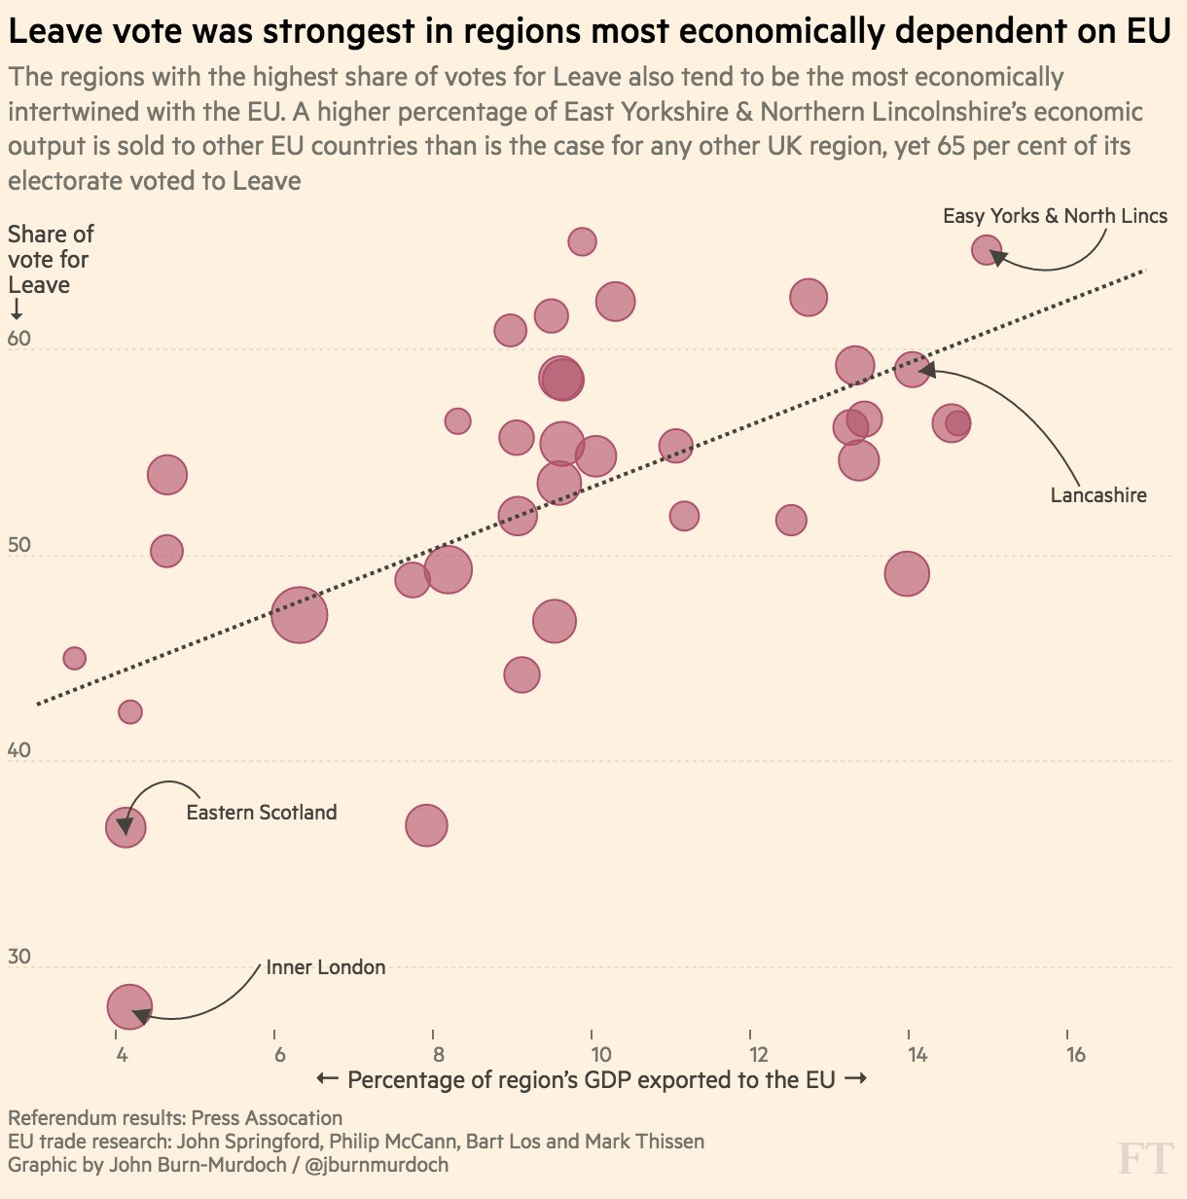
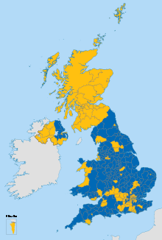
Brexit: regional impacts
Regional economic analysis shows that the impact of Brexit will be much harsher in the North of England than elsewhere (McCann et al 2017).

Slide 3
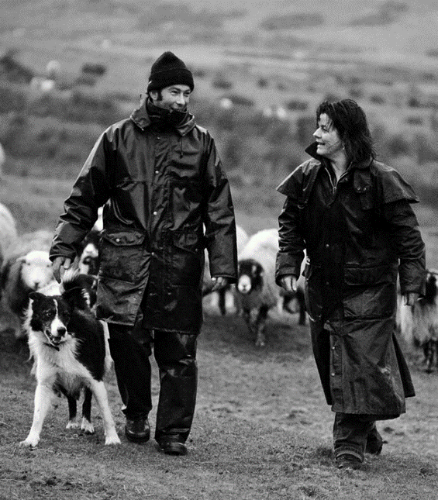
Impacts on rural economy
House of Commons Library’s analysis:
CAP payments to UK farmers 2014-20 are €251bn direct payments + €2.6bn agri-environment and rural development
Size and nature of Brexit effect depends on the trading relationships agreed and on replacement UK or devolved policies.
If no trade deal, WTO rules would mean:
  Hill sheep farms facing >30% tariff on exports
  Beef farms facing >50% tariff on exports
  Dairy farms facing >36% tariff on exports
  WTO rules would still limit payment under agri-env schemes to income foregone and must be trade non-distorting. 95% of UK’s sheep exports go to EU.
Most hill farms are expected to go out of business under this scenario, with uncertain effects on broader rural economy (eg tourism).
Meanwhile, the Government is confident of negotiating a good trade deal for UK farmers and has given some short term assurances.

Slide 4

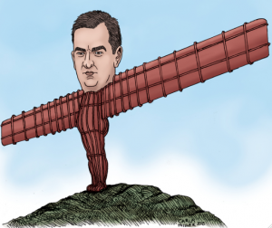
Devolution impacts
Will the ‘far north’ be marginalised between an M62 powerhouse and an independent Scotland?
Current initiatives include:
  North of Tyne Combined Authority
  Borderlands Initiative
  Border Uplands Pilot Project
But local councils have suffered huge cuts and more are planned.
Possibility that some devolved powers may be taken back to UK?

Slide 5
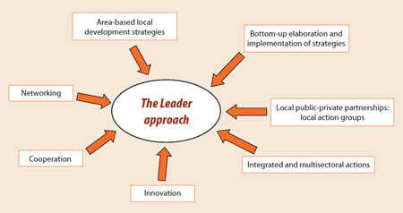
10 key questions for rural policy
1. How can national and local government support rural communities to reach their full economic potential?

Slide 6
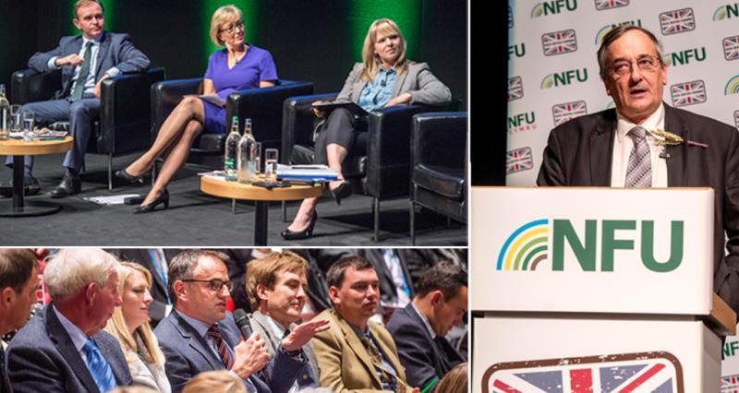

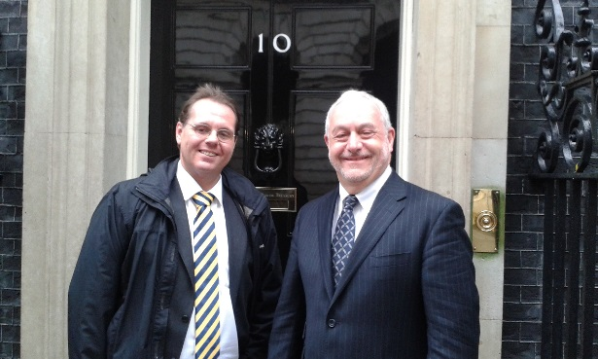
10 key questions for rural policy
2. Who should take the lead on policy for rural areas?

Slide 7

10 key questions for rural policy
3. How can public, private and voluntary sector work together in support of sustainable social and economic growth in rural areas?

Slide 8
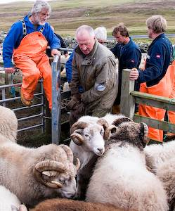
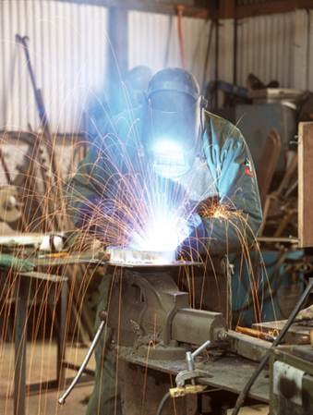

10 key questions for rural policy
4. How can we ensure we have an adequate, appropriately skilled rural labour force?

Slide 9


10 key questions for rural policy
5. How can the housing needs of rural communities be addressed?

Slide 10
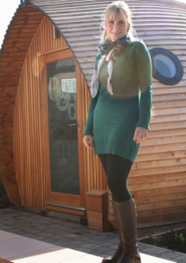

10 key questions for rural policy
6. How can UK and devolved governments encourage an enterprising countryside?

Slide 11



10 key questions for rural policy
7. Can the creative industries play a significant role in the future of the countryside?

Slide 12

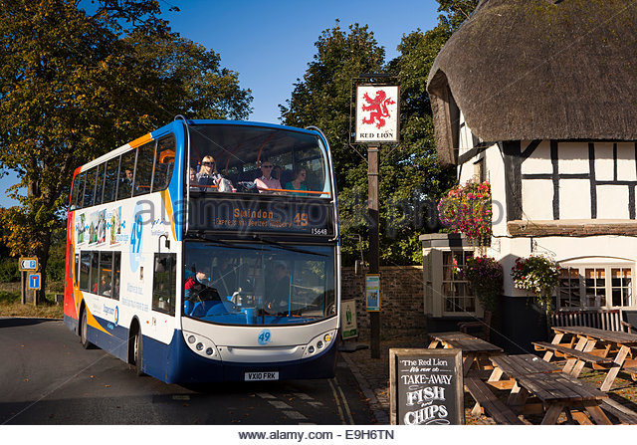
10 key questions for rural policy
8. How can we ensure that rural communities are well connected?

Slide 13

10 key questions for rural policy
9. How can we maintain the supply of public goods in the countryside?
How can we support not only the farmers who manage the public goods but also the rural communities within which they are embedded?

Slide 14
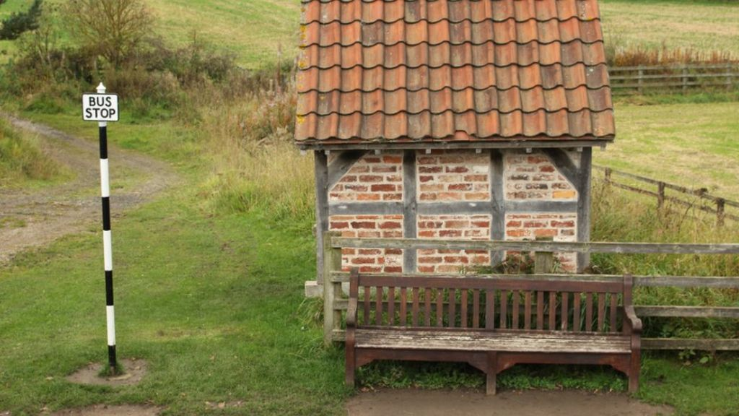
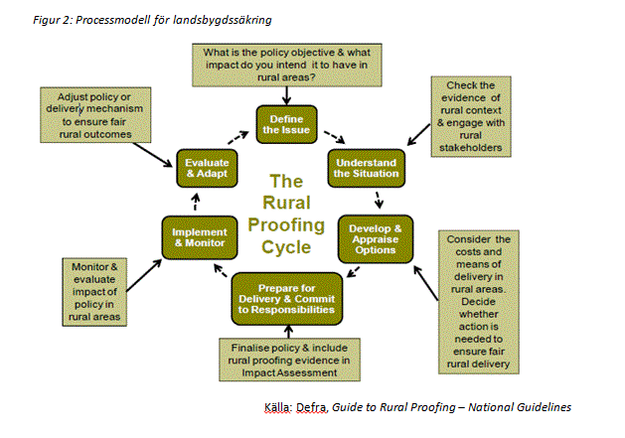
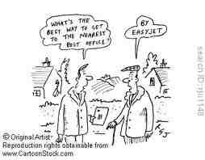
10 key questions for rural policy
10. How can policy be rural-proofed in the future?

Slide 15

Conclusion
Brexit poses huge challenges for the rural North, but it may also offer an opportunity to tackle deep-seated problems.
So far public debates tend to focus only on farming and environment to the neglect of wider rural economy & society
What rural policy do we need and how to achieve it?
What voice for the North?

