Slide 1

The NORTHERN POWERHOUSE AND THE WEST MIDLANDS ENGINE
THE CHANGING ROLE OF THE LEPS IN ENTEREPRENUERIAL GOVERNANCE IN ENGLAND:
WILL DEVOLUTION AND BREXIT DELIVER?
IMPLICATIONS FOR LEADERSHIP
Professor John Shutt, Leeds Business School, Leeds Metropolitan University
Gill Bentley, The University of Birmingham
Professor Lee Pugalis, University of Technology, Sydney
LINKING URBAN & REGIONAL LEADERSHIP: MAKING CONNECTIONS AND IDENTIFYING LEADERSHIP NEEDS

Slide 2
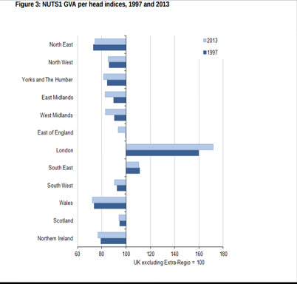
The Widening North/South Divide 1997 - 2013
London increased 12.2 points to 171.9
North East increased 1.2 points to 74.3
All other regions decreased compared to UK average, particularly West and East Midlands.
Source ONS Dec. 2014.

Slide 3
Proposition
Tackling the North/South divide impossible given:
  The changes in sub-national governance structures:
    LEPS to Combined Authorities and Meso-level (Northern Powerhouse & West Midlands Engine)
  Devolution Deals = Delegation not re-territorialisation
  BREXIT
  New INDUSTRIAL strategy?
  Devolution and BREXIT will not deliver
  To enable place-base Leadership at subnational level

Slide 4
LEADERSHIP
A process of social influence in which one person (Mayor?) can enlist the aid and support of others in the accomplishment of a common task
(ROBINSON, 2009)
A process/exercise of leadership by a collective …
Leadership for place-based development is
  a collective relationship between institutional actors
(STIMSON et al. 2002,cited by SOTARAUTA, 2014)
  Collaborative Governance Structures (ie CAs) practice collective leadership
Leadership (place-based) as autonomy /power to make decisions about strategy and bring about action

Slide 5
What is happening: The Story
LEPs
Combined authorities
Devolution Deals
Metro Mayors
Powerhouse and Engine
Central Government control
BREXIT – A TSUNAMI
New Industrial Strategy ?

Slide 6
Local Enterprise Partnerships
“joint local authority-business bodies brought forward by local authorities themselves to promote local economic development”
Bentley et al (2010)
Some of the hallmarks of a place-based approach….
  Based on functional economic geography
  Analysis of development potentials
  Multi-level/collaborative governance
  Planning, housing, and employment and enterprise growth
  SHIFTING TO…

Slide 7
Combined Authorities (England)
Groupings of city-region based local authorities
Reflect the relational geographies of production (got it wrong)and the fragmentation of economic governance in the LEPs

Slide 8
Scale Geographies of production and Governance Structures: The Complexities……
Boundary issues
- Counties & districts
- LEPs cross boundaries
Types of membership
- Full & Associate
Politics
West Yorkshire and Sheffield
Combined Authorities
Part of the Northern Powerhouse

Slide 9
Combined Authorities Emerging…
• The Greater Manchester Combined Authority* (Manchester, Salford, Stockport, Tameside, Trafford, Wigan, Bolton, Bury, Rochdale, and Oldham). May 2017
• The Sheffield City Region Combined Authority (Sheffield, Doncaster, Rotherham and Barnsley, plus associate members: Bassetlaw, Chesterfield, Derbyshire Dales, North-East Derbyshire, Bolsover LEGAL CHALLENGE Not proceeding- MAY 2018?
• The West Yorkshire Combined Authority*, covering Leeds, Bradford, Calderdale, Kirklees and Wakefield. York City Council is an associate member; no progress
• The Liverpool City Region Combined Authority* (Liverpool, St Helens, Sefton, Knowsley, Wirral and Halton); May 2017
• West Midlands* (Birmingham, Dudley, Sandwell, Walsall, Wolverhampton, Coventry, Solihull; with Cannock Chase, Telford, Redditch, Tamworth, and Nuneaton and Bedworth as associate members);
* Metro Mayoral elections May 2017 Manchester,Liverpool,Birmingham,Teeside

Slide 10
COMBINED AUTHORITIES
The North-East Combined Authority (Northumberland, County Durham, Newcastle-upon-Tyne, Gateshead, Sunderland, North Tyneside and South Tyneside). WITHDRAWN
Tees Valley (Darlington, Middlesbrough, Hartlepool, Stockton on-Tees, Redcar & Cleveland)
Norfolk/Suffolk
Cambridge/Peterborough
West of England
PLUS
Cornwall. The devolution deal in Cornwall does not require the creation of a combined authority. Cornwall Council, which is a unitary authority, will exercise the devolved powers.
Greater London - Health and Social care pilot, does not include the creation of a combined authority.
BUT THEN: DEVOLUTION

Slide 11
DEVOLUTION

Slide 12
DEVOLUTION
The Local Democracy, Economic Development and Construction Act 2009 allows central government functions to be devolved to the sub-national level
General power of competence introduced via the Localism Act 2011
Devolution does not mean that sub-national economic development governance structures - are better empowered to make decisions on strategy and action

Slide 13
DEVOLUTION DEALS
Devolution deals and the establishment of the combined authorities compromises sub-national economic development leadership by LEPs
Combined Authorities have absorbed their Local Enterprise Partnerships …
Powers being devolved…

Slide 14
POWERS BEING DEVOLVED
Predicated on having an elected METRO MAYOR….. a contentious issue

Slide 15
Principles of Devolution: George Osborne Northern Powerhouse Speech -14 May 2015
Here’s the deal:
We will hand power from the centre to cities to give you greater control over your local transport, housing, skills and healthcare. And we’ll give the levers you need to grow your local economy and make sure local people keep the rewards.
But it’s right people have a single point of accountability: someone they elect, who takes the decisions and carries the can. So with these new powers for cities must come new city-wide elected mayors who work with local councils.
I will not impose this model on anyone. But nor will I settle for less. London has a mayor.
Greater Manchester has agreed to have a mayor as part of our Northern Powerhouse - and this new law will make that happen.
My door now is open to any other major city who‎ wants to take this bold step into the future.

Slide 16
POWERS SOUGHT FOR MAYOR
Example – West Midlands CA
To be the chair of the WMCA…
Power to increase tax on businesses in the region by adding a supplementary rates levy
Power to add a precept to the council tax bills of residents
Transport powers including control of investment in the area
Power to introduce an Oyster-style pay-as-you-go card for the region’s rail and bus network
Power over the region’s highways
Power to enforce restrictions on commercial freight
The ability to discount travel for specific groups
Control over the commission of transport infrastructure projects
Control over a devolved £1.3bn transport fund for the next 10 years
Strategic compulsory purchase order powers

Slide 17
Greater Manchester Example
Powers to Mayor?
Create a revolving Infrastructure Fund by allowing Greater Manchester to ‘earn back’ a portion of additional tax revenue from GVA increases resulting from local investment in infrastructure
Establish a Greater Manchester Investment Framework to align core economic development funds
Strengthen Greater Manchester’s Business Growth Hub, which integrates trade, investment and businesses advice Develop Manchester’s role as a beacon for high value inward investment
Create a City Apprenticeship and Skills Hub to place apprentices with SMEs, as well as piloting a skills tax incentive and locally determined outcome payments to providers
Establish a Low Carbon Hub, with a plan to reduce emissions by 48% by 2020
Establish a housing investment fund to use local and national investment to develop new housing
Work with DfT on a broad package of transport proposals encompassing devolution of the Northern Rail franchise, bus improvement measures and devolution of local transport majors funding
BUT DEVOLUTION DEALS ARE ABOUT DEAL MAKING!

Slide 18
DEAL-MAKING
Reflects multi-level governance and a contractual relationship between Centre and Sub-national level:
Transactional contract: the respective duties of both central and sub-national parties can be stated in advance; contracting thus implements incentive mechanisms and sanctions to influence behaviour of the signatory parties.
Relational contract: the parties commit mutually to co-operate after the signature of the contract and design governance mechanisms for that purpose.
Charbit and Romano, 2016

Slide 19
IMPLICATIONS
Higher level of governance Meso-level emerging - Engine and Powerhouses- unclear governance and structures
Scope for SNG leadership constrained
  Conditionalities in the deals suggest they represent localisation and regionalisation of national policy and not re-territorialisation
Bentley and Pugalis, 2016
Conditionalities (Sticks but also Carrots)
  Strategy, budget, resources
  Bentley, Pugalis & Shutt, 2016

Slide 20
NORTHERN POWERHOUSE
Local Authority areas: West to East in the North of England
Includes: Liverpool; Manchester; Leeds; Sheffield; Yorkshire; Newcastle

Slide 21
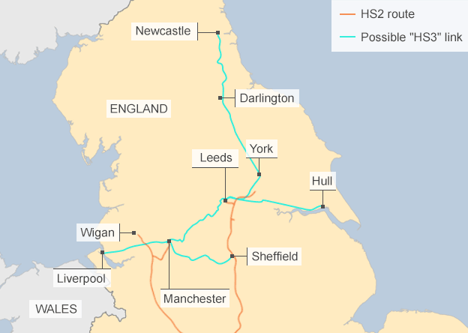

Slide 22
West Midlands Engine of Growth
7 Local Authorities and 3 LEPS in the West Midlands: including Birmingham; Sandwell, Coventry, Dudley, Solihull, Walsall and Wolverhampton .

Slide 23
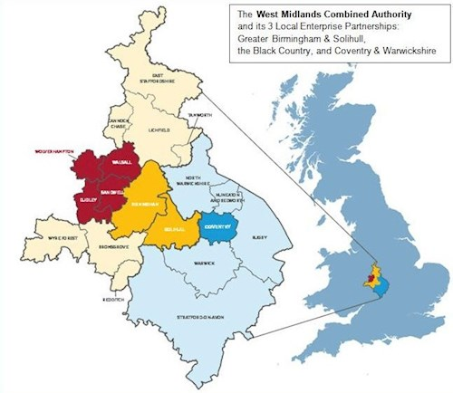

Slide 24
The Challenge… BREXIT
A TSUNAMI…..

Slide 25
CHALLENGE FROM EUROPE -
Europe 2020: Flagship Initiatives 2014 – 2020
Smart Growth
        Digital Agenda for Europe
        Innovation Union
        Youth on the Move
Sustainable Growth
        Resource Efficient Europe
        An Industrial Policy for Globalisation
        Low carbon Strategies
        Energy Action Plans
Inclusive Growth
        New Skills for Jobs
        European Platform Against Poverty
        A new Cohesion and Agricultural Policy
BUT, BREXIT…

Slide 26
BREXIT AND LOCAL ECONOMIES
Issues | Impacts | Unknowns
Single Market exit? | On sectors of Industry | New competition laws
Customs Union | New procedures and controls | Budget payment?
Financial services | Future VAT and ‘passporting’ | Access Deal for the City?
Free Trade Deals | EU, BRICS and USA | Art 50 – 2 years 2019?
Transitional Deal | 2019- 202?? | Joining WTO/Tariffs?
EU Budget 2020 - 2027 | Pay for access? EU territorial cooperation could continue? | UK contribution = tax
EU Regional and CAP budget | What replacement programmes? From 2020? | Size of UK budget
Immigration and skills | Only skilled jobs will attract work permits | Impact on sectors; skills policy for UK
New industrial policy | On industry/regions/sectors Rand D?? | Details released – 23 November and Green Paper January 2017

Slide 27
BREXIT AND LOCAL GOVERNMENT
2014-2020 UK receives £5.3bn of EU Structural Funds
West Wales and the Valleys and Cornwall are net beneficiaries of EU funding
May has guaranteed that projects in place before 23 Nov 2016 will go ahead but post 2020 funding will be lost
Includes CAP, ESF, EMFF, ERDF, ETC & Horizon 2020
Impact on Energy, waste, trading standards, procurement, State Aid rules
LG is arguing for greater Devolution of fiscal responsibility – led by Kahn – will impact on Devolution Deals
CG proposes Reform of LG Finance- implications 2020

Slide 28
Conclusions
If (place-based) leadership is seen as autonomy /power to make decisions about strategy and bring about action
LEPs disappear into combined authorities
CA’s not properly constituted for England
Conditionalities in the devolution deals do not represent re-territorialisation
BREXIT Tsunami.. Rewrites the rulebook
North-South divide will prevail and be worse in 2020.

Slide 29
A new UK Regional Development Policy
Conversation on new regional economic development policy and programme 2020- 2030 needs to start now.
Deal Culture inappropriate to the climate that we are going to be in.
Industrial strategy,regional strategy,rural strategy and spatial strategy and infrastructure need to be considered together

